Slide 1
Ensemble Methods

Slide 2
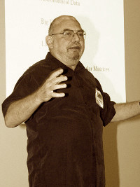
Leo Breiman (1928-2005)
Professor of Statistics at UC Berkeley
Invented Bagging and Random forests.
http://www2.math.uu.se/~thulin/mm/breiman.pdf Statistical Modeling: The Two Cultures
If anyone asks you what is the difference
between Statistics and Machine Learning,
this is the best answer, I think.

Slide 3
Ensemble Methods
Improve classification accuracy by aggregating the predictions of multiple classifiers
Construct a set of base classifiers from training data and perform classification by taking a vote on the predictions made by each classifier.
Consider an ensemble of 20 base models.
The ensemble will make a wrong prediction only if more than half of the base classifiers predict incorrectly.
If the models make independent mistakes.

Slide 4
Ensemble Classifiers
Easy sufficient condition for an ensemble to perform better than each classifier:
All base classifiers must perform better than 50% (i.e. better than random guessing)
All base classifiers must be independent
Accurate & Diverse

Slide 5
Independent Ensembles
Would you rather have 1 classifier with 90% accuracy
or 30 classifiers with 60% each that are independent?

Slide 6
Independent Ensembles
Would you rather have 1 classifier with 90% accuracy
or 30 classifiers with 60% each that are independent?
30*0.1/1.54=1.94 standard deviations so?

Slide 7
Types of Ensembles
Homogenous – All base classifiers are of the same type
Typically these are called “ensemble classifiers”
Heterogeneous – Multiple types of base classifiers
Typically these are called “voting classifiers” or “multiple classifier systems”
The ensemble itself is a supervised learner
It is trained then used to make a classification

Slide 8
Voting using confidence
Say you have 2 trees: m1 and m2.
Say for some example x
m1(x) = 1 and m2(x) = 0
Can you weight the two votes with different confidence?
Use general performance of m1,m2 on train or test error.
Get a confidence of m1 and m2 particular to sample x?
Example: x= [A:0.3, S: 0.7]
m1[x]= 0 , m2[x]=1
which model do you trust more?
 | Acidity(A) | Sweetness (S) | y=‘Great taste’?
Bev1 | 0.8 | 0.8 | 1
Bev2 | 0.3 | 0.25 | 0
Bev3 | 0.2 | 0.8 | 0
Bev4 | 0.3 | 0.7 | 0
Bev5 | 0.9 | 0.7 | 1
m1
S>= 0.75
o/w
A<= 0.5
o/w
0
1
1
0

Slide 9
Voting using confidence
Say you have 2 trees: m1 and m2.
Say for some example x
m1(x) = 1 and m2(x) = 0
Can you weight the two votes with different confidence?
Use general performance of m1,m2 on train or test error.
Get a confidence of m1 and m2 particular to sample x?
Example: x= [A:0.3, S: 0.7]
m1[x]= 0 , m2[x]=1
which model do you trust more?
 | Acidity(A) | Sweetness (S) | y=‘Great taste’?
Bev1 | 0.8 | 0.8 | 1
Bev2 | 0.3 | 0.25 | 0
Bev3 | 0.2 | 0.8 | 0
Bev4 | 0.3 | 0.7 | 0
Bev5 | 0.9 | 0.7 | 1
m1
S>= 0.75
o/w
A<= 0.5
o/w
0
1
1
0
Bev2
Bev1 Bev5
Bev2, Bev3, Bev4
Bev1, Bev3, Bev4,Bev5

Slide 10
Bagging
Bootstrap aggregating – Use the bootstrap sampling method (sampling with replacement) to train base classifiers

Slide 11
Bagging
Bootstrap aggregating – Use the bootstrap sampling method (sampling with replacement) to train base classifiers
Given n initial training rows.
Sample randomly n with replacement. Create a new bootstraped dataset1
 | f1 | f2 | .. | y
Bev1 | A | 0.8 |  | 1
Bev2 | B | 0.2 |  | 0
Bev3 | A | 0.7 |  | 1
Bev4 | C | 0.5 |  | 1
 | f1 | f2 | .. | y
Train model m1 using this training set

Slide 12
Bagging
Bootstrap aggregating – Use the bootstrap sampling method (sampling with replacement) to train base classifiers
Given n initial training rows.
Sample randomly n with replacement. Create a new bootstraped dataset.
 | f1 | f2 | .. | y
Bev1 | A | 0.8 |  | 1
Bev2 | B | 0.2 |  | 0
Bev3 | A | 0.7 |  | 1
Bev4 | C | 0.5 |  | 1
 | f1 | f2 | .. | y
Bev2 | B | 0.2 |  | 0
Bev1 | A | 0.8 |  | 1
Bev2 | B | 0.2 |  | 0
Bev3 | A | 0.7 |  | 1
Train model m1 using this training set

Slide 13
Bagging
Bootstrap aggregating – Use the bootstrap sampling method (sampling with replacement) to train base classifiers
Given n initial training rows.
Sample randomly n with replacement. Create a new bootstraped dataset 2:
 | f1 | f2 | .. | y
Bev1 | A | 0.8 |  | 1
Bev2 | B | 0.2 |  | 0
Bev3 | A | 0.7 |  | 1
Bev4 | C | 0.5 |  | 1
 | f1 | f2 | .. | y
Bev4 | C | 0.5 |  | 1
Bev3 | A | 0.7 |  | 1
Bev2 | B | 0.2 |  | 0
Bev2 | B | 0.2 |  | 0
Train model m2 using this training set

Slide 14
Bagging
Bootstrap aggregating – Use the bootstrap sampling method (sampling with replacement) to train base classifiers
Given n initial training rows.
Sample randomly n with replacement. Create a new bootstraped dataset 2:
 | f1 | f2 | .. | y
Bev1 | A | 0.8 |  | 1
Bev2 | B | 0.2 |  | 0
Bev3 | A | 0.7 |  | 1
Bev4 | C | 0.5 |  | 1
 | f1 | f2 | .. | y
Bev4 | C | 0.5 |  | 1
Bev3 | A | 0.7 |  | 1
Bev2 | B | 0.2 |  | 0
Bev2 | B | 0.2 |  | 0
Train model m2 using this training set
Final model is majority voting between m1,m2, m3, .. mk bagged models

Slide 15
Random Forests
An extension of bagged decision trees
Randomly select a subset of the input features for candidate splits, instead of examining all available features

Slide 16
Bagging
Random Forrest
Bagging but also randomly drop one column each time
Given n initial training rows.
Sample randomly n with replacement. Create a new bootstraped dataset.
 | f1 | f2 | .. | y
Bev1 | A | 0.8 |  | 1
Bev2 | B | 0.2 |  | 0
Bev3 | A | 0.7 |  | 1
Bev4 | C | 0.5 |  | 1
 | f1 | f2 | .. | y
Bev2 | B | 0.2 |  | 0
Bev1 | A | 0.8 |  | 1
Bev2 | B | 0.2 |  | 0
Bev3 | A | 0.7 |  | 1
Train model m1 using this training set
(m1 does not use feature 2)

Slide 17
Bagging
Bootstrap aggregating – Use the bootstrap sampling method (sampling with replacement) to train base classifiers
Given n initial training rows.
Sample randomly n with replacement. Create a new bootstraped dataset 2:
 | f1 | f2 | .. | y
Bev1 | A | 0.8 |  | 1
Bev2 | B | 0.2 |  | 0
Bev3 | A | 0.7 |  | 1
Bev4 | C | 0.5 |  | 1
 | f1 | f2 | .. | y
Bev4 | C | 0.5 |  | 1
Bev3 | A | 0.7 |  | 1
Bev2 | B | 0.2 |  | 0
Bev2 | B | 0.2 |  | 0
Train model m2 using this training set
m2 does not use feature 1

Slide 18
Bagging
Bootstrap aggregating – Use the bootstrap sampling method (sampling with replacement) to train base classifiers
Given n initial training rows.
Sample randomly n with replacement. Create a new bootstraped dataset 2:
 | f1 | f2 | .. | y
Bev1 | A | 0.8 |  | 1
Bev2 | B | 0.2 |  | 0
Bev3 | A | 0.7 |  | 1
Bev4 | C | 0.5 |  | 1
 | f1 | f2 | .. | y
Bev4 | C | 0.5 |  | 1
Bev3 | A | 0.7 |  | 1
Bev2 | B | 0.2 |  | 0
Bev2 | B | 0.2 |  | 0
Train model f2 using this training set
Final RF model is majority voting between m1,m2, m3, .. mk bagged models

Slide 19
Boosting
Iteratively change the distribution of the training examples so the base classifiers will focus on hard-to-classify examples
Assign a weight to each example and update that weight at the end of each boosting round.
Use weight as a sampling distribution to draw a set of bootstrap samples.

Slide 20
Boosting
Next model m2 will be trained so that the SUM m1+m2 will perform better
How? Add create residual y-m1 and train model 2 to predict that.
Given original dataset, train model 1.
 | f1 | f2 | .. | y
Bev1 | A | 0.8 |  | 100
Bev2 | B | 0.2 |  | 80
Bev3 | A | 0.7 |  | 90
Bev4 | C | 0.5 |  | 55

Slide 21
Boosting
Next model m2 will be trained so that the SUM m1+m2 will perform better
How? Add create residual y-m1 and train model 2 to predict that.
Given original dataset, train model 1.
 | f1 | f2 | .. | y | m1
Bev1 | A | 0.8 |  | 100 | 100
Bev2 | B | 0.2 |  | 80 | 70
Bev3 | A | 0.7 |  | 90 | 100
Bev4 | C | 0.5 |  | 55 | 70
 | f1 | f2 | .. | Y’
Bev1 | A | 0.8 |  | 0
Bev2 | B | 0.2 |  | 10
Bev3 | A | 0.7 |  | -10
Bev4 | C | 0.5 |  | -15
Train model m2 to predict Y’
Repeat by training new model to refine
mistakes of current sum of models
m1+m2+m3 ,..+ mk
Boosting is a sequential process, unlike bagging, which can be done in parallel.

Slide 22
Recap: Methods of constructing ensembles
By manipulating the training set (e.g. bagging and boosting)
By manipulating the input features (e.g. random forests)
By manipulating the class labels (e.g. multi-class partitioning)
By manipulating the learning algorithm (e.g. randomness)
Can give each base classifier an equal vote, or can weight each vote based on the accuracy of the base classifier

Slide 23
Boosting and bagging.
Bagging and specifically Random Forests are extremely useful, simple and robust classifiers
Boosting and especially Gradient Boosting Machines are extremely well performing and the most useful tools for tabular data, in addition to Linear models and Neural networks.
Tools to use
Random Forests: sklearn.ensemble.RandomForestClassifier
Gradient Boosting machines: XGBoost and Catboost.

Slide 24
Understanding Overfitting and model complexity

Slide 25
Overfitting
A model that fits the training data too well (has a low training error) may have a higher generalization error than a model with a higher training error.
An over-fitted model has memorized the training data and will not generalize well to new data.

Slide 26
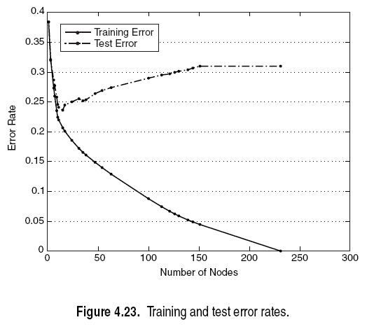
Over and Under Fitting

Slide 27
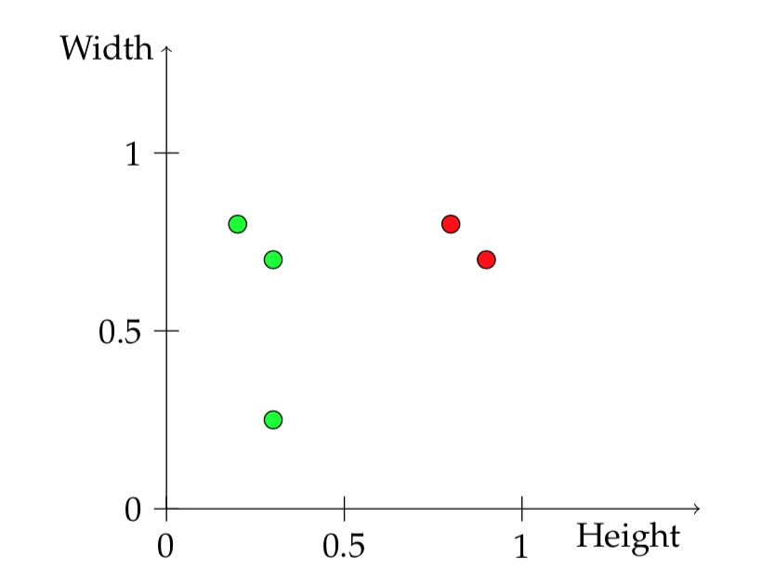
Decision Tree Algorithm
Sweetness
Sweetness
Acidity
Acidity
Big training error
Big test error
Model too simple
Underfitting
Very small training error
Big test error
Model too complex
Overfitting

Slide 28
Regression
Big training error
Big test error
Model too simple
Underfitting

Slide 29
Regression
Very small training error
Big test error
Model too complex
Overfitting

Slide 30
Measures of complexity
Measures of complexity:
For trees: Depth
Number of splits
Number of leaves
For ensembles also: Number of trees
Measures of complexity:
For Linear Regression
Number of nonzero coefficients
Magnitude of coefficients.
Can be controlled with regularization. Either l1 norm or l2 norm.
L2 norms makes all coefficients smaller
Called Ridge Regression
L1 norm promotes sparsity in the coefficients
Called Lasso or L1 regularization.

Slide 31
Measures of complexity
Key idea:
Don’t only find a model that predicts well on the training set
but find a model that is BOTH simple AND predicts well the training set.
Minimize: Training Loss + λ Complexity Measure
λ is a hyperparameter that controls this tradeoff
Measures of complexity:
For trees: Depth
Number of splits
Number of leaves
For ensembles also: Number of trees
Measures of complexity:
For Linear Regression
Number of nonzero coefficients
Magnitude of coefficients.
Can be controlled with regularization. Either l1 norm or l2 norm.
L2 norms makes all coefficients smaller
Called Ridge Regression
L1 norm promotes sparsity in the coefficients
Called Lasso or L1 regularization.

