Slide 1
Evaluating Classifiers Performance Metrics Pitfalls

Slide 2
Kaggle competition
Done by one person at a time- no collaboration or communication. Public communication with everyone on canvas discussions is fine but you can keep it limited.
Counts for 20% of the grade.
It will be binary classification with categorical data. No external data.
Like a regular Kaggle competition you will have 5 submissions per day (observe Kaggle timezone on when they reboot. You observe your public LB score.
I want you to try many things: XGBoost, CATboost, Random forests, logistic regression. Anything in python is fair game. Feature engineering, feature exploration, data preparation.
You will submit a pdf report were you describe your approach. What worked what did not work, what you found etc. Your report must include: Your name, your Kaggle name, a Kaggle screenshot from public and private LBs and also your findings. Full code is not needed in report but you can include it in homework submission as a separate file.
You will be graded on: 1. Private LB score. ALSO we will give bonus on creativity and also a bonus on quality of your data science report.

Slide 3
Data engineering best practices
Good version control and good software practices.
Random seed=42 (Reproducibility)
Data is immutable.
Make scripts you have pre-used.
Using other code from Kaggle forums is fine as long as you share your sources.
Hyperparameter tuning is 80% of the game here.
Also try to discuss interpretability and other findings.
Ex: A feature is either NAN or is perfectly equal to the label y.

Slide 4
How do we evaluate how good a classifier is
Let’s focus on binary classification for simplicity.
The most important thing we learned is that we never train and test on the same data. Either we split our data into train/test split and evaluate the performance on the test set, or we do CV.
But what metric to use?
Accuracy = #correct predictions/ Total # of examples.

Slide 5
How do we evaluate how good a classifier is
Accuracy = #correct predictions/ Total # of examples.
Example: if your classifier is correct on 85 out of 100 examples of the test set, you have test set accuracy 85%.
Problems with accuracy as a metric?
``Machine learning researchers were able to make a neural network that looks at your photograph online and can predict if you have COVID or not!
-Does it work well ?
-It has accuracy about 99% !
Accuracy is a mix of two different types of errors

Slide 6
You can be wrong in two ways
Type 1 error / False Positive / Incorrect rejection of the Null hypothesis
Type 2 error/ Missed Detection/ Null was false but failed to reject it.
Typically Type 1 and type 2 errors have very different business impact.

Slide 7
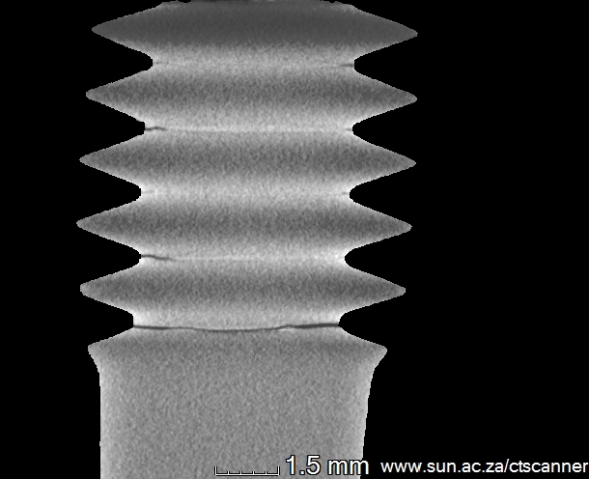
You can be wrong in two ways
Type 1 error / False Positive / Incorrect rejection of the Null hypothesis
Type 2 error/ Missed Detection/ Null was false but failed to reject it.
Typically Type 1 and type 2 errors have very different business impact.

Slide 8
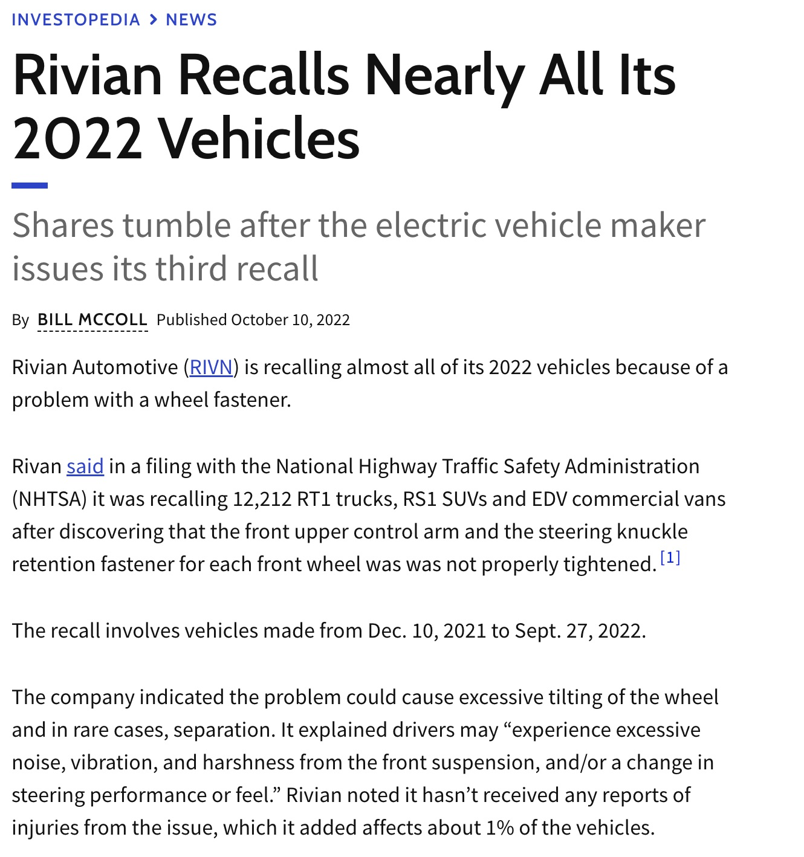
Type 1 error / False Positive / Incorrect rejection of the Null hypothesis
Type 2 error/ Missed Detection/ Null was false but failed to reject it.
Typically Type 1 and type 2 errors have very different business impact.

Slide 9
You can be wrong in two ways
Type 1 error / False Positive / Incorrect rejection of the Null hypothesis
Type 2 error/ Missed Detection/ Null was false but failed to reject it.
Typically Type 1 and type 2 errors have very different business impact.
1 in 100 cars has faulty steering wheel fastener.
Increase cost by 1 percent vs end of company and people hurt.
Shipping a faulty product can be much more expensive compared to discarding some good products.
It is the job of the data scientist to factor these costs and model with the correct business-specific cost function.
If specific costs can be assigned to these different mistakes, a problem specific metric can be designed.

Slide 10
Confusion Matrix (Binary Classification)
 |  | True label
 |  | Event | No Event
Model Predicts | Event
 | No Event

Slide 11
Confusion Matrix (Binary Classification)
 |  | True label
 |  | Event | No Event
Model Predicts | Event | TP | FP
 | No Event | FN | TN
Error rate: fraction of mistakes
Error rate = (FP + FN) / n
Accuracy: fraction of correct predictions
Accuracy = (TP + TN) / n
Recall/ Sensitivity/True positive rate (TPR) = TP/ (All Events) =>
TPR = TP / (TP + FN)
Precision / Positive Predictive Value (PPV) = TP/ (TP+FP) =
TP/ (Predicted events)
Which one is which ?
Pr( True event/ Model predicts event)
Pr ( Model predicts event / True event)

Slide 12
Confusion Matrix (Binary Classification)
 |  | True label
 |  | Event | No Event
Model Predicts | Event | TP | FP
 | No Event | FN | TN
Error rate: fraction of mistakes
Error rate = (FP + FN) / n
Accuracy: fraction of correct predictions
Accuracy = (TP + TN) / n
Recall/ True positive rate (TPR)/ sensitivity= TP/ (All Events) => TPR = TP / (TP + FN)
Precision / Positive Predictive Value (PPV) = TP/ (TP+FP) = TP/ (Predicted events)
Which one is which ?
Pr( True event/ Model predicts event) =Precision
Pr ( Model predicts event / True event) = Recall
If you go to get tested for Coronavirus. Model says positive. Which metric Precision (PPV) or recall do you care about ?

Slide 13
Confusion Matrix (Binary Classification)
 |  | True label
 |  | Event | No Event
Model Predicts | Event | TP | FP
 | No Event | FN | TN
Error rate: fraction of mistakes
Error rate = (FP + FN) / n
Accuracy: fraction of correct predictions
Accuracy = (TP + TN) / n
Recall/ True positive rate (TPR)/ sensitivity= TP/ (All Events) => TPR = TP / (TP + FN)= =Pr (MP event / True event)
Precision / Positive Predictive Value (PPV) = TP/ (TP+FP) = TP/ (Predicted events) =Pr(True Event/ MP event).
False positive rate (FPR): fraction of negative examples predicted as positive= FP/ (Non events)
FPR = FP / (FP + TN) = Probability of false alarm.
1-FPR = Specificity/TNR = fraction of negative examples correctly predicted

Slide 14
Example
 |  | True label
 |  | Event | No Event
Model Predicts | Event | 2 | 1
 | No Event | 8 | 989
Error rate: fraction of mistakes
Error rate = (1 + 8) / 1000 = 0.009 = 0.9%
Accuracy: fraction of correct predictions
Accuracy = (2 + 989) / 1000 = 0.991 = 99.1%
Recall/ True positive rate (TPR)/sensitivity/ Pr(MP/ E) = TPR = TP / (TP + FN)= ?
Precision /PPV/ Pr(E/MP) = ?
FPR = FP/ (TN+FP) = ?
True negative rate (TNR), or specificity: fraction of negative examples correctly predicted
=?
Notes:
True negative rate (TNR), or specificity: fraction of negative examples correctly predicted
TNR = 989 / 990 = 0.999 = 99.9%
FPR =1 – Specificity.
False negative rate (FNR): fraction of positive examples predicted as negative
FNR = 8 / 10 = 0.8 = 80%

Slide 15
Example
 |  | True label
 |  | Event | No Event
Model Predicts | Event | 2 | 1
 | No Event | 8 | 989
Error rate: fraction of mistakes
Error rate = (1 + 8) / 1000 = 0.009 = 0.9%
Accuracy: fraction of correct predictions
Accuracy = (2 + 989) / 1000 = 0.991 = 99.1%
Recall/ True positive rate (TPR)/sensitivity/ Pr(MP/ E) = TPR = TP / (TP + FN)=
TPR = 2 / 10 = 0.2 = 20%
Precision /PPV/ Pr(E/MP) = 2/3
FPR = FP/ (TN+FP) = 1/ 990.
True negative rate (TNR), or specificity: fraction of negative examples correctly predicted
=1-FPR = TNR = 989 / 990 = 0.999 = 99.9%
Notes:
True negative rate (TNR), or specificity: fraction of negative examples correctly predicted
TNR = 989 / 990 = 0.999 = 99.9%
FPR =1 – Specificity.
False negative rate (FNR): fraction of positive examples predicted as negative
FNR = 8 / 10 = 0.8 = 80%

Slide 16
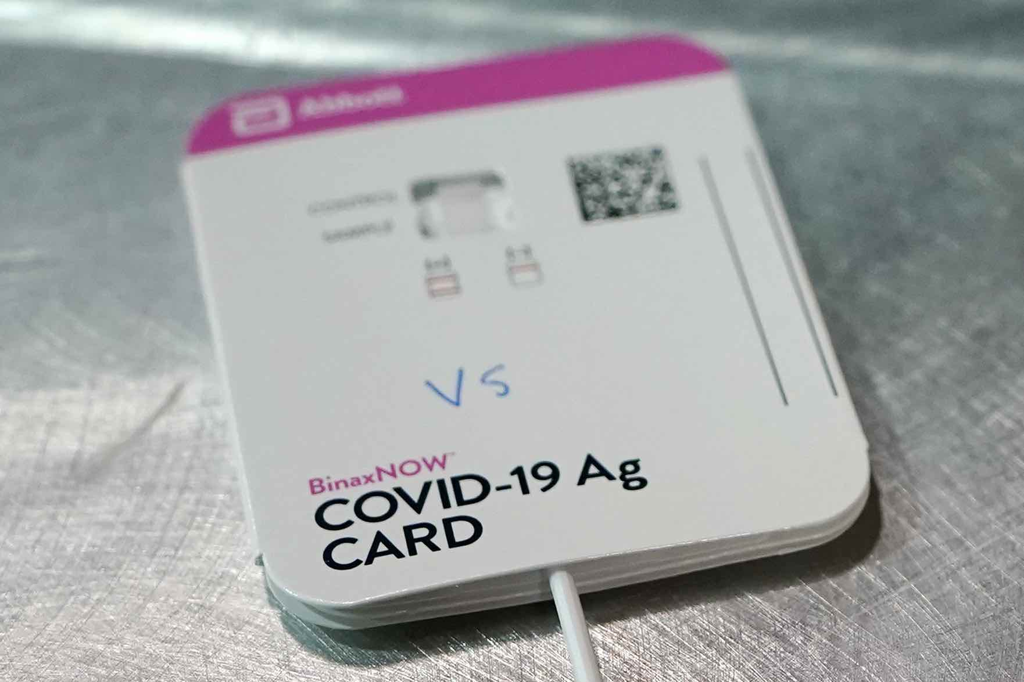
You rapid test is positive, what’s the probability you have COVID?
Test measures you can find:
Sensitivity = Number of True positives/ Number of Infected =
Pr (MP|positive) (How good is the test for infected people)
Specificity = Number of True Negatives / Number of Uninfected =
Pr(Model Negative/ Uninfected ) (How good is the test for uninfected)
You also need
Prevalence= Infected / (Total Population)
Show that
Infected
Uninfected
True Positives
False Positives
False Negatives
True Negatives
Notes:
PPV= \frac{ \text{Sensitivity} \cdot \text{Prevalence}} { \text{Sensitivity} \cdot \text{Prevalence}+ (1-\text{Sensitivity})(1-\text{Prevalence}) }

Slide 17
You rapid test is positive, what’s the probability you have COVID?
Test measures you can find:
Sensitivity = Number of True positives/ Number of Infected =
Pr (MP|positive) (How good is the test for infected)
Specificity = Number of True Negatives / Number of Uninfected =
Pr(Model Negative/ Uninfected ) (How good is the test for uninfected)
You also need
Prevalence= Infected / (Total Population)
Show that
Infected
Uninfected
True Positives
False Positives
False Negatives
True Negatives
Notes:
PPV= \frac{ \text{Sensitivity} \cdot \text{Prevalence}} { \text{Sensitivity} \cdot \text{Prevalence}+ (1-\text{Sensitivity})(1-\text{Prevalence}) }

Slide 18
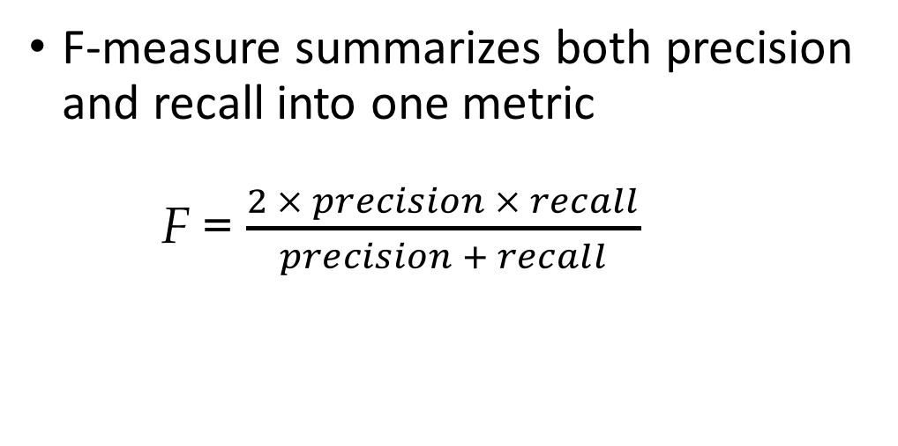
F-measure
F-measure summarizes both precision and recall into one metric
F = $\frac{2 × precision × recall}{precision + recall}$
The overall F-measure of the classifier is the mean of the class-specific F-measures
Or you could consider the F-measure of only the positive class
Notes:
F-measure: a combo of both precision and recall that measures the extent to which a group contains *only* objects of a particular class, and *all* objects of that class

Slide 19
Area under the ROC curve
We will vary the decision threshold θ and see what TPR/FPR we get.
There is a tradeoff between TPR and FPR.
Assume your model gives soft information:
Ytrue= [ 1 , 0, 1, 1]
MP = [ 0.3, 0.6, 0.8, 0.9]
Recall/Sensitivity/TPR=#correct ones/(# total 1s)
FPR= FP/ (# of true 0s)
 | TPR | FPR
θ=0.1

Slide 20
Area under the ROC curve
We will vary the decision threshold θ and see what TPR/FPR we get.
There is a tradeoff between TPR and FPR.
Assume your model gives soft information:
Ytrue= [ 1 , 0, 1, 1]
MP = [ 0.3, 0.6, 0.8, 0.9]
Recall/Sensitivity/TPR=#correct ones/(# total 1s)
FPR= FP/ (# of true 0s)
 | TPR | FPR
θ=0.1 | 3/3 | 1/1

Slide 21
Area under the ROC curve
We will vary the decision threshold θ and see what TPR/FPR we get.
There is a tradeoff between TPR and FPR.
Assume your model gives soft information:
Ytrue= [ 1 , 0, 1, 1]
MP = [ 0.3, 0.6, 0.8, 0.9]
Recall/TPR=#correct ones/(# total 1s)
FPR= FP/ (# of true 0s)
 | TPR | FPR
θ=0.1 | 3/3 | 1/1
θ in (0, 0.3) | 3/3 | 1/1
θ in (0.3, 0.6) | 2/3 | 1/1
θ in (0.6, 0.8) | 2/3 | 0/1
θ in (0.8, 0.9) | 1/3 | 0/1
θ in (0.9, 0.1) | 0/3 | 0/1

Slide 22
Area under the ROC curve
We will vary the decision threshold θ and see what TPR/FPR we get.
There is a tradeoff between TPR and FPR.
Assume your model gives soft information:
Ytrue= [ 1 , 0, 1, 1]
MP = [ 0.3, 0.6, 0.8, 0.9]
Recall/TPR=#correct ones/(# total 1s)
FPR= FP/ (# of true 0s)
 | TPR | FPR
θ=0.1 | 3/3 | 1/1
θ in (0, 0.3) | 3/3 | 1/1
θ in (0.3, 0.6) | 2/3 | 1/1
θ in (0.6, 0.8) | 2/3 | 0/1
θ in (0.8, 0.9) | 1/3 | 0/1
θ in (0.9, 0.1) | 0/3 | 0/1

Slide 23
Area under the ROC curve
We will vary the decision threshold θ and see what TPR/FPR we get.
There is a tradeoff between TPR and FPR.
Assume your model gives soft information:
Ytrue= [ 1 , 0, 1, 1]
MP = [ 0.3, 0.6, 0.8, 0.9]
Recall/TPR=#correct ones/(# total 1s)
FPR= FP/ (# of true 0s)
 | TPR | FPR
θ=0.1 | 3/3 | 1/1
θ in (0, 0.3) | 3/3 | 1/1
θ in (0.3, 0.6) | 2/3 | 1/1
θ in (0.6, 0.8) | 2/3 | 0/1
θ in (0.8, 0.9) | 1/3 | 0/1
θ in (0.9, 0.1) | 0/3 | 0/1
TPR
1
2/3
1/3
1
FPR

Slide 24
Area under the ROC curve
We will vary the decision threshold θ and see what TPR/FPR we get.
There is a tradeoff between TPR and FPR.
Assume your model gives soft information:
Ytrue= [ 1 , 0, 1, 1]
MP = [ 0.3, 0.6, 0.8, 0.9]
Recall/TPR=#correct ones/(# total 1s)
FPR= FP/ (# of true 0s)
 | TPR | FPR
θ=0.1 | 3/3 | 1/1
θ in (0, 0.3) | 3/3 | 1/1
θ in (0.3, 0.6) | 2/3 | 1/1
θ in (0.6, 0.8) | 2/3 | 0/1
θ in (0.8, 0.9) | 1/3 | 0/1
θ in (0.9, 0.1) | 0/3 | 0/1
TPR
1
2/3
1/3
1
FPR

Slide 25
Area under the ROC curve
We will vary the decision threshold θ and see what TPR/FPR we get.
There is a tradeoff between TPR and FPR.
Assume your model gives soft information:
Ytrue= [ 1 , 0, 1, 1]
MP = [ 0.3, 0.6, 0.8, 0.9]
Recall/TPR=#correct ones/(# total 1s)
FPR= FP/ (# of true 0s)
 | TPR | FPR
θ=0.1 | 3/3 | 1/1
θ in (0, 0.3) | 3/3 | 1/1
θ in (0.3, 0.6) | 2/3 | 1/1
θ in (0.6, 0.8) | 2/3 | 0/1
θ in (0.8, 0.9) | 1/3 | 0/1
θ in (0.9, 0.1) | 0/3 | 0/1
TPR
1
2/3
AUC= 2/3
1/3
1
FPR

Slide 26
Area under the ROC curve
We will vary the decision threshold θ and see what TPR/FPR we get.
Observations: AUC can be one iff there is a perfect threshold θ*
A perfect threshold is one such that scores of all 0s have scores below θ* and all 1s score above θ*.
Example:
Ytrue= [ 1 , 0, 1, 1 , 0]
MP = [ 0.9, 0.6, 0.95, 0.73, 0.7]
is there a perfect threshold θ* here?
There is a tradeoff between TPR and FPR.
Assume your model gives soft information:
Ytrue= [ 1 , 0, 1, 1]
MP = [ 0.3, 0.6, 0.8, 0.9]
Recall/TPR=#correct ones/(# total 1s)
FPR= FP/ (# of true 0s)

Slide 27
Area under the ROC curve
We will vary the decision threshold θ and see what TPR/FPR we get.
Observations: AUC can be one iff there is a perfect threshold θ*
A perfect threshold is one such that scores of all 0s have scores below θ* and all 1s score above θ*.
Example:
Ytrue= [ 1 , 0, 1, 1 , 0]
MP = [ 0.9, 0.6, 0.95, 0.73, 0.7]
θ*=0.71 works here.
There is a tradeoff between TPR and FPR.
Assume your model gives soft information:
Ytrue= [ 1 , 0, 1, 1]
MP = [ 0.3, 0.6, 0.8, 0.9]
Recall/TPR=#correct ones/(# total 1s)
FPR= FP/ (# of true 0s)

Slide 28
Breakout session
https://docs.google.com/spreadsheets/d/1zXaUTvHJ_-x17F0dGwQSQwbG9Sul75FNroVXoOWRS4g/edit?usp=sharing
https://tinyurl.com/y54kgvk8
Performance metrics.

Slide 29
Area under the ROC curve
We will vary the decision threshold θ and see what TPR/FPR we get.
Observation: I can get (FPR, TPR )=(1/2, 1/2) without looking at the data.
I can actually get any point (p,p) for p=[0,1]
There is a tradeoff between TPR and FPR.
Assume your model gives soft information:
Ytrue= [ 1 , 0, 1, 1]
MP = [ 0.3, 0.6, 0.8, 0.9]
Recall/TPR=#correct ones/(# total 1s)
FPR= FP/ (# of true 0s) =Probability of false alarm
TPR
1
2/3
1/3
1
FPR

Slide 30


Area under the ROC curve
There is a tradeoff between TPR and FPR.
Assume your model gives soft information:
Ytrue= [ 1 , 0, 1, 1]
MP = [ 0.3, 0.6, 0.8, 0.9]
My favorite interpretation of AUC:
Pick randomly a zero out of the true zeros
Pick randomly a one out of true ones.
AUC= Probability (Random 1 has higher score compared to random 0).
equivalent: Add a directed edge from every 0 to every 1.
An edge is `happy’ if the score of its end is higher than the score of its start.
AUC = # happy edges / total edges.

Slide 31
Good things about AUC
Random guessing always gives you AUC=0.5 even for imbalanced problems.
If you get AUC less than 0.5 your classifier is worse than guessing
It’s a good way to summarize precision and recall in a single number- used widely in Kaggle competitions and as a quick way to estimate performance for binary classifiers.

Slide 32
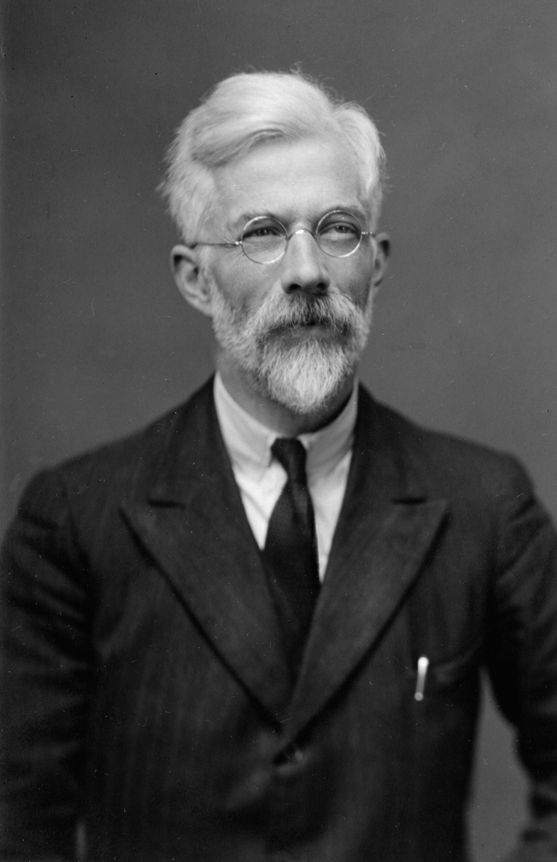
P-values
Story: Ronald Fisher made tea
Muriel Bristol claimed
she could tell if tea or milk was first added in the cup.
How to know indeed there is a difference ?
Randomized experiment!

Slide 33
P-values and the tea testing experiment
n=5 trials, correct 3 out of 5
Can she tell/ does treatment have an effect ?
Null Hypothesis H0:
Cannot tell/ No effect.
In frequentist statistics we compute the p-value: Probability under the Null to observe the data or something more extreme
(i.e. something supporting rejection of the null even more).
 | Milk before tea | MPrediction
Sample 1 | 0 | 0
Sample 2 | 1 | 1
Sample 3 | 1 | 0
Sample 4 | 0 | 0
Sample 5 | 1 | 0

Slide 34
P-values and the tea testing experiment
Warmup: n=5 trials, correct 5 out of 5
Null Hypothesis H₀: Cannot tell/ No effect.
p-value: Probability under the Null to observe the data or something more extreme (i.e. something supporting rejection of the null even more).
Under the null she would be randomly guessing. So probability to get 5 out of 5 correct is
p-value: (1/2)^5 = 1/32=0.031. How to decide how small to set this threshold?
Frequently scientists consider p-values below 0.05 significant
p-value is NOT the probability that the Null hypothesis is true
p-value is NOT the probability this drug cures cancer.
p-value: probability that a placebo matches or outperforms this drug’s performance.
i.e. someone randomly guessing would present equal or stronger evidence of discovery with p-value probability.
I.e. willing to accept 1 in 20 discoveries to be false by chance.

Slide 35
P-values and the tea testing experiment
Warmup: n=5 trials, correct 3 out of 5
Null Hypothesis H₀: Cannot tell/ No effect.
p-value: Probability under the Null to observe the data or something more extreme (i.e. something supporting rejection of the null even more).
Under the null she would be randomly guessing. So probability to get 3 out of 5 correct is
A binomial random variable Z with n trials and probability of success p has

Slide 36
P-values and the tea testing experiment
Warmup: n=5 trials, correct 3 out of 5
Null Hypothesis H₀: Cannot tell/ No effect.
p-value: Probability under the Null to observe the data or something more extreme (i.e. something supporting rejection of the null even more).
p-value= Pr(3 out of 5 correct) + Pr(4 out of 5 correct)+ Pr(5 out of 5 correct)
Under the null she would be randomly guessing. So probability to get 3 out of 5 correct is 5*4*3/3! = 10 1/32
A binomial random variable Z with n trials and probability of success p has

Slide 37
P-values and the tea testing experiment
Warmup: n=5 trials, correct 3 out of 5
Null Hypothesis H₀: Cannot tell/ No effect.
p-value: Probability under the Null to observe the data or something more extreme (i.e. something supporting rejection of the null even more).
p-value= Pr(3 out of 5 correct) + Pr(4 out of 5 correct)+ Pr(5 out of 5 correct)
1/16 *(10+ 5+ 1) = 16/32 = ½

Slide 38
P-values and the tea testing experiment
Warmup: n=5 trials, correct 3 out of 5
Null Hypothesis H₀: Cannot tell/ No effect.
p-value: Probability under the Null to observe the data or something more extreme (i.e. something supporting rejection of the null even more).
p-value= Pr(3 out of 5 correct) + Pr(4 out of 5 correct)+ Pr(5 out of 5 correct)
1/32 *(10+ 5+ 1) = 16/32 = ½
0
1
2
3
4
5

Slide 39
P-values
Control group
Treatment group
Warmup: n=100 trials, correct 75 out of 100.
Baseline: each patient survives with p=0.5. In treatment group 75 survived. Should we administer this medication? What is the p-value ?
Z= number of people that survive in treatment group.
Under Null, the this is Z ~ Bin( n=100, p=0.5).
E[Z]= np = 100*0.5 =50
Var(Z)= np(1-p)= 100*1/4 = 25, so σ=5.

Slide 40
Central Limit Theorem recap
A binomial Random variable with n trials and probability of success p
approaches a gaussian with mean mu=n*p and Var= n p (1-p)
0
1
2
3
4
5

Slide 41
brief discussion on pitfalls

Slide 42
Pitfalls in Data science
Multiple comparisons (P-value hacking aka Data Fishing)
Wald’s paradox
Other issues you can look up:
Berkson’s paradox
Simpson’s paradox
False Causal interpretation
Greedily following the data

Slide 43
Pitfalls on performance metrics and A/B testing
Data-driven decision making has been recently put on a pedestal as the right way to make any decision.
Example: Marissa Mayer’s test of 41 shades of blue.
What color to make the Google toolbar to maximize clicks.
Team tried 41 shades of blue to find which one maximizes clicks.
After trying 10 blue shades we get 1.5% increase in clicks
After trying 21 we get 2.5% increase in clicks
After trying 121 we get 3.1% increase in clicks
It never ends !

Slide 44
Pitfalls on performance metrics and evaluation
This is just a recipe to get a false positive.
Code to simulate:
import numpy as np import matplotlib.pyplot as plt v1= np.random.normal(10,1,[10,1]) max(v1) #get 11.6 v1= np.random.normal(10,1,[21,1]) max(v1) #get 12.5 v1= np.random.normal(10,1,[121,1]) max(v1) #get 13.1

Slide 45
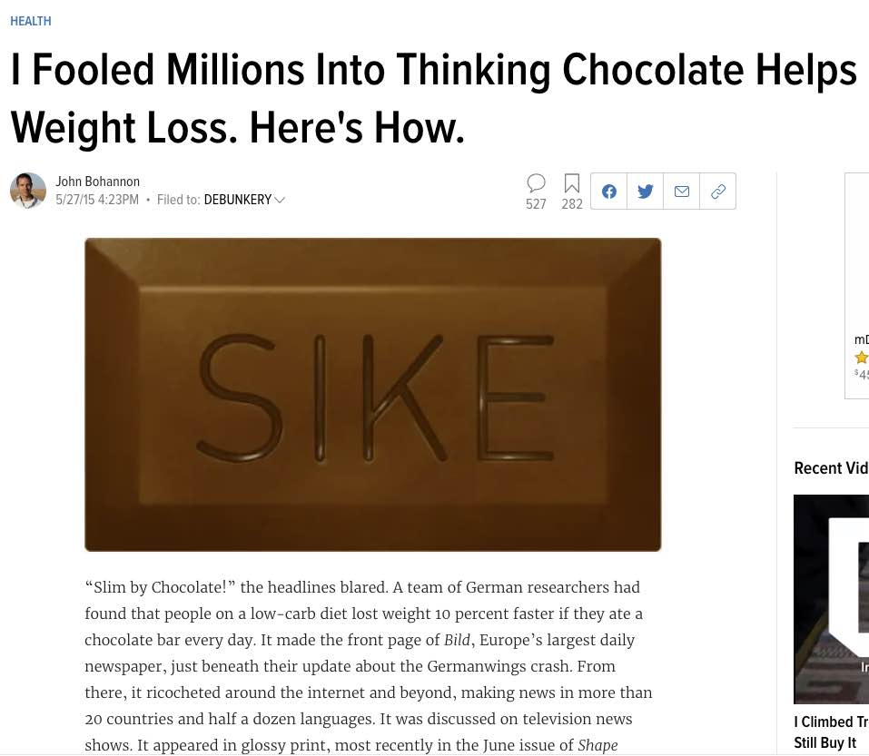
Pitfalls on performance metrics and evaluation
Dark chocolate helps in weight loss !
Design experiment, take 10 people give them chocolate every day
In 10 control, do not. measure 20 metrics: blood sugar levels, cholesterol, hair loss, life satisfaction, etc.
Each one will be found to have an effect just by chance
Textbook p-value hacking
https://io9.gizmodo.com/i-fooled-millions-into-thinking-chocolate-helps-weight-1707251800

Slide 46
Multiple comparisons
A 1992 Swedish study tried to determine whether power lines caused some kind of poor health effects.
The researchers surveyed persons living within 300 meters of high-voltage power lines over a 25-year period and looked for statistically significant increases.
Considered 800 ailments. The study found that the incidence of childhood leukemia was four times higher among those who lived closest to the power lines.

