Slide 1
Logistic Regression
Logistic regression is not a regression.
It is a method for binary classification, i.e. the target variable y is 0 or 1.
Working example: Predict if a customer will click on a Home insurance Ad given two features we know about them.

Slide 2
Logistic Regression
Predict if a customer will click on a Home insurance Ad given two features we know about them.
Logistic Regression model: Predict probability that a customer clicks on ad given their features
x1=[30,0,0]

Slide 3
Logistic Regression
Predict if a customer will click on a Home insurance Ad given two features we know about them.
Sigmoid function:
Sigmoid converts score to a probability (something from 0 to 1)
Logistic Regression model: Prob(Y=1 for some x) = S(z)
=S( w^{T}x)

Slide 4
Logistic Regression
Predict if a customer will click on a Home insurance Ad given two features we know about them.
Sigmoid function:
Say we have customer 1: x=[30,0,0].
Compute their score and probability to click
Logistic Regression model: Prob(Y=1 for some x) = S(z)
=S( w^{T}x)

Slide 5
Logistic Regression
Predict if a customer will click on a Home insurance Ad given two features we know about them.
Sigmoid function:
Say we have customer 1: x=[30,0,0].
Compute a score z = w₁*x[1] + w₂*x [2] + w₃*x[3]
z= w^{T}x
Logistic Regression model: Prob(Y=1 for some x) = S(z)
=S( w^{T}x)

Slide 6
Logistic Regression
Predict if a customer will click on a Home insurance Ad given two features we know about them.
Example: For Customer 2. x₂=[45,0,1].
Compute the probability of this customer clicking on the Ad,
for a logistic regression with parameters w=[0.1,1,10]
Solution: 1. Compute the score z₂= w^{T}x₂.
z₂= 0.1*45+1*0+10*1 = 14.5.
2. Use the logistic regression model: Prob(Y=1 for x₂)= S(w^{T}x₂)
=1/(1+exp(-14.5))= 0.9999
So this logistic regression thinks that customer 2 will click with probability 0.9999. The training data says that y₂ =1 indeed.
Sigmoid function:
Say we have customer 1: x=[30,0,0].
Compute a score z = w₁*x₁ + w₂*x₂ + w₁*x₁ w₃*x₃
z= w^{T}x
Big score-> Likely to click on Ad.
very negative score-> Likely to NOT click on Ad
Logistic Regression model: Prob(Y=1 for some x) = Sigmoid(z)
=Sigmoid( w^{T}x)

Slide 7
The likelihood of the data
The logistic regression model hallucinates some probability for each customer clicking or not the Ad. But we know what actually happened in the training data.
Likelihood of the data= the probability of the data happening under the logistic regression probabilities.
Example 3: For this dataset, and model w=[0.1,1,10] find the likelihood of the data.
L(w)= P(Customer 1 not clicking) * P(Customer 2 clicking)
Prob(Customer 2 clicking )= S(w*x₂)= 0.999
Prob(Customer 1 not clicking)= 1- Prob(Customer 1 clicking) = 1-S(w*x₁)
=1-sigmoid(30*0.1+0*1+0*10)= 1-S(3)= 0.047
So Likelihood of the data for this w is L(w)= 0.999*0.047 =0.046
pretty low.

Slide 8
The likelihood of the data
Likelihood of the data= the probability of the data happening under the logistic regression probabilities. General calculation.
For each sample i, if y_{i}=1 we want S(z_{i})
if y_{i}= 0, we want 1- S(z_{i})
This can be compactly written as (S(z_{i}))^{yi} (1-S(z_{i})) ^{1-yi}
So for n training samples the likelihood is
L(w)= Product over all i : (S(z_{i}))^{yi} (1-S(z_{i})) ^{1-yi}
Log L(w)= Sum over all i: yi Log S(z_{i}) + (1-yi)* Log 1- S(z_{i})
Lets call μi= S(zi), Then Log L(w)= Sum over all i: yi Log μi + (1-yi)* Log 1- μi
So Log L(w) is the minus cross entropy between two distributions: y= [yi, 1-yi] and μ= [μi , 1- μi]
Log L(w) = - Sum over all i: H( [yi, 1-yi] , [μi , 1- μi])
Negative Log Likelihood = Cross Entropy ([yi, 1-yi] , [μi , 1- μi]).

Slide 9
The likelihood of the data
Likelihood of the data= the probability of the data happening under the logistic regression probabilities. General calculation.
For each sample i, if y_{i}=1 we want S(z_{i})
if y_{i}= 0, we want 1- S(z_{i})
This can be compactly written as (S(z_{i}))^{yi} (1-S(z_{i})) ^{1-yi}
So for n training samples the likelihood is
L(w)= Product over all i : (S(z_{i}))^{yi} (1-S(z_{i})) ^{1-yi}
Log L(w)= Sum over all i: yi Log S(z_{i}) + (1-yi)* Log 1- S(z_{i})
Lets call μi= S(zi), Then Log L(w)= Sum over all i: yi Log μi + (1-yi)* Log 1- μi
So Log L(w) is the minus cross entropy between two distributions: y= [yi, 1-yi] and μ= [μi , 1- μi]
Log L(w) = - Sum over all i: H( [yi, 1-yi] , [μi , 1- μi])
Negative Log Likelihood = Cross Entropy ([yi, 1-yi] , [μi , 1- μi]).
Cross Entropy

Slide 10
Recap: Logistic Regression
Logistic Regression is a model for binary classification
Produces soft scores for classes 0,1 by performing a linear regression to compute a score and then that score is converted to a probability through the logistic function.
To find the best logistic regression parameters we maximize the likelihood.
Negative Log Likelihood = Cross Entropy ([yi, 1-yi] , [μi , 1- μi]).

Slide 11
How to do multi-class classification? Multi-class logistic regression. sigmoid-> Softmax
Given a vector of scores z= [ 1,2, 3] the softmax is another vector s
si = exp(zi)/ C
where C= sum exp(zi)
exp(1)=2.7. exp(2)= 7.39, exp(3)= 20.08
So s= [ exp(1) exp(2) exp(3) ] /30.19 = [0.09 , 0.24, 0.66]
Exercise, compute softmax of z where z= [-1, 0, 1]

Slide 12
multi-class logistic regression
Given d features x, and k classes, you have a matrix of weights that is k by d.
Final probabilities are softmax (z) = softmax( W x)
d
W
x
z
k
k

Slide 13
multi-class logistic regression
Given d features x, and k=3 classes, you have a matrix of weights that is k by d.
Final probabilities are softmax (z) = softmax( W x)
k=3 so we have 3 classes.
d
W
x
z
w1
w1^{T} x
k
w2
w2^{T} x
w3
w3^{T} x

Slide 14
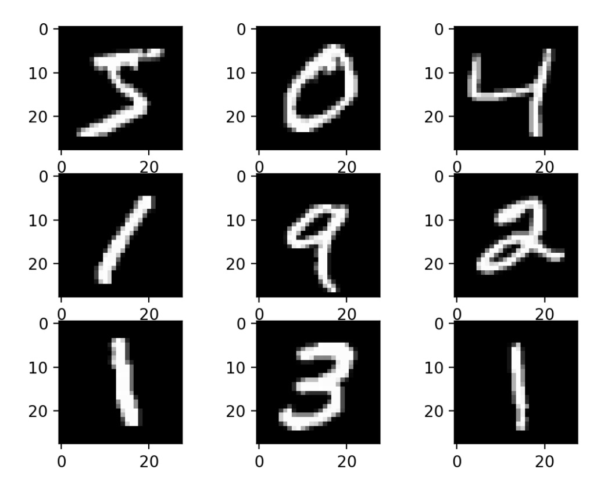
MNIST dataset
60000 handwritten digits
28x28 pixels,
black and white.

Slide 15
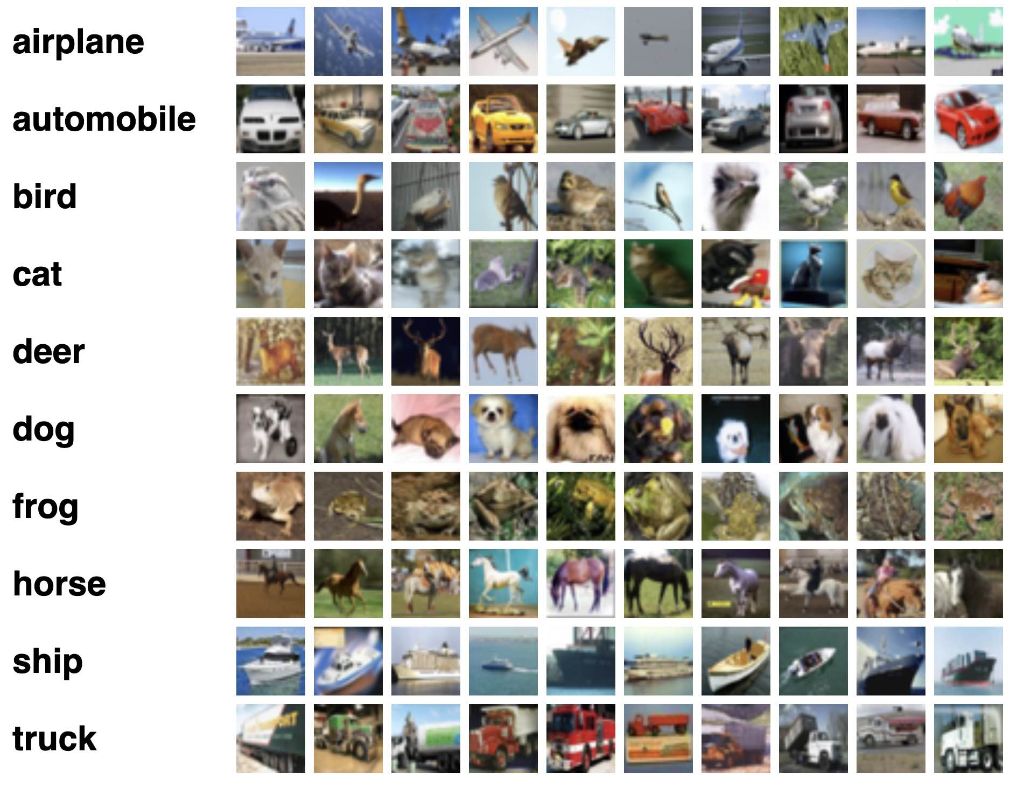
CIFAR10 dataset

Slide 16
CIFAR10 dataset
60k 32x32 colour images in 10 classes,
6k images per class.
50k training images and 10k test images.
Divided into five training batches and one test batch (each with 10k images)
The test batch: 1000 randomly-selected images from each class.
The training batches contain the remaining images in random order,
Some training batches may contain more images from one class than another. Between them, the training batches contain exactly 5000 images from each class.

Slide 17
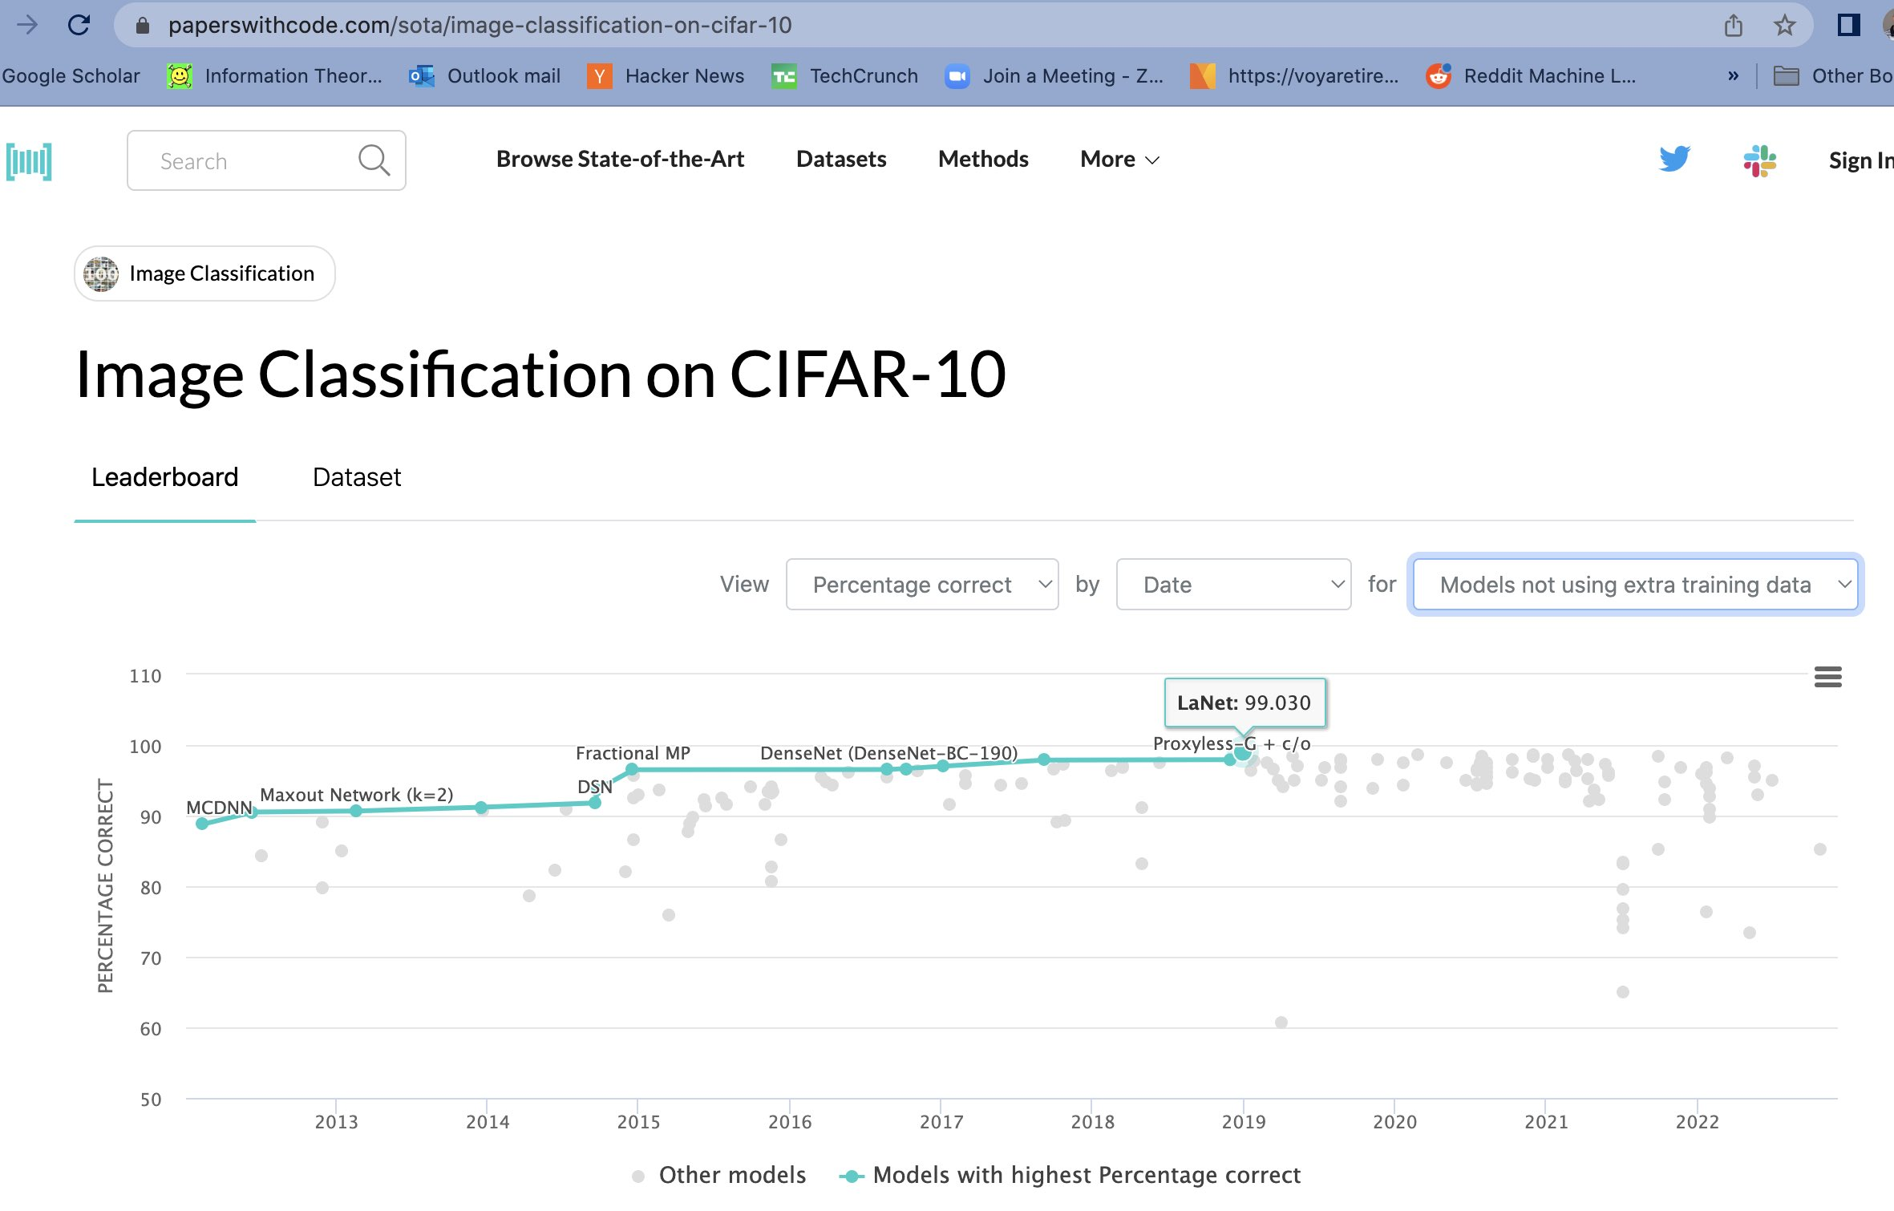
What is SOTA
Notes:
Special Operations and Training Area
Satellite Oceanography Tactical Applications
Safety Officer Training Academy

Slide 18
multi-class logistic regression
Given d features x, and k=3 classes, you have a matrix of weights that is k by d.
note that w1 has the same dimension as x.
if x is 28x28 =784 pixels then
w1 is also a vector of length 784.
d
W
x
z
w1
w1^{T} x
k
w2
w2^{T} x
w3
w3^{T} x

Slide 19
multi-class logistic regression, Cross entropy loss
d
Example:
Say w1= [1,0,0] w2=[0,1,0], w3=[0,1,1] ,x= [1,2,3] , y= class 2.
Compute the scores , the probabilities of the logistic regression for these 3 classes and the loss.
scores=[ 1,2, 5], probabilities = softmax (scores)
= [exp(1), exp(2) , exp(5)] / C
C= exp(1)+exp(2)+exp(5) =158.5
= [2.7, 7.38, 148] / 158 =
probabilities= p= [0.01, 0.04, 0.94]
loss =cross entropy of [y,p ]
=-sum yi log pi
y= [0,1,0] if y = class 2.
=- log ( 0.04) = 4.64
If correct class was 3
y=[0,0,1]
loss = - log(0.94)= 0.09
If logistic regression is sure and correct it pays loss:
- log 1 = 0
if logistic regression is sure and wrong it pays loss:
-log 0 =+ infinity.
W
x
z
w1
w1^{T} x
k
w2
w2^{T} x
w3
w3^{T} x

Slide 20
Observation on Cross Entropy loss
y= [ 1, 0, 0 ]
model1: softmax (W1 x) = [0.8 0.1 0.1]
model2: softmax( W2 x) = [ 0.8 0 0.2]
cross entropy loss for model1 VS cross entropy loss for model 2
Question: Which model has higher loss?

Slide 21
Observation on Cross Entropy loss
y= [ 1, 0, 0 ]
model1: softmax (W1 x) = [0.8 0.1 0.1]
model2: softmax( W2 x) = [ 0.8 0 0.2]
the cross entropy for model1= cross entropy loss for model 2
the most straightforward way to give ‘partial credit’ is to ‘soften’ the true labels.
ysoft= [ 0.9 0.1/(k-1) 0.1/(k-1) ]

Slide 22
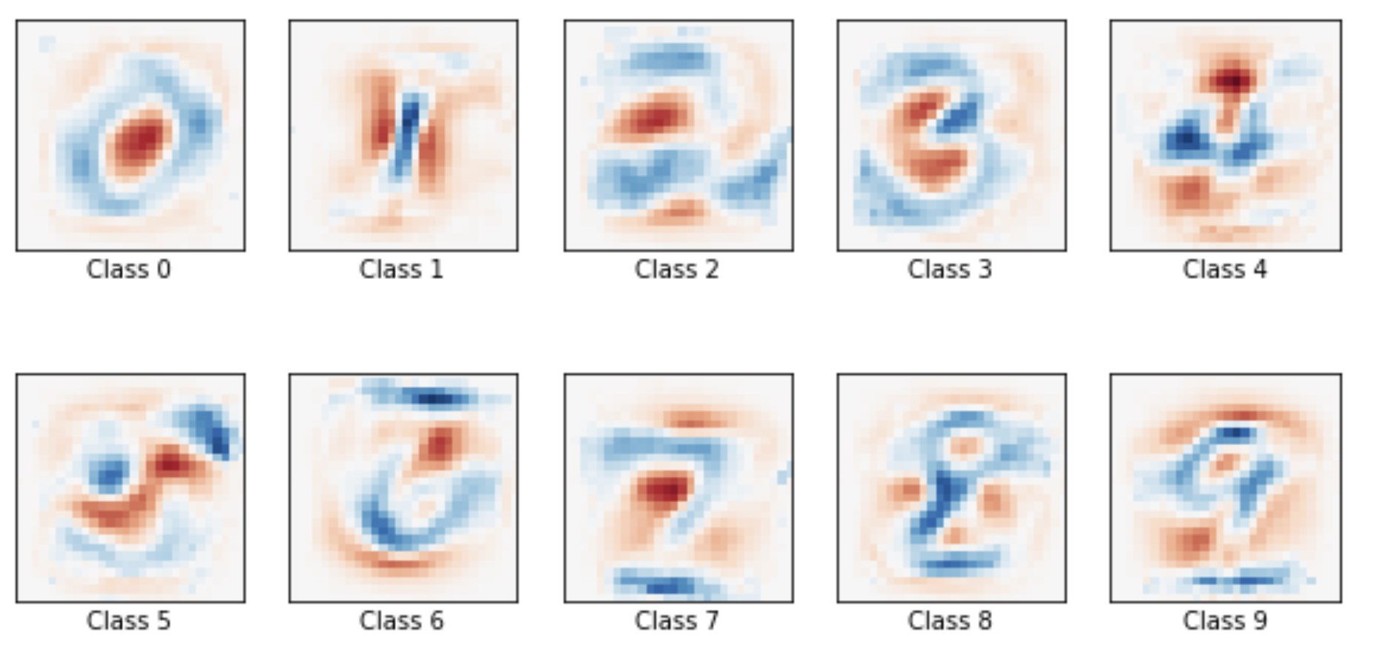
visualizing w0:
this is model.coefs reshaped as a 28 by 28 image
coefs = model.coef_.copy()
plt.imshow(coefs[0].reshape(28,28) )
plt.show()

Slide 23
visualizing w0,w1, w2 .. w9

Slide 24
Things to try in scikit
https://scikit-learn.org/stable/auto_examples/linear_model/plot_sparse_logistic_regression_mnist.html
https://scikit-learn.org/stable/modules/generated/sklearn.linear_model.LogisticRegression.html#sklearn.linear_model.LogisticRegression
https://towardsdatascience.com/logistic-regression-using-python-sklearn-numpy-mnist-handwriting-recognition-matplotlib-a6b31e2b166a
Notes:
https://scikit-learn.org/stable/auto_examples/linear_model/plot_sparse_logistic_regression_mnist.html
import numpy as np
import matplotlib.pyplot as plt
from sklearn.model_selection import train_test_split
from sklearn.datasets import fetch_openml
mnist = fetch_openml('mnist_784')
mnist.data.shape
im1=mnist.data[1,:] im1= np.reshape(im1, (28,28)) plt.imshow(im1) plt.show()
from sklearn.linear_model import LogisticRegression
logisticRegr = LogisticRegression(solver = 'lbfgs',verbose=1)
logreg= LogisticRegression
#The vars() function returns the __dict__ attribute of the given object.
vars(logreg)
from sklearn.model_selection import train_test_split
train_img, test_img, train_lbl, test_lbl = train_test_split(
mnist.data, mnist.target, test_size=1/7.0, random_state=0)
logisticRegr.fit(train_img, train_lbl)
--
clf = LogisticRegression(C=50. / 60000, multi_class='multinomial',
penalty='l1', solver='saga', tol=0.1)
clf.verbose=1
clf2 = LogisticRegression(C=1000, multi_class='multinomial',
penalty='l1', solver='saga', tol=0.1)
clf2.verbose=1
clf2.fit(train_img, train_lbl)
score = clf.score(test_img, test_lbl)
plt.imshow(coef[2].reshape(28, 28),cmap=plt.cm.RdBu)
plt.show()
-
from sklearn.preprocessing import StandardScaler
scaler = StandardScaler()
X_train = scaler.fit_transform(train_img)
X_test = scaler.transform(test_img)
y_train=train_lbl
y_test=test_lbl
--
clf2.fit(X_train, y_train)
sparsity = np.mean(clf2.coef_ == 0) * 100
score = clf2.score(X_test, y_test)
--
coef2 = clf2.coef_.copy()
plt.figure(figsize=(10, 5))
scale = np.abs(coef).max()
for i in range(10):
l1_plot = plt.subplot(2, 5, i + 1)
l1_plot.imshow(coef2[i].reshape(28, 28), interpolation='nearest',
cmap=plt.cm.RdBu, vmin=-scale, vmax=scale)
l1_plot.set_xticks(())
l1_plot.set_yticks(())
l1_plot.set_xlabel('Class2 %i' % i)
plt.suptitle('Classification vector for...')
plt.show()

Slide 25
clf = LogisticRegression(C=50. / 60000, multi_class='multinomial',
penalty='l1', solver='saga', tol=0.1)
clf.verbose=1
clf.fit(train_img, train_lbl)
score = clf.score(test_img, test_lbl)
print(score) # we get about 91 percent in the test set- not bad!
#lets look at the learned weight matrix
wmatrix= clf.coef_
wmatrix.shape #this is a 10 by 784 matrix
#lets see the first row of wmatrix as an image
plt.imshow(wmatrix[0].reshape(28, 28),cmap=plt.cm.RdBu)
plt.show()
another thing to try
from sklearn.preprocessing import StandardScaler
scaler = StandardScaler()
X_train = scaler.fit_transform(train_img)
X_test = scaler.transform(test_img)
y_train=train_lbl
y_test=test_lbl
#https://towardsdatascience.com/logistic-regression-using-python-sklearn-numpy-mnist-handwriting-recognition-matplotlib-a6b31e2b166a
#https://scikit-learn.org/stable/auto_examples/linear_model/plot_sparse_logistic_regression_mnist.html
#https://scikit-learn.org/stable/modules/generated/sklearn.linear_model.LogisticRegression.html#sklearn.linear_model.LogisticRegression
import numpy as np
import matplotlib.pyplot as plt
from sklearn.model_selection import train_test_split
from sklearn.datasets import fetch_openml
mnist = fetch_openml('mnist_784')
mnist.data.shape
#im1=mnist.data[1,:] im1= np.reshape(im1, (28,28)) plt.imshow(im1) plt.show()
#ok lets load a logistic regression
from sklearn.linear_model import LogisticRegression
#split the data in train and test
from sklearn.model_selection import train_test_split
train_img, test_img, train_lbl, test_lbl = train_test_split(
mnist.data, mnist.target, test_size=1/7.0, random_state=0)

