Slide 1


WHO IS AFFECTED?
TEAM
Binary Brains
Target users, stakeholders, beneficiaries
Primary users / target group:
  Hostel residents: Students who travel off-campus for weekends, home visits, railway or bus stations. Need: flexible, on-demand ride sharing at a low or zero cost.
  Day-scholar commuters: Students who travel daily between home and campus.
      Need: predictable schedules, lower monthly commute cost, and reliable pick-up points.
Student drivers (ride providers): Students with cars or two-wheelers who offer empty seats. Need: fuel cost recovery, ride-matching with trusted peers, and control over who joins.
Secondary stakeholders:
  First-year and out-of-state students: Newcomers who are unfamiliar with local transport and benefit most from trusted ride networks.
  Faculty and non-teaching staff: Regular commuters who can anchor stable, recurring carpool routes.

Slide 2
WHO IS AFFECTED?
TEAM
Binary Brains
Target users, stakeholders, beneficiaries
Who benefits if the problem is solved?​ :
Students (direct beneficiaries) : Students save money and time on every trip, whether they ride or drive, while building a stronger campus community.
University administration : The university gains less traffic, safer student travel, better punctuality, and a measurable sustainability record.
Transport department : Finally, data tells us where the buses should be, instead of students tracking them down by word of mouth, while carpooling quietly covers the gaps without competing with the existing services.

Slide 3
CURRENT SITUATION & CONTEXT
TEAM
Binary Brains
1)Existing Scenario:
A. Train Travel: The railway station is located near the campus entrance, but train delays can disrupt travel plans.
B. Schedule Conflicts: Train timings sometimes clash with class schedules, limiting students’ ability to use rail transport conveniently.
C. Cabs: Students rely on services like Uber, Ola, and Red Taxi to reach railway stations, bus stands, and other destinations.
D. Personal Transport: Travelling with friends or students who own personal vehicles is an option, but availability is limited.
E. Ride-Sharing: Students search for fellow travellers heading to the same destination to share cab fares, but finding and coordinating with them can be difficult.
F. Holiday Rush: During holidays, large numbers of students travel simultaneously, causing overcrowded trains and congestion from cabs and private vehicles at the campus entrance.
2)Current Workflow:
Identify need → Find co-travellers → Coordinate pickup → Share a ride → Split costs

Slide 4
KEY CHALLENGES
TEAM
Binary Brains
Main difficulties, bottlenecks, root causes and consequences
Bottleneck | Root Cause | Consequence if Left Unsolved
Trust and safety | Unverified strangers, no accountability | Riders avoid booking, women exit first, and the platform never gains users
Legal grey area | Motor Vehicles Act bars private cars from “hire or reward” | Fines, app shutdown, and loss of university approval
Insurance gap | Private policies not designed for passenger sharing | Drivers withdraw seats, and accident costs fall on students
Coordination effort | Fixed timings, loss of flexibility | Students revert to solo travel, and usage never becomes a habit
Cold start | Riders and drivers must exist on the same route | Empty search results, early users leave, and growth stalls

Slide 5
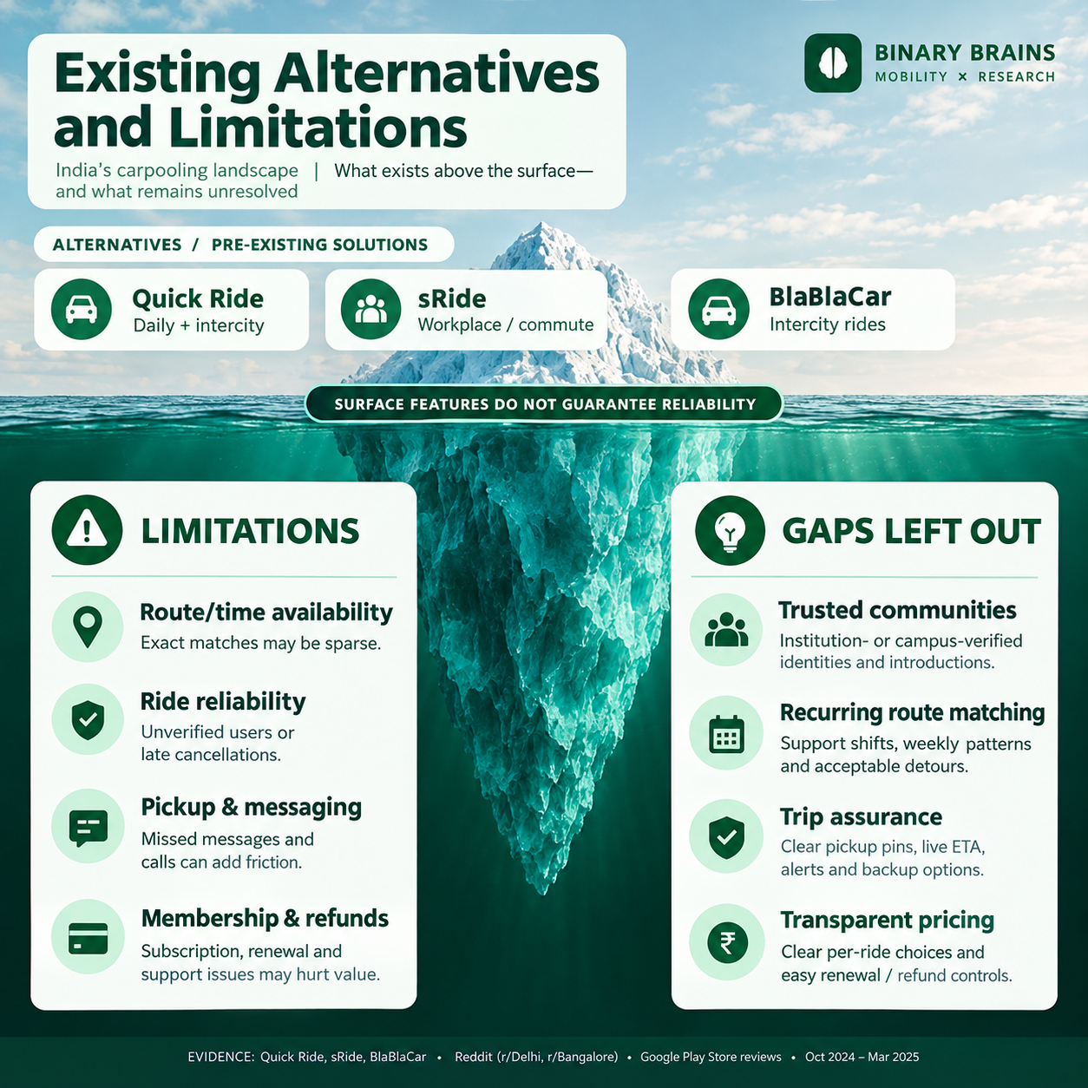





EXISTING SOLUTIONS / APPROACHES
TEAM
Binary Brains
Made with Chatgpt

Slide 6
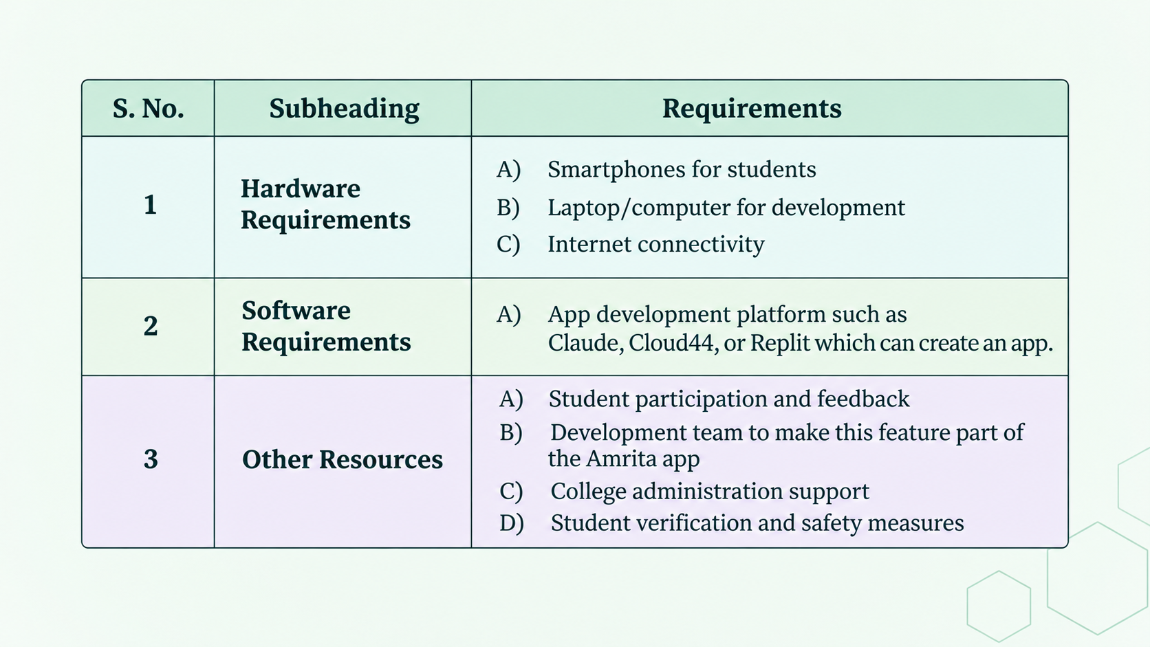
PROBLEM INSIGHTS & OPPORTUNITY AREAS
TEAM
Binary Brains
Resources required to solve the problem

Slide 7
INITIAL DIRECTION & EXPECTED OUTCOME
TEAM
Binary Brains
What Is Your Expected Outcome?
What our team intends to do:
Our team wants to build an inter‑campus carpooling platform that connects students, professors and non‑teaching staff who travel along the same routes. The inter‑campus carpooling platform will help local students find travel partners. The inter‑campus carpooling platform will also let out‑of‑state students who are unfamiliar, with local transport routes commute safely and efficiently.
What we want to improve:
We aim to enhance passenger safety and accountability by maintaining a UID-based record of students and staff participating in each carpool. By linking ride details and passenger identities to their unique login IDs, the platform will enable easier identification and traceability in emergencies, promote responsible ride-sharing, and provide an additional layer of security, particularly for female passengers.
What successful improvement we hope to achieve:
To establish a safe, reliable, and accountable carpooling network with UID-based passenger traceability, enabling quicker emergency response and enhanced security, particularly for female passengers.

