Slide 1
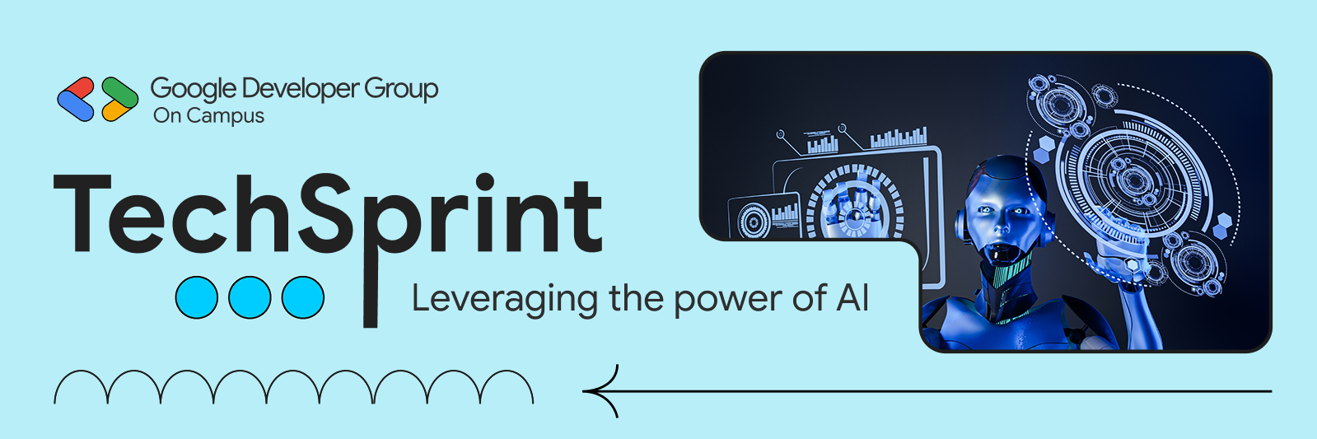
Team Details
Team name: AgentForge
Team leader name: M. Rithvik Goud
Problem Statement: Learners lack a clear, structured system to assess career readiness, identify skill gaps, prepare for interviews, and navigate job opportunities effectively—leading to unplanned learning and career confusion.

Slide 2

Brief about the solution and problem statement addressed:
CareerForge addresses the common challenge faced by students and early professionals who lack clarity about their career readiness, are unsure of required skills, follow unstructured learning paths, and struggle with interview preparation and job applications. The solution acts as an AI-powered personal career operating system that analyzes a user’s resume and target role to evaluate readiness, identify skill gaps, and provide actionable guidance. By offering personalized learning roadmaps, role-specific project recommendations, AI-driven mock interviews with feedback, and intelligent job and market insights, CareerForge transforms scattered career preparation into a structured, data-driven, and goal-oriented process, enabling users to clearly understand where they stand and what steps to take next in their career journey.

Slide 3
Opportunities
CareerForge addresses the increasing need for personalized career guidance in a rapidly evolving job market. By helping students and early professionals align their skills with industry demands through structured planning and AI insights, it opens opportunities to bridge the gap between learning and employability, with strong potential for future expansion into real-time job data and career analytics.
How is it different from existing solutions?
CareerForge stands out by offering a unified, end-to-end career platform instead of isolated tools. It integrates resume analysis, skill gap detection, learning plans, project ideas, interview practice, and job insights into one personalized experience tailored to a user’s target role.

Slide 4

How does it solve the problem?
CareerForge solves the problem of career confusion and unstructured preparation by converting user data—such as resumes and career goals—into clear, actionable guidance. Through AI-powered analysis, it helps users understand their career readiness, identify missing skills, and follow a structured learning roadmap. The platform reinforces learning with practical project ideas, builds confidence through AI-driven mock interviews with feedback, and supports informed decision-making using job recommendations and market trends. This structured, personalized approach replaces guesswork with clarity, enabling users to progress systematically toward their career goals.

Slide 5
List of features offered by the solution
AI-powered resume analysis and career readiness scoring.
Skill extraction and detailed skill gap analysis for target roles.
Personalized, structured weekly learning plans.
Task management with progress tracking (add, delete, mark complete).
Role-specific project recommendations with resume value insights.
AI-driven mock interviews with chat and voice support.
Post-interview feedback including scores, strengths, and improvement areas.
AI-assisted job matching with skill match scores.
Market trend insights covering demand, salaries, and emerging technologies.
Secure user authentication with personalized data persistence

Slide 6
Google Technologies used in the solution
Google Gemini API – Role in CareerForge
Google Gemini API acts as the core AI engine of CareerForge, enabling intelligent analysis of user resumes and target roles. It is responsible for extracting skills, evaluating career readiness, identifying skill gaps, and generating meaningful insights that help users understand their current standing in the job market.
Beyond analysis, Gemini powers the personalized experience within CareerForge by generating structured learning plans, role-specific project ideas, and AI-driven mock interviews with detailed feedback. It also supports job recommendations and market trend insights, ensuring users receive context-aware, practical guidance tailored to their career goals.

Slide 7
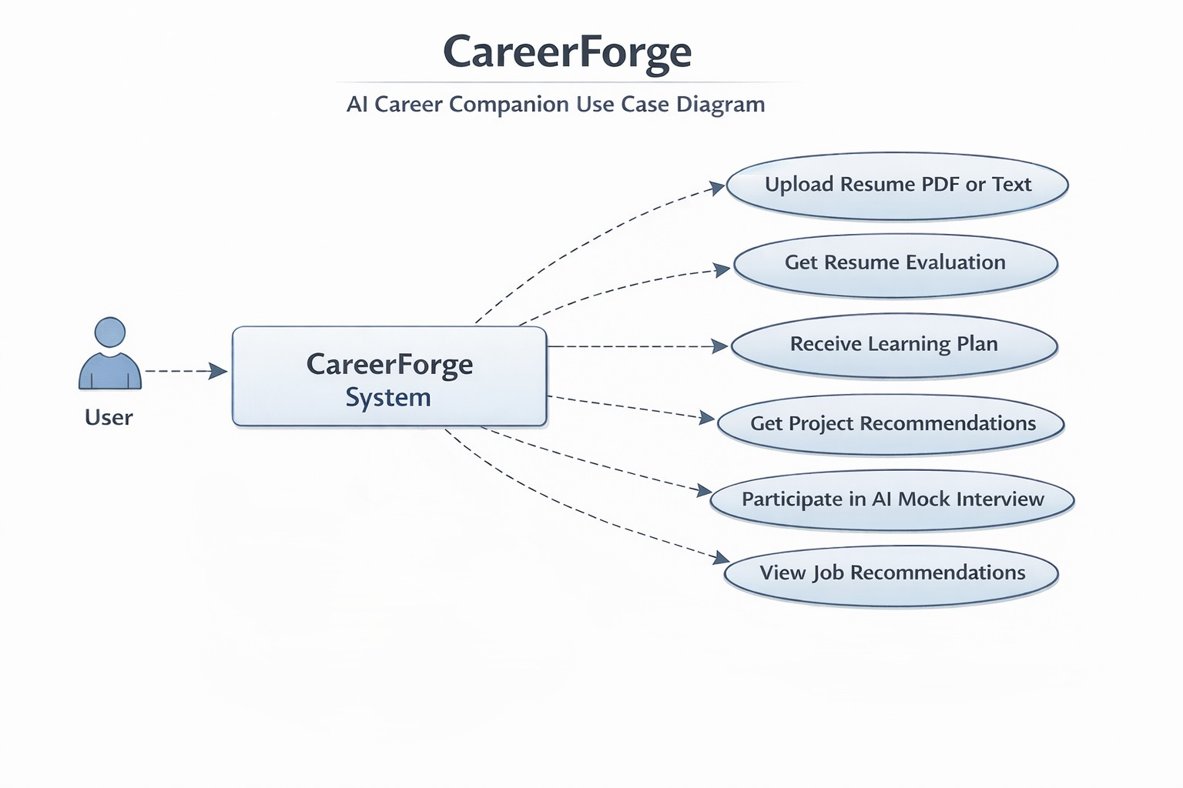
Process flow diagram or Use-case diagram

Slide 8
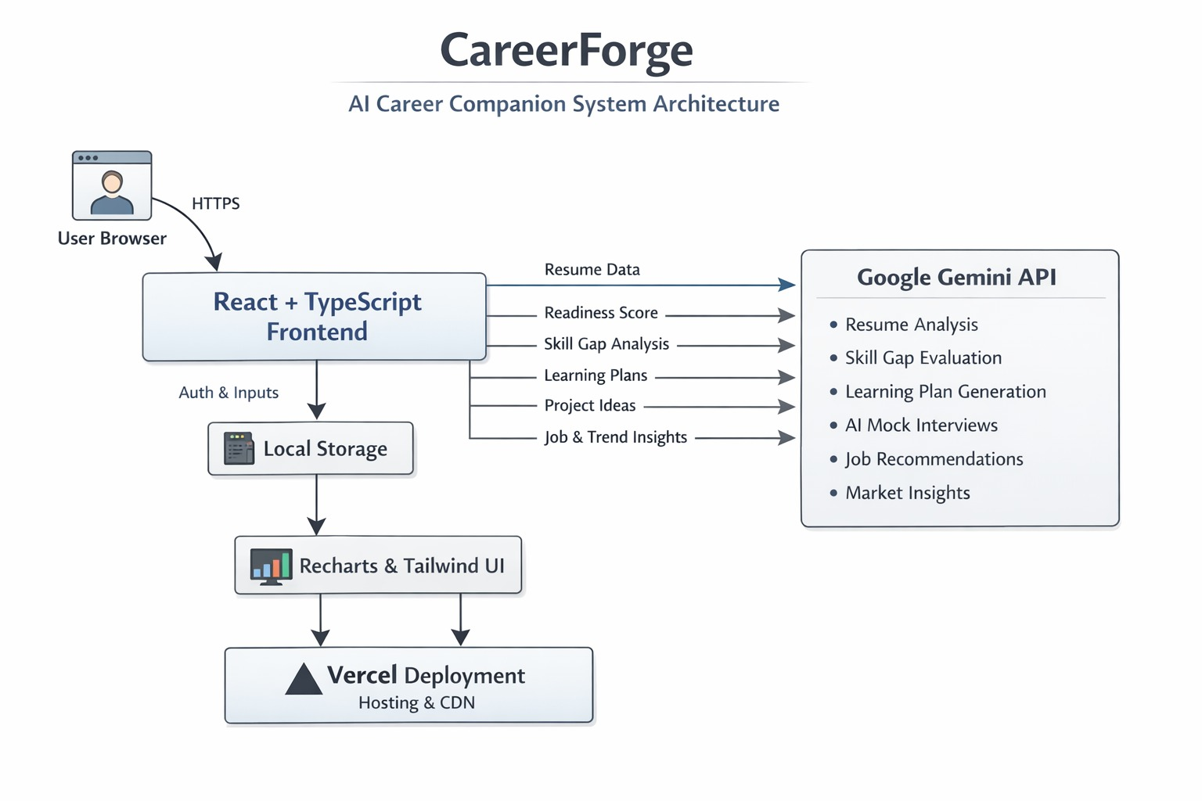
Architecture diagram of the proposed solution

Slide 9
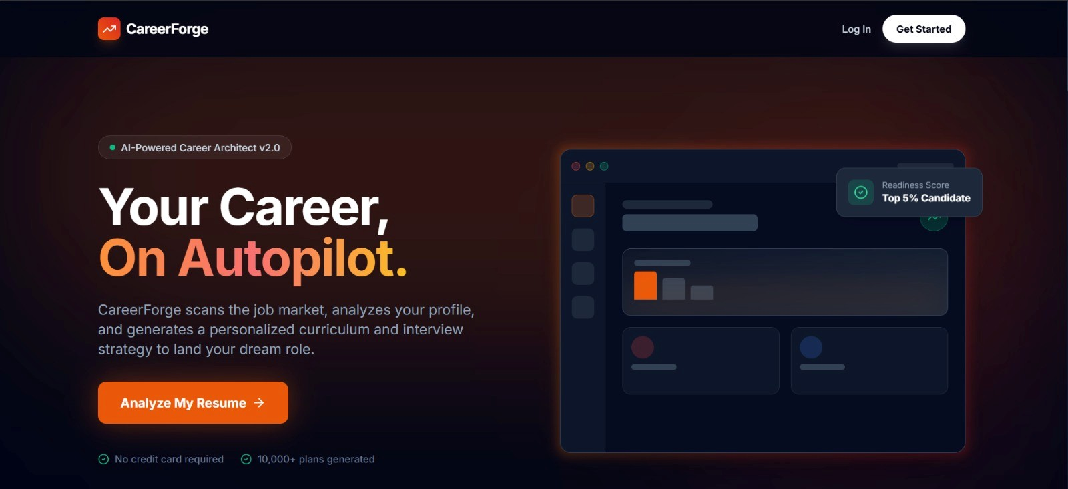
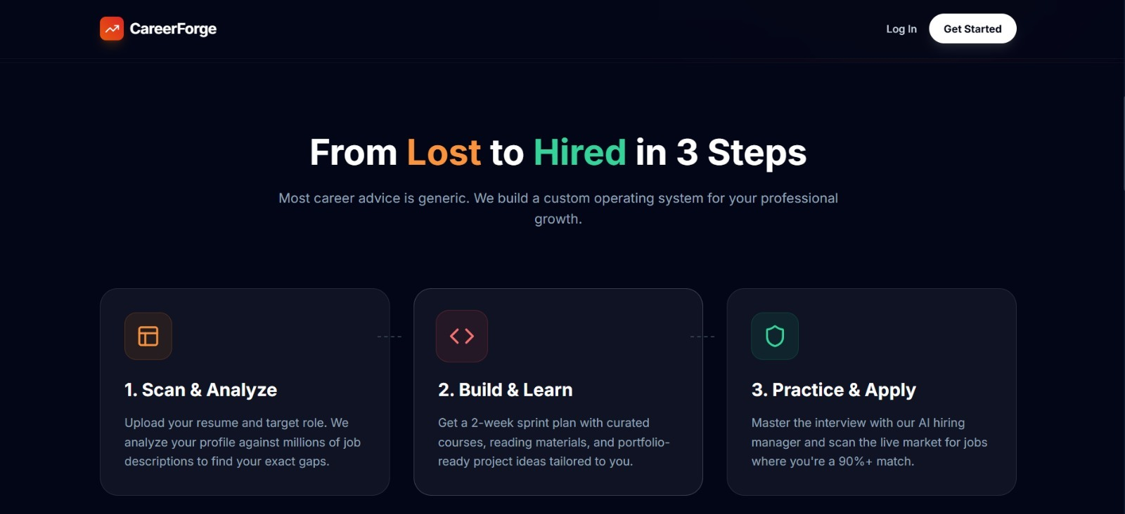
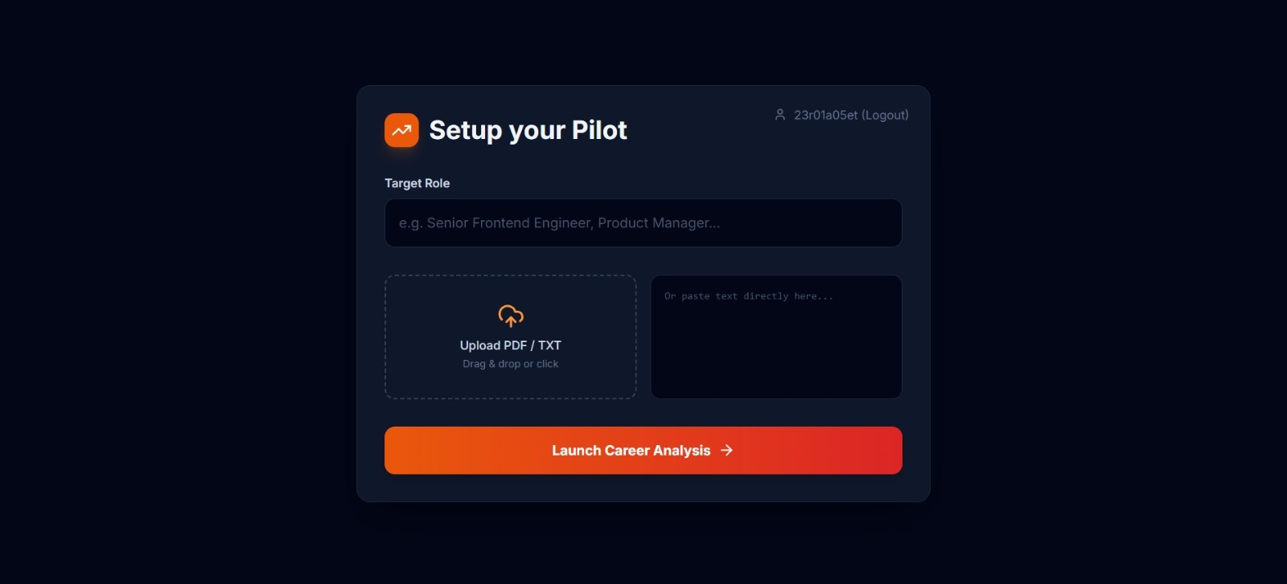
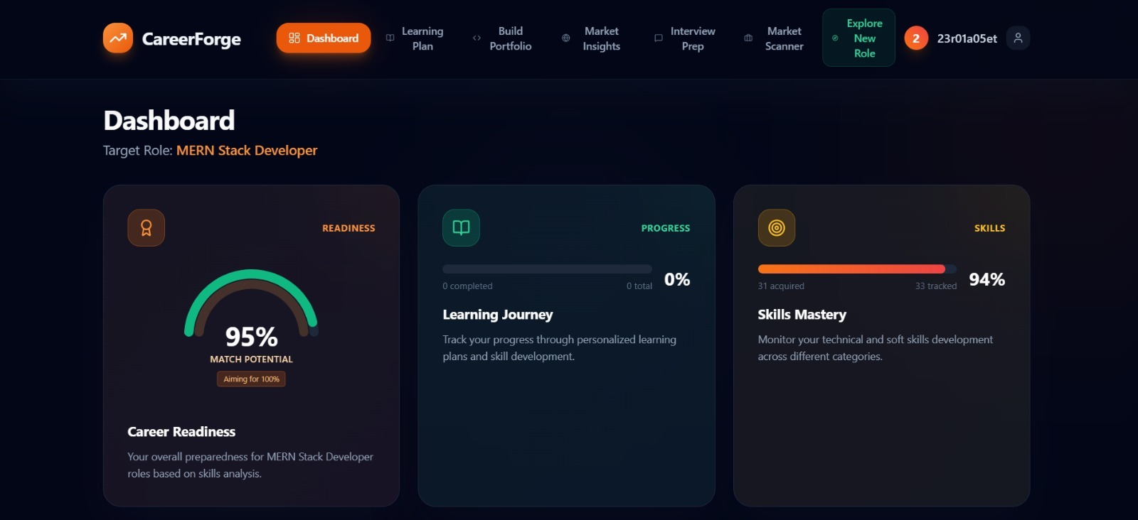
Snapshots

Slide 10
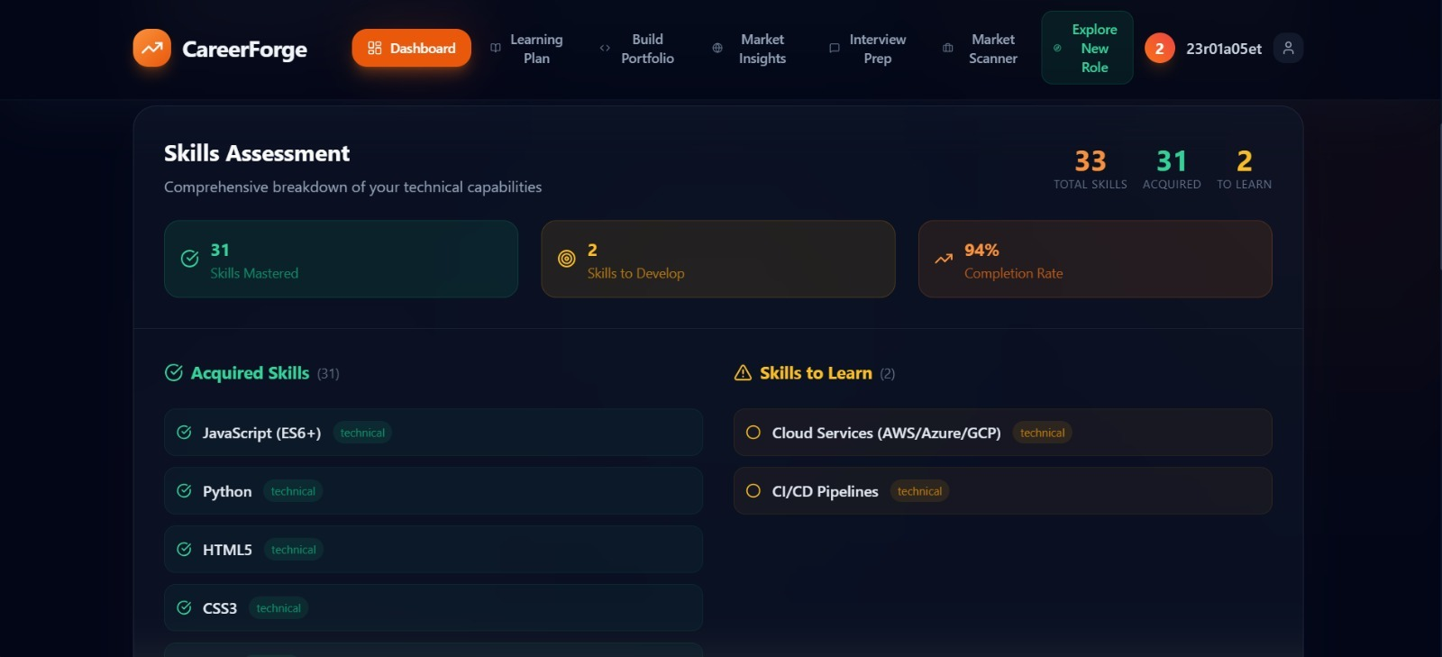
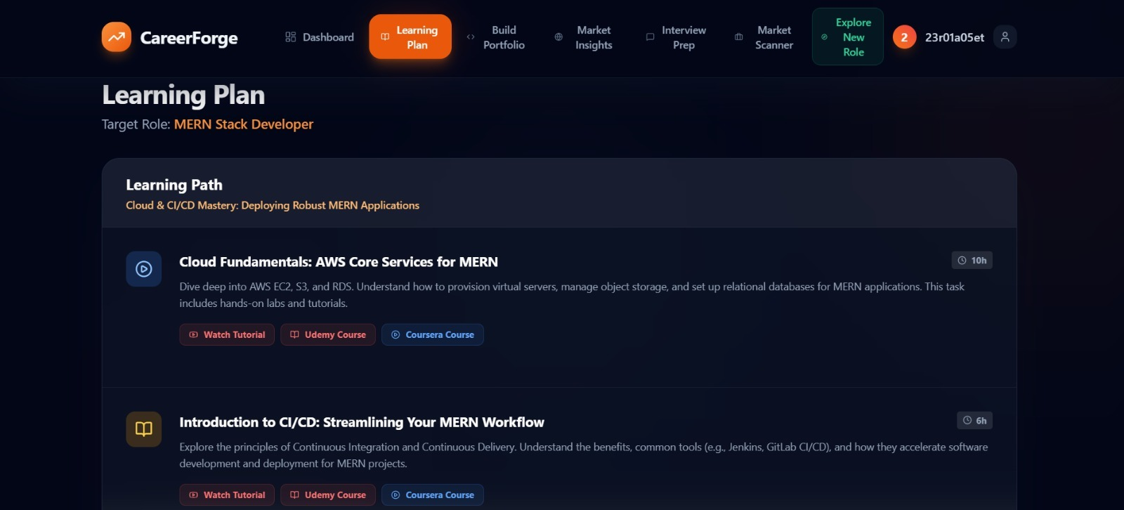
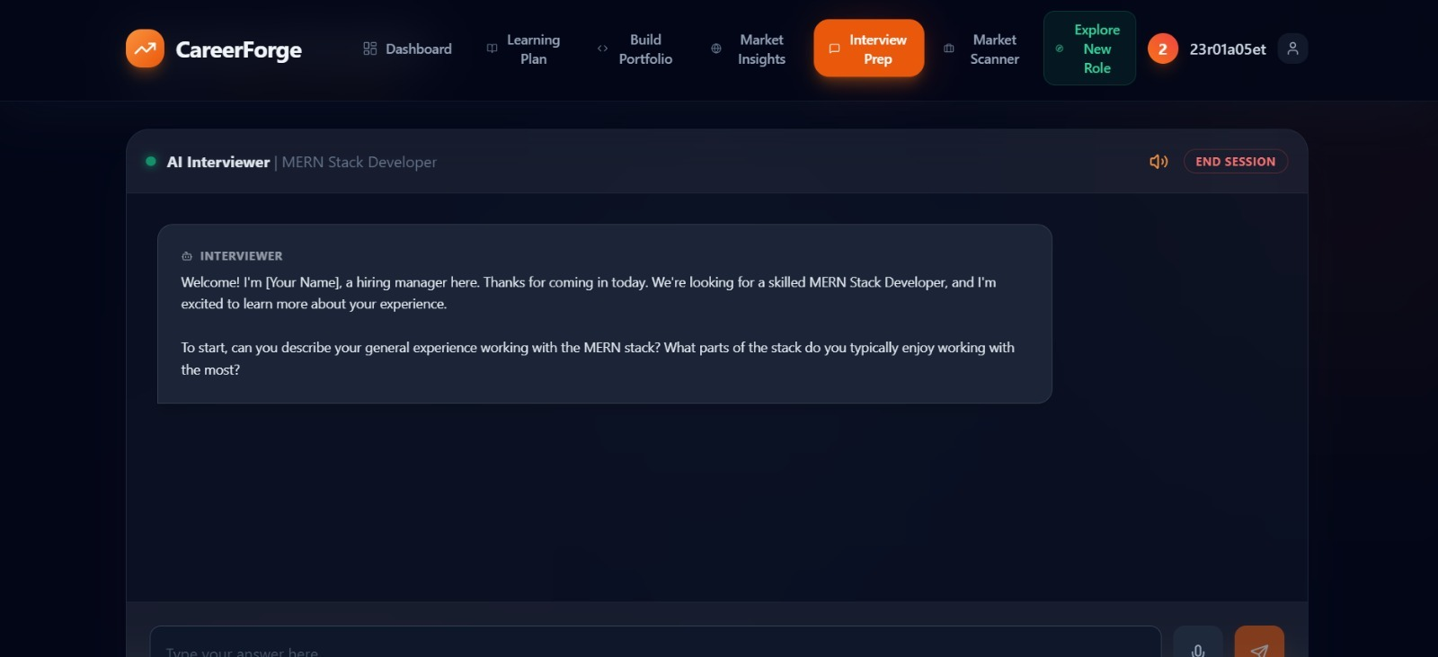
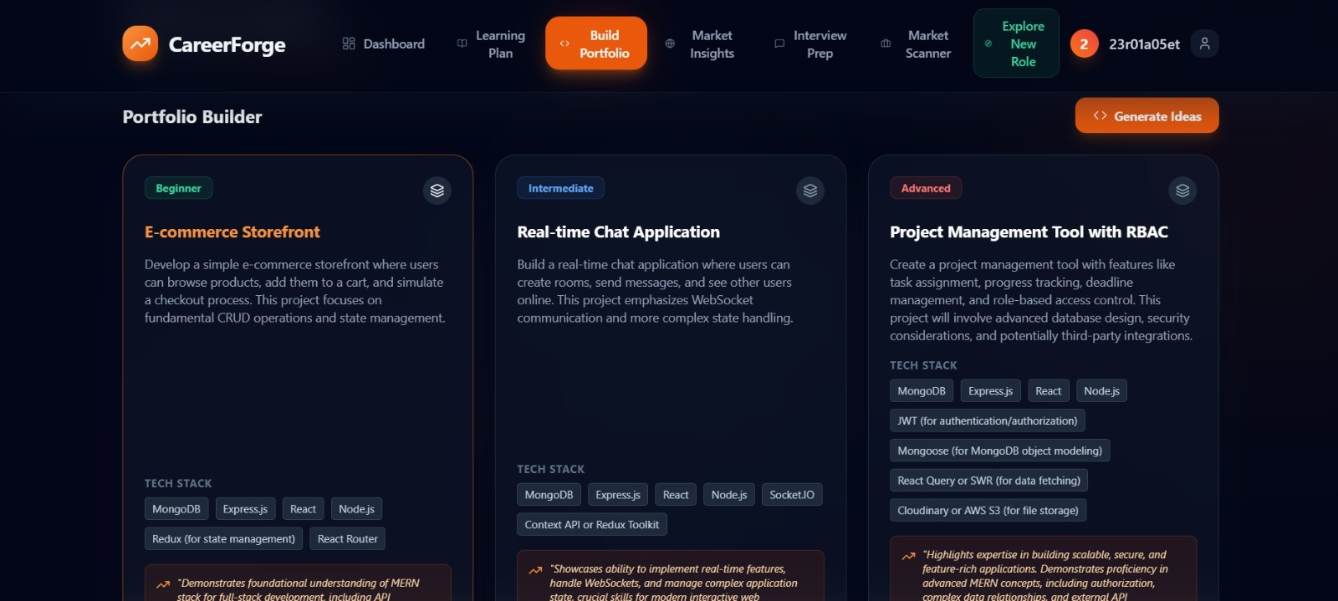

Slide 11
Future Development
Real-Time Job API Integration; Fetch live job openings from LinkedIn and Indeed.
Firebase Authentication; Enable secure, scalable, production-grade user login.
Cloud Database (Firestore); Store and manage user data reliably in the cloud.
Resume Versioning; Track, compare, and improve multiple resume versions.
Career Progress Analytics; Visualize skill growth and readiness over time.
Multi-Language Support; Expand accessibility for users across regions.

Slide 12
Provide links to your:
GitHub Public Repository: https://github.com/rithvik0906/CareerForge
MVP Link: https://career-forge-pi.vercel.app/
Demo Video Link: https://drive.google.com/file/d/1M53s-GIzK7CcC3uDiUkDNBBy5ZfkuBYh/

Slide 13
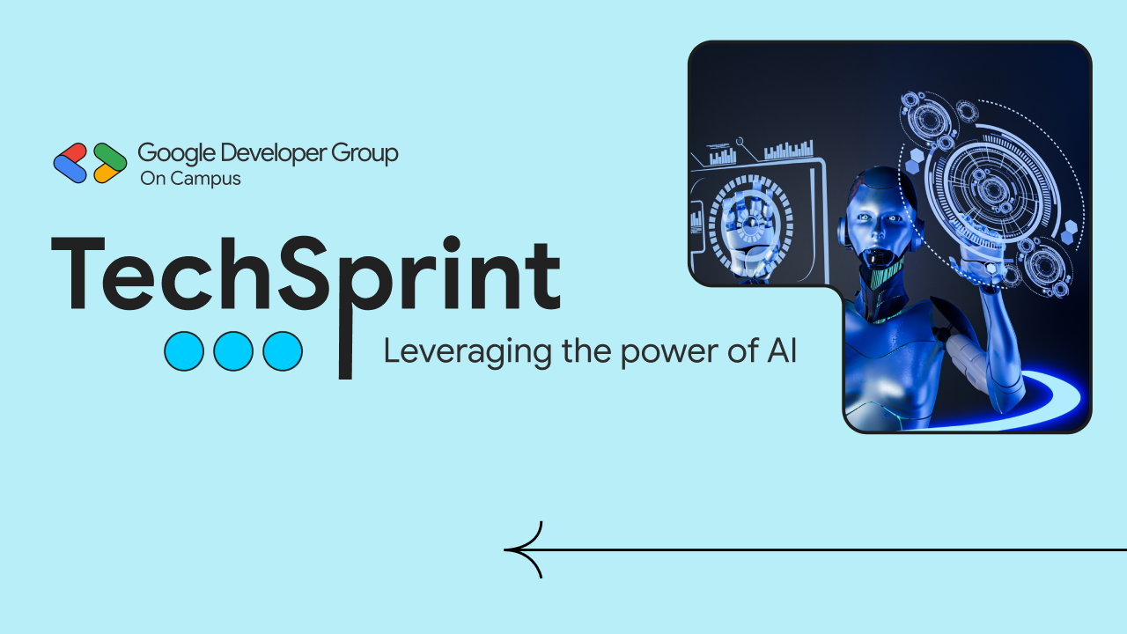
Thank you!

