Slide 1


Animal Classifier

Slide 2

Learning Objectives
By the end of this project, you will be able to:
Understand the concept of multi-class classification using
deep learning
Apply transfer learning using pretrained MobileNetV2 for
image recognition tasks
Use Image Data Generator for efficient image
preprocessing and data augmentation
Train and evaluate a CNN model for classifying
90 different animal species
Build and deploy a responsive Streamlit web application
for real-time predictions
Interpret model confidence scores and visualize predictions
GOAL
Source :
www.freepik.com/

Slide 3
Tools and Technology used
Python – Core programming language for model development
TensorFlow & Keras – For building, training, and saving the deep learning model
MobileNetV2 – Pretrained CNN model used for transfer learning
Pandas & NumPy – Data handling and numerical operations
Matplotlib – For visualizing training progress and predictions
Streamlit – For deploying the model as an interactive web application
Kaggle Datasets – Source of the 90-class animal image dataset

Slide 4
Methodology
Data Collection :
Sourced from Kaggle: 90 animal categories, folder-structured format
Data Preprocessing :
Resized images to 224×224
Normalized pixel values (0–1 scaling)
Used ImageDataGenerator for augmentation and loading
Model Development :
Used MobileNetV2 (pretrained on ImageNet) as the base
Added custom layers: GlobalAveragePooling, Dropout, Dense(90)
Model Training :
Trained on augmented dataset using categorical crossentropy
Optimized using Adam optimizer
Model Evaluation & Saving :
Evaluated accuracy and loss
Saved the model as MCAR.keras
Deployment :
Built a web interface using Streamlit for real-time image prediction

Slide 5
Problem Statement:
The ability to automatically classify animal species from images has a wide range of applications in fields such as wildlife monitoring, conservation, zoology, and education. However, it presents significant challenges:
🧬 Visual Similarity: Many animals from different species may look visually similar (e.g., leopards vs. jaguars), making classification difficult even for humans.
🐾 Diverse Appearances: The same species can appear very different due to changes in age, color, or region (e.g., different types of parrots or tigers).
🖼️ Unstructured Input Data: Real-world animal images may have varying lighting conditions, background noise, camera angles, and occlusions.
📊 High Dimensionality: Handling a multi-class problem with 90 categories requires a deep, well-optimized model that generalizes well to unseen data.
✅ Objective
To develop a robust image classification system using deep learning and transfer learning techniques that can:
Accurately classify an animal image into one of 90 species
Be efficiently deployed as a Streamlit web application
Deliver real-time predictions with high confidence and interpretability

Slide 6
Solution:
🧠 Transfer Learning with MobileNetV2
Leveraged MobileNetV2, a lightweight and efficient convolutional neural network pretrained on ImageNet.
Reused the feature extraction layers and replaced the classification head with custom layers for our 90-class problem.
🧪 Custom Model Architecture
Added layers: GlobalAveragePooling → Dropout (0.3) → Dense(90, softmax)
Ensured the model is small, fast, and deployable on low-resource environments
🖼️ Image Preprocessing
Standardized all images to 224×224 resolution
Applied normalization and augmentation to improve generalization
🚀 Deployment via Streamlit
Built a clean, interactive web app using Streamlit
Allows users to upload any image and get real-time species prediction with confidence score

Slide 7
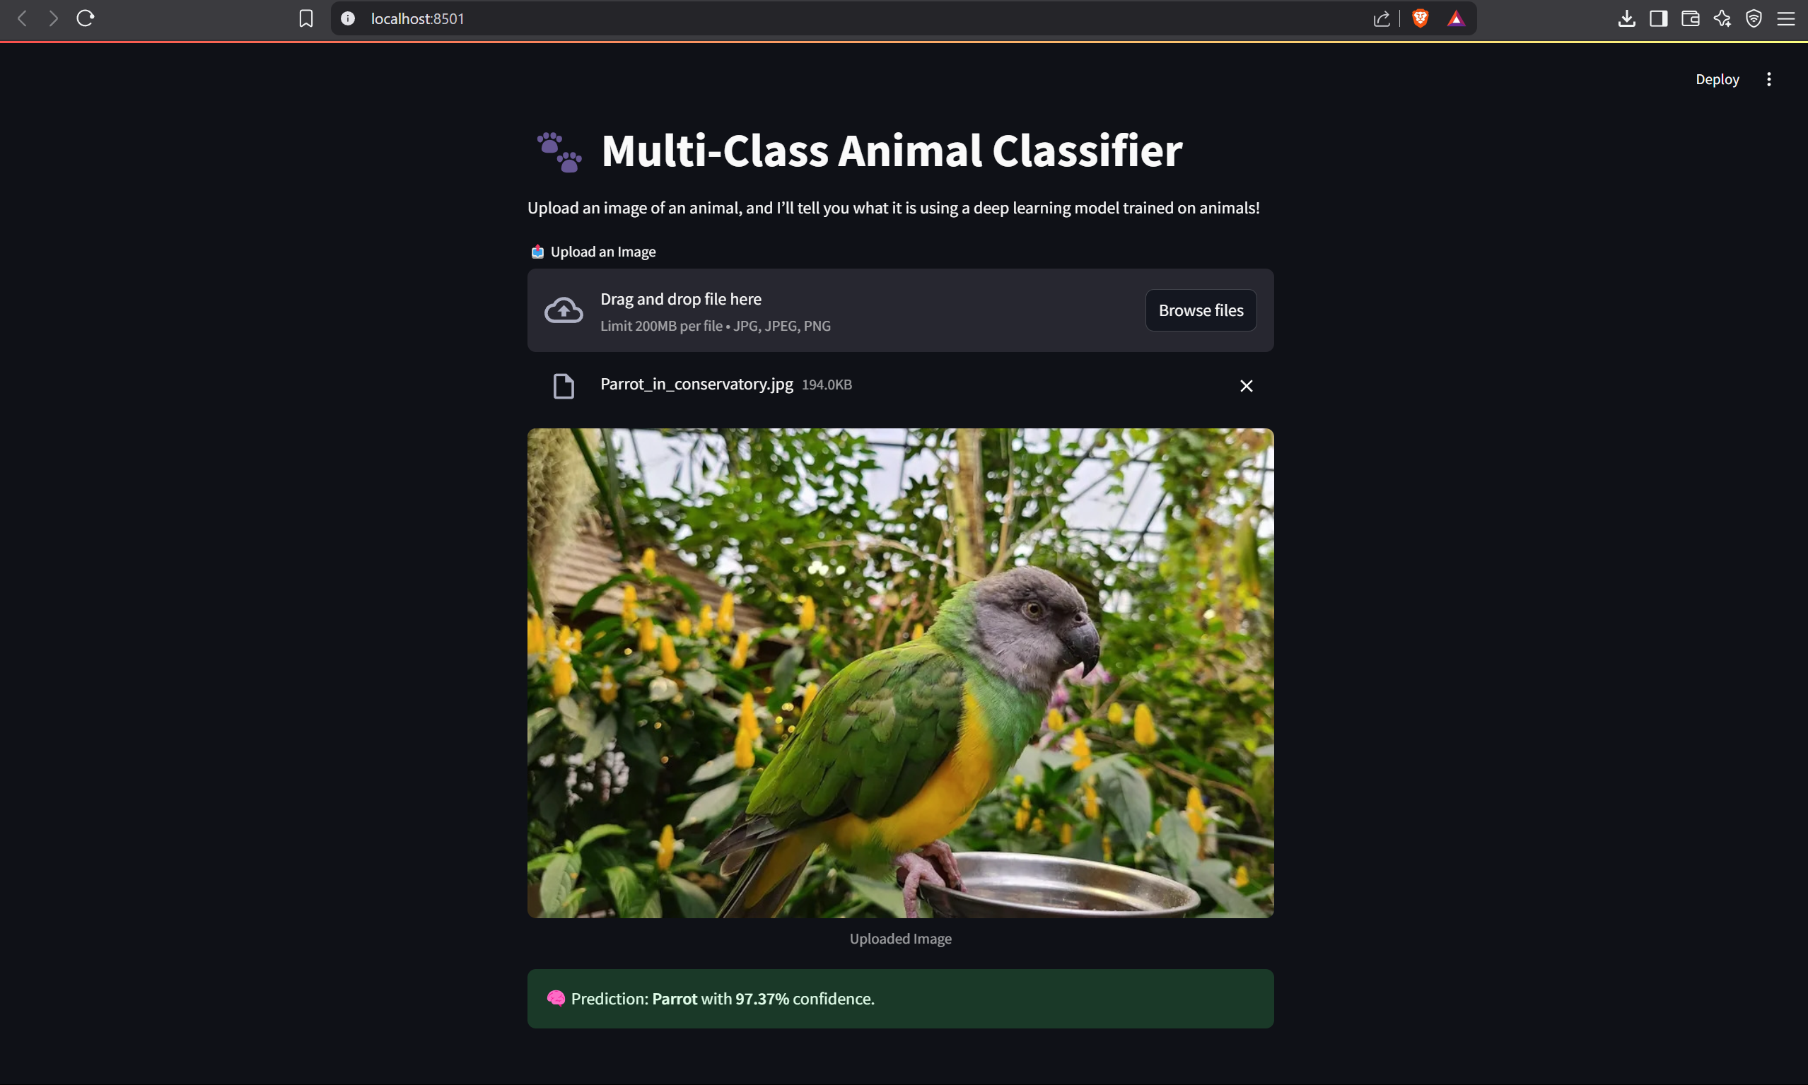
Screenshot of Output:

Slide 8
Conclusion:
This project successfully demonstrates the use of deep learning and transfer learning to solve a complex multi-class image classification task.
By training on a well-curated dataset of 90 animal categories, the model learned to generalize across diverse species and visual conditions.
The integration of MobileNetV2 ensured that the model remains lightweight, fast, and suitable for deployment.
The final product, a Streamlit-based web app, provides a clean and interactive interface for real-time animal species prediction from uploaded images.
The project not only highlights the power of pretrained CNNs but also shows how AI can be made accessible to end-users through deployment platforms.

