Slide 1
AGENTIC AI & GENERATIVE AI
FUNDAMENTALS
Trainer: Mr. Venkatesh
A hands-on course covering Generative AI foundations, prompt engineering, AI agents, and agentic project building.
Generative AI
Prompt Engineering
AI Agents
Agentic Projects
Agentic AI & Generative AI Fundamentals
1
Notes:
Welcome learners to the program. Introduce yourself as Mr. Venkatesh and set expectations: this is a practical, project-driven course spanning Generative AI fundamentals, prompt engineering, AI agents, and hands-on agentic projects. Real-time example: Mention that tools like ChatGPT and GitHub Copilot are everyday examples of Generative AI already in use. Learning outcome: Learners should leave this slide understanding the scope and structure of the course ahead.

Slide 2




Course Overview
What you will learn across this program
Generative AI Fundamentals
Prompt Engineering
Core concepts behind LLMs and generative models.
Techniques to design effective, reliable prompts.
AI Agents
Agentic AI Projects
How autonomous agents perceive, reason, and act.
Build real, end-to-end agentic workflows.
Agentic AI & Generative AI Fundamentals
2
Notes:
Walk through the four pillars of the course: Generative AI Fundamentals, Prompt Engineering, AI Agents, and Agentic AI Projects. Explain that each module builds on the previous one. Real-time example: Compare a plain chatbot (Generative AI) to an AI agent that can book a flight for you (Agentic AI) to show the progression. Learning outcome: Learners should be able to name and briefly describe the four core areas covered in this course.

Slide 3




Learning Objectives
By the end of this course, you will be able to
01
Understand LLM Concepts
02
Learn Prompt Engineering
Outcome-Driven Learning
Each module builds toward the next — from core LLM theory to fully autonomous, agentic AI systems you design and deploy yourself.
03
Explore AI Agents
04
Understand Agent Workflows
Capstone: Build your own AI agent end-to-end.
05
Build a Capstone Project
Agentic AI & Generative AI Fundamentals
3
Notes:
Present the five learning objectives in order, emphasizing that they build progressively toward the capstone project. Pause on 'Understand Agent Workflows' to preview upcoming agent-architecture content. Real-time example: A customer-support LLM (LLM concepts) evolving into a scripted support bot (prompt engineering) and finally into an autonomous support agent that resolves tickets end-to-end (agent workflows). Learning outcome: Learners can state all five objectives and understand how the capstone ties them together.

Slide 4





Evolution of AI
From broad intelligence to autonomous, goal-driven agents
Artificial Intelligence
Real-Time Example
Machines that mimic human reasoning and decision-making.
Netflix recommendations (ML) evolved into ChatGPT (Generative AI) and now into autonomous AI agents that book trips or manage tasks end-to-end.
Machine Learning
Systems that learn patterns from data instead of fixed rules.
Deep Learning
Learning Outcome
Neural networks that learn complex patterns from vast data.
Learners can position Agentic AI within the broader AI landscape and explain how each stage builds on the last.
Generative AI
Models that create new text, images, code, and media.
Agentic AI
AI that plans, decides, and acts autonomously toward goals.
Agentic AI & Generative AI Fundamentals
4
Notes:
Walk down the funnel diagram stage by stage: AI is the broad field of mimicking human intelligence; Machine Learning lets systems learn from data; Deep Learning uses neural networks for complex pattern recognition; Generative AI creates new content; Agentic AI adds autonomous planning and action. Real-time example: Netflix recommendations (ML) evolving into ChatGPT (Generative AI) and then into autonomous booking or research agents (Agentic AI). Learning outcome: Learners can place Agentic AI correctly within the broader evolution of AI and explain what distinguishes each stage.

Slide 5





What is Generative AI?
AI systems that create original content from learned patterns
Leading Examples
Definition
AI models that generate new text, images, audio, code, or video by learning patterns from large datasets — rather than simply classifying or predicting.
ChatGPT
Google Gemini
Conversational AI by OpenAI
Google's multimodal AI model
Importance
Accelerates content creation, coding, design, and decision-making, unlocking major productivity gains across every industry.
Claude
GitHub Copilot
Industry Adoption
Anthropic's AI assistant
AI pair-programmer for developers
Widely adopted across tech, finance, healthcare, education, and media — from customer support to software engineering.
Agentic AI & Generative AI Fundamentals
5
Notes:
Define Generative AI clearly: models that create new content rather than just classify or predict. Emphasize why it matters for productivity across industries, then walk through the four leading examples on the right. Real-time example: Show how ChatGPT drafts an email, Copilot writes code, Claude summarizes documents, and Gemini answers multimodal queries — all generating new content on demand. Learning outcome: Learners can define Generative AI in their own words and name at least three real-world tools that use it.

Slide 6


Traditional AI vs Generative AI
How generative systems fundamentally differ from rule-based AI
Dimension
Traditional AI
Generative AI
Approach
Rule-Based
Content Creation
Logic
Fixed Logic
Pattern Learning
Output
Limited Output
Dynamic Output
Agentic AI & Generative AI Fundamentals
6
Notes:
Contrast the two paradigms row by row: Traditional AI follows fixed, rule-based logic and produces limited, pre-defined outputs; Generative AI learns patterns from data and produces dynamic, novel content. Real-time example: A traditional spam filter uses fixed keyword rules, while a generative AI writing assistant creates original, context-aware responses each time. Learning outcome: Learners can clearly articulate the three key differences between traditional and generative AI systems.

Slide 7






Applications of Generative AI
A general-purpose technology reshaping every major industry
Content Creation
Code Generation
Customer Support
Articles, images, and video generated on demand.
AI pair-programmers that write and debug code.
Conversational agents that resolve queries 24/7.
Education
Healthcare
Marketing
Personalized tutoring and adaptive learning content.
Faster diagnostics, research, and clinical documentation.
Campaign copy, creative assets, and personalization.
Agentic AI & Generative AI Fundamentals
7
Notes:
Walk through each of the six application areas, noting that Generative AI is a general-purpose technology rather than a single-use tool. Real-time example: Show how the same underlying model powers a marketing copy generator, a coding assistant like Copilot, and a customer support chatbot. Learning outcome: Learners can list at least four industries actively using Generative AI and describe one use case in each.

Slide 8




What are LLMs?
Large Language Models: the engine behind modern Generative AI
01
02
Definition
Training Process
A deep learning model trained on massive text corpora to understand and generate human-like language.
Learns statistical patterns of language by processing billions of words across diverse sources.
03
04
Language Understanding
Token Prediction
Captures grammar, context, and meaning to interpret nuanced human instructions.
Generates text by repeatedly predicting the most likely next token in a sequence.
Agentic AI & Generative AI Fundamentals
8
Notes:
Define LLMs and explain the four pillars: what they are, how they're trained, how they understand language, and how they actually generate output token by token. Real-time example: When you type a prompt into ChatGPT, the model predicts one token at a time, each based on everything written so far, until it forms a full response. Learning outcome: Learners can explain, in plain language, how an LLM goes from raw text data to generating a coherent response.

Slide 9
LLM Architecture
From raw internet data to a generated response
Internet Data
Real-Time Example
Vast, diverse text collected from the web and other sources.
GPT models are trained on massive web-scale datasets using transformer architecture, enabling ChatGPT to generate fluent, context-aware replies.
Training Dataset
Cleaned, filtered, and structured data prepared for training.
Transformer Model
A neural network architecture that learns relationships between tokens.
Learning Outcome
LLM
Learners can trace the full pipeline from raw internet data to a generated response and name each stage in order.
The trained model capable of understanding and generating language.
Response Generation
The model produces a coherent, context-aware output for the user.
Agentic AI & Generative AI Fundamentals
9
Notes:
Trace the pipeline top to bottom: raw internet data is filtered into a training dataset, fed into a transformer model, which becomes the trained LLM, which finally generates responses to user prompts. Real-time example: Explain that GPT-style models ingest web-scale text, learn attention patterns via transformers, and use that to generate ChatGPT's replies. Learning outcome: Learners can walk through the five-stage LLM architecture pipeline unaided.

Slide 10

Popular LLM Models
Leading large language models and where each one excels
Model
Company
Strength
GPT
OpenAI
General Tasks
Gemini
Google
Productivity
Claude
Anthropic
Long Context
Llama
Meta
Open Source
Agentic AI & Generative AI Fundamentals
10
Notes:
Review the four major LLM families and their standout strength: GPT for general-purpose versatility, Gemini for productivity integration across Google Workspace, Claude for long-context reasoning, and Llama for open-source flexibility. Real-time example: A developer might choose Claude for analyzing a lengthy legal document, but choose Llama when they need an open-source model they can fine-tune and self-host. Learning outcome: Learners can match each major LLM to its company and its primary strength, and reason about which model fits a given use case.

Slide 11




Understanding Tokens
The basic units of text an LLM reads and generates
What are Tokens?
Small chunks of text — words, sub-words, or characters — that models process.
Examples of Tokens
Tokenization Process
Text is split into tokens using a tokenizer before entering the model.
"ChatGPT is helpful"
Chat
G
PT
Context Window
The maximum number of tokens a model can consider at one time.
is
help
ful
6 tokens for 3 words — punctuation and word-splits each count.
Token Limits
Each model has a fixed token capacity for input plus output combined.
Agentic AI & Generative AI Fundamentals
11
Notes:
Explain that models don't read whole words — they read tokens, which can be whole words, sub-words, or even punctuation. Walk through the tokenization example on the right showing how 'ChatGPT is helpful' breaks into 6 tokens. Then connect this to context windows and token limits. Real-time example: GPT-4 class models have context windows spanning tens of thousands of tokens, which is why very long documents sometimes need to be summarized or chunked before processing. Learning outcome: Learners can define a token, explain why token counts differ from word counts, and describe what a context window limits.

Slide 12

How LLMs Generate Responses
A simplified view of the generation workflow, stage by stage
01
02
03
04
Prompt
Token Processing
Prediction
Output
The user provides an instruction or question as input text.
The input is broken into tokens the model can process.
The model predicts the most likely next token, repeatedly.
Predicted tokens are assembled into the final response.
Agentic AI & Generative AI Fundamentals
12
Notes:
Walk through the four-stage generation workflow left to right: the user's prompt is tokenized, the model predicts the next token repeatedly, and those predicted tokens are assembled into the final output text. Real-time example: When you ask ChatGPT a question, it doesn't retrieve a stored answer — it generates the response one token at a time based on learned probabilities. Learning outcome: Learners can explain, stage by stage, what happens between typing a prompt and receiving a generated response.

Slide 13


Real-Time GenAI Applications
Generative AI already at work across everyday business functions
HR Resume Screening
Customer Support
Content Writing
Automatically shortlists candidates by matching resumes to role requirements.
Chat assistants resolve common queries instantly, 24/7.
Drafts articles, product copy, and social posts in minutes.
Software Development
Business Automation
Generates, reviews, and debugs code alongside developers.
Automates reports, emails, and repetitive workflow tasks.
Agentic AI & Generative AI Fundamentals
13
Notes:
Ground the course in familiar, real-world scenarios: HR teams use GenAI to pre-screen resumes, support teams deploy chat assistants, marketing and content teams draft copy instantly, developers pair-program with AI, and operations teams automate routine workflows. Real-time example: An HR platform like a resume screener can rank hundreds of applicants against a job description in seconds using the same underlying technology as ChatGPT. Learning outcome: Learners can name at least three business functions already being transformed by Generative AI today.

Slide 14



Introduction to Prompt Engineering
The skill of communicating effectively with AI models
Definition
Importance
The practice of crafting clear, structured inputs to guide an AI model toward the desired output.
The same model can produce vastly different results depending on how a prompt is written.
Benefits
Real-World Usage
Improves accuracy, reduces back-and-forth, and unlocks more advanced model capabilities.
Used daily in coding, writing, research, customer support, and business automation.
Agentic AI & Generative AI Fundamentals
14
Notes:
Introduce prompt engineering as the core interface skill between people and AI models: precise, well-structured prompts consistently produce better output. Cover the definition, why it matters, its practical benefits, and where it's used today. Real-time example: Asking an AI 'write about dogs' produces a generic result, while a well-engineered prompt specifying tone, audience, and length produces a publish-ready draft. Learning outcome: Learners can explain why prompt quality directly affects AI output quality and name two real-world contexts where prompt engineering is applied.

Slide 15




Anatomy of a Good Prompt
A five-part framework for writing consistently effective prompts
Role
Who the AI should act as.
Worked Example
ROLE: You are an experienced travel consultant.
Task
What the AI should do.
TASK: Plan a 5-day itinerary for Japan.
Context
Background details it needs.
CONTEXT: The traveler loves food and history, not nightlife.
Constraints
Rules or limits to follow.
CONSTRAINTS: Budget-friendly, under $1,500 total.
OUTPUT FORMAT: Present as a day-by-day bullet list.
Output Format
How the answer should look.
Agentic AI & Generative AI Fundamentals
15
Notes:
Introduce the five-part R-T-C-C-O framework — Role, Task, Context, Constraints, Output Format — as a repeatable structure for writing strong prompts. Walk through the worked travel-planning example on the right, showing how each element maps to a concrete line in the prompt. Real-time example: The same travel-planning task, written without this structure, often produces a generic, unusable itinerary; adding role, context, constraints, and format produces a ready-to-use plan. Learning outcome: Learners can construct a complete, well-structured prompt using all five framework elements for a task of their own choosing.

Slide 16
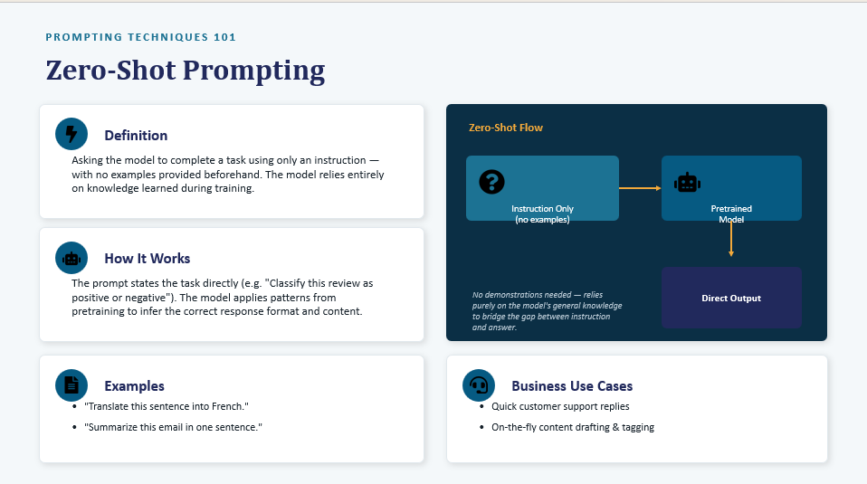

Slide 17
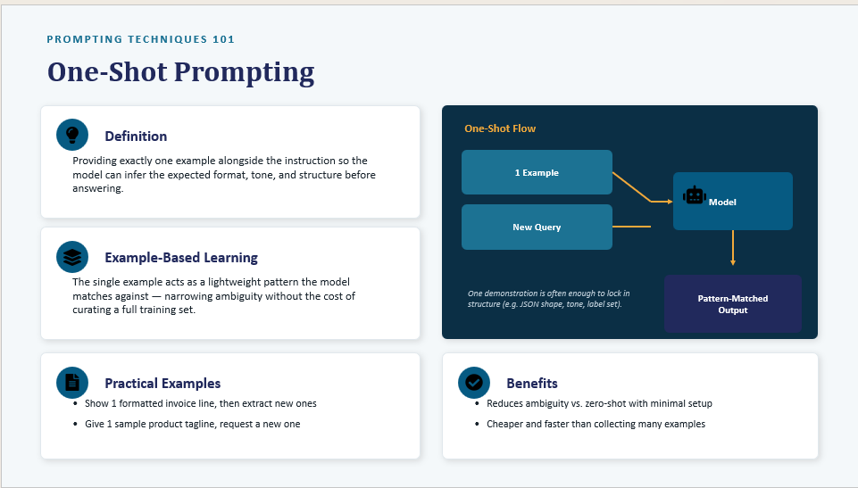

Slide 18
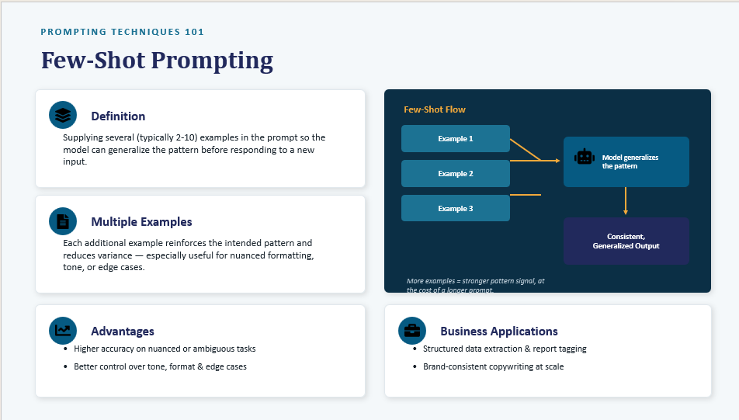

Slide 19
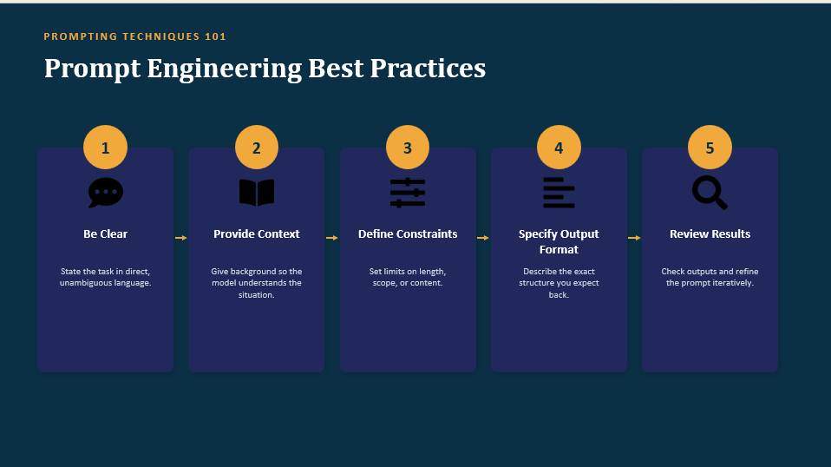

Slide 20
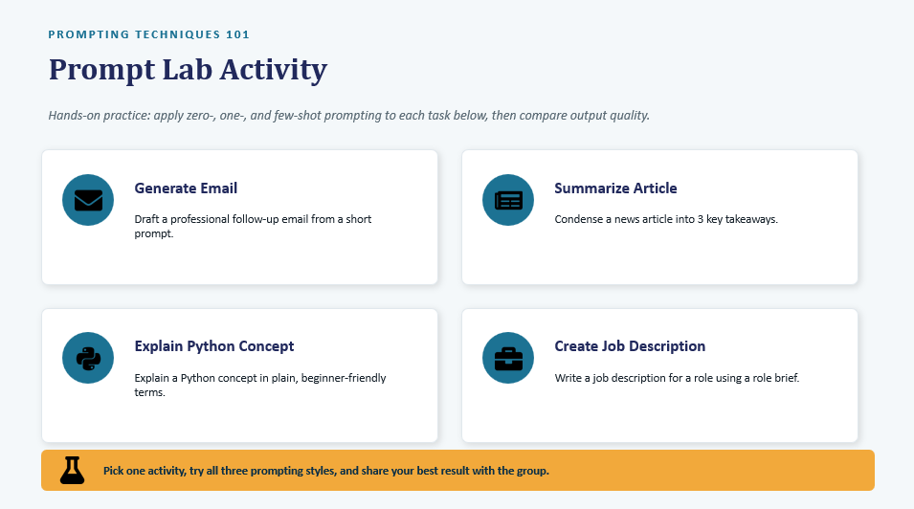

Slide 21
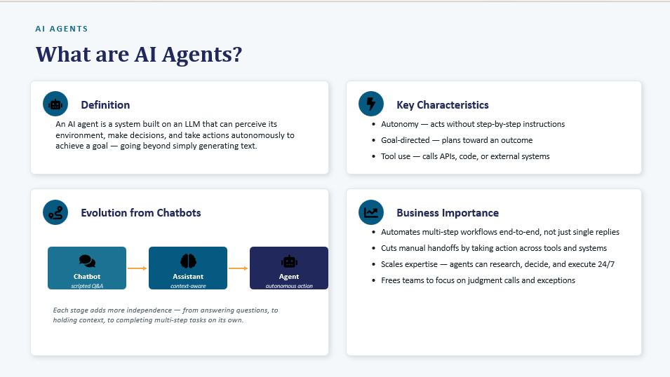

Slide 22
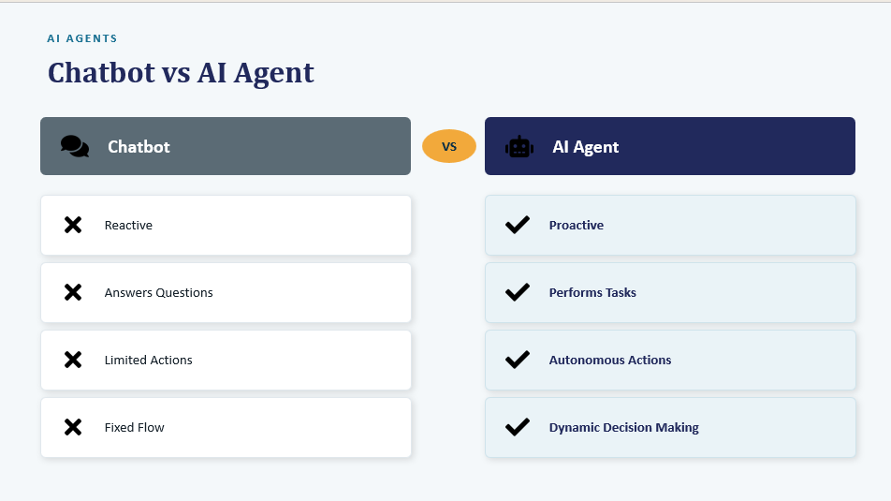

Slide 23
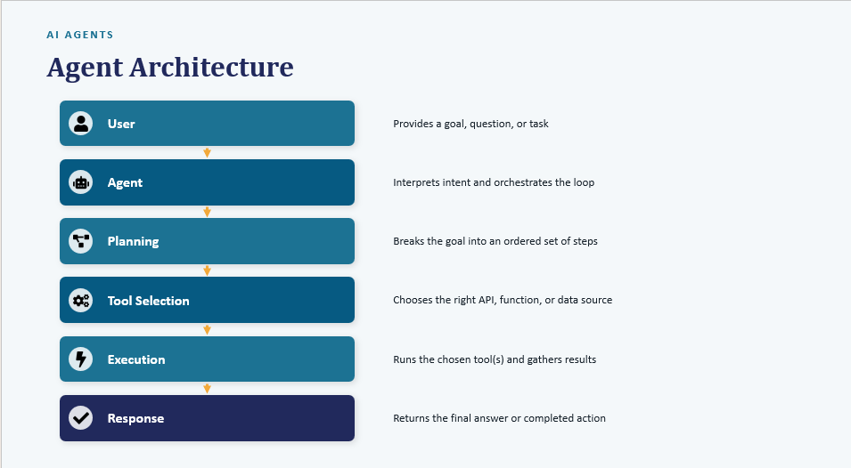

Slide 24
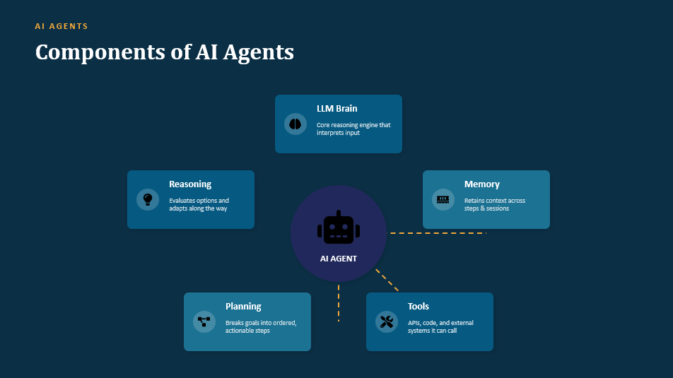

Slide 25
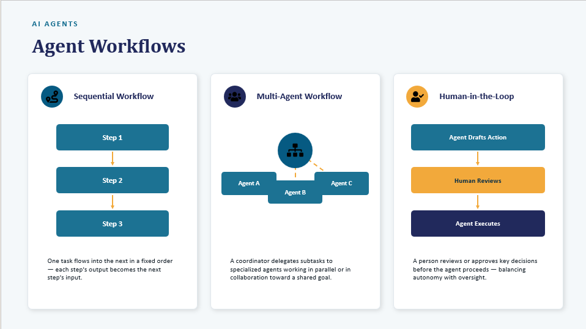

Slide 26
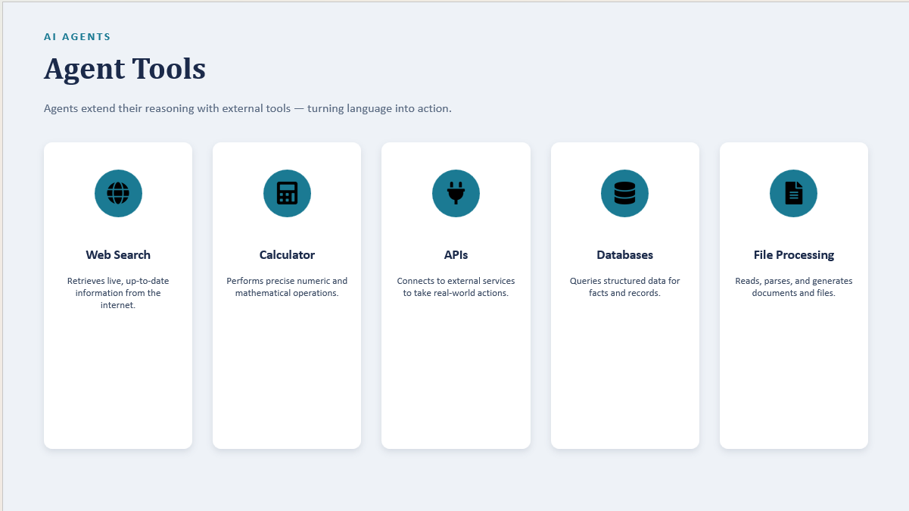

Slide 27
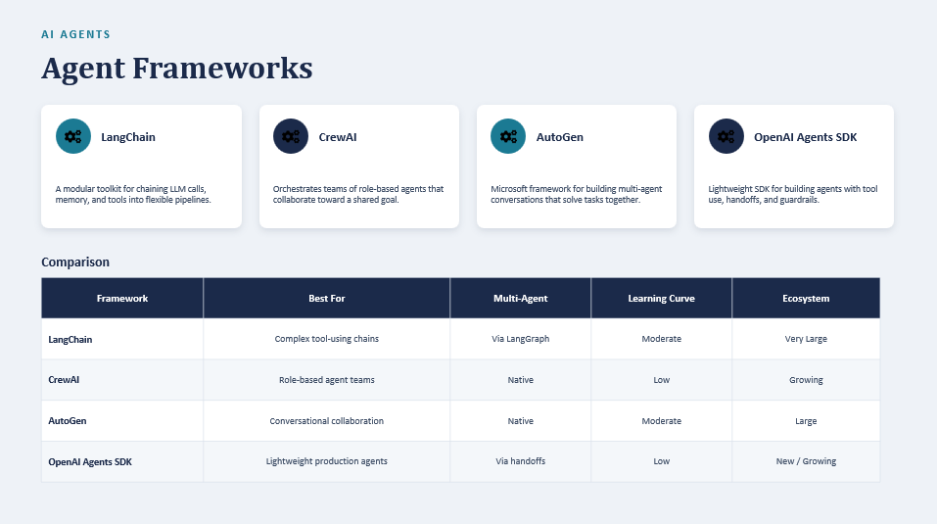

Slide 28
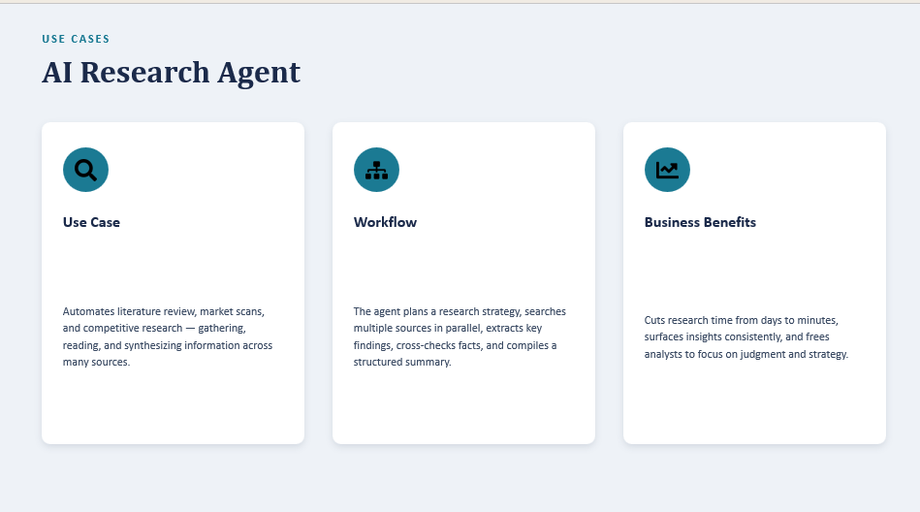

Slide 29
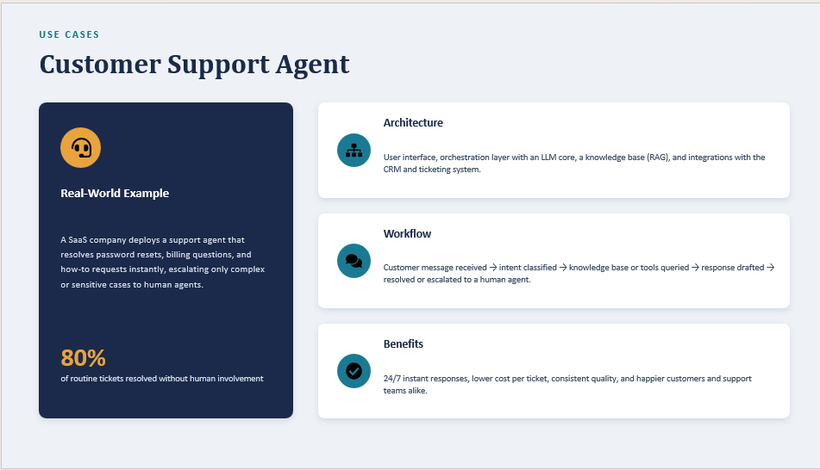

Slide 30
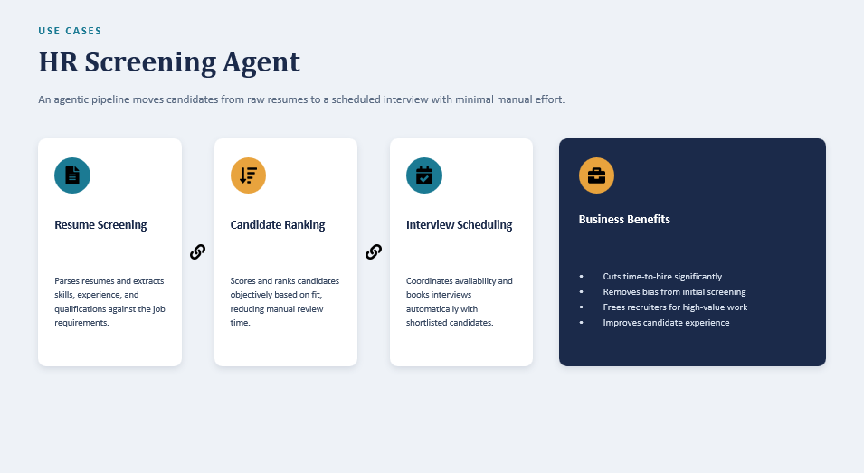

Slide 31
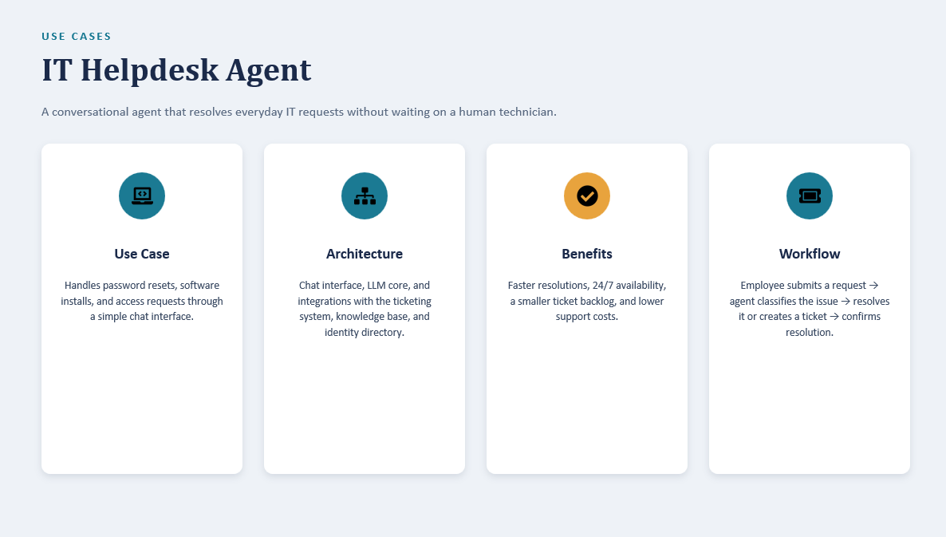

Slide 32
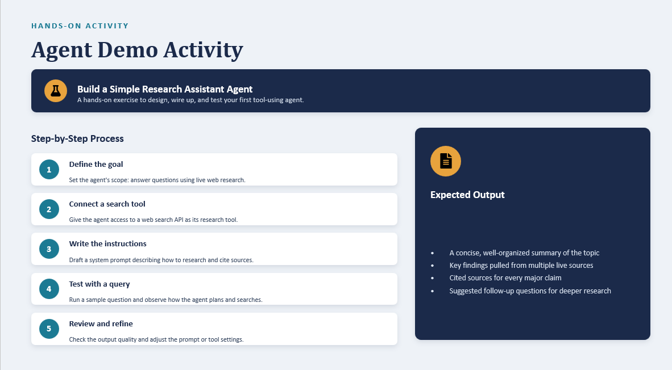

Slide 33
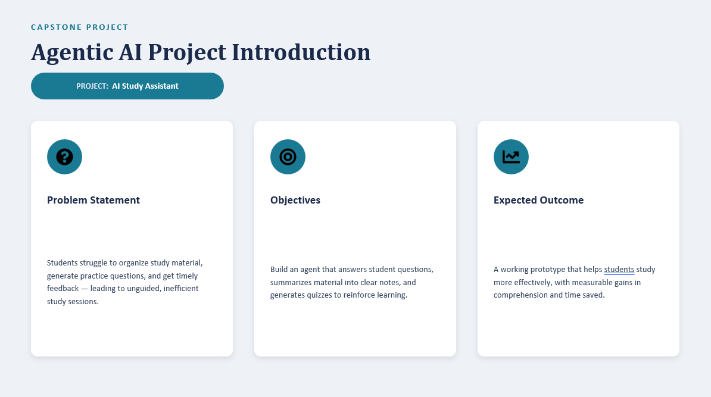

Slide 34
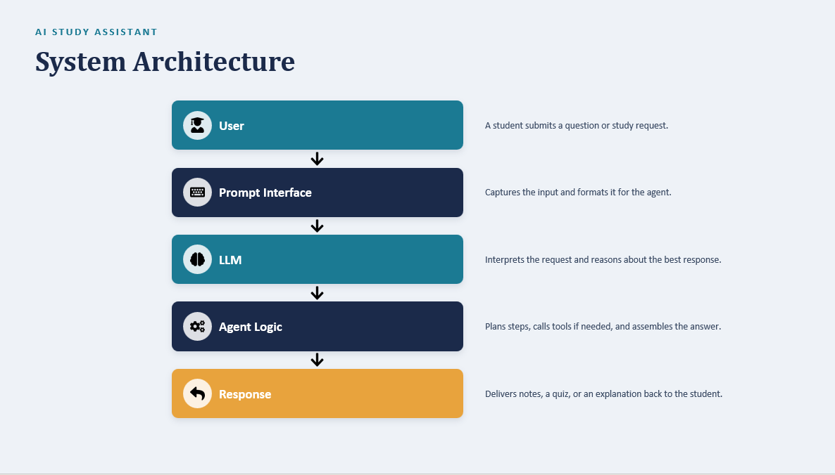

Slide 35
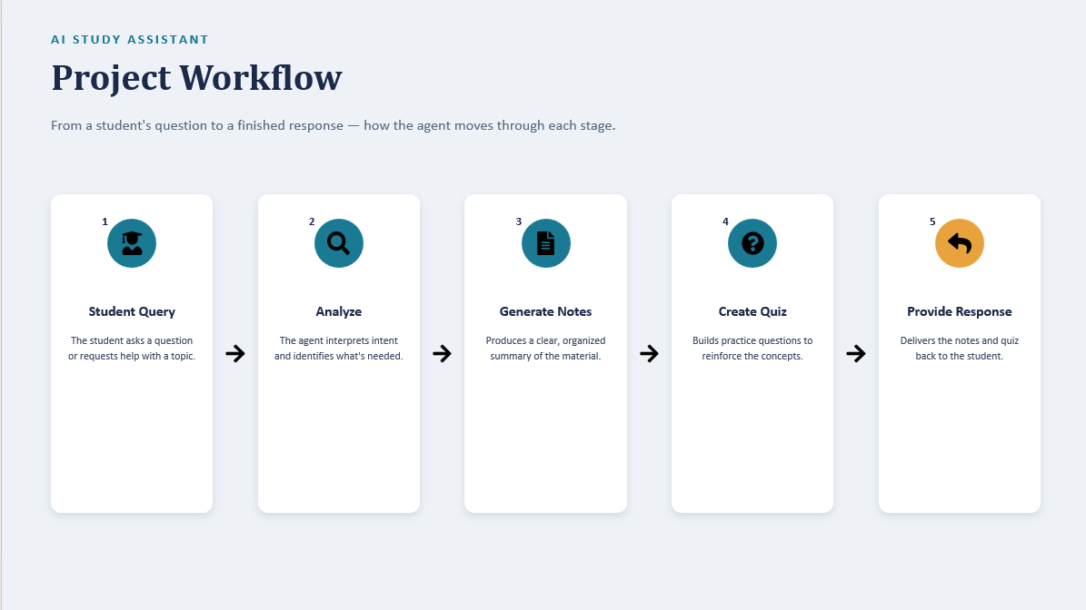

Slide 36
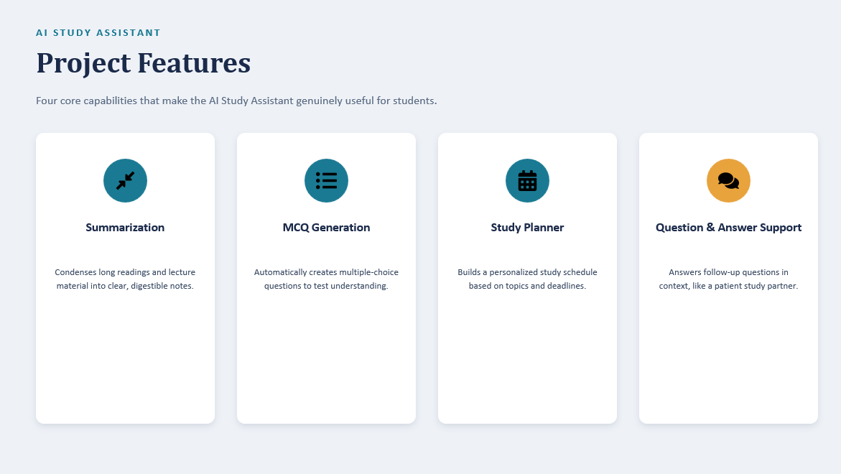

Slide 37
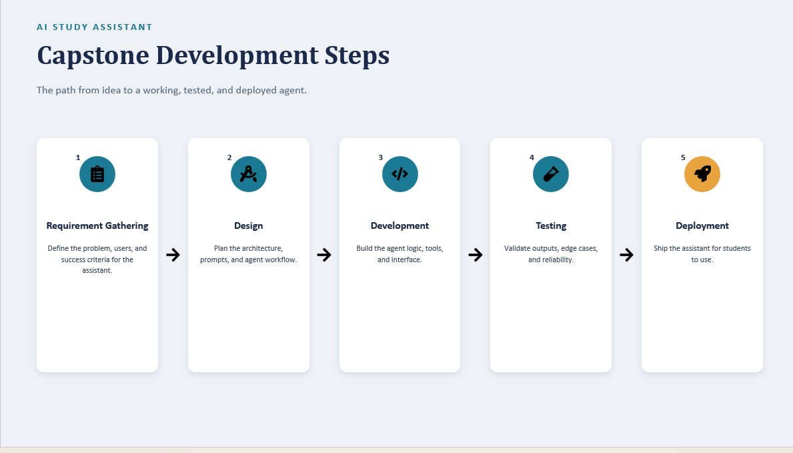

Slide 38
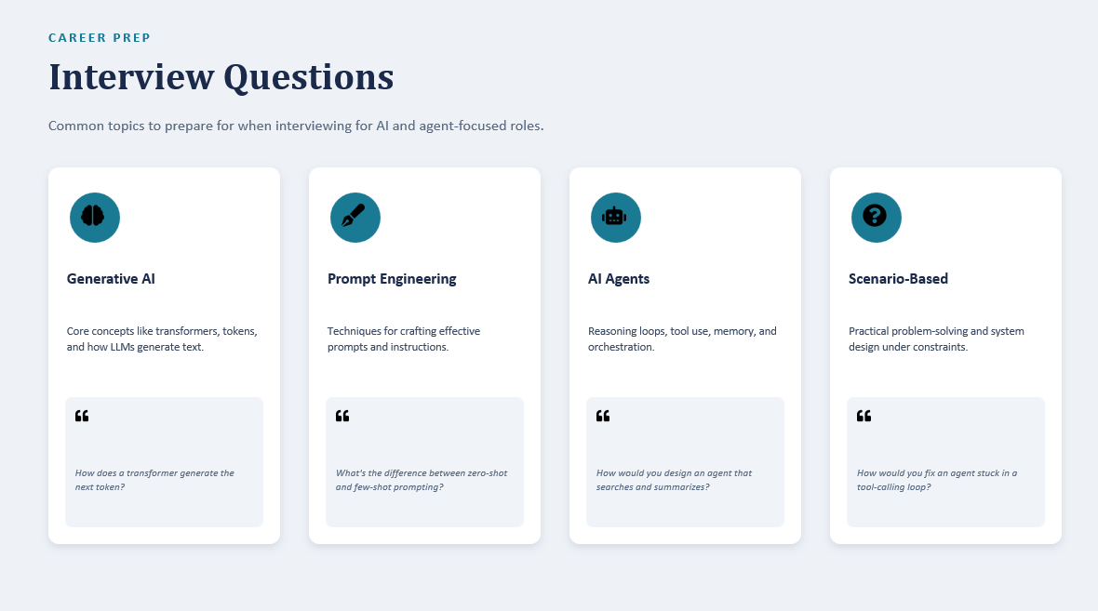

Slide 39
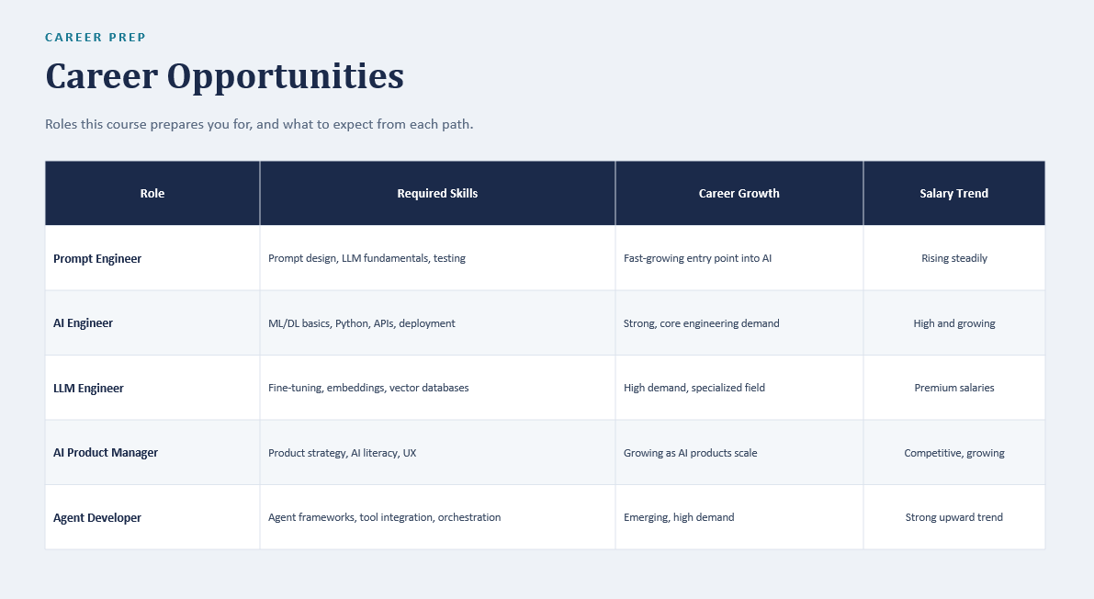

Slide 40
