Slide 1
INTRODUCTION TO BANKING DATASET
Overview of Term Deposits:
Significant revenue stream for banks
Cash investments held within financial institutions
Funds committed for a predetermined period
Accrue interest at an agreed-upon rate
Promotion Strategies for Term Deposits: Email marketing, Advertisements, Telephonic marketing, Digital marketing
Importance of Telephonic Marketing:
Effective means of engaging customers
Requires substantial investment (large call centers)
Essential to pre-identify potential customers
Objective of the Analysis: Predict if the client will subscribe to a term deposit (target variable ‘y’)

Slide 2
Data Description
Related to direct marketing campaigns (phone calls) of a Portuguese banking institution
Contains data from May 2008 to November 2010
Key Attributes in the Dataset:
Age: Numeric variable indicating the client's age in years
Job: Categorical variable indicating the client's job type
Marital Status: Categorical variable (married, divorced, single)
Education: Categorical variable (unknown, secondary, primary, tertiary)
Default: Binary variable indicating if the client has credit in default
Balance: Numeric variable representing the average yearly balance in euros
Housing Loan: Binary variable indicating if the client has a housing loan
Personal Loan: Binary variable indicating if the client has a personal loan
Contact: Categorical variable representing the type of communication used
Day: Numeric variable indicating the last contact day of the month
Month: Categorical variable indicating the last contact month of the year

Slide 3
Duration: Numeric variable representing the duration of the last contact in seconds
Campaign: Numeric variable representing the number of contacts performed during this campaign
Pdays: Numeric variable representing the number of days since the client was last contacted
Previous: Numeric variable representing the number of contacts before this campaign
Poutcome: Categorical variable representing the outcome of the previous campaign
Target Variable (‘y’): Binary variable indicating if the client subscribed to a term deposit (yes/no)

Slide 4
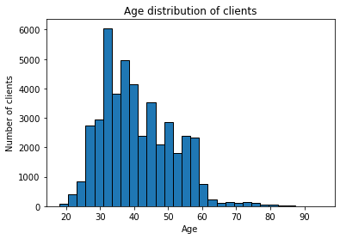
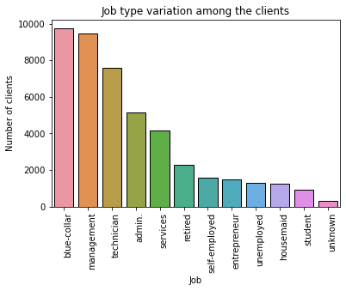
EXPLORATORY DATA ANALYSIS
Distribution of Age:
Majority of clients are between 30 and 40 years old
Right-skewed distribution
Some clients are aged 60 and above
Visualization:
Histogram to show the age distribution
Job Type Variation:
Most common job types: blue-collar, management, and technician
Least common job types: unknown, unemployed, and student
Visualization:
Bar plot showing the frequency of each job type

Slide 5
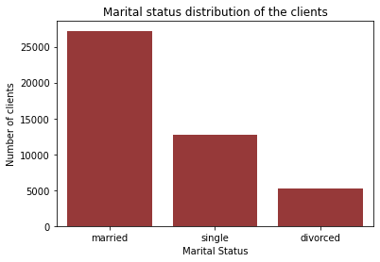
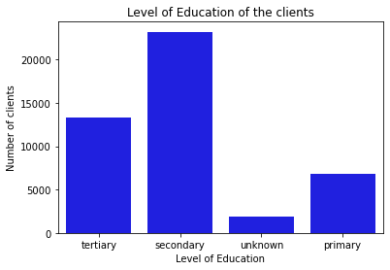
EXPLORATORY DATA ANALYSIS
Marital Status Distribution:
Majority of clients are married
Significant proportion of single clients
Smaller proportion of divorced clients
Visualization:
Count plot showing the count of each marital status
Education Level Distribution:
Most clients have secondary education
Fewer clients have primary education
Some clients have tertiary education or unknown education level
Visualization:
Count plot showing the count of each education level

Slide 6
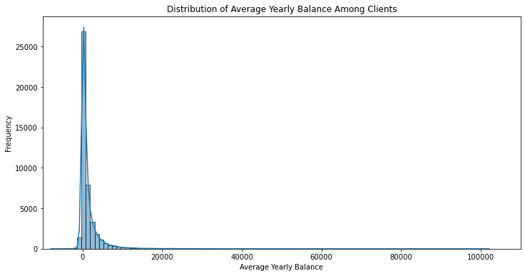
EXPLORATORY DATA ANALYSIS
Distribution of Average Yearly Balance:
Wide range of balances
Right-skewed distribution with some negative balances
Outliers with very high balances
Visualization:
Histogram with KDE to show the balance distribution
Credit in Default Proportion:
Majority of clients do not have credit in default
Small proportion of clients have credit in default
Result:
The percentage of clients having credit in default is: 1.80%

Slide 7
EXPLORATORY DATA ANALYSIS
Housing Loan Proportion:
More clients have housing loans than not
Significant proportion without housing loans
Result:
Number of clients having housing loan: 25130
Personal Loan Proportion:
Fewer clients have personal loans compared to those who do not
Clear majority without personal loans
Result:
Number of clients having personal loan: 7244
Communication Types Used:
Most contacts made via cellular
Fewer contacts made via telephone
Some contacts have unknown type
Result:
The communication types used for contacting clients during the campaign are: Telephone, Cellular, Unknown

Slide 8
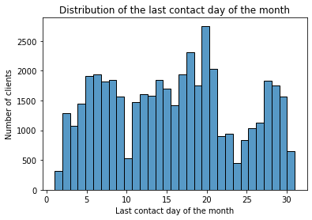
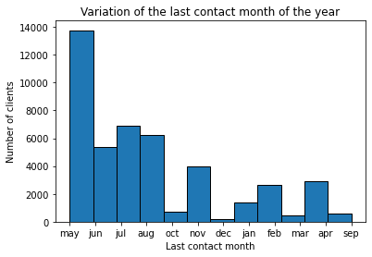
EXPLORATORY DATA ANALYSIS
Distribution of Last Contact Day:
Even distribution across the days of the month
No significant peaks or dips on specific days
Visualization:
Histogram showing the distribution of last contact days
Last Contact Month Variation:
Higher contact frequency in certain months (e.g., May, July)
Lower contact frequency in other months (e.g., December)
Visualization:
Bar plot showing the count of contacts per month

Slide 9
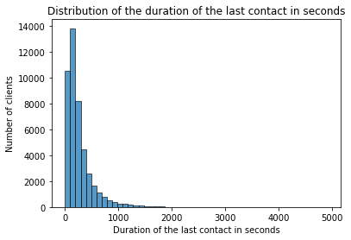
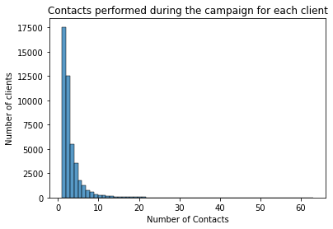
EXPLORATORY DATA ANALYSIS
Distribution of Contact Duration:
Most calls are short (under 300 seconds)
Right-skewed distribution with few long calls
Visualization:
Histogram showing the contact duration distribution
Number of Contacts During Campaign:
Most clients contacted few times (1-3 times)
Few clients contacted more frequently.
Visualization:
Histogram showing the distribution of campaign contacts

Slide 10
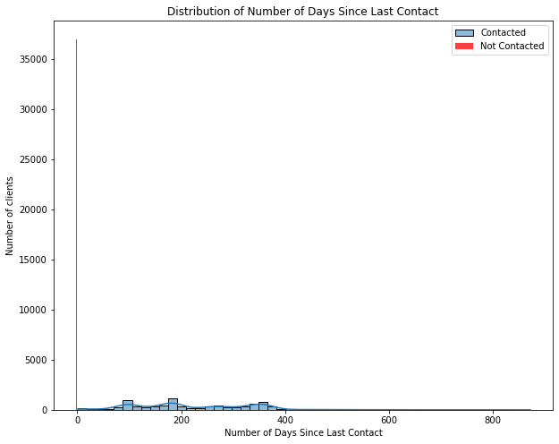
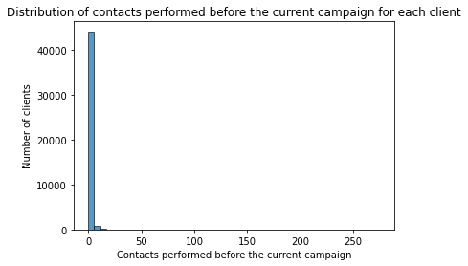
EXPLORATORY DATA ANALYSIS
Days Passed Since Last Contact:
Most clients have -1 value indicating no previous contact
Other values show the days passed distribution
Visualization:
Histogram showing the distribution of days passed since last contact
Number of Previous Contacts:
Most clients had few previous contacts
Some clients contacted more frequently in previous campaigns
Visualization:
Histogram showing the distribution of previous contacts

Slide 11
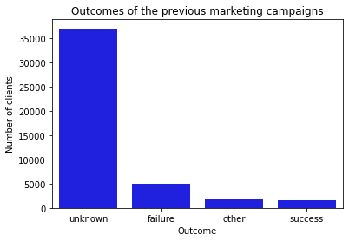
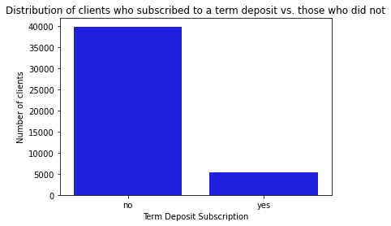
EXPLORATORY DATA ANALYSIS
Outcomes of Previous Campaigns:
Most outcomes are unknown or failure
Few outcomes are success or other
Visualization:
Count plot showing the count of each previous campaign outcome
Subscription Status:
Majority of clients did not subscribe to term deposits
Significant minority subscribed
Visualization:
Count plot showing the count of clients who subscribed vs. those who did not

Slide 12
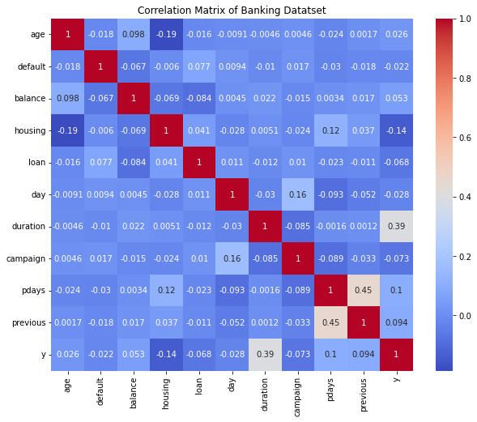
CORRELATION ANALYSIS
Objective: Identify correlations between different attributes and the likelihood of subscribing to a term deposit.
Correlation values range from -1 to 1
1: Perfect positive correlation
-1: Perfect negative correlation
0: No correlation
Visualization of Correlation Matrix:
Heatmap used to visualize correlations
Darker colours indicate stronger correlations (positive or negative)
Lighter colors indicate weaker correlations
Insights for Targeted Campaigns:
Duration of contact is a strong indicator of subscription likelihood
Balance and previous campaign outcomes also influence subscription

Slide 13
CONCLUSION
Focus on clients with higher balances and positive previous campaign outcomes.
Prioritize longer contact durations to increase subscription likelihood.

