Slide 1
1. INTRODUCTION TO Advertising sales DATA
Overview of the dataset:
Contains information about advertising expenditures of a company across three major platforms: TV, radio, and newspapers
For each type of advertisement, the dataset records the amount of money spent and the resulting sales figures in terms of units sold.
Purpose of the Analysis:
The primary objective of this analysis is to understand how advertising expenditures on TV, radio, and newspapers influence sales.
By analyzing this dataset, we aim to answer several key questions:
What is the average amount spent on each advertising medium?
How do expenditures on each medium correlate with sales?
Which advertising medium has the highest impact on sales?
How can we predict future sales based on new advertising expenditure data?

Slide 2
2. Data Description
Related to money spent on different advertising mediums and the sales observed
Key Attributes in the Dataset:
TV: Money spent on TV advertising
Data Type: Numerical (e.g., dollars spent)
Radio: Money spent on radio advertising
Data Type: Numerical (e.g., dollars spent)
Newspaper: Money spent on newspaper advertising
Data Type: Numerical (e.g., dollars spent)
Sales: Units sold
Data Type: Numerical (e.g., units sold)

Slide 3
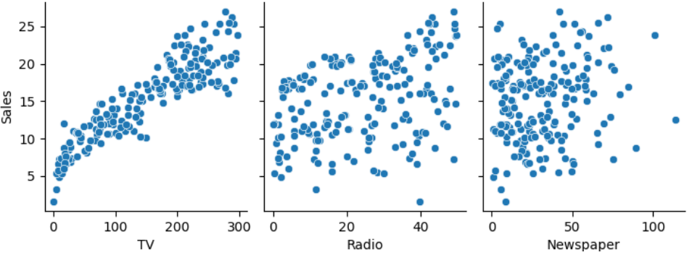
3. EXPLORATORY DATA ANALYSIS
We perform an exploratory data analysis (EDA) to understand the distribution and relationships within the dataset.
Visualizing the distribution of advertising expenditures helps in understanding how the company allocates its budget across different mediums.
These scatter plots will help visualize how advertising expenditures on TV, radio, and newspapers relate to sales. They will provide a clearer picture of the strength and direction of these relationships.

Slide 4
4. modelling
We build a linear regression model to predict sales based on advertising expenditures. We will split the dataset into training and testing sets, train the model, evaluate its performance, and make predictions for new data.
Linear Regression Model
Linear regression is a statistical method for modeling the relationship between a dependent variable and one or more independent variables. In our case, we use TV, radio, and newspaper advertising expenditures to predict sales.
The Root Mean Squared Error (RMSE) is a measure of the differences between predicted and actual values. A lower RMSE indicates a better fit of the model to the data.
Model Evaluation
To evaluate the model, we compare the predicted sales values to the actual sales values. This can be visualized using a line plot of actual vs. predicted sales.

Slide 5
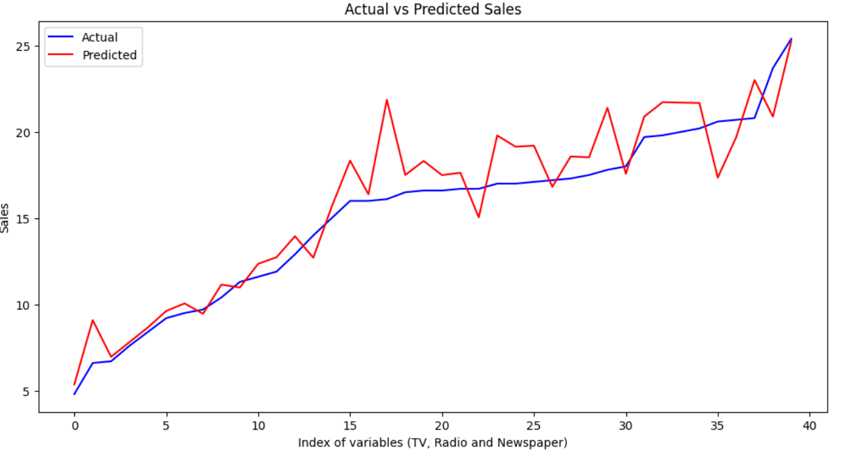
This plot will help us visualize the accuracy of our model. Ideally, the red line should lie close to the blue line, which represents perfect predictions.
Predictions
We can use the trained model to make predictions for new advertising expenditure data. For example, we predict sales for a new set of advertising expenditures: $200 on TV, $40 on radio, and $50 on newspapers.

Slide 6
5. results
Average amount spent on TV advertising in the dataset: 146.79
Correlation between radio advertising expenditure and product sales: 0.35
Advertising medium that has the highest impact on sales based on the dataset can be found out by obtaining a coefficient matrix.
Impact of Advertising Mediums: The coefficients indicate the contribution of each advertising medium to sales. Understanding these impacts help in optimizing the advertising budget.
TV advertising coefficient is higher than the others, it suggests that increasing TV advertising expenditure could lead to a higher increase in sales compared to radio or newspaper advertising.
 | TV | Radio | Newspaper | Sales
TV | 1.000000 | 0.054848 | 0.059075 | 0.901372
Radio | 0.054848 | 1.000000 | 0.354987 | 0.349728
Newspaper | 0.059075 | 0.354987 | 1.000000 | 0.159125
Sales | 0.901372 | 0.349728 | 0.159125 | 1.000000

Slide 7
Regression Line Plot: Visualizes the relationship between advertising expenditure and sales, showing how well the model fits the data.
- The red regression line help in understanding the trends and patterns in the data.
- Comparison of Actual vs. Predicted Sales: Helps in assessing the model's accuracy.
- The closer the red line is to the blue line, the better the model's predictions.

Slide 8
6. CONCLUSION
The analysis suggests that reallocating the advertising budget to focus more on TV advertising could lead to higher overall sales. Given its strong positive correlation and high impact coefficient, TV advertising appears to be the most effective medium.
Radio advertising, while less impactful than TV, still plays a significant role in driving sales. Maintaining a balanced but slightly reduced expenditure on radio advertising could still be beneficial.
Newspaper advertising, given its relatively lower impact, could be considered for budget reduction. However, it should not be completely disregarded as it still contributes to sales and might be effective for targeting specific demographics or regions.
By following these recommendations and focusing on data-driven strategies, the company can optimize its advertising expenditures to achieve better sales outcomes and maximize ROI. The insights gained from this analysis provide a solid foundation for making informed marketing decisions and improving overall advertising effectiveness.

