Slide 1
DIGITAL LOGIC DESIGN PROJECT
LOGIC GATES
Basic gates, universal gates, and NAND-only / NOR-only realizations
Team Leader: Sowmya Seelam — 2620030543
Rohitha — 2620030588 | Siddarada — 2620030572 | Rithvik — 2620030592
AND • OR • NOT • NAND • NOR • XOR • XNOR

Slide 2
1. Basic Logic Gates
AND
OR
NOT
Y = A · B
Y = A + B
Y = ¬A
Output is 1 only when both inputs are 1.
Output is 1 when at least one input is 1.
Reverses the input bit: 0 becomes 1, 1 becomes 0.
All conditions must be true.
Any condition may be true.
Inverts a signal.
A truth table shows the output for every possible input combination.
2/6

Slide 3
2. Truth Table and Universal Gates
A | B | AND | OR | NAND | NOR | XOR | XNOR
0 | 0 | 0 | 0 | 1 | 1 | 0 | 1
0 | 1 | 0 | 1 | 1 | 0 | 1 | 0
1 | 0 | 0 | 1 | 1 | 0 | 1 | 0
1 | 1 | 1 | 1 | 0 | 0 | 0 | 1
Why NAND and NOR?
• NAND = NOT(AND); output is 0 only for A=B=1.
• NOR = NOT(OR); output is 1 only for A=B=0.
• Each is universal: either type alone can build all common logic gates.
XOR gives 1 when inputs differ. XNOR gives 1 when inputs match.
3/6

Slide 4
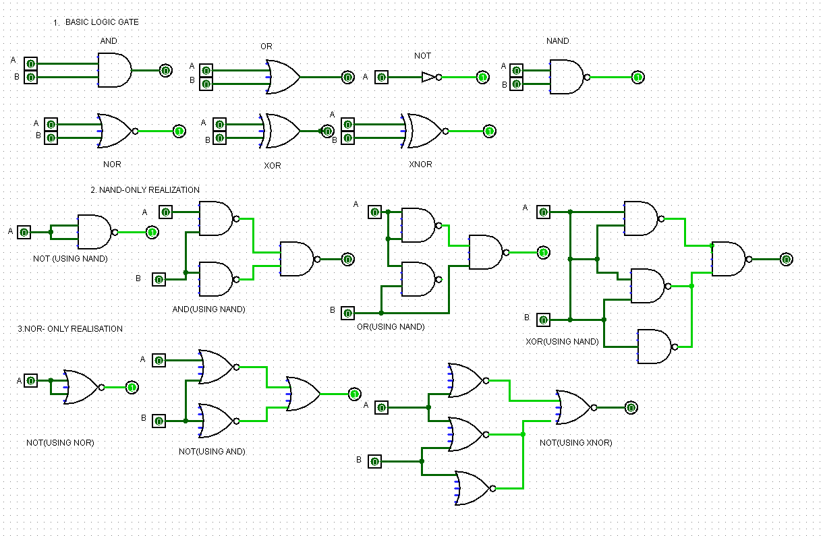
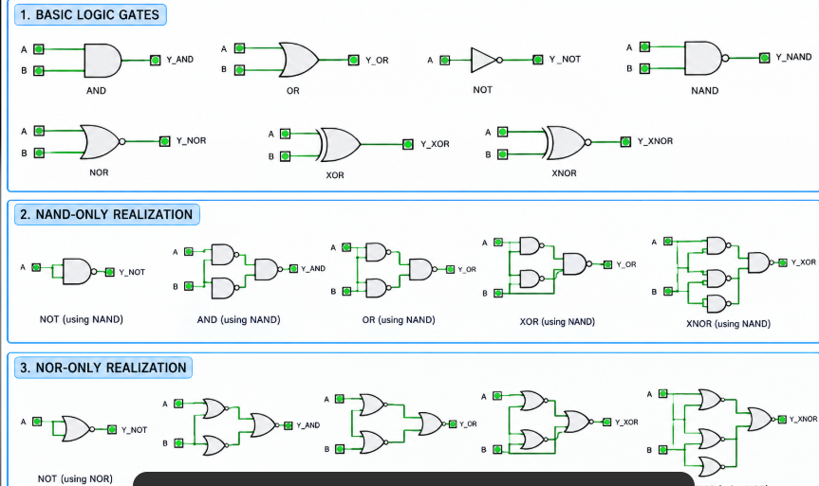
3. Combined Logisim-Style Circuit Diagram
Reference schematic: basic gates + NAND-only + NOR-only realizations
4/6

Slide 5
4. Universal-Gate Realizations and Applications
NAND-only examples
NOR-only examples
• NOT: ¬A = A NAND A
• AND: A·B = (A NAND B) NAND (A NAND B)
• OR: A+B = (A NAND A) NAND (B NAND B)
• XOR/XNOR can also be made using NAND gates.
• NOT: ¬A = A NOR A
• OR: A+B = (A NOR B) NOR (A NOR B)
• AND: A·B = (A NOR A) NOR (B NOR B)
• XOR/XNOR can also be made using NOR gates.
Applications: processors and ALUs • memory and registers • alarms • security systems • communication
5/6

Slide 6
CONCLUSION
One idea. Many circuits.
• Logic gates process binary inputs (0 and 1) to produce outputs.
• NAND and NOR are universal gates because either one can build the other common gates.
• XOR and XNOR are useful for arithmetic, parity, and comparing bits.
Thank you! • Questions?

