Slide 1

Intelligent AI-Based Inventory Management with Predictive Stock Analysis
GUIDE: Dr. J. Kavitha Reddy
Batch no : 5
M. Sai Sahasra - 2420030706
CH. Lucky reddy - 2420030739
Shaik Aliza - 2420030120
V. Rithvik - 2420090037

Slide 2
INTRODUCTION
Inventory management is an important process in businesses that involves tracking, controlling, and maintaining product stock.
Traditional inventory management systems mainly depend on manual monitoring and basic stock records, which can lead to stock shortages and overstocking.
This project proposes an Intelligent AI-Based Inventory Management System that uses Artificial Intelligence and Machine Learning techniques to improve inventory operations.
The system analyzes historical sales and inventory data to predict future product demand.
It identifies potential stock shortages, generates timely stock alerts, and recommends suitable reorder quantities.
The proposed system helps businesses make better purchasing decisions, reduce inventory-related losses, and improve operational efficiency.

Slide 3

PROBLEM STATEMENT
Traditional inventory management systems often depend on manual stock monitoring and basic inventory tracking methods.
Businesses face difficulties in maintaining optimal stock levels because future customer demand is uncertain.
Insufficient stock can result in lost sales and customer dissatisfaction, while excessive stock increases storage costs and the risk of product wastage.
Therefore, there is a need for an intelligent inventory management system that analyzes historical sales data, predicts future demand, identifies potential stock problems, and recommends suitable reorder quantities.
Challenges:
Manual inventory monitoring.
Unexpected stock shortages.
Overstocking and unnecessary storage costs.
Difficulty in predicting future product demand.
Delayed stock replenishment decisions.

Slide 4
PROJECT OBJECTIVES
To develop an intelligent inventory management system using AI and Machine Learning techniques.
To maintain product details, supplier information, sales records, and inventory levels.
To analyze historical sales and inventory data to predict future product demand.
To identify potential stock shortages and overstocking situations.
To generate timely stock alerts based on predicted demand and available inventory.
To recommend suitable reorder quantities for products.
To reduce manual inventory monitoring and improve operational efficiency.
To support better purchasing decisions through data-driven insights.

Slide 5
Innovation
The proposed system introduces the following innovative features:
AI/ML-Based Demand Prediction: Analyzes historical sales data to estimate future product demand.
Intelligent Stock Monitoring: Monitors available inventory levels and identifies potential stock problems.
Predictive Stock Alerts: Identifies possible shortages and overstocking situations in advance.
Smart Reorder Recommendations: Suggests suitable reorder quantities based on predicted demand and current stock.
Adaptive Analysis: Updates predictions and recommendations as new sales data becomes available.
Data-Driven Decisions: Helps businesses make informed purchasing and inventory management decisions.

Slide 6
Feasibility
TECHNICAL FEASIBILITY:
Can be developed using Python and AI/ML technologies.
Uses historical sales and inventory data for demand prediction.
Can be implemented as a web-based inventory management application.
Supports product, supplier, and sales record management.
ECONOMIC FEASIBILITY:
Can use open-source programming languages and libraries.
Does not require expensive proprietary software.
Can be developed using commonly available computer systems.
Helps reduce unnecessary inventory and storage costs.
OPERATIONAL FEASIBILITY:
Provides a simple and user-friendly interface for managing inventory.
Reduces manual stock monitoring.
Generates timely stock alerts and reorder recommendations.
Helps business owners make better inventory decisions.

Slide 7
Project Plan
Phase | Activity | Description
Phase 1 | Requirement Analysis | Identify the project objectives, scope, required tools, and user requirements.
Phase 2 | Literature Survey | Study existing inventory management and demand prediction systems.
Phase 3 | Dataset Collection | Collect historical sales and inventory data.
Phase 4 | Data Preprocessing | Clean and organize the collected data.
Phase 5 | Model Development | Develop an ML model for demand prediction.
Phase 6 | Model Evaluation | Evaluate prediction performance using suitable metrics.
Phase 7 | Frontend Development | Develop the inventory management user interface.
Phase 8 | Backend Development | Develop the inventory management user interface.
Phase 9 | Testing & Validation | Test stock monitoring, predictions and reorder recommendations.
Phase 10 | Documentation | Prepare the project report, presentation, and demonstrate the working model.

Slide 8
Methodology
DATA COLLECTION:
Collect product details, supplier information, historical sales records, and inventory data.
DATA PREPROCESSING:
Clean and organize historical sales and inventory records for analysis.
DATA ANALYSIS:
Analyze previous sales patterns to understand product demand and stock movements.
MODEL DEVELOPMENT:
Develop a Machine Learning model using historical data to predict future product demand.
DEMAND PREDICTION:
Estimate the future demand for individual products using the trained model.
STOCK ANALYSIS:
Compare predicted demand with currently available inventory to identify potential shortages and overstocking.
ALERT GENERATION:
Generate stock alerts and recommend suitable reorder quantities.
RESULT DISPLAY:
Display inventory information, demand predictions, alerts, and recommendations through the application interface.

Slide 9
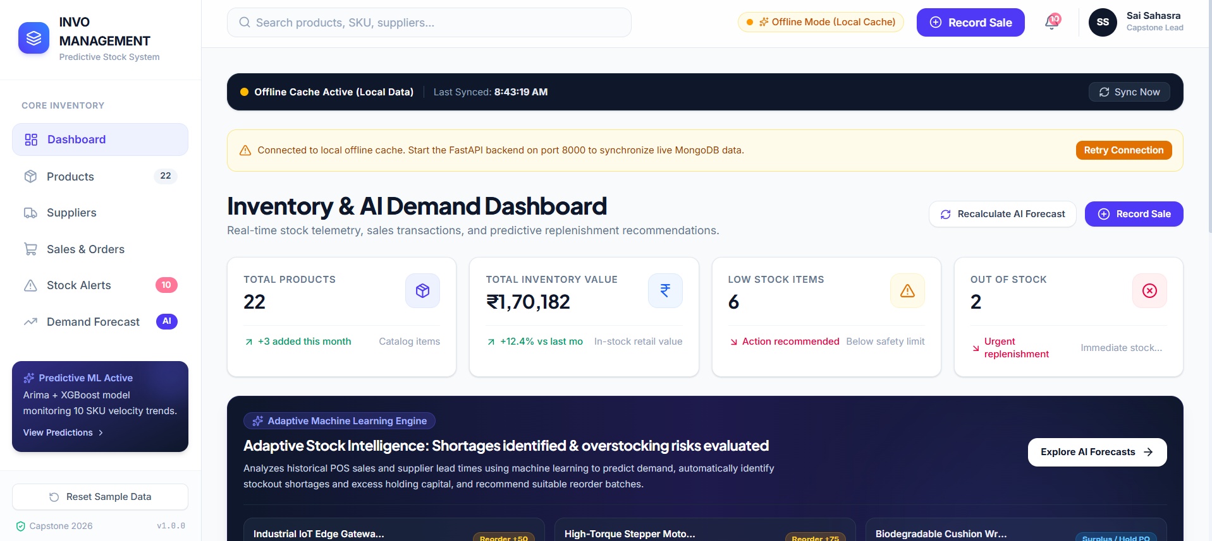
Result

Slide 10
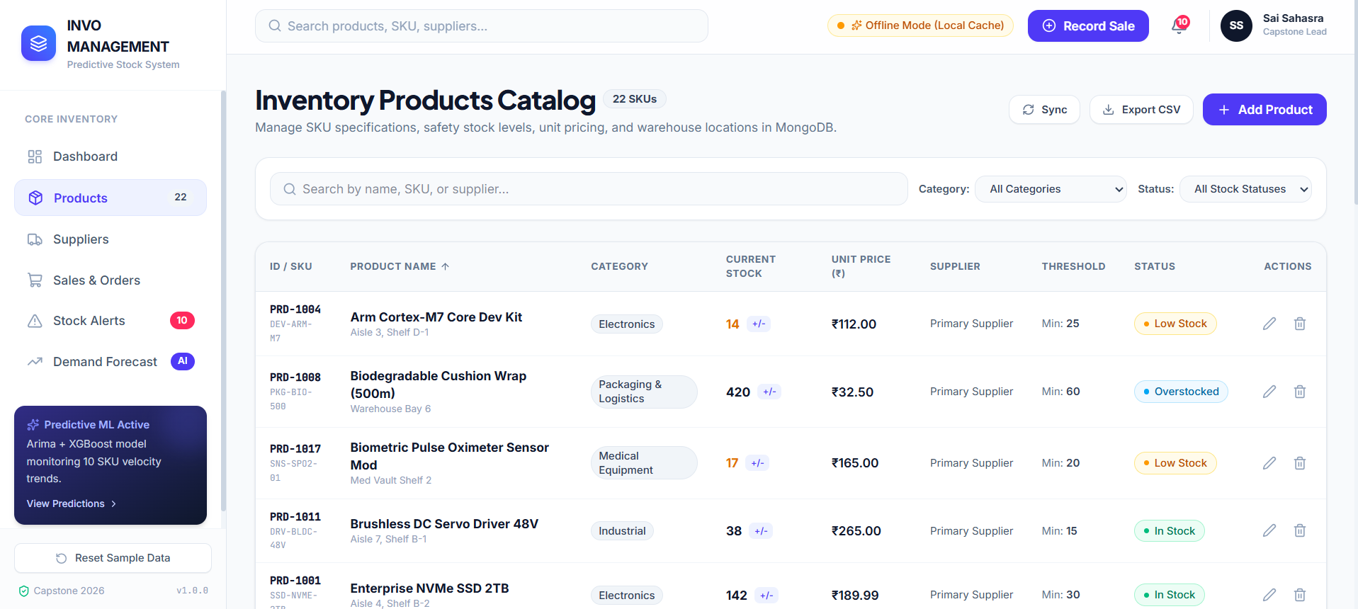
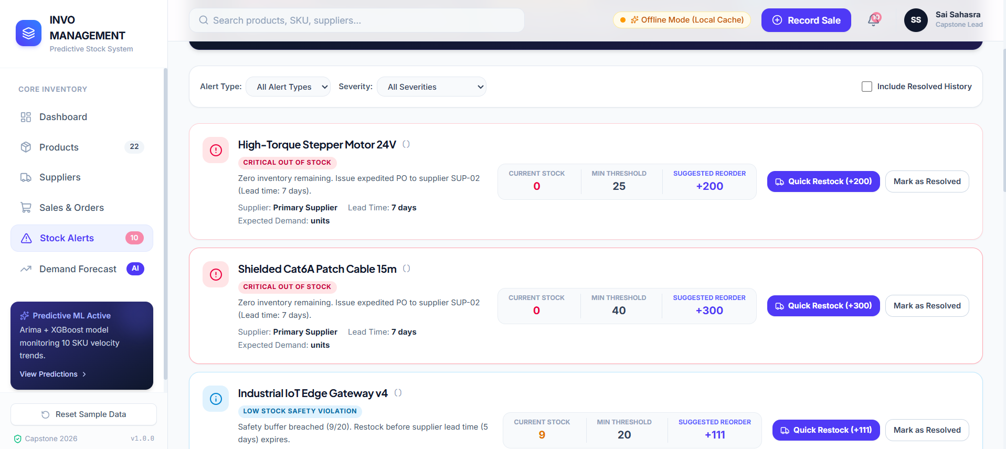

Slide 11
THANK YOU

