Slide 1
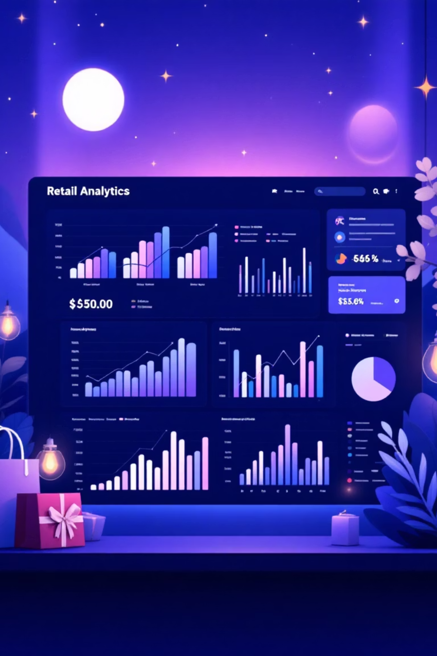
Customer Shopping Behavior Analysis
Uncovering insights from 3,900 customer transactions to drive strategic business decisions through data-driven analysis of spending patterns, preferences, and behavior.

Slide 2
Dataset Overview
3,900
18
50
25
Total Purchases
Data Features
Locations
Products
Transactions analyzed across all categories
Comprehensive customer and purchase attributes
Geographic diversity in customer base
Unique items across four categories

Slide 3
Data Preparation & Cleaning
01
02
Data Loading & Exploration
Missing Data Handling
Imported dataset using pandas, examined structure with df.info() and summary statistics
Imputed 37 missing Review Rating values using median rating per product category
03
04
Feature Engineering
Database Integration
Created age_group bins and purchase_frequency_days columns for deeper analysis
Connected to PostgreSQL and loaded cleaned data for SQL analysis

Slide 4
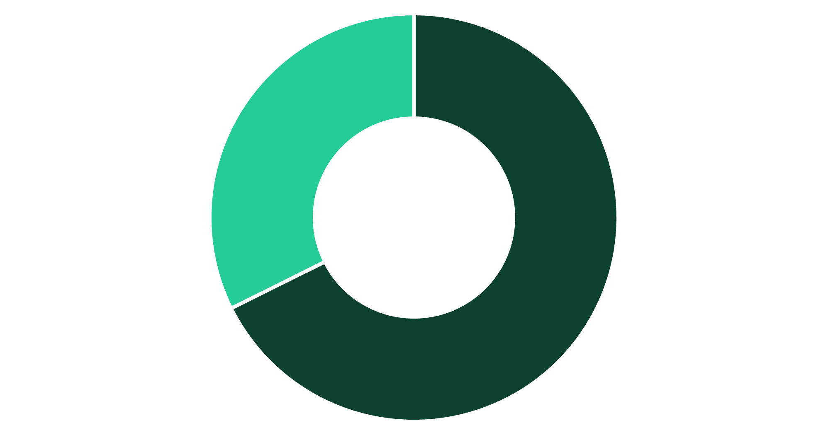
Revenue Insights by Gender
Male Customers Drive Revenue
Male customers generated $157,890 in total revenue, more than double the female customer contribution of $75,191.
This represents a 68% vs 32% revenue split, suggesting opportunities for targeted marketing to female segments.
Male
Female

Slide 5

Top-Rated Products
Gloves
Sandals
Boots
Rating: 3.86
Rating: 3.84
Rating: 3.82
Hat
Skirt
Rating: 3.80
Rating: 3.78
These top-rated products should be prominently featured in marketing campaigns and product positioning strategies to maximize customer satisfaction and sales.

Slide 6


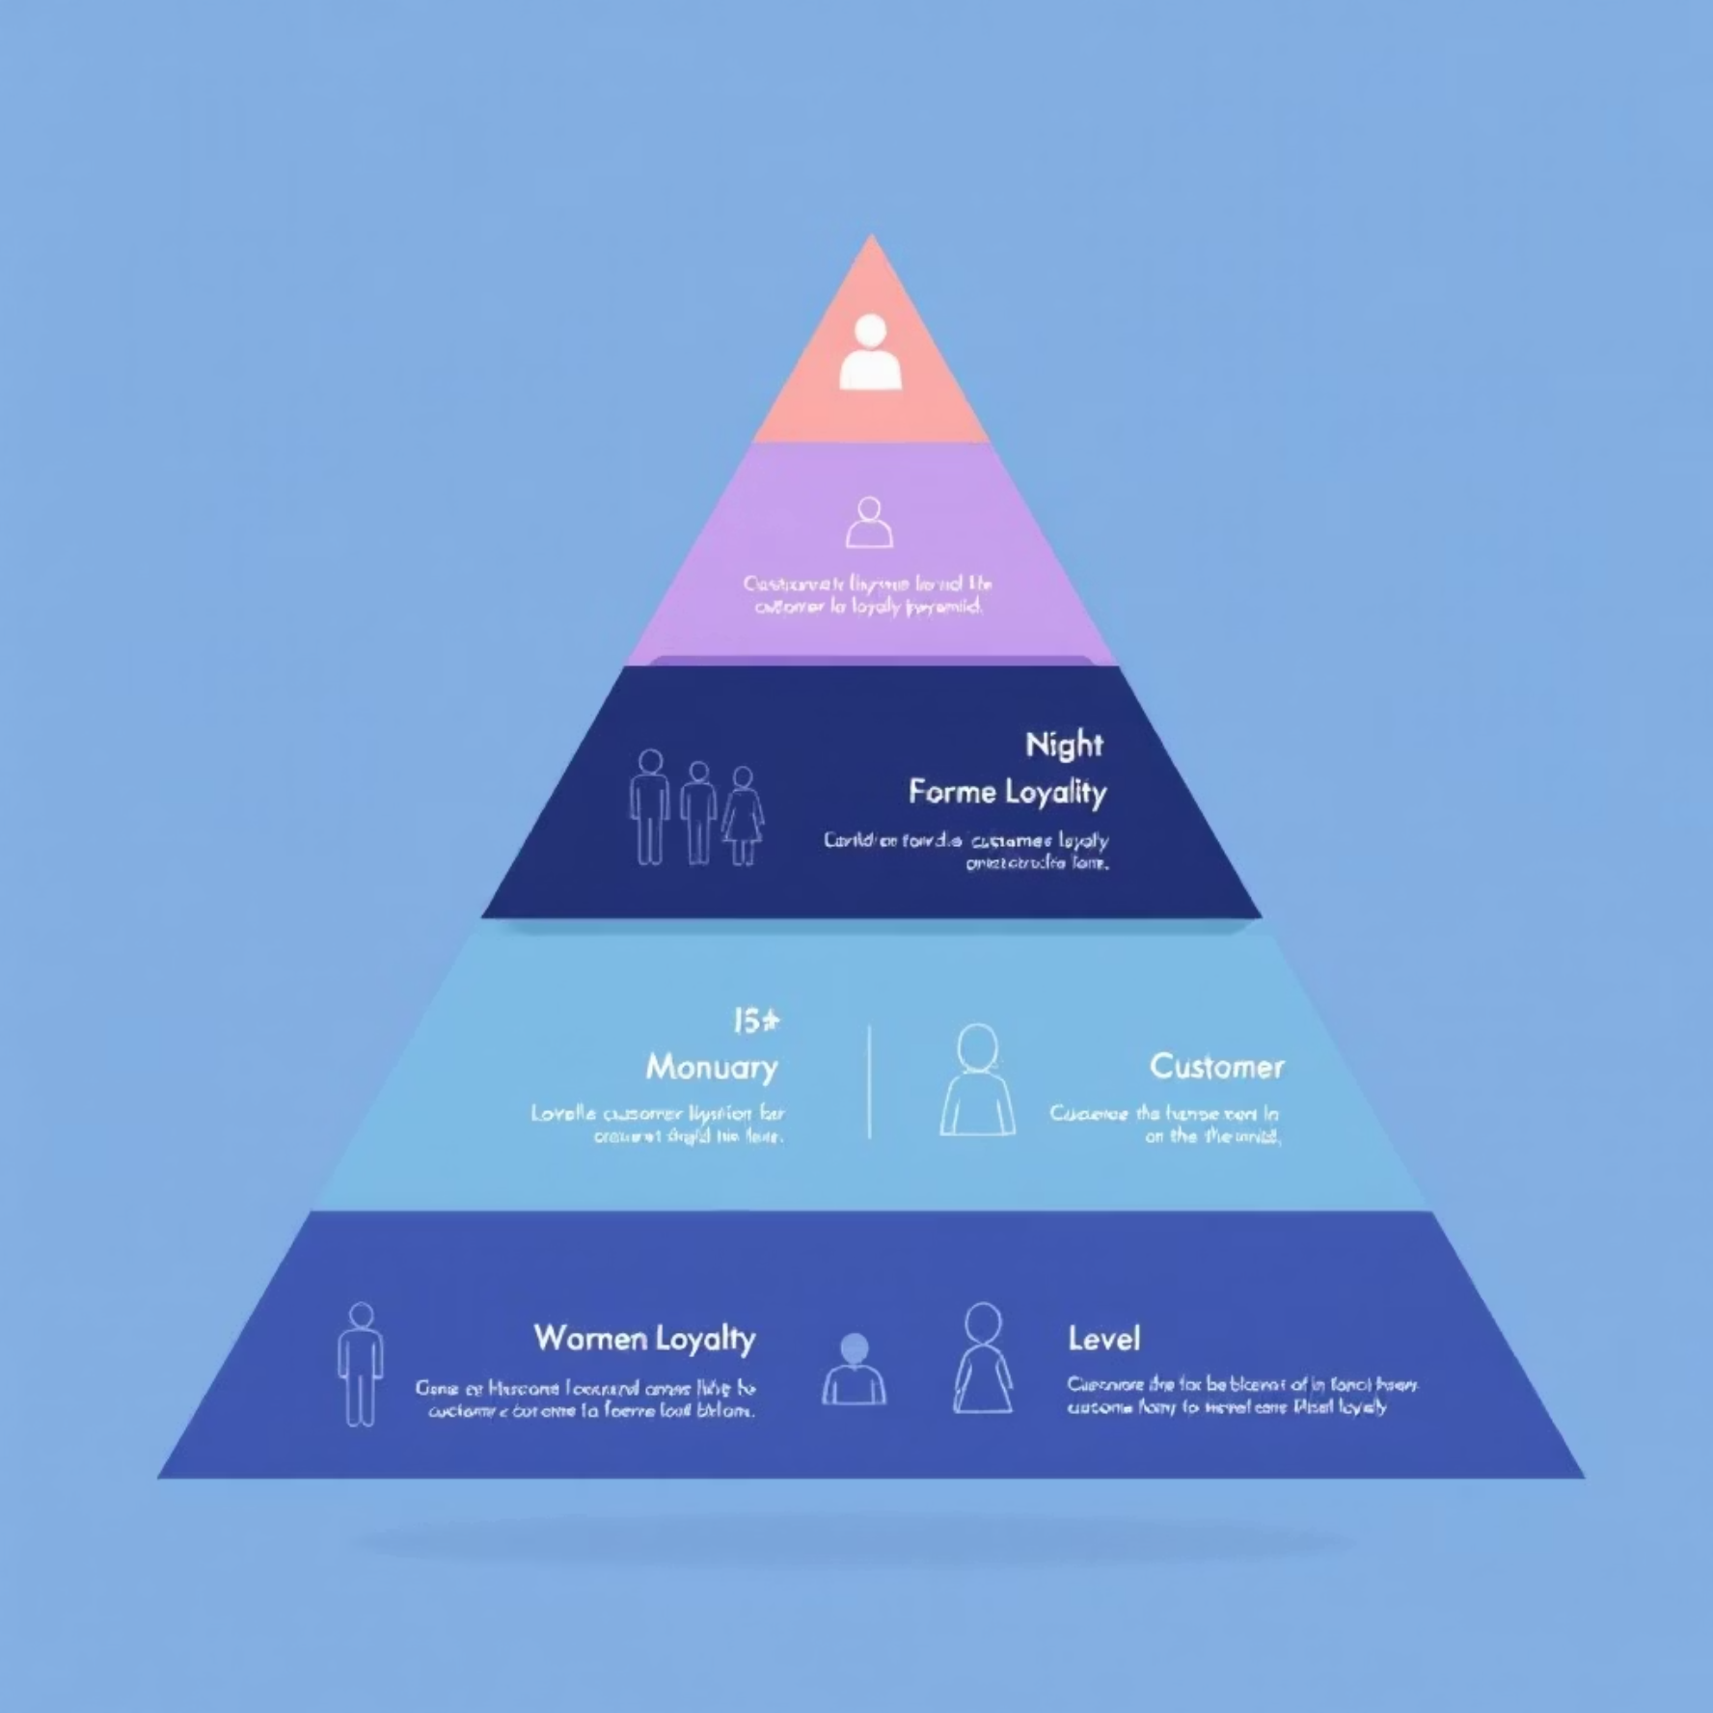
Customer Segmentation Analysis
New Customers
1
83 customers
2
Returning Buyers
701 customers
3
Loyal Customers
3,116 customers
80% of customers fall into the Loyal segment, demonstrating strong retention. Focus on converting the 701 Returning customers into Loyal status through targeted engagement programs.

Slide 7
Subscription Status Impact
Subscribers
Non-Subscribers
Total customers: 1,053
Total customers: 2,847
Average spend: $59.49
Average spend: $59.87
Total revenue: $62,645
Total revenue: $170,436
Subscription rate: 27%
Non-subscription rate: 73%
Despite similar average spending, the large non-subscriber base represents significant opportunity. Converting just 10% more customers to subscriptions could substantially increase predictable revenue.

Slide 8
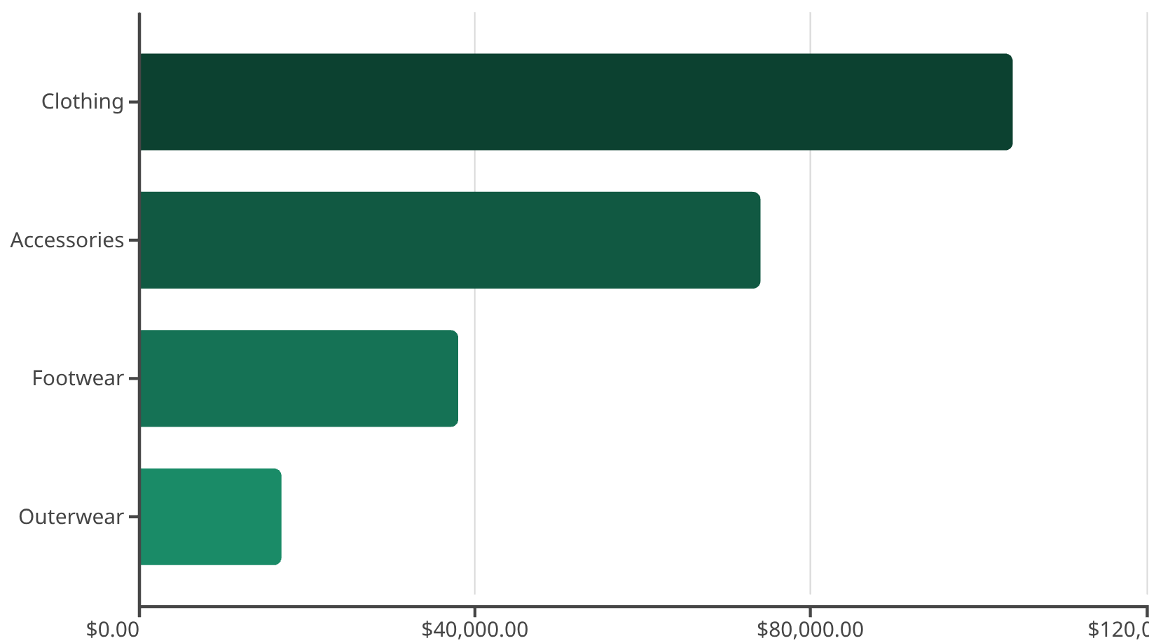
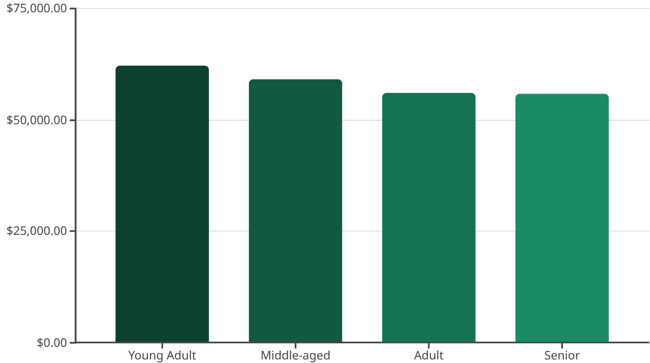
Revenue by Category & Age Group
Category Performance
Age Group Revenue
Clothing dominates revenue at $104K, while Young Adults lead age group spending at $62K. Target marketing efforts toward these high-performing segments.

Slide 9



Discount Strategy Insights
50%
49.7%
839
Hat Discount Rate
Sneakers
High-Value Discount Users
Highest percentage of discounted purchases
Second highest discount dependency
Customers using discounts but spending above average
Balance discount strategies carefully—839 customers used discounts while maintaining above-average spend. Review discount policies to optimize margin control without sacrificing sales volume.

Slide 10
Strategic Recommendations
1
2
3
Boost Subscriptions
Customer Loyalty Programs
Optimize Discount Policy
Promote exclusive benefits to convert the 73% non-subscriber base into recurring revenue streams
Balance promotional sales boosts with margin control, especially for high-discount products
Reward repeat buyers to accelerate movement from Returning to Loyal segment
4
5
Product Positioning
Targeted Marketing
Feature top-rated products (Gloves, Sandals, Boots) prominently in marketing campaigns
Focus on Young Adults and express-shipping users who demonstrate higher revenue potential

