Slide 1
Pricing and Hedging an Option Book
Black–Scholes PDE, American options, and twenty years of S&P 500 stress tests
Rithwik Pandey
Erdos Institute - Quantitative Finance Boot Camp · Fall 2026
Notes:
Hello, this is team Rithwik. Our project asks a practical question. If you sell options, how do you price them accurately, and how much of the risk can you really hedge away, especially in a crisis? We built the pricing tools ourselves, and then tested the hedging on twenty years of real S&P 500 data.

Slide 2
Three questions: price it, hedge it, stress it
1 Price it
2 Hedge it
3 Stress it
Black–Scholes PDE solved from first principles, including American options. Checked against closed forms, trees and Monte Carlo.
Sell a 3-month option book every month, 236 months from 1999 to 2018. Compare six hedging strategies.
Dot-com bust, 2008, 2011, 2015, 2018. Do the hedges, and standard Value-at-Risk methods, still work?
Core question: on real data, how much of an option book's risk does each hedging layer remove, and does it hold up in a crisis?
Pricing and Hedging an Option Book
2
Notes:
The project has three parts. First, a pricing engine built on the Black–Scholes partial differential equation, including American options. Second, a hedging experiment. Every month for twenty years, 236 months in all, we sell a small book of options and compare six hedging strategies. Third, a stress test. How do those hedges behave in the dot-com bust, in 2008 and in other crises, and do standard Value-at-Risk methods understand the book?

Slide 3
The Black–Scholes PDE is the heat equation in disguise
Black–Scholes PDE
∂V/∂t + ½σ²S² ∂²V/∂S² + rS ∂V/∂S − rV = 0
Substitution
x = ln(S/K), τ = ½σ²(T − t), k = 2r/σ², V = K·e^(−½(k−1)x − ¼(k+1)²τ)·y(x, τ)
Heat equation
∂y/∂τ = ∂²y/∂x² (initial value problem)
American option = free boundary
y ≥ g, (∂y/∂τ − ∂²y/∂x²)(y − g) = 0
Crank–Nicolson: second order in time and space
Rannacher start-up: a few implicit steps tame the payoff kink, so gamma is clean
PSOR: iterate, then clip at the payoff; the exercise boundary falls out of the solution
Greeks (delta, gamma) come straight from the grid, which is what the hedging study uses
Pricing and Hedging an Option Book
3
Notes:
Black–Scholes says option value obeys a diffusion-type equation. With a change of variables, log-price and a rescaled time that runs backward from expiry, it becomes exactly the heat equation. We solve it with Crank–Nicolson, which is second-order accurate, plus a few implicit start-up steps called Rannacher smoothing, which stop the kink in the payoff from corrupting gamma. For American options the holder can exercise early, so the value must stay above the payoff. That makes it a free-boundary problem, and we solve it with projected successive over-relaxation: ordinary iteration, clipped from below by the payoff.

Slide 4
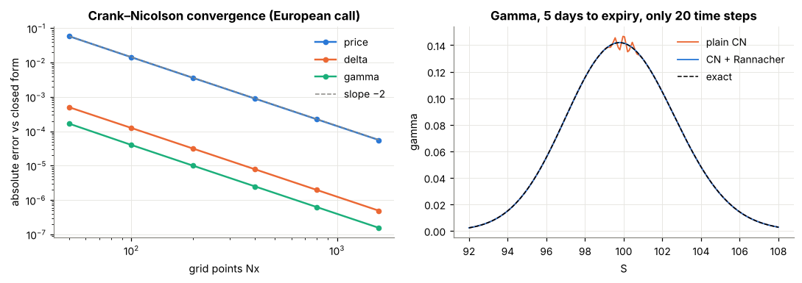
The solver converges at order 2.0 for price, delta and gamma
Measured convergence orders: price 2.00, delta 2.00, gamma 2.00. Rannacher start-up removes the gamma oscillations of plain Crank–Nicolson.
Pricing and Hedging an Option Book
4
Notes:
Does it work? On the left is error against grid size on a log scale. Price, delta and gamma all fall with a slope of minus two, second order, as theory predicts. On the right, five days before expiry, plain Crank–Nicolson wiggles in gamma near the strike. With Rannacher start-up the curve matches the exact answer. This matters because we hedge with gamma.

Slide 5
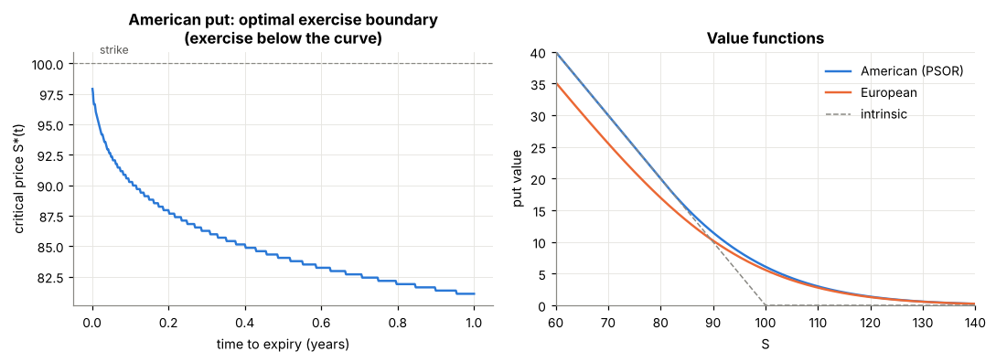
American puts: the exercise boundary is part of the answer
Put, S=K=100, T=1, r=5%, σ=20%
PSOR (PDE): 6.0899
Binomial, N=4000: 6.0905
Longstaff–Schwartz: 6.087 ± 0.016
European put: 5.5735
Early-exercise premium: 0.516. The PDE agrees with the tree to 5.3e-04.
Monte Carlo is low-biased by construction (a sub-optimal exercise rule), as the theory predicts.
Pricing and Hedging an Option Book
5
Notes:
For the American put, the early-exercise boundary on the left is part of the answer: exercise whenever the stock falls below the curve. The value is 6.0899 from our solver, against 6.0905 from a four-thousand-step binomial tree. Monte Carlo with Longstaff and Schwartz gives 6.087, slightly low, as expected. The early-exercise premium over the European put is about 52 cents.

Slide 6
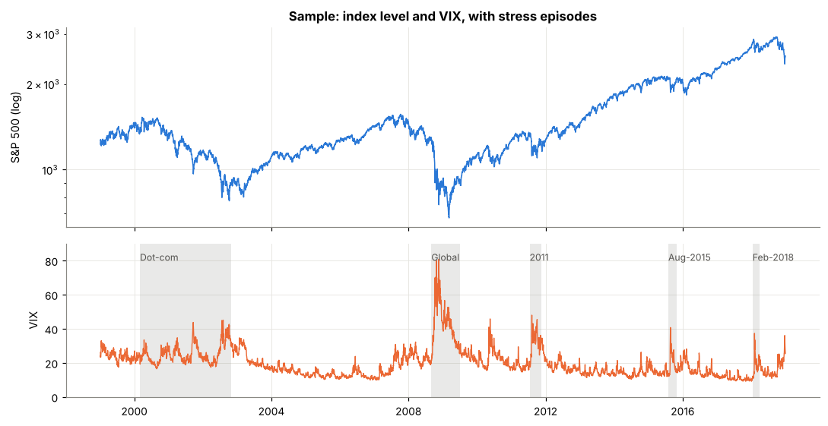
Experiment: sell an option book every month for 20 years
The book (3 months to expiry)
Short ATM call (European)
Short 95% put (American, PSOR)
Long 105% call (European)
Held 21 days, then rolled: 236 cycles
Six strategies
1 Unhedged 2 Static delta
3 Daily delta (VIX vol)
4 Daily delta (realized vol)
5 Delta + static gamma
6 Delta + gamma + vega
Costs: 5 bp stock, 2% of premium on options
S&P 500 and VIX, 1999–2018, with the stress episodes shaded.
Pricing and Hedging an Option Book
6
Notes:
Now the hedging experiment. Each month we sell a three-month book: a short at-the-money call, a short ninety-five percent American put, and a long one-oh-five call. We mark it at the VIX, hold it for twenty-one trading days, and compare six strategies: no hedge; a static delta hedge; daily delta hedging; daily delta hedging with realized volatility instead of the VIX; delta plus gamma, using a two-month option; and delta plus gamma plus vega, using two options. Costs are included. The data are the S&P 500 and the VIX from 1999 to 2018.

Slide 7
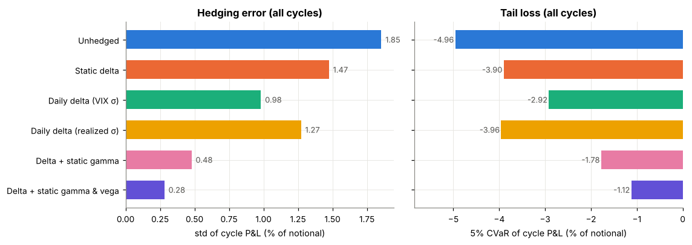
Each hedge layer roughly halves the hedging error
Std of monthly P&L, % of notional: 1.85 → 0.98 → 0.48 → 0.28. Daily delta / unhedged std ratio 0.53 (95% CI 0.47–0.69).
Pricing and Hedging an Option Book
7
Notes:
Result one. Monthly P&L volatility falls from 1.85 percent of notional unhedged, to 0.98 with daily delta hedging, 0.48 with gamma, and 0.28 with vega. That is roughly half at every step. The bootstrap confidence intervals are tight: delta hedging cuts the standard deviation by about half, with an interval of 0.47 to 0.69 for the ratio. The tail tells the same story: the average of the worst five percent of months improves from -5.0 percent to -1.1 percent.

Slide 8
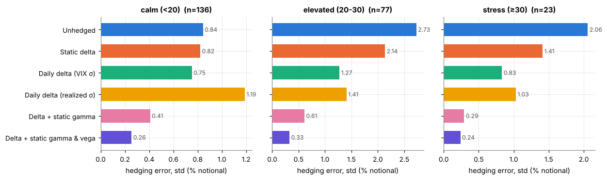
Calm markets: delta hedging adds little, and the vol input matters
Calm months: daily delta 0.75 vs unhedged 0.84; realized-vol hedge 1.19, worse than no hedge.
Overall, hedging with realized vol is 1.30× noisier than with the VIX (95% CI 1.13–1.54).
Pricing and Hedging an Option Book
8
Notes:
Result two: calm versus stress. In calm markets, delta hedging helps only a little, from 0.84 to 0.75. And hedging with realized volatility instead of the VIX is worse than not hedging at all in calm months. In elevated and stress regimes the hedges matter far more in absolute terms. But there is a twist on the next slide.

Slide 9
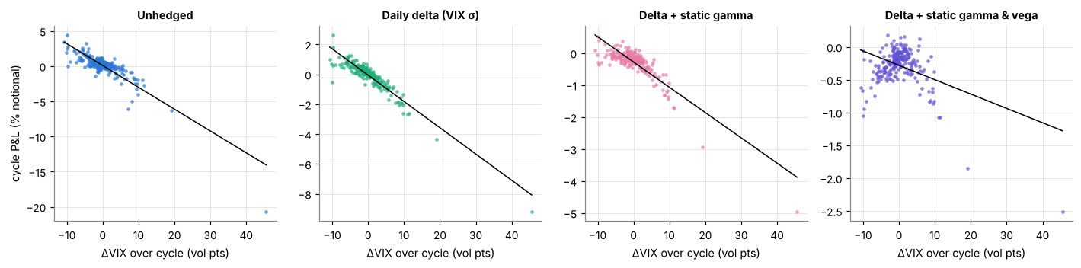
After delta hedging, what is left is volatility; Lehman showed it
Worst month: began 2008-09-11, VIX 24, index -28%, VIX +46 points.
Loss in % of notional: unhedged 20.7 → daily delta 9.2 → + gamma 5.0 → + gamma & vega 2.5
Delta-hedge P&L per +1 VIX point: -0.18% of notional (R² 0.87); after vega hedge: -0.02%.
Pricing and Hedging an Option Book
9
Notes:
The risk left after delta hedging is volatility. This chart plots each month's P&L against the change in the VIX. For the delta hedge it is almost a straight line, explaining 87 percent of the variation. Only when we add a vega hedge does the slope flatten. The worst month began on the eleventh of September 2008. The VIX was only 24, not alarming. Then came Lehman: the index fell 28 percent and the VIX rose 46 points. The unhedged book lost 20.7 percent of notional. Daily delta hedging cut that to 9.2, adding gamma to 5.0, and adding vega to 2.5. Notice that only 1 of the ten worst months started in our stress regime. The starting VIX gave no warning.

Slide 10
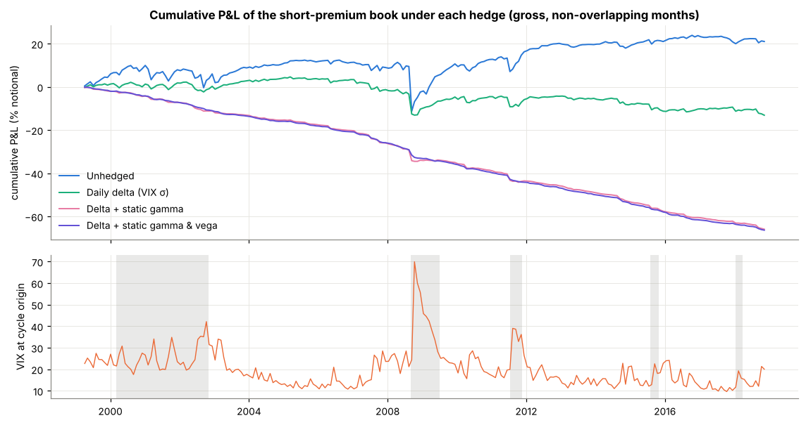
Hedging has a price: insurance with a steady premium
Cumulative P&L, % of notional
Unhedged: +21
Daily delta: -13
Delta + gamma: -66
Delta + gamma + vega: -66
Rebalancing cost per month
Daily: 0.058% error 0.98
Weekly: 0.034% error 1.02
Pricing and Hedging an Option Book
10
Notes:
But hedging is not free. Cumulatively, the unhedged short book earns about 21 percent of notional over twenty years, with a big drop in 2008. The gamma-and-vega hedged book loses about 66 percent. Removing vega risk also removes the volatility premium the short book collects. This is insurance with a steady premium. On frequency, daily rebalancing costs 0.058 percent per month. Weekly costs 0.034 percent, with almost the same error, because what is left is volatility risk, not rebalancing noise.

Slide 11
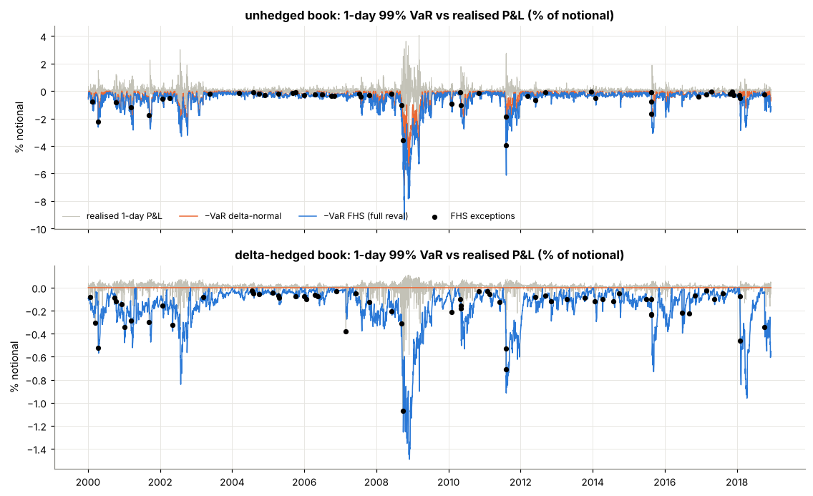
Value-at-Risk: linear methods cannot see gamma
Exceptions, target 1%
Unhedged book
Delta-normal: 3.7%
Delta-gamma: 1.2%
FHS full reval: 1.0%
Delta-hedged book
Delta-normal: 23% (VaR = 0)
Delta-gamma: 2.7%
FHS full reval: 1.3%
Pricing and Hedging an Option Book
11
Notes:
Finally, Value-at-Risk. For the unhedged book, delta-normal VaR is breached on 3.7 percent of days when it should be one, so it is rejected. Delta-gamma gets 1.2, and filtered historical simulation with full revaluation, which reprices the American put in every scenario, gets 1.0. For the delta-hedged book, delta-normal VaR is exactly zero, so it sees no risk, yet it is breached on 23 percent of days. The risk of a hedged book is gamma.

Slide 12
Conclusions and limitations
What we found
PDE and PSOR pricing is second-order accurate and matches trees and Monte Carlo.
Each hedge layer roughly halves hedging error: 1.85 → 0.28.
Volatility is the residual risk; the worst month (Lehman) did not start in a stress regime.
Gamma and vega hedges are insurance with a steady premium.
Linear VaR cannot see gamma; full revaluation can.
Limitations and next steps
Flat VIX marks, no skew or dividends: hedge ratios are the finding, not absolute P&L.
Only 23 stress-origin cycles; intervals are wide.
VaR is spot-only.
Next: Heston, jump or GARCH models calibrated to option quotes.
Pricing and Hedging an Option Book
12
Notes:
To conclude. Our solver is second-order accurate and matches independent methods. Hedging cuts risk step by step, but volatility is what remains, and the month that hurt most did not announce itself. The limitations: we used flat VIX marks rather than option quotes, with no skew or dividends, and only 23 stress-origin months. The natural next step is stochastic volatility, jump or GARCH models, calibrated to option quotes. Thank you.

