Slide 1
MACHINE LEARNING • PROJECT REPORT • A.Y. 2026-27
Match Outcome Prediction in Cricket and Football Using Random Forest and Artificial Neural Networks
A hybrid machine-learning pipeline combining ensemble decision trees and deep neural networks to forecast match outcomes across two sports
PROJECT TEAM
UNDER THE GUIDANCE OF
Rapaka Rithwik
2520030427
Dr. Jyothsna Datti
Professor, CSE Department

Slide 2
OVERVIEW
What We'll Cover
01
Introduction
05
Exploratory Data Analysis
The prediction problem and why data-driven insight matters
Football and cricket dataset structure and patterns
02
Abstract & Objectives
06
Key Observations
Project goals, datasets, and evaluation metrics
Insights that shape model design
03
Proposed Approach
07
Conclusion & Next Steps
Random Forest + ANN hybrid modeling pipeline
Roadmap toward a working prediction system
04
System Requirements
Software stack and hardware setup
Match Outcome Prediction using Random Forest & ANN
2

Slide 3
INTRODUCTION
Why Predict Match Outcomes with Machine Learning?
WHERE PREDICTION ADDS VALUE
Cricket and football generate enormous volumes of match data every season, yet outcome forecasting has traditionally relied on pundit intuition and simple averages. These approaches struggle to capture the tangled web of factors — team form, player availability, venue conditions, and head-to-head history — that actually decide a result.
Machine learning offers a data-driven alternative. By learning directly from historical statistics, models can surface patterns invisible to manual analysis and produce objective, repeatable pre-match predictions across multiple sports.
Fan-engagement platforms & pre-match previews
Broadcaster analytics and match-day storytelling
Team strategy, scouting & opposition analysis
Sports-analytics dashboards for coaches & analysts
This project targets two sports — cricket and football — using a shared hybrid modeling framework that blends interpretable ensemble learning with deep pattern recognition.
Match Outcome Prediction — Cricket & Football
3

Slide 4
ABSTRACT & OBJECTIVES
Project Abstract
This project proposes a hybrid machine-learning approach to predicting cricket and football match outcomes, combining Random Forest — an ensemble decision-tree method suited to structured tabular data — with Artificial Neural Networks (ANN), which capture complex non-linear relationships among features. Historical match data from public sports repositories, covering team form, shot and wicket statistics, and venue-related factors, will be used to train and compare both models using accuracy, precision, recall, and F1-score.
1
2
3
4
Multi-Sport Modeling
Hybrid Approach
Robust Evaluation
Actionable Insights
Build outcome-prediction models spanning both cricket and football.
Pair Random Forest's interpretability with ANN's pattern recognition.
Compare models on accuracy, precision, recall & F1-score.
Surface feature importances that explain what drives outcomes.
Match Outcome Prediction — Cricket & Football
4

Slide 5
PROPOSED APPROACH
Random Forest + ANN Modeling Pipeline
1
›
2
›
3
›
4
›
5
›
6
Raw Match Data
Feature Engineering
Random Forest
ANN Training
Model Comparison
Predicted Outcome
Cricket deliveries & football match-stat records
Form, shots/wickets, venue & head-to-head features
Baseline prediction + feature-importance ranking
Deep model learns non-linear feature interactions
Accuracy, precision, recall & F1-score evaluation
Win / loss / draw probability, ready for reporting
Random Forest delivers a robust, interpretable baseline and ranks the features that matter most, while the ANN is trained on the same feature set to learn deeper, non-linear patterns — together forming a dependable multi-sport outcome-prediction system.
Match Outcome Prediction — Cricket & Football
5

Slide 6
SYSTEM REQUIREMENTS
Software & Hardware Stack
Building a reliable dual-sport prediction system calls for data-processing libraries, both classical ML and deep-learning frameworks, and enough compute to train Random Forest and ANN models efficiently on historical match data.
SOFTWARE STACK
HARDWARE SETUP
Python 3.8+
Core development language
Standard PC / Laptop
Base compute platform
Scikit-learn
Random Forest implementation
8 GB RAM (min.)
Recommended for smooth training
TensorFlow / Keras
ANN implementation & training
GPU Support
Optional — accelerates ANN training
Pandas / NumPy
Data handling & preprocessing
Matplotlib / Seaborn
Exploratory analysis & visualization
Jupyter / Colab
Model development environment
Match Outcome Prediction — Cricket & Football
6

Slide 7
EXPLORATORY DATA ANALYSIS
Dataset Overview
EDA was performed on two public datasets: E0_2018-2019.csv, English Premier League match-level statistics, and deliveries.csv, ball-by-ball IPL cricket records.
Football — 380 EPL Matches (2018-19)
Cricket — 260,920 IPL Deliveries
Season-level match records with full-time & half-time stats, shots, cards and betting odds.
Ball-by-ball records across 1,095 matches, covering every delivery bowled.
CATEGORICAL
NUMERICAL
CATEGORICAL
NUMERICAL
HomeTeam / AwayTeam
FTR (Result)
HTR (HT Result)
Referee
FTHG / FTAG (Goals)
HS / AS (Shots)
HST / AST (On Target)
HC / AC (Corners)
HY / AY (Cards)
batting_team / bowling_team
dismissal_kind
extras_type
batter / bowler
over / ball
batsman_runs
extra_runs
total_runs
is_wicket
Match Outcome Prediction — Cricket & Football
7

Slide 8
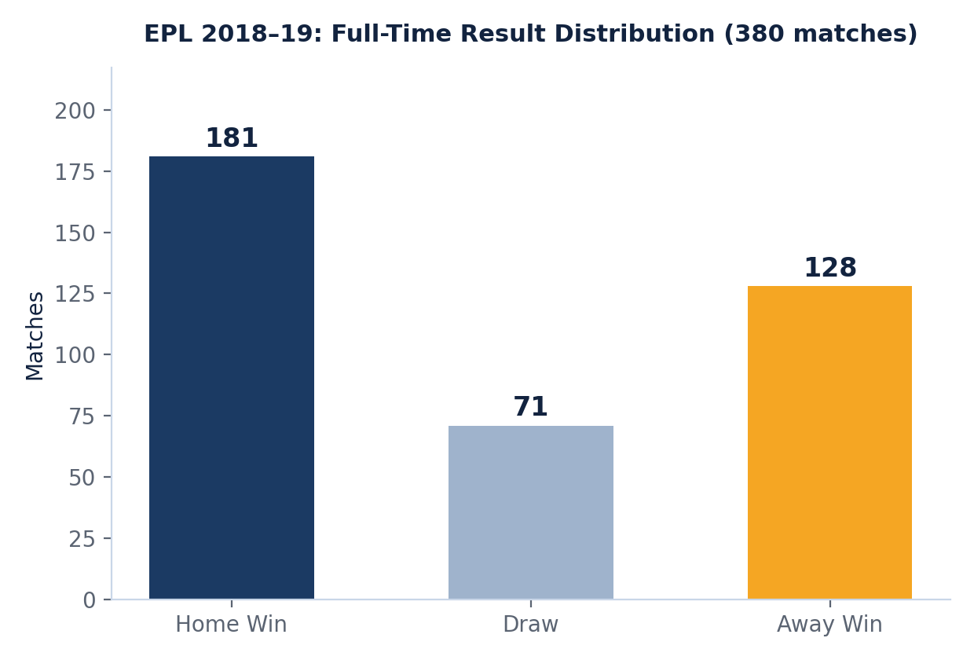
EXPLORATORY DATA ANALYSIS
Football: Match-Result Distribution
OBSERVATION
Home wins account for 181 of 380 matches (47.6%) versus 128 away wins and 71 draws — a clear home-advantage signal the model must weight.
This class imbalance between home, away and draw outcomes needs to be accounted for during training and evaluation, e.g. via stratified sampling or weighted metrics.
Match Outcome Prediction — Cricket & Football
8

Slide 9
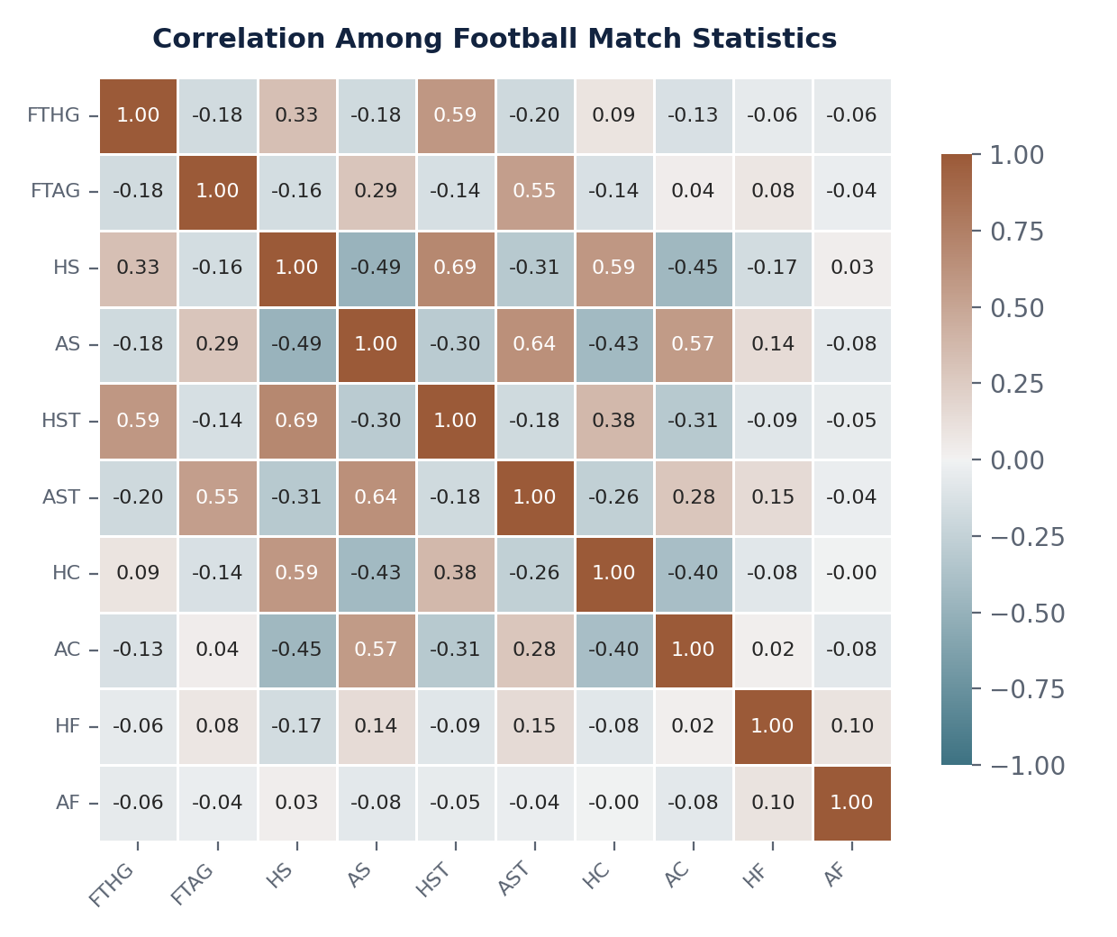
EXPLORATORY DATA ANALYSIS
Football: Correlation Between Match Statistics
0.69
Home Shots ↔ Shots on Target
0.59
Home Shots on Target ↔ Goals Scored
Shot-quality metrics (shots on target) are far more predictive of goals than raw shot counts — a strong, reusable feature for the outcome-prediction model. Corners and fouls stay weakly correlated with the rest, meaning they add distinct information rather than duplicating other features.
Match Outcome Prediction — Cricket & Football
9

Slide 10
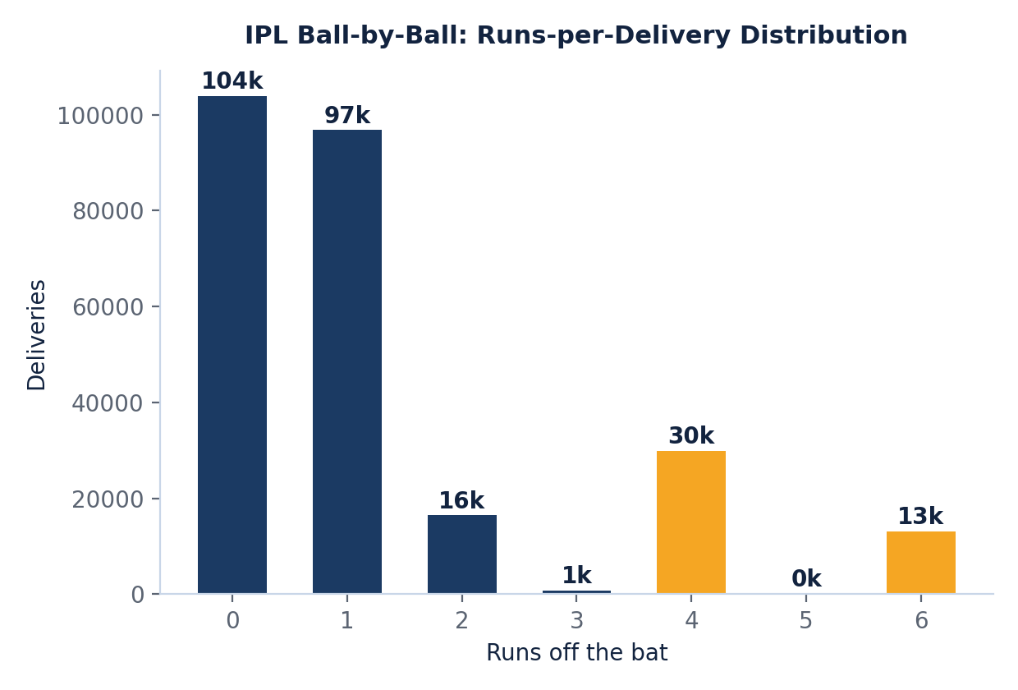
EXPLORATORY DATA ANALYSIS
Cricket: Runs-per-Delivery Distribution
OBSERVATION
Dot balls and singles make up over 77% of all 260,920 deliveries, while boundaries (4s and 6s) contribute just under 17% — runs are earned in small increments far more often than in bursts.
Ball-by-ball run distribution can be aggregated into over-level or innings-level run-rate features — a key input alongside wickets for cricket-specific model design.
Match Outcome Prediction — Cricket & Football
10

Slide 11
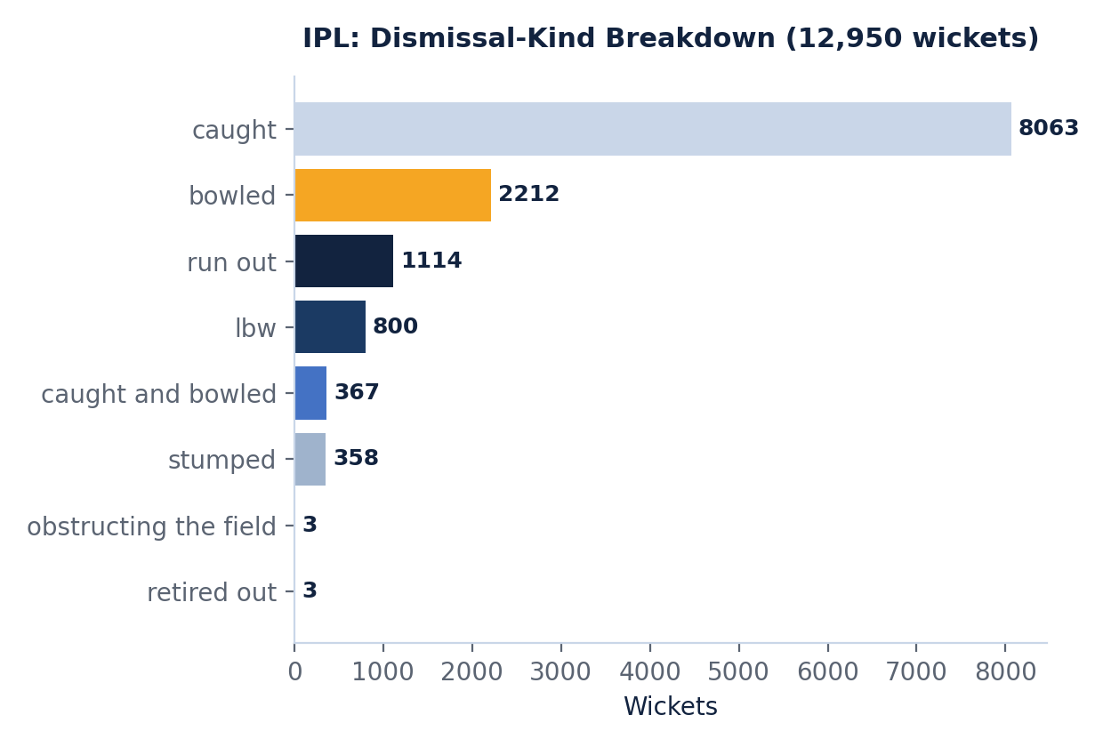
EXPLORATORY DATA ANALYSIS
Cricket: Dismissal-Kind Breakdown
OBSERVATION
Catches account for 8,063 of 12,950 wickets (62%) — more than four times the next-largest category, bowled (2,212).
Fielding quality has an outsized effect on wicket totals, suggesting fielding-side team-strength features are worth engineering alongside bowling statistics.
Match Outcome Prediction — Cricket & Football
11

Slide 12
KEY OBSERVATIONS
Key Observations
1
Home Advantage
2
Shot Quality Predicts Goals
Home teams win 47.6% of EPL matches — a strong prior feature for football outcome models.
Shots on target correlate far more strongly with goals scored (0.59) than raw shot volume.
3
Dot-Ball Dominance
4
Fielding Drives Wickets
77% of IPL deliveries yield 0 or 1 run — run-rate features must capture accumulation, not just boundaries.
62% of dismissals are catches, making fielding-side strength a key cricket feature.
Match Outcome Prediction — Cricket & Football
12

Slide 13
CONCLUSION
Conclusion & Next Steps
This project demonstrates how combining Random Forest's interpretability with ANN's pattern-recognition strength can build a dependable, multi-sport outcome-prediction system. Initial EDA on the EPL and IPL datasets clarifies the features and imbalances that will guide model design.
1
Engineer features from team form, shot/wicket statistics, and venue factors
2
Train the Random Forest baseline and extract feature importances
3
Train the ANN on the same feature set to capture non-linear patterns
4
Evaluate and compare both models using accuracy, precision, recall & F1-score
Match Outcome Prediction — Cricket & Football
13

Slide 14
Thank You
Questions & Discussion Welcome
Rapaka Rithwik
Guided by Dr. Jyothsna Datti, Professor, CSE

