Slide 1
ONLINE EXAMINATION
& AI-ASSISTED PROCTORING
A secure web-based examination and monitoring platform
PROJECT PRESENTATION
Presented by: M. Sai Ajith Reddy | P. Likith Kumar | P. Rithwik Rao
Project Guide / Faculty: Dr. Khaja Shareef | Team 7 | Section 12

Slide 2
Problem Statement & Objectives
Why combine online examinations with assisted monitoring?
THE CHALLENGE
OUR OBJECTIVES
• Remote supervision can be difficult.
• Manual monitoring can be resource-intensive.
• Exam, submission, and review information may be scattered across tools.
• Provide registration, login, and scheduled exams.
• Support timed attempts, submissions, and results.
• Detect selected exam-environment events using browser-based AI.
• Enable administrators to review records and unlock requests.
02

Slide 3
Platform Overview
Student, administrator, and proctoring capabilities
STUDENT PORTAL
ADMIN PORTAL
PROCTORING
• Register / log in
• View available exams
• Attempt timed exams
• Navigate and answer questions
• Submit and view results
• Request unlock when applicable
• Manage students
• Create/manage exams
• Manage questions
• Review submissions/results
• Review proctoring indicators
• Approve unlock requests
• Browser webcam access
• Person / phone detection
• Tab visibility monitoring
• Violation logging
• Rule-based risk indicator
• Human/admin review
03

Slide 4
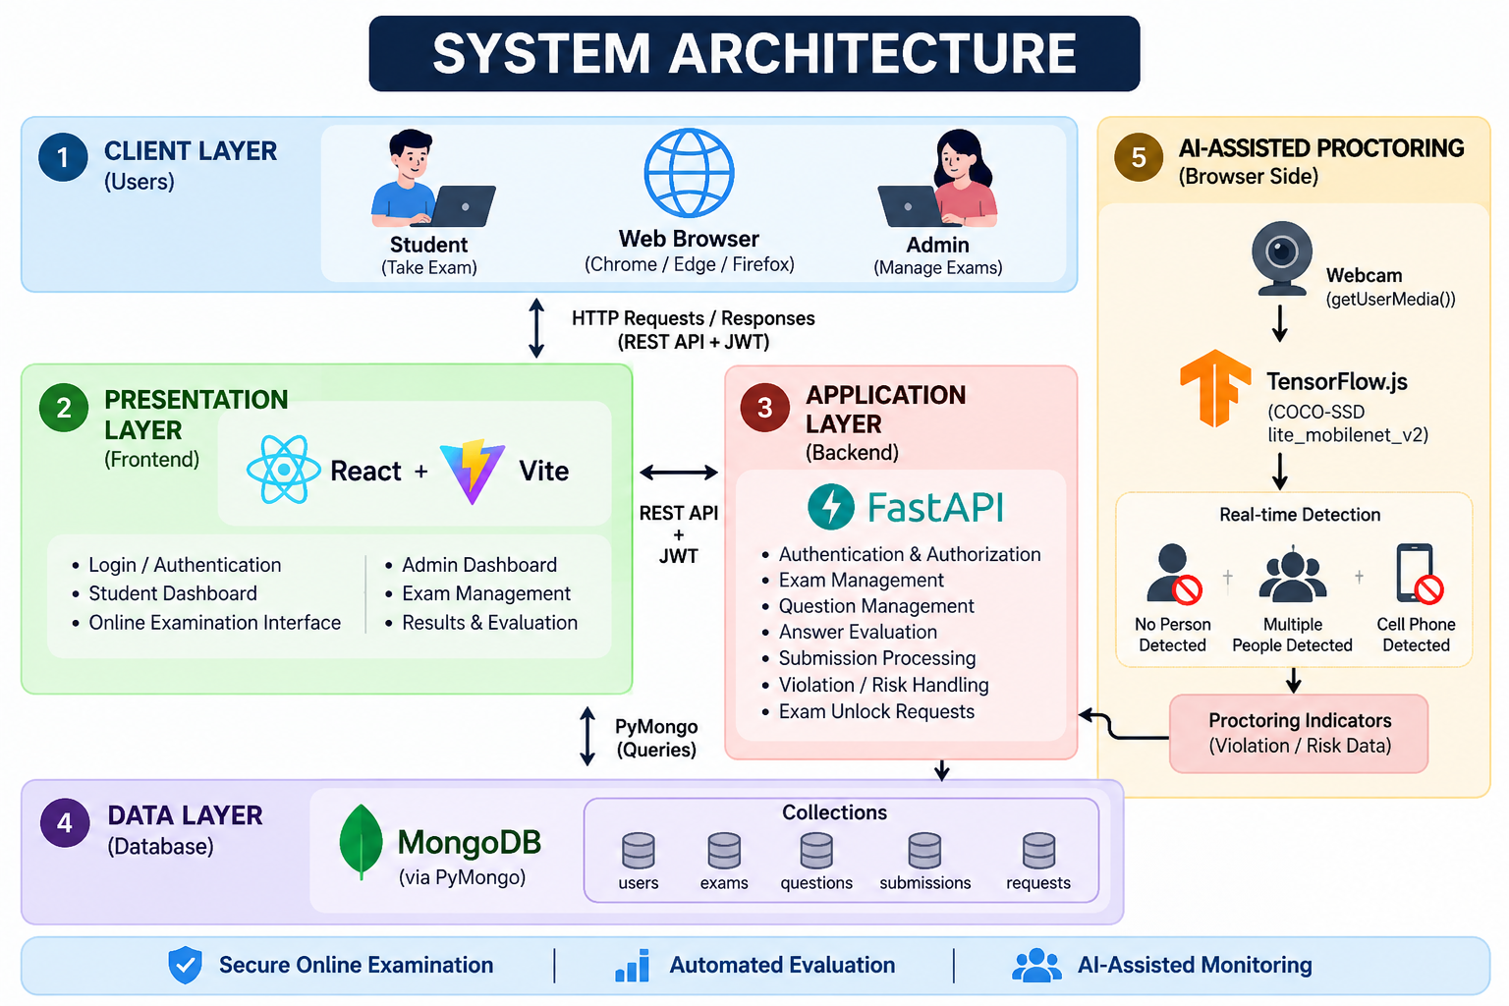

Slide 5
Authentication & Security
Account validation and protected API requests
01
02
03
04
Register
Login
Issue JWT
Protected API
Validate input, hash password with bcrypt, and save user record.
Find account and verify the stored password hash.
Return a signed token containing user identity and role.
Frontend sends Bearer token; FastAPI validates it.
Pydantic validates request data • .env stores configuration • CORS allows the configured frontend origin
05

Slide 6
Examination Workflow
From scheduled exam to server-calculated result
Select exam
Load questions
Attempt + timer
Submit answers
Score + save
BACKEND SCORING
RESULT & REVIEW
FastAPI retrieves stored correct answers, evaluates responses, calculates marks, and stores the result.
Student sees the result; administrators can review submissions and related monitoring indicators.
06

Slide 7
AI-Assisted Proctoring
Browser-based detection and rule-driven event handling
Webcam
Inference
Signals
Rules
Output
MediaDevices API
TensorFlow.js + COCO-SSD
Person / cell phone
Thresholds, grace period, cooldown
Violation log + risk indicator
BROWSER EVENT
IMPORTANT LIMITATION
The Page Visibility API helps detect when the exam tab becomes hidden.
Detections are indicators, not definitive proof of cheating. False positives are possible; admin review matters.
07

Slide 8
Backend & Data Management
FastAPI routes organize the application by responsibility
API MODULES
MONGODB COLLECTIONS
Authentication
POST /api/auth/register • POST /api/auth/login
Exams & questions
/api/exams/ • /api/questions/
Submissions & requests
/api/submissions/ • /api/requests/
Protected endpoints validate the authenticated user.
users — account and role information
exams — exam settings and schedule
questions — prompt, options, answer key
submissions — answers, scores, timestamps, monitoring indicators
requests — unlock request status and review data
08

Slide 9
Benefits, Limitations & Future Scope
A practical foundation for online assessment workflows
BENEFITS
LIMITATIONS
FUTURE SCOPE
• Centralized exam workflow
• Role-based experiences
• Backend-side scoring
• Browser-based monitoring
• Admin review workflow
• Object detection can be imperfect
• Camera needs user permission
• Browser monitoring isn't foolproof
• Risk score is rule-based
• No facial identity verification
• Stronger identity verification
• Improved temporal/head-pose analysis
• Audit logs and richer analytics
• More robust admin review
• Deployment hardening & testing
09

Slide 10
CONCLUSION
One platform.
A complete exam workflow.
React frontend + FastAPI backend + MongoDB + browser-based AI-assisted proctoring
MANAGE
MONITOR
EVALUATE
Users, exams, questions
Selected exam events
Submit, score, review
Thank you • Questions?

