Slide 1
COURSE:ELECTRONIC SYSTEM AUTOMATION
COURSE CODE:22SDEC02A
PROJECT PROJECT PROJECT PROJECT
: BLUETOOTH BASED HOME AUTOMATION
: SAVE AND REPRODUCE VOICE USING I2S PROTOCOL
:RFID BASED ATTENDANCE REGISTER IN GOOGLE SHEETS
: AGRICULTURE MONITORING THROUGH THINGSPEAK
BATCH 50
2200040107 S. RITHWIK REDDY
2200040084 HIMA TEJA
2200040085 GNANA VENKATA PRADEEP

Slide 2




1. Bluetooth-Based Home Automation:
This project involves controlling electronic devices using a microcontroller and Bluetooth communication. Users can manage appliances via an Android smartphone using the Device Control app. The Arduino receives commands wirelessly from the app and controls connected devices12.

Slide 3

Objective:
To create a home automation system using Bluetooth technology, ESP32 microcontroller, relays, and LEDs.
Components Used:
ESP32 microcontroller Relays
LEDs
Bluetooth module
Description:
This project aims to develop a system where home appliances can be controlled wirelessly via Bluetooth using a smartphone application. The ESP32 acts as the central controller, receiving commands from the app and controlling the relays to switch the appliances on or off. LEDs provide visual feedback on the status of appliances

Slide 4
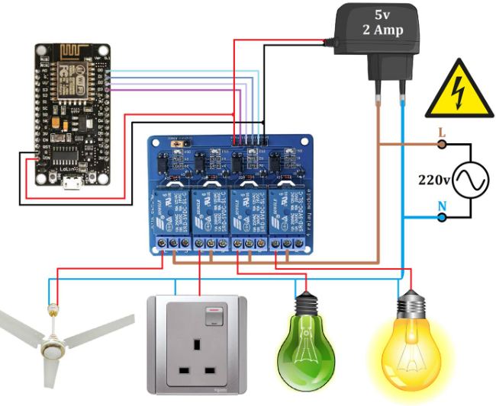
CIRCUIT DIAGRAM :

Slide 5
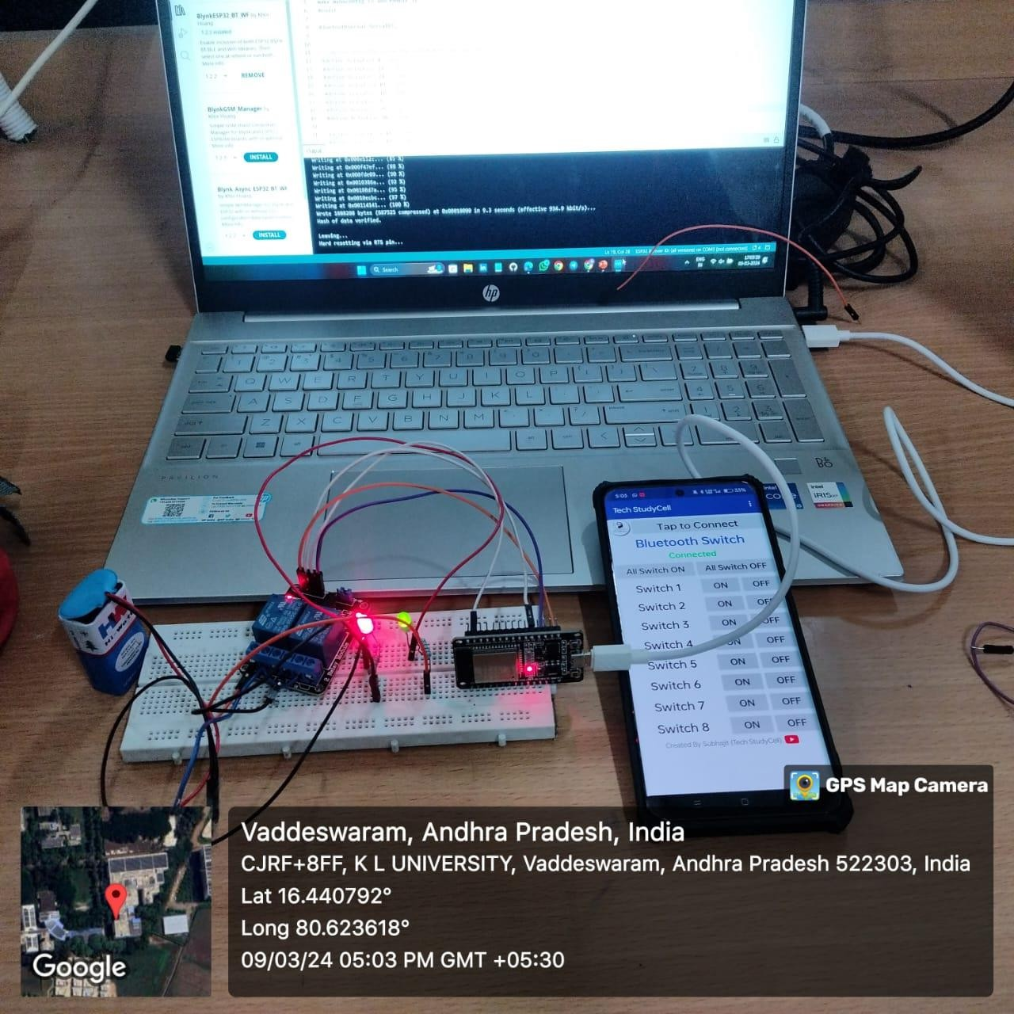
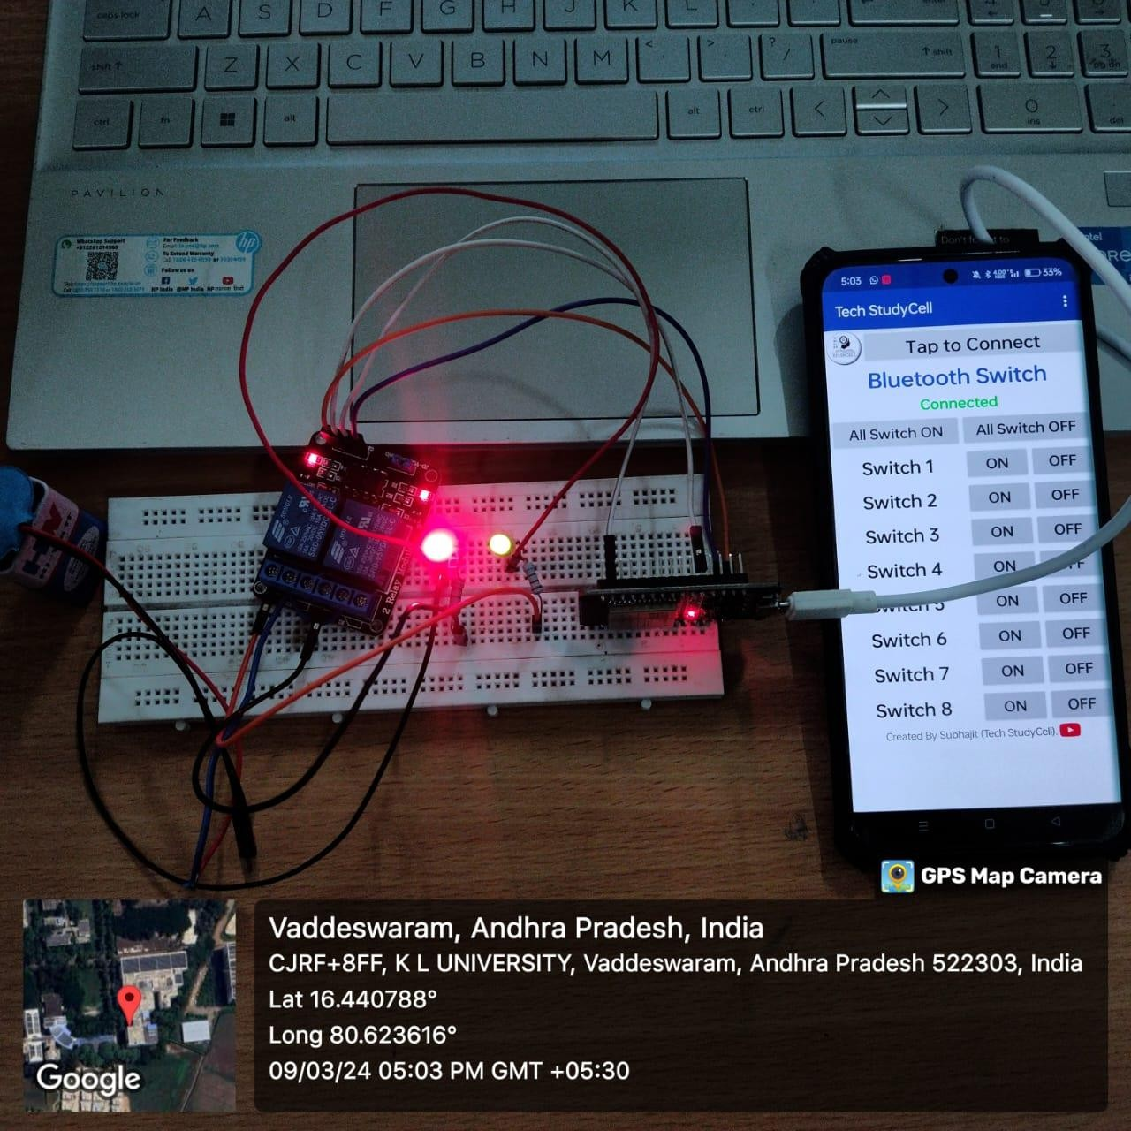
OUTPUTS :

Slide 6
2. ESP32 with I2S Audio Amplifier :
In this task, you’ll explore using an ESP32 microcontroller in conjunction with an I2S audio amplifier. The ESP32 can communicate with the amplifier via the I2S protocol, allowing you to enhance audio capabilities in your project.

Slide 7
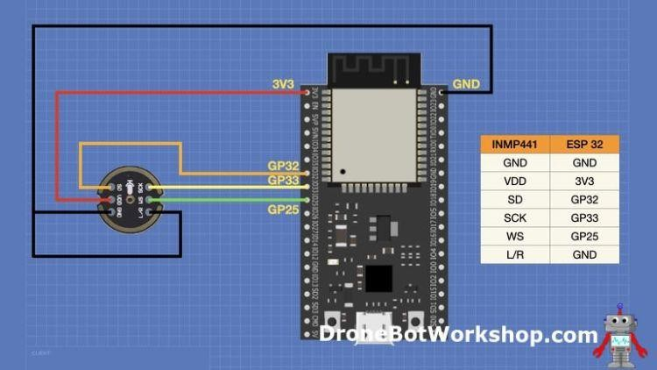
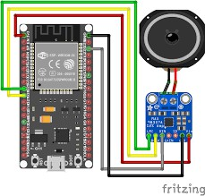
Circuit Diagram / References:

Slide 8
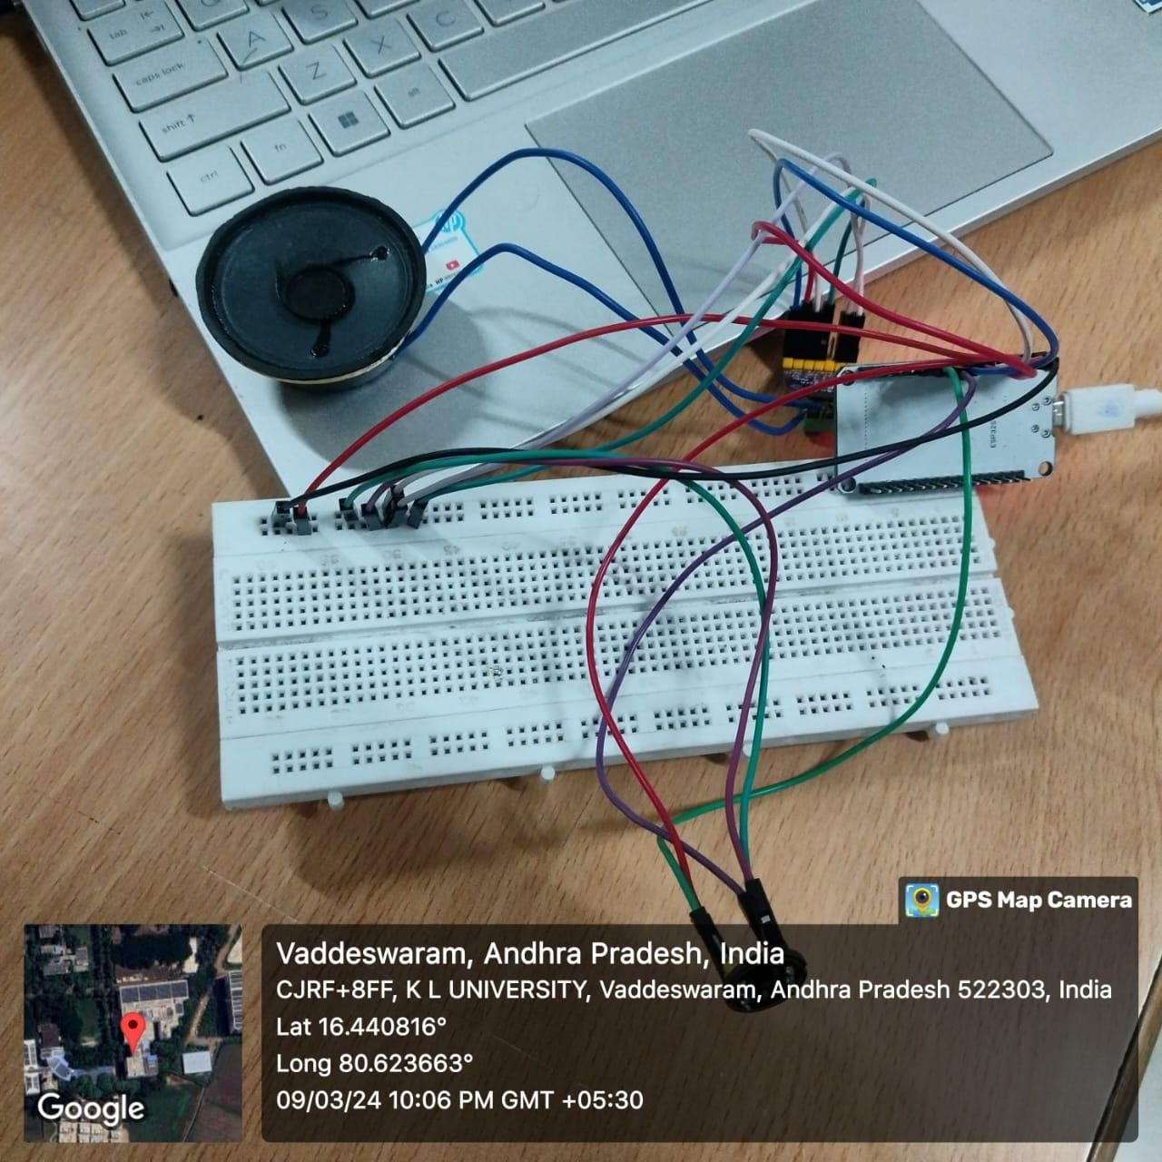
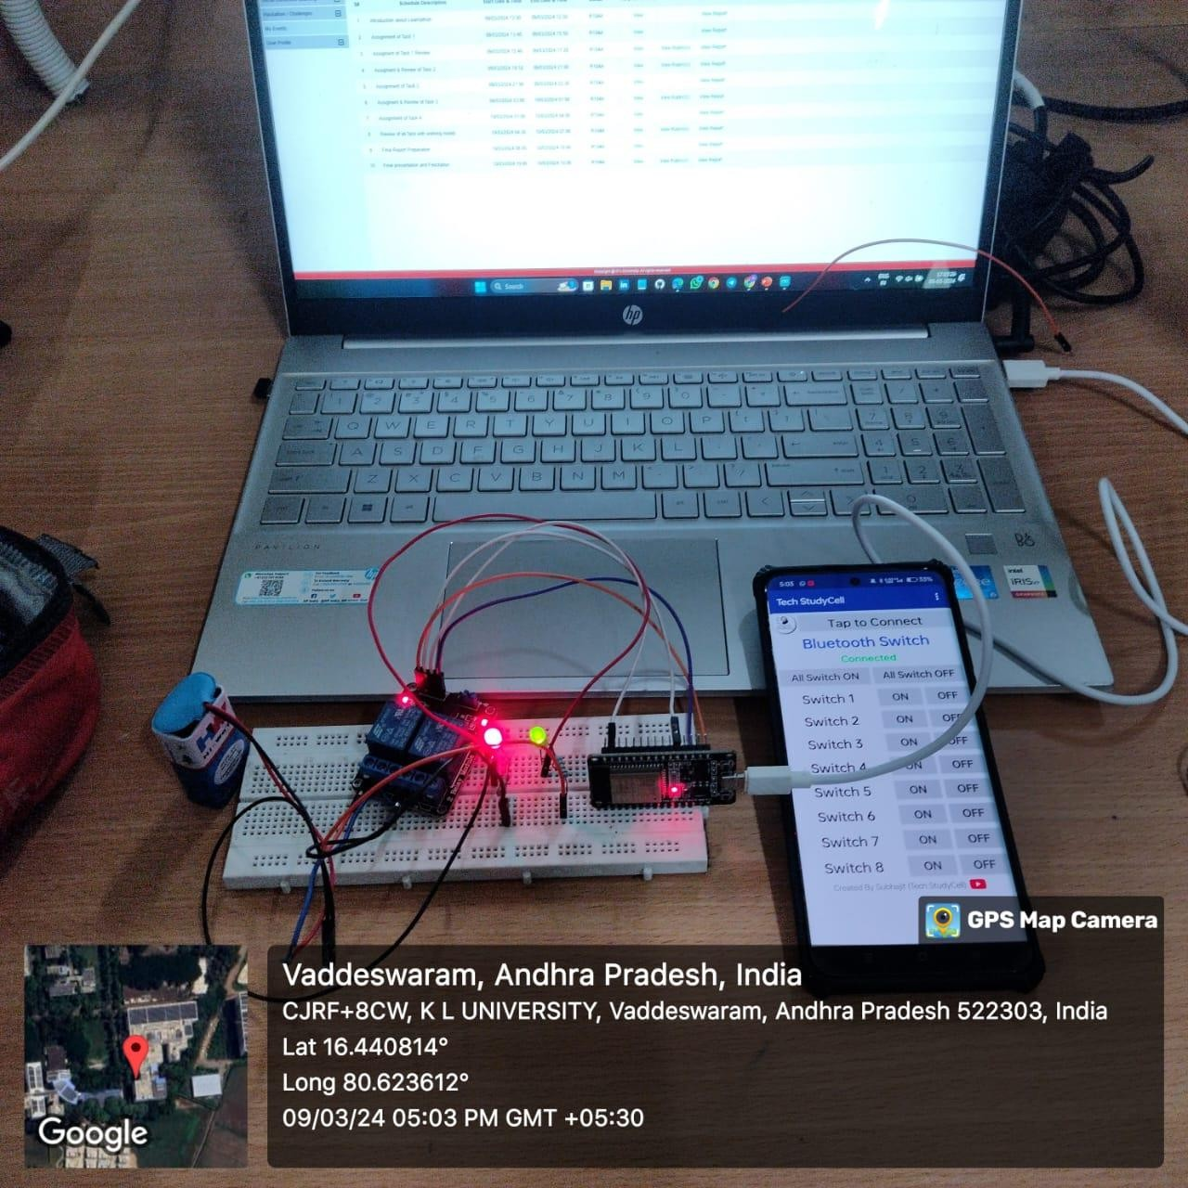
RESULTS :

Slide 9



3. ESP32 with RFID:
For this task, you’ll integrate an ESP32 with an RFID (Radio Frequency Identification) module. RFID technology enables contactless identification and tracking. You can use it for access control, inventory management, or other applications.

Slide 10
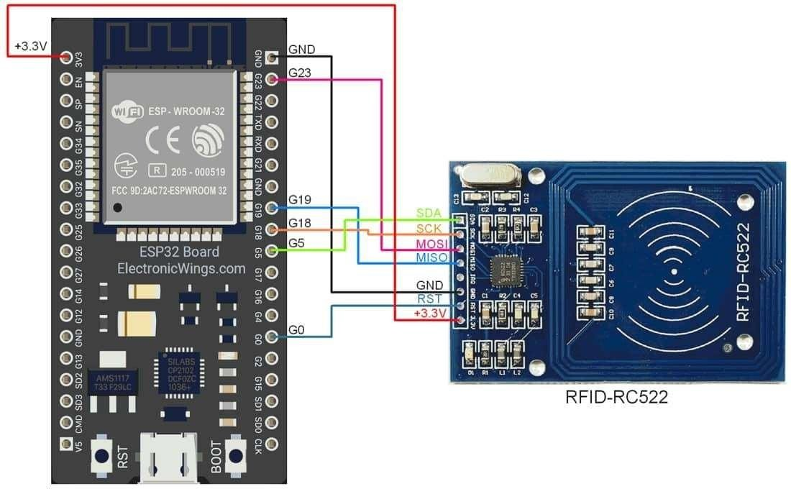
Circuit Diagram

Slide 11
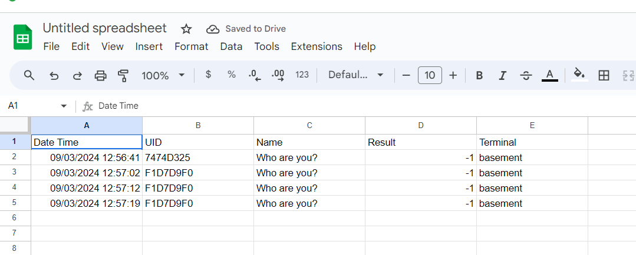
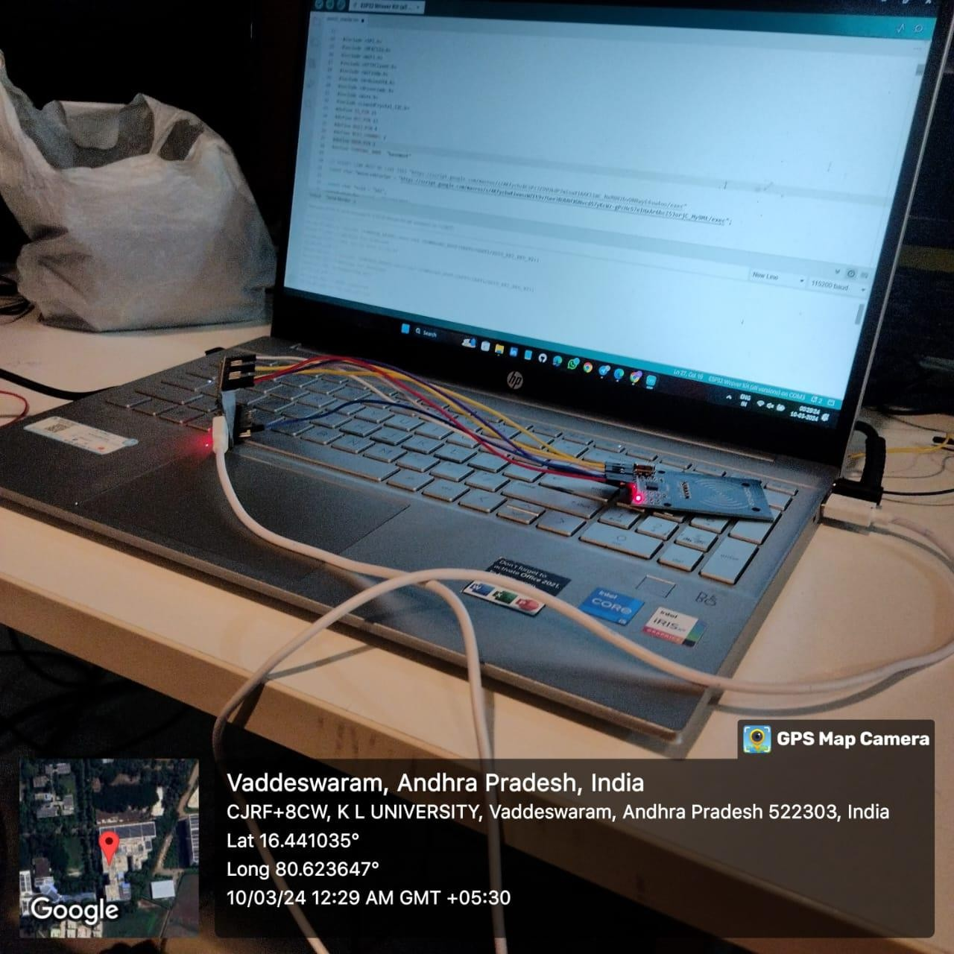
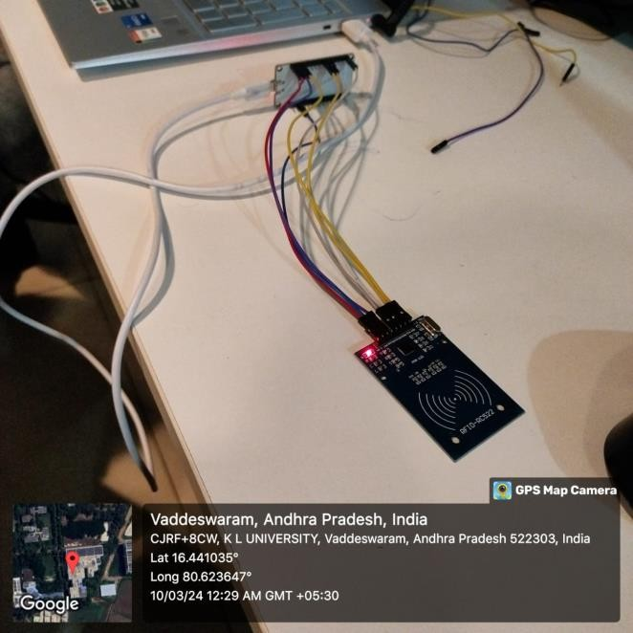
RESULTS :

Slide 12
4. Agriculture Monitoring System using Thing Speak, ESP32, and DHT11:
Create an agriculture monitoring system using the following components:
ESP32: A versatile microcontroller with built-in Wi-Fi and Bluetooth capabilities.
DHT11: A temperature and humidity sensor.
Thing Speak: An IoT platform for data collection and visualization.
Monitor environmental conditions (temperature and humidity) in agricultural settings and send data to Thing Speak for analysis and visualization

Slide 13
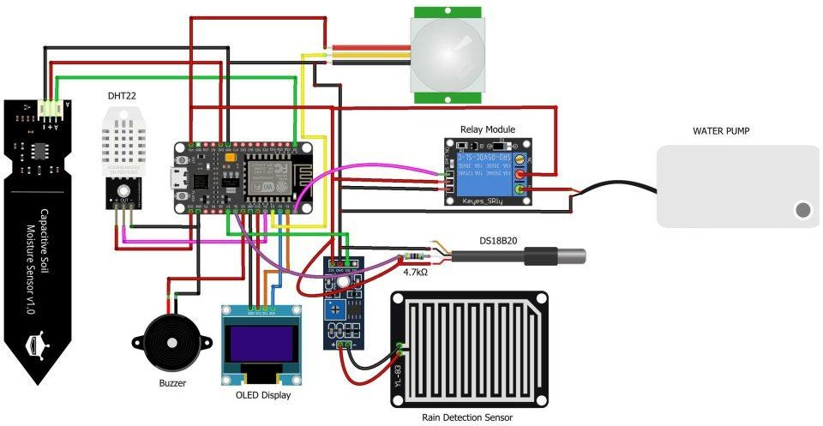
Circuit Diagram :

Slide 14
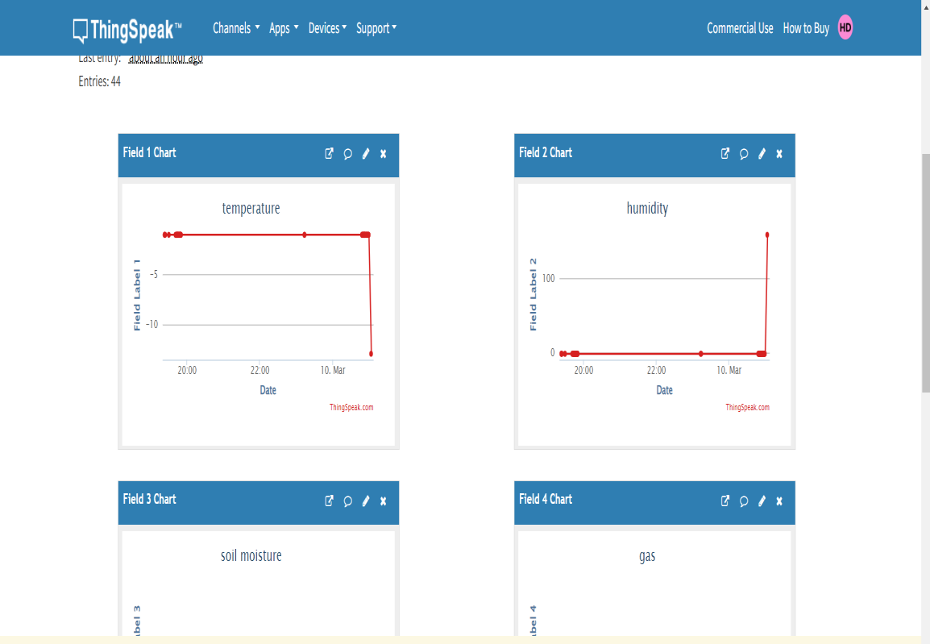
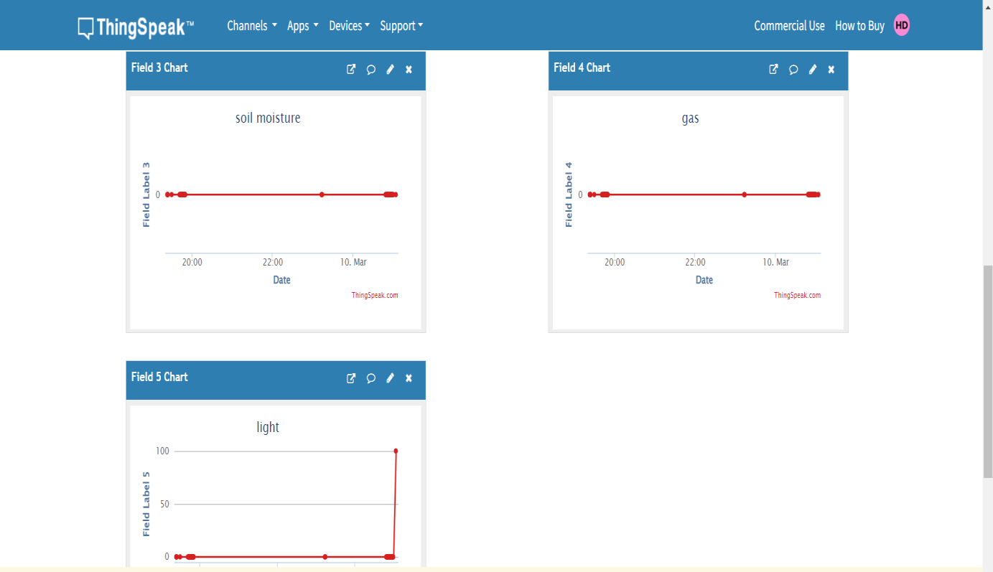
RESULTS :

