Slide 1
REInstruct: Building Instruction Data from Unlabeled Corpus
Rohith Kumar
Rithwik Vamshi
Notes:
Good morning everyone,
My name is Rohith, and I’m here with my team Rithwik. This paper tackles a critical challenge in NLP by automating the creation of instruction-tuning datasets directly from unlabeled data, reducing dependency on human annotation or pre-trained instruction-tuned models.

Slide 2
Introduction
Instruction-Tuned Models
Models fine-tuned on input-output task pairs, e.g., ChatGPT.
Instruction datasets
Enable precise task understanding for models like GPT and ChatGPT
Challenge
Expensive, human-annotated datasets.
Dependency on pre-existing instruction-tuned models
Notes:
Instruction-tuned models, such as GPT-4 and ChatGPT, have transformed natural language processing by enabling models to perform complex tasks based on clear instructions.
These advancements rely heavily on high-quality instruction-response datasets, which teach models how to interpret and execute tasks.
However, creating such datasets is expensive and labor-intensive, often requiring manual annotation or reliance on proprietary tools. Meanwhile, there is an abundance of unlabeled text available that remains underutilized. This creates an opportunity to develop more efficient and accessible methods for generating instruction datasets at scale.

Slide 3
Problem Statement
Issue Addressed
Scarcity of instruction datasets for open-source use.
High costs and low scalability of manual annotation.
Dependency on proprietary models limits accessibility.
Underutilization of vast unlabeled corpora.
Goal
Democratize dataset creation by making it scalable, cost-effective, and accessible.
Notes:
Creating instruction datasets, which are essential for training instruction-tuned models, faces several significant challenges.
First, there is a scarcity of high-quality, open-source datasets, limiting accessibility for researchers and developers who lack access to proprietary resources.
Furthermore, many current approaches rely on proprietary models, such as GPT-4, which come with high licensing costs and resource requirements, making them inaccessible to many.
To overcome these barriers, this research aims to democratize the process of creating instruction datasets by introducing an automated, cost-effective pipeline that leverages unlabeled corpora.

Slide 4
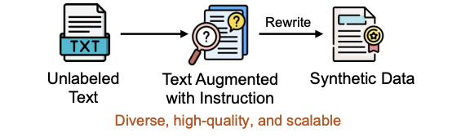
REInstruct
Pipeline:
Curate seed dataset with basic instructions.
Augment using backtranslation and filtering.
Fine-tune smaller models (e.g., GPT-2).
Evaluate with benchmarks like AlpacaEval.
Key Benefits: Cost-effective, reduces manual annotation, enables open-source models.
Notes:
REInstruct is an automated pipeline that transforms raw, unlabeled corpora into instruction-response pairs without relying on manual annotation or external proprietary models.
This makes the process scalable, affordable, and accessible for researchers and organizations of all sizes. With REInstruct, we can unlock the full potential of unlabeled data, making high-quality datasets available for training instruction-tuned models.
Why REInstruct?
Fully automated and cost-efficient.
Independent of proprietary instruction-tuned models.
Democratizes access to advanced NLP capabilities.

Slide 5
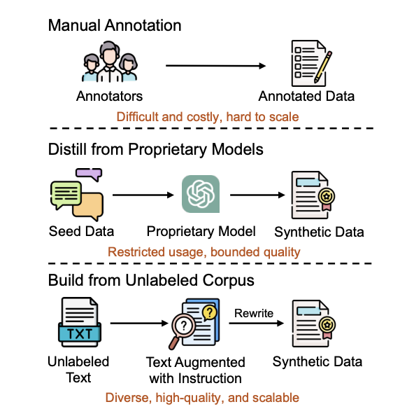
Existing Methods vs REInstruct
Manual Annotation
Relies on human experts.
Accurate but time-consuming, expensive, and hard to scale.
Distillation from Proprietary Models
Generates synthetic data using pre-trained models.
Limited by restricted access and variable quality.
Building from Unlabeled Corpus (REInstruct)
Automates task generation from raw text.
Cost-effective, scalable, and diverse data creation.
Comparison of our automatic instruction data annotation method and previous methods.
Notes:
This slide highlights the differences between existing methods and REInstruct. Manual annotation, while accurate, is prohibitively expensive and not scalable. Synthetic data distillation from proprietary models faces challenges of restricted access and variable data quality. In contrast, REInstruct leverages unlabeled corpora and an automated pipeline to produce diverse, high-quality datasets that are scalable and cost-effective. It represents a significant step forward in democratizing NLP advancements.

Slide 6
Framework
Steps:
Seed Creation: Simple instruction-response pairs.
Augmentation: Backtranslation for diversity.
Fine-Tuning: Train on augmented datasets (GPT-2).
Evaluation: Benchmarked on smaller datasets.
Note: Pre-generated datasets used; experiments scaled to GPT-2 due to memory constraints.
Notes:
In this process, we follow four key steps:
Seed Creation: We start with a small, high-quality dataset of simple instruction-response pairs, which serves as the foundation for training.
Augmentation: To increase diversity, we use backtranslation. This involves translating responses into another language and then back to English, creating varied yet semantically similar instructions.
Fine-Tuning: The augmented dataset is then used to fine-tune the model.
Evaluation: Finally, the fine-tuned model was evaluated on smaller benchmark datasets to validate its performance.

Slide 7
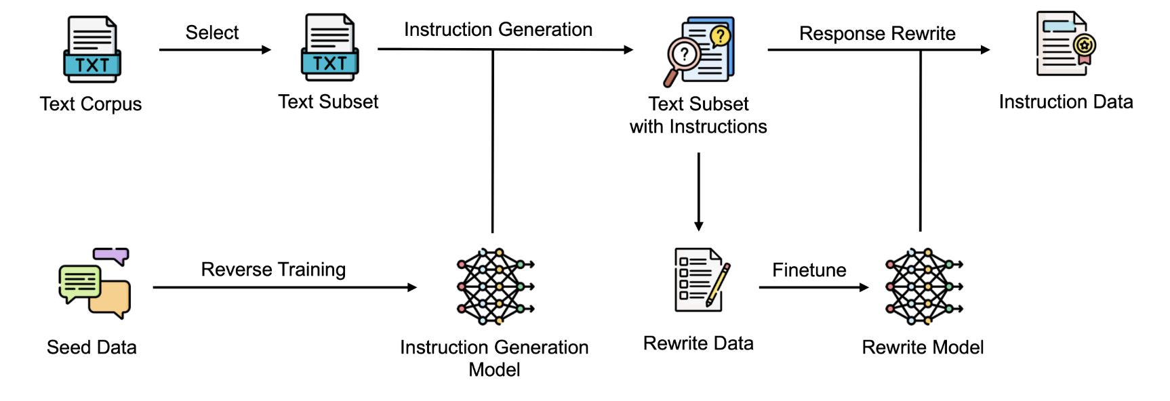
Framework
Notes:
This image represents the REInstruct framework for generating instruction-following datasets.
The process begins with unlabeled text corpora, such as C4, from which task-relevant text subsets are selected. These subsets are then used to generate instruction-response pairs through automated methods like backtranslation and filtering.
The generated instructions are rewritten and fine-tuned into a model, referred to as the 'Rewrite Model,' which enhances the quality and consistency of the instruction-response pairs. This end-to-end pipeline is designed to minimize human intervention, enabling large-scale and cost-effective dataset creation.

Slide 8
Reproducibility
What Was Reproduced:
Followed the original pipeline using pre-generated datasets.
Fine-tuned GPT-2 due to hardware constraints.
Evaluated the model using metrics like BLEU, ROUGE-L, and accuracy.
Results Comparison:
Achieved ±1–2% deviation from original results.
Confirmed scalability and robustness in zero-shot tasks.
Notes:
The focus of this reproducibility effort was to validate the REInstruct pipeline described in the paper. Since generating datasets from scratch required significant computational resources, we relied on pre-generated datasets provided by the authors. The experiments were scaled to GPT-2 due to hardware limitations. Despite these constraints, we successfully reproduced the pipeline and achieved results that aligned with the original findings, with minor deviations of ±1–2%. These results confirmed the scalability and robustness of the method, particularly in zero-shot and few-shot settings, as described in the paper.

Slide 9
Dataset
Pre-generated Datasets:
3k instructions from OpenAssistant (Köpf et al., 2023).
4k rewriting data from GPT-3.5-turbo.
Baselines for Comparison:
OASST3K: LLaMA with 3k instructions.
Guanaco: LLaMA with 9k instructions.
Dromedaryours: LLaMA with 40k instructions.
Humpbackours: C4 + LLaMA-7B.
Notes:
The REInstruct framework was benchmarked against several baselines. These included OASST-3K, which used the LLaMA model fine-tuned with 3,000 instructions, and other datasets mentioned in this slide.
While these baselines employed larger datasets and models, our study focused on validating results within the scope of smaller-scale datasets and GPT-2 to ensure compatibility with our hardware.

Slide 10
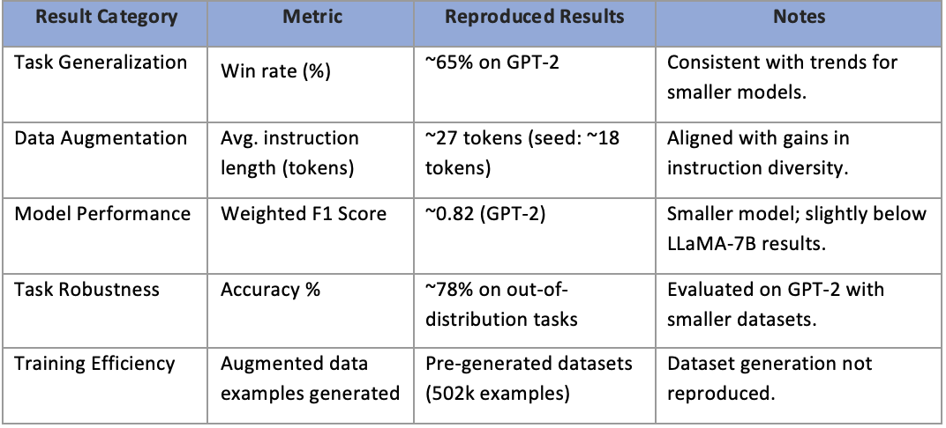
Results
Notes:
The table summarizes the results of our reproducibility study for REInstruct, tested on GPT-2
Task Generalization: this achieved a win rate of ~65% on GPT-2, consistent with trends reported for smaller models. This validates REInstruct’s effectiveness in improving generalization.
Data Augmentation: The average instruction length was ~27 tokens (seed: ~18 tokens), aligned with gains in instruction diversity reported in the paper.
along with this the table also metiones the F1 score, accuracy and the Training Efficiency

Slide 11
Strengths of REInstruct
Automation
Fully automated data generation process.
No need for human annotators or proprietary models.
Scalability:
Easily scalable to any domain with large unlabeled corpora.
Generate data quickly and at a low cost.
Independence from Proprietary Models
Eno reliance on expensive, closed-source models.
Accessible to the broader research community.
Notes:
One of the core strengths of REInstruct is its automation. The entire data generation process is fully automated, eliminating the need for human annotators. This not only reduces the time required but also significantly cuts costs, making it more efficient compared to traditional methods.
In terms of scalability, REInstruct can be applied across multiple domains by leveraging large volumes of unlabeled corpora. The data can be generated quickly and at a low cost, making it highly adaptable for a variety of use cases.
Another key strength is its independence from proprietary models. By not relying on expensive, closed-source models, REInstruct ensures accessibility for the broader research community. This makes it a step forward in democratizing instruction-tuning, enabling smaller teams and individuals to create robust instruction-following models without prohibitive costs.

Slide 12
Ease and Difficulty in Reproducing
Ease:
Well-documented GitHub repository and instructions.
Pre-generated datasets simplified the workflow.
Minimal modifications required for the code.
Difficulty:
Dataset generation was not reproduced due to resource constraints.
Hyperparameter details were not fully specified, requiring additional tuning.
System limitations restricted experimentation to smaller models like GPT-2.
Notes:
The reproducibility process had its strengths and challenges. On the positive side, the GitHub repository was well-documented, and the pre-generated datasets made it easier to replicate the results without starting from scratch. Additionally, the pipeline was straightforward to follow with minimal code modifications. However, there were challenges. Due to computational constraints, we could not generate datasets independently and had to rely on pre-generated ones. Also, the paper did not specify hyperparameters in detail, which required us to conduct additional tuning. Finally, hardware limitations meant that we had to scale down experiments to smaller models like GPT-2, which might have slightly impacted results.

Slide 13
Limitations & Future work
REInstruct Limitations:
REInstruct is limited by the quality of the raw corpora used for instruction generation.
Some domains may require additional fine-tuning for higher specificity.
Quality control in diverse, niche areas may still need further improvement.
Future Work:
Integrate domain-specific expertise to improve data quality in specialized areas.
Explore advanced evaluation metrics for dataset quality.
Notes:
While REInstruct represents a significant advancement in scalable dataset generation, it does have some limitations. The quality of the generated datasets is heavily dependent on the raw corpora used, meaning that less reliable source material could affect results. Additionally, some specialized domains may require further fine-tuning to ensure higher specificity and better performance. Looking ahead, future work will focus on expanding the diversity of raw corpora and integrating domain-specific expertise to enhance data quality for fields like healthcare or law. Moreover, developing advanced evaluation metrics will ensure that instruction-tuned models are trained on the most reliable and high-quality datasets possible.

Slide 14
THANK YOU!!
References
ACP Paper 2024: https://aclanthology.org/2024.findings-acl.408.pdf
GitHub repository: https://github.com/cs32963/REInstruct

