Slide 1
MOVIE RENTAL
ANALYSIS
Sakila DVD Rental Dataset
16,000+ Rentals
2 Stores
15 Categories
599 Customers

Slide 2
Company & Dataset Overview
Sakila Movie Rental Business
🎬 About the Company
Dataset Details
Sakila is a fictional DVD rental company operating two physical stores — Store 1 (Location A) and Store 2 (Location B).
Each store is managed by dedicated staff with its own inventory of films.
The business serves a globally distributed customer base across 100+ countries.
Revenue is generated through time-based rental fees across 15 film categories.
Business period spans from 2005 with primary data in May–August window.
Table | Records
rental | 16,044
payment | 14,596
customer | 599
film | 1,000
inventory | 4,581
staff | 2
store | 2
category | 16

Slide 3
Data Cleaning & Preprocessing
Data Cleaning Steps taken to ensure data quality and consistency
1
Null Value Treatment
2
Duplicate Removal
Identified and handled NULL values in return_date (unreturned films), email, and address fields. Unreturned rentals were flagged separately for analysis.
Scanned all tables for duplicate records using primary key constraints. No duplicate rentals or payments were found — confirming data integrity.
3
Data Type Standardization
4
Derived Columns Created
Converted rental_date, return_date, and payment_date to proper DATETIME format. Ensured amount fields were stored as DECIMAL(5,2).
Computed rental_duration = DATEDIFF(return_date, rental_date). Created customer_segments, payment_segments, and loyalty_tier derived columns.
5
Outlier & Consistency Check
Validated rental durations — outliers >30 days were reviewed. Verified that all payment amounts matched expected ranges per film category.

Slide 4
Exploratory Data Analysis — Key Findings
Statistical patterns discovered during EDA phase
Rental Volume
Revenue
16,044 total rentals recorded across both stores with near-equal split: Store 1 — 8,004 and Store 2 — 8,040.
Total revenue ≈ $67.5K. Both stores generated virtually identical revenue (~$34K each), indicating well-balanced operations.
Top Categories
Avg Rental Duration
Sports (1,179), Animation (1,166), and Action (1,112) are the top 3 rented categories. Music (830) and Classics (939) are least rented.
Games, Sports & Comedy lead with avg 5.2 days. Classics and New have the lowest at 5.0 days — minimal variation across categories.
Customer Geography
Payment Segments
India is the top revenue-generating country, followed by China and the United States. Aurora and London top the customer city list.
Mid Payment accounts for 46.26% of revenue ($31.18K), followed by High Payment (31.77%) and Low Payment (21.97%).
Peak Revenue Month
Film Inventory
July is the highest revenue month (~$28K), followed by August (~$24K). February shows the lowest activity.
Sports (344), Animation (335), and Action/Sci-Fi (312 each) have the largest inventories. PG-13 is the most common rating.

Slide 5
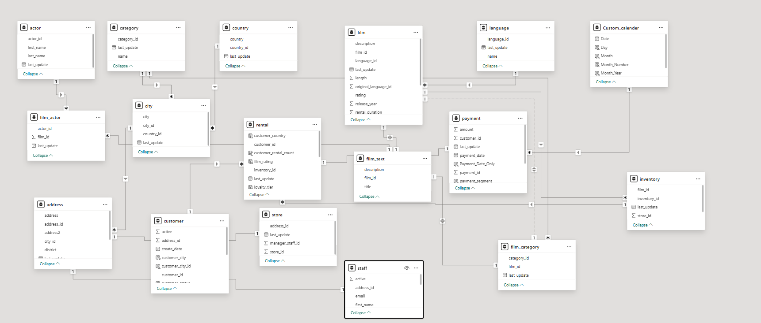
Data Model — Entity Relationship Diagram
Schema used to link rental, customer, film, and payment data

Slide 6
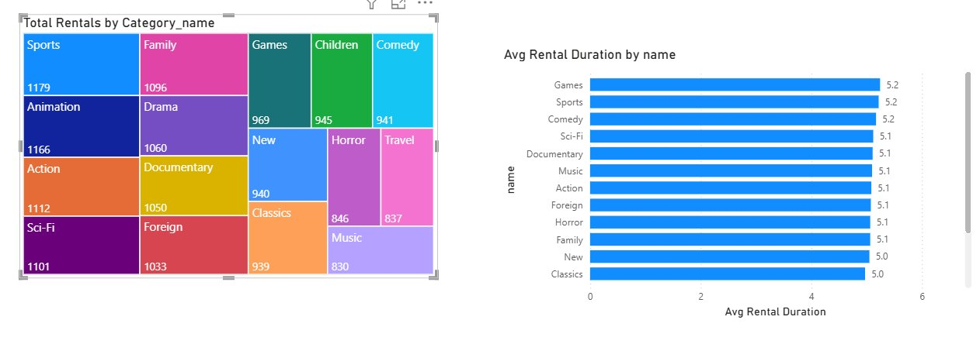
Insights: Rentals by Category & Avg Duration
Sports leads with 1,179 rentals — most popular category
Games & Sports tied at 5.2 days avg duration
Classics & New lowest at 5.0 days avg

Slide 7
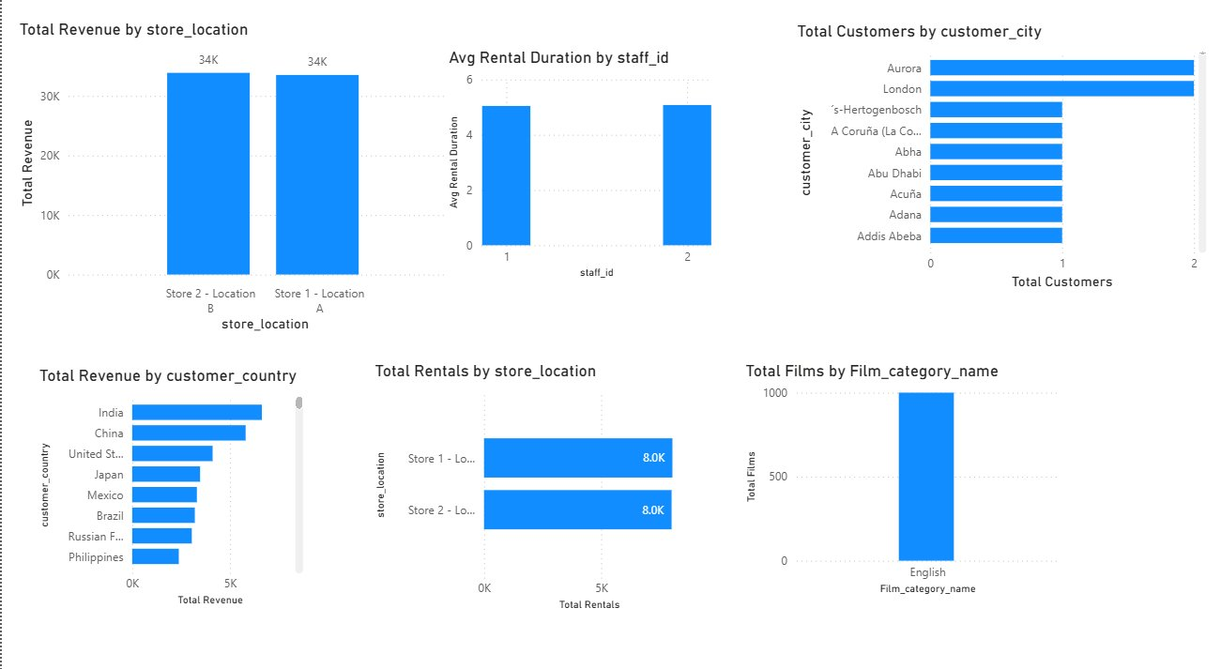
Insights: Store Performance & Geography
Both stores equal: ~$34K revenue & 8K rentals each
India tops revenue by country; Aurora leads by city
All 1,000 films in English — single-language catalog

Slide 8
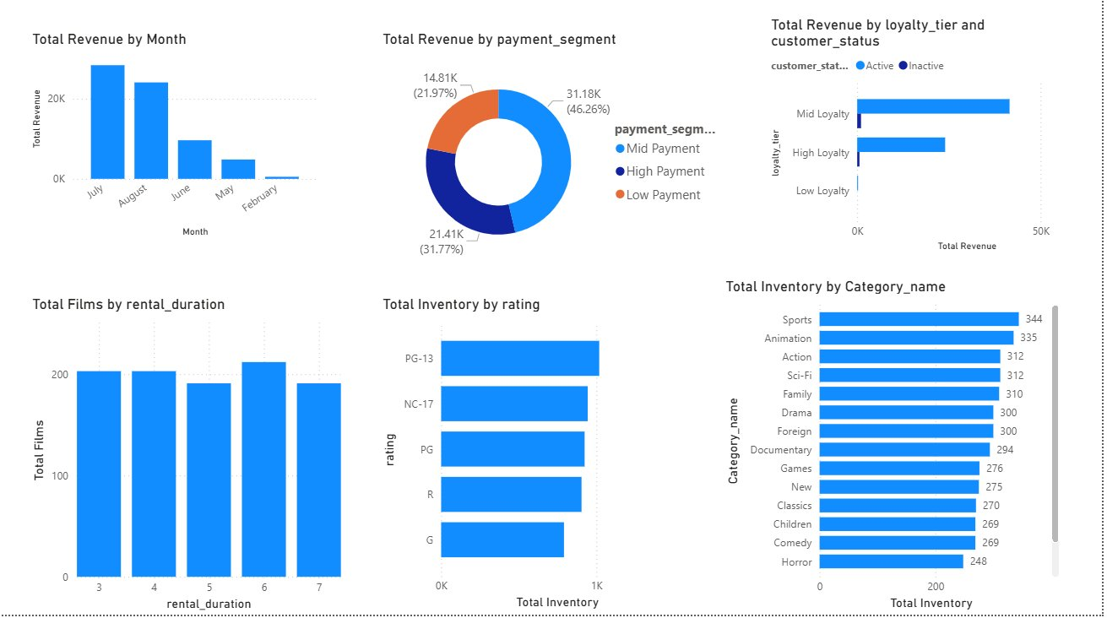
Insights: Revenue Trends, Payments & Inventory
July peaks at ~$28K — summer is prime rental season
Mid Payment = 46% of revenue — largest segment
Mid Loyalty customers drive most total revenue

Slide 9
Business KPI Dashboard
16,044
$67.5K
599
1,000
Total Rentals
Total Revenue
Customers
Film Titles
4,581
5.1 days
2
15
Inventory Items
Avg Rental Duration
Store Locations
Film Categories
Top 5 Categories by Rentals:
Sports (1179)
Animation (1166)
Action (1112)
Drama (1060)
Sci-Fi (1101)

Slide 10
Summary & Business Recommendations
📋 Summary
💡 Recommendations
Both stores perform equally well in revenue & rentals, indicating good operational balance.
Sports, Animation, and Action dominate rentals — these are the core revenue categories.
Rental duration is consistent (~5.1 days) across most categories with minimal variance.
July–August are peak months; February sees the lowest rental activity.
Mid-payment and Mid-loyalty customers form the largest revenue-contributing segments.
India and China are the top international markets with significant customer counts.
All 1,000 films are in English — a major market limitation for non-English regions.
1
Expand Sports & Animation inventory
These categories have high demand but may face stockouts during peak months.
2
Run off-season promotions (Feb–May)
Seasonal discounts or bundled rentals can boost the low-activity months.
3
Introduce multilingual content
Customers in India, China, Philippines may prefer non-English titles — a growth opportunity.
4
Upgrade High-Loyalty customer perks
High-loyalty customers generate strong revenue — exclusive deals can improve retention.
5
Invest in online/digital rental option
Extending to digital streaming can capture demand beyond physical locations.
6
Cross-sell Classics & New releases
These underperforming categories can benefit from promotional bundling.

Slide 11
THANK YOU
Movie Rental Business Analysis | Sakila Dataset
Insights • EDA • Recommendations
Dataset
Tools Used
Prepared
Sakila Database
SQL, Power BI / Excel, Python
March 2026

