Slide 1

NORTHWIND
TRADERS
Sales Analysis Report
Power BI Dashboard • Northwind Dataset • 2026
9
7
5
Tables
Pages
Pillars
Prepared using Power BI | Data Source: Northwind Traders Database

Slide 2
TABLE OF CONTENTS
Company Introduction
Data Model & ER Diagram
01
05
Northwind Traders – who they are and what they do
Relationships powering the Power BI report
Dataset Overview
Dashboard Insights
02
06
9 source tables and their relationships
Visuals and charts from the Power BI file
Data Cleaning Process
Summary & Suggestions
03
07
Steps taken in Excel & Power Query
Findings, recommendations and next steps
Key Insights (Q1–Q14)
04
14 business questions answered with data

Slide 3
01 | COMPANY INTRODUCTION
About Northwind Traders
Industry:
Specialty Food Import/Export
▸ Northwind Traders is a fictional specialty food import/export company used as a classic database training scenario developed by Microsoft.
HQ:
Seattle, USA (Fictional)
Customers:
91 Companies, 21 Countries
▸ The company buys specialty foods from suppliers across the globe and sells them to restaurants, cafes, and food retailers worldwide.
Products:
77 Products, 8 Categories
▸ Operations span order management, employee tracking, supplier relationships, product inventory, and multi-carrier shipping logistics.
Employees:
9 Sales Representatives
▸ The dataset has been used in data analytics, BI development, and SQL training for over two decades — making it an industry standard for reporting demos.
Suppliers:
29 Global Suppliers
Shippers:
3 Carrier Companies
Orders:
830 Total Orders on Record

Slide 4
02 | DATASET OVERVIEW
Orders
Order Details
Products
OrderID, CustomerID, EmployeeID, OrderDate, ShipVia, Freight, ShipCountry
OrderID, ProductID, UnitPrice, Quantity, Discount
ProductID, ProductName, SupplierID, CategoryID, UnitPrice, UnitsInStock, Discontinued
Customers
Employees
Suppliers
CustomerID, CompanyName, ContactTitle, City, Country
EmployeeID, FirstName, LastName, Title, HireDate, ReportsTo, Country
SupplierID, CompanyName, City, Country
Categories
Shippers
CustomCalendar
CategoryID, CategoryName, Description
ShipperID, CompanyName
Date, Month, Quarter, Year, Month Name — used for time intelligence

Slide 5
03 | DATA CLEANING PROCESS
All 9 source tables were imported into Excel and Power Query, then cleaned and validated before loading into Power BI.
Removed Duplicates
Handled Nulls & Blanks
01
Scanned all tables for duplicate primary key values (OrderID, CustomerID, ProductID). No duplicates found — data integrity confirmed.
02
Identified null values in ShipRegion, Fax, and Region columns. Replaced with 'N/A' where needed. ShippedDate nulls retained as unshipped orders.
Standardized Date Formats
Created Calculated Columns
03
Converted all date columns (OrderDate, RequiredDate, ShippedDate, HireDate) to consistent DD-MM-YYYY format using Excel TEXT() formula.
04
Added TotalAmount = Quantity × UnitPrice × (1 - Discount) in Order Details. Added Employee Tenure and Shipping Duration columns in respective tables.
Data Type Validation
Removed Irrelevant Columns
05
Ensured numeric fields (Quantity, UnitPrice, Freight, Discount) had correct Number data types. Converted IDs to Text to prevent aggregation errors in Power BI.
06
Dropped Photo, Notes, and HomePhone columns from Employees table. Removed binary/attachment columns from Categories and Suppliers tables.

Slide 6
04 | KEY INSIGHTS (EDA) — Questions 1 to 7
Total Revenue
Top 5 Customers by Revenue
Q1
~$1.35M total revenue generated across all orders. Beverages and Dairy Products are the top contributing categories.
Q2
QUICK-Stop, Ernst Handel, Save-a-lot Markets, Rattlesnake Canyon, and Hungry Owl lead revenue, contributing ~35% of total sales.
Monthly Order Trends
Average Order Value (AOV)
Q3
Orders peak in April and October. A notable dip is observed in January–February, suggesting seasonal demand patterns.
Q4
AOV is approximately $1,631 per order. High-freight orders (>$50) tend to have significantly higher order values.
Top Products by Units Sold
Category Revenue Distribution
Q5
Camembert Pierrot, Raclette Courdavault, and Gorgonzola Telino are top sellers by quantity shipped across all regions.
Q6
Beverages (21%), Dairy Products (18%), and Meat/Poultry (17%) together account for over 56% of total revenue.
Employee Order Count
Q7
Margaret Peacock handles the most orders (156), followed by Janet Leverling (127). Top 3 employees handle ~50% of all orders.

Slide 7
04 | KEY INSIGHTS (EDA) — Questions 8 to 14
Shipping Duration by Country
Discount Impact on Revenue
Q8
Ireland and Norway show the longest average shipping duration (>10 days). Nearby European countries average 5–7 days.
Q9
~6% of orders have discounts >15%. Heavy discounting (20–25%) reduces net revenue by an estimated 12–18% for those orders.
Stock vs Reorder Level
Customer Country Distribution
Q10
23 products are at or below their reorder level, posing stockout risk. Chef Anton's Gumbo Mix is discontinued but still in the system.
Q11
USA leads with 13 customers, followed by Germany (11) and France (11). Only 3 customers are in Asia, indicating low Eastern penetration.
Freight Cost by Shipper
Supplier Geographic Risk
Q12
United Package handles highest freight volume. Federal Shipping has lowest average freight per order. Speedy Express is priciest per kg.
Q13
29 suppliers from 16 countries. USA (8) and Germany (5) dominate. High concentration in 2 countries creates supply chain vulnerability.
Revenue by Year / Quarter
Q14
1997 was the highest revenue year. Q4 consistently outperforms other quarters across all years — driven by holiday season demand.

Slide 8
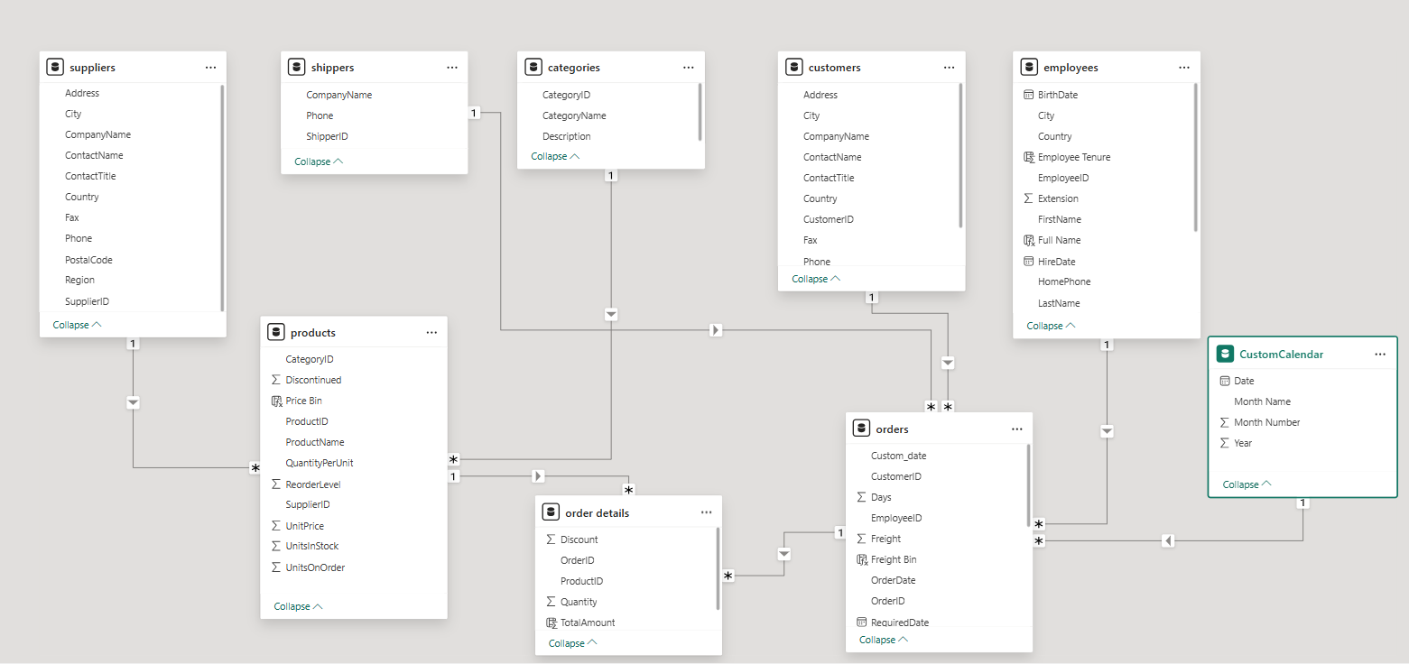
05 | DATA MODEL & ER DIAGRAM

Slide 9
06 | DASHBOARD INSIGHTS — Sales & Orders
$1.35M
830
$1,631
$78.24
Total Revenue
Total Orders
Avg Order Value
Avg Freight Cost
Monthly Order Volume Trend
Revenue by Product Category

Slide 10
06 | DASHBOARD INSIGHTS — Customers & Products
Top 10 Customers by Revenue
Top 10 Products by Revenue ($)

Slide 11
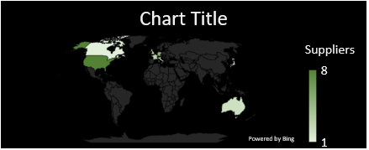
06 | DASHBOARD INSIGHTS — Employees & Suppliers
Orders Handled per Employee
Shipper Freight Cost Comparison
Suppliers by Country (Top 8)

Slide 12
MECE FRAMEWORK — Five Analytical Pillars
Sales Analysis
Customer Analysis
Product & Inventory
Employee Performance
Supplier & Logistics
Revenue Trends
Segmentation
Sales Performance
Sales by Employee
Supplier Reliability
Order Patterns
Geographic Distribution
Category Trends
Order Handling
Shipping Performance
Freight & Discount Impact
Purchase Behavior
Stock & Reorder
Tenure & Structure
Geographic Sourcing
Orders, Order Details, Shippers
Customers, Orders, Order Details
Products, Order Details, Categories
Employees, Orders
Suppliers, Products, Shippers, Orders
MECE = Mutually Exclusive, Collectively Exhaustive | Each pillar covers a distinct, non-overlapping business domain.

Slide 13
07 | SUMMARY & STRATEGIC SUGGESTIONS
✦ KEY FINDINGS
✦ STRATEGIC SUGGESTIONS
◆ Beverages & Dairy are revenue leaders — together driving ~39% of total revenue.
1
Diversify customer base — reduce over-dependence on top 5 accounts with targeted outreach to mid-tier customers.
◆ Top 5 customers (QUICK-Stop, Ernst Handel, etc.) contribute ~35% of all revenue — extreme concentration.
2
Restock flagged products — set automated procurement triggers for the 23 items below reorder level.
◆ Q4 seasonality is strong — holiday period consistently drives peak performance.
3
Optimize shipper selection — route high-volume orders to Federal Shipping (lowest avg freight $68/order).
◆ 23 products face stockout risk — procurement planning needs attention.
4
Leverage Q4 seasonality — plan promotional campaigns for Q1–Q2 to flatten the revenue trough.
◆ Shipping duration varies significantly — Ireland/Norway orders take 10+ days on average.
5
Reduce single-supplier risk — identify backup suppliers for products sourced exclusively from one country.
◆ Margaret Peacock leads order volume at 156 orders, ~19% of all orders solo.
6
Employee workload balancing — top 3 employees handle 50% of all orders; consider capacity reallocation.

Slide 14
Thank You
Northwind Traders Sales Analysis
Power BI Report • MECE Framework • Excel Data Cleaning
9 Tables Analyzed
14 Key Questions
5 MECE Pillars
7 Dashboard Pages
Data Source: Northwind Traders Database | Visualized with Microsoft Power BI | Analysis by MECE Framework

