Slide 1
Cloud based Ecommerce Website
Team Members:
Ashrit Deebadi
Riti Gupta
Vedashree Bhandare

Slide 2
INTRODUCTION / MOTIVATION
Built e-commerce site on cloud using AWS services
SaaS model
Due to high usage (large traffic), need to ensure customer faces no issues
Many tasks sensitive, security important
User passwords
Credit card information
If downtime, high latency in tasks, customer will move to other ecommerce websites

Slide 3
AWS Services Used : Overview
EC2 instances
S3
RDB
Cloud Front
CloudWatch
Virtual Private Cloud
Internet Gateway
Application Load Balancer
Auto Scaling
Glacier
Route53

Slide 4
Architecture Functionalities : Overview
Multi-tenant
High Availability
Load Balancing
Security
Logs Monitoring
Strong Consistency
Data Replication
Scalability (Scale In / Scale Out)

Slide 5
Functionalities : Overview
Login, Register, Logout, Reset Password
Used hashed passwords for enhancing security
Receive Marketing Emails
Receive Transaction Emails
Search catalog based on certain criterias
View product catalog
Checkout the products
View product details

Slide 6
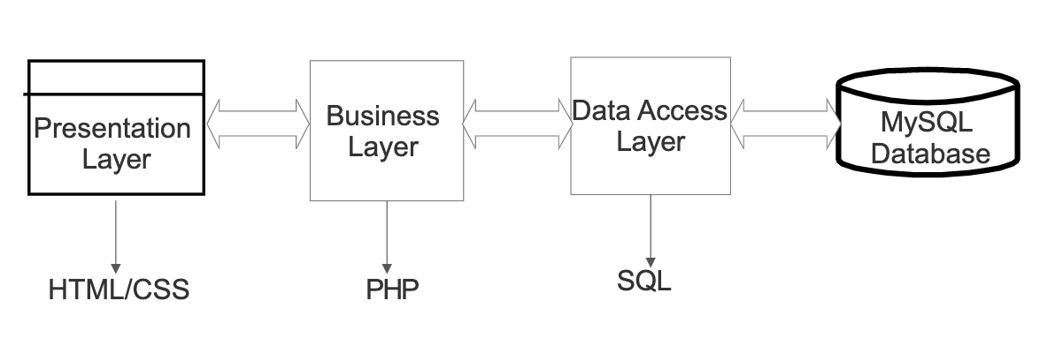
Project Architecture : Overview
Front-end Development
Used HTML/CSS for frontend development.
Business logic Layer
Developed in PHP.
Database
Used RDS from Amazon - SQL for handling queries.

Slide 7
Architecture
S3 Buckets and CloudFront
Used to store image related to products.
Inherently scales to handle thousands of HTTP/HTTPS request per second.
Amazon S3 is designed for 99.999999999% durability, and carries a service level agreement (SLA) of 99.9% availability.
Low Latency
CloudFront Edge locations cache content from an origin i.e Amazon S3 bucket in this case.

Slide 8
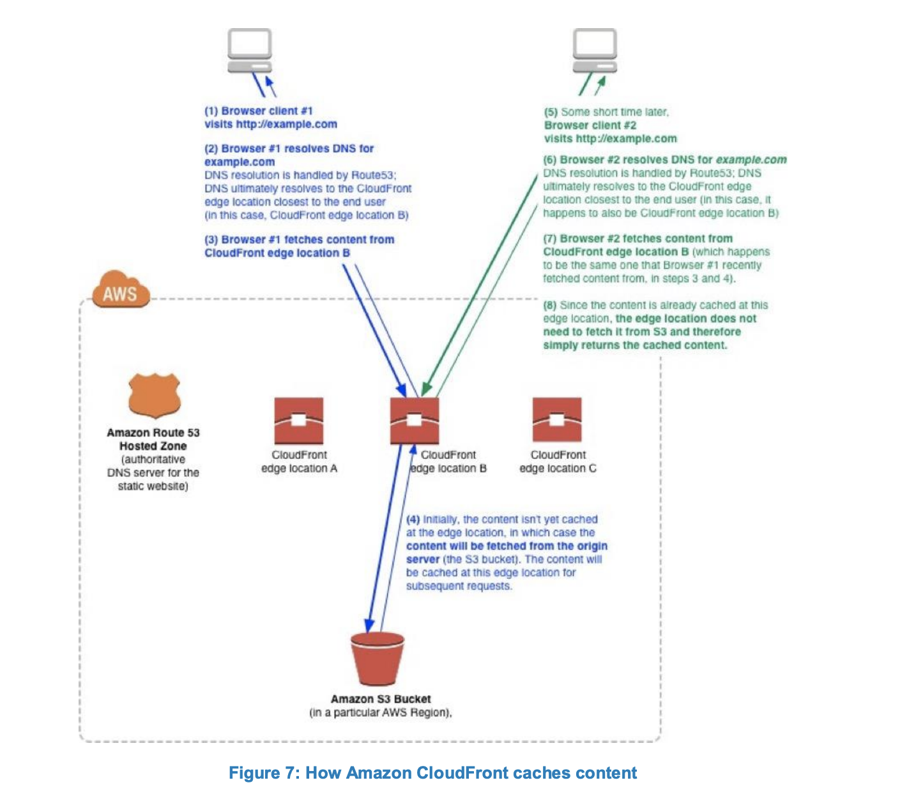

Slide 9
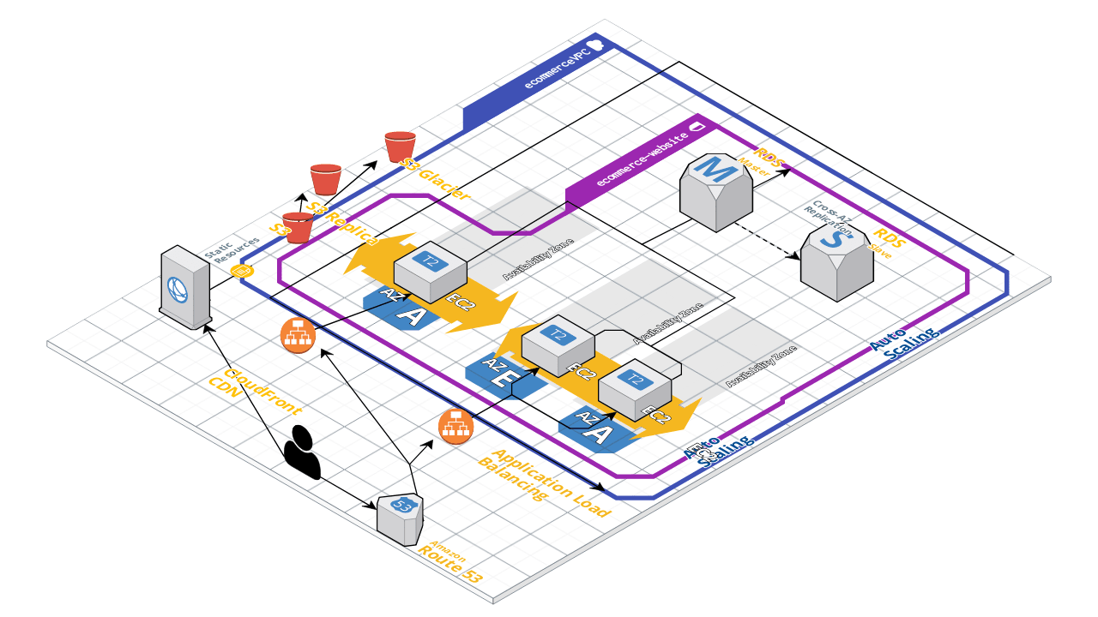
Architecture(Continued)
Request is sent to Route53
Route 53 has equal load distribution policy
Each region had Application Load Balancer with Auto Scaling

Slide 10
Architecture(Continued)
The Request are equally distributed within the instances by the Application Load Balancer
Auto Scaling runs health checks and scales out if the overall cpu utilization is over 60%
If a node fails then AutoScaling creates an new instance within a minute
Static Images are stored in S3 bucket and are cached by cloudfront
Code is backed in S3 buckets with older versions transferred to S3 Glacier in 365 days

Slide 11
Architecture(Continued)
Amazon Relational Database Service
DB Instance
DBEngine - MySQL
DB Instance - t2 micro, capacity - 1 GiB
Regions and Availability Zones
Multi AZ Deployment.
Security
Security group controls the access - set to private.
Monitoring an Amazon RDS DB Instance
Cloudwatch to monitor the performance and health of a DB instance.

Slide 12
Conclusion
The ecommerce website is designed using many AWS services
It is Highly Available
It is Fault Tolerant
It is easily Scalable
It improves throughput and latency using AWS cloudfront and AWS AutoScaling

Slide 13
Future Work
Support consistency based on user needs and their roles
Incorporate Artificial Intelligence based recommendation system.
Add chatting service where users can enquire about the products.

Slide 14
References
[1]https://d1.awsstatic.com/whitepapers/Building%20Static%20Websites%20on%20AWS.pdf.
[2]https://aws.amazon.com/rds/faqs/.
[3]F.Shaikh and D.Patil, “Multi-tenant e-commerce based on SaaS model to minimize IT cost”, in IEEE Conf. on Adv. in Eng. and Tech. Research, 2014.
[4]A.G.Recuero, S.Esteves and L.Veiga, “Quality-of-data for consistency levels in geo-replicated cloud datastores”, in IEEE 5th Conf. on Cloud Computing Tech. and Science, 2013.

