Slide 1
Natural language driven client onboarding
Hackathon POC | From natural language to automated client onboarding
Prototype / Proof of Concept
Team: ____________________

Slide 2
The problem
Client onboarding test-data creation is repetitive and automation is fragmented.
• Testers need to translate business requests into structured test data.
• Multiple client/account combinations require manual preparation of CSV data.
• Existing API automation can execute onboarding, but input preparation still requires effort.
• Failures and generated client IDs are spread across automation output and reports.
• Goal: make the workflow accessible through a simple natural-language request.

Slide 3
Proposed solution
A natural-language layer sits on top of the existing onboarding automation.
1
Natural language
request
2
Local LLM
intent extraction
3
Rule-based
test-data generation
4
CSV
creation
5
Existing Newman
automation
6
Client IDs +
result summary
→
→
→
→
→
Key idea: AI understands intent; deterministic code controls test-data rules and execution.

Slide 4
POC architecture
Local processing keeps the prototype independent of external LLM APIs.
Node.js /
Express
Ollama +
Qwen 2.5 3B
Generation rules
+ CSV
Frontend
Web UI
→
→
→
Existing
Newman
Bank onboarding
APIs
Report /
client IDs
→
→

Slide 5
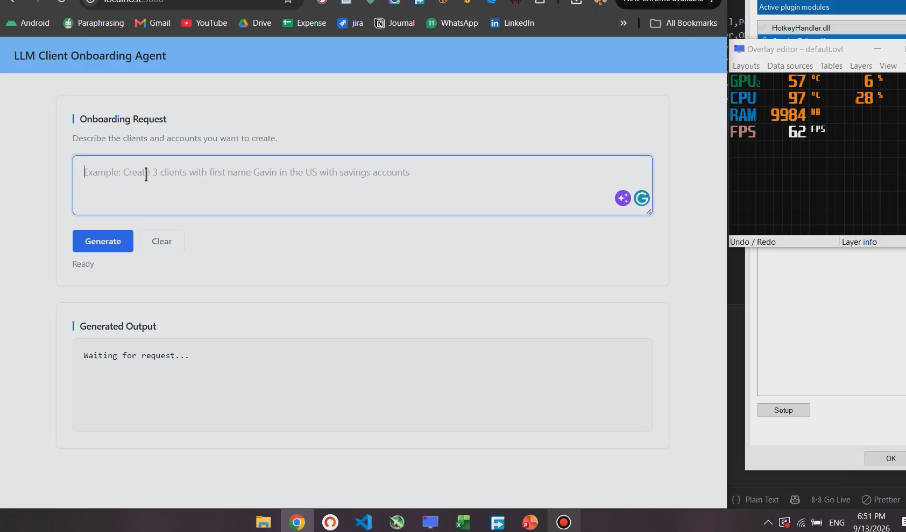
Demo 1 — Natural language → CSV
Personal laptop POC demonstration
Example request
“Create 2 individual clients with
first name Robin and 2 organisations”
What the POC demonstrates
• Natural-language input
• Structured intent extraction
• Deterministic data generation
• Downloadable CSV

Slide 6
Deterministic test-data generation
LLM output is intentionally limited to intent and parameters.
LLM OUTPUT
requestType
count
firstName
accountType
organisationType
RULES + TEMPLATES
Random names
Email / phone
SIN / identifiers
Defaults
Account templates
Static fields
GENERATED CSV
Ready for
existing Newman
automation
→
→
This separation reduces hallucination risk and keeps business rules under application control.

Slide 7
Demo 2 — CSV → Newman → client onboarding in DE74 Env
Office laptop demonstration
PASTE OFFICE LAPTOP VIDEO HERE
CSV → Newman → Bank website
→ Clients created → Newman report
SCREENSHOT PLACEHOLDER
Newman execution
SCREENSHOT PLACEHOLDER
Bank client created
SCREENSHOT PLACEHOLDER
Newman HTML report
SCREENSHOT PLACEHOLDER
Frontend result / IDs

Slide 8
End-to-end experience
Target workflow demonstrated across the two POC videos.
1. Tester describes onboarding requirement in plain language
2. Local Qwen extracts structured requirements
3. Application applies deterministic rules and creates CSV
4. Existing Newman collection executes onboarding APIs
5. Bank platform creates the requested clients/accounts
6. Newman report is generated and results are surfaced to the user

Slide 9
Expected value
Why this POC is worth taking to the next development stage.
• Reduces manual effort in preparing onboarding test data.
• Allows testers to express complex combinations in natural language.
• Reuses existing API/Newman automation instead of replacing proven components.
• Improves consistency through centralized rules and templates.
• Creates a foundation for automated validation, failure analysis and result summarization.
• Local LLM approach can support privacy-sensitive test-data workflows, subject to organizational approval.

Slide 10
Next phase / roadmap
POC proves the core concept; the next stage turns it into an agent.
• Automatically trigger Newman from the application.
• Read Newman results and identify failed onboarding steps.
• Extract newly created client/account IDs.
• Show execution progress and results in the frontend.
• Support richer multi-client / multi-account natural-language requests.
• Add validation, audit logging, error handling and enterprise security controls.

Slide 11
Natural language driven client onboarding
From “what I want” → to “clients are created”
Thank you

