Slide 1
amazon
Sales Dataset Analysis

Slide 2
01
Mission and Vision
02
Importing Libraries and Dataset
03
Describing the dataset and creating heatmap
04
Data Preprocessing
Contents
05
Data Transformation
06
Exploratory Data Analysis (EDA)
07
Data Visualisation
08
Result of analysis
09
Analysis summary and recommendation

Slide 3
Mission
The "Amazon India Sales Dataset" from the 31st March 2022 to 29th June ,2022 offers detailed insights into sales transactions, covering order details, fulfillment information, sales channels, shipping specifics, product characteristics, financial metrics, and geographical data.
Vision
It serves as a valuable resource for data analysts to conduct comprehensive sales analysis, identify trends, and evaluate performance, facilitating strategic decision-making for business optimization.

Slide 4


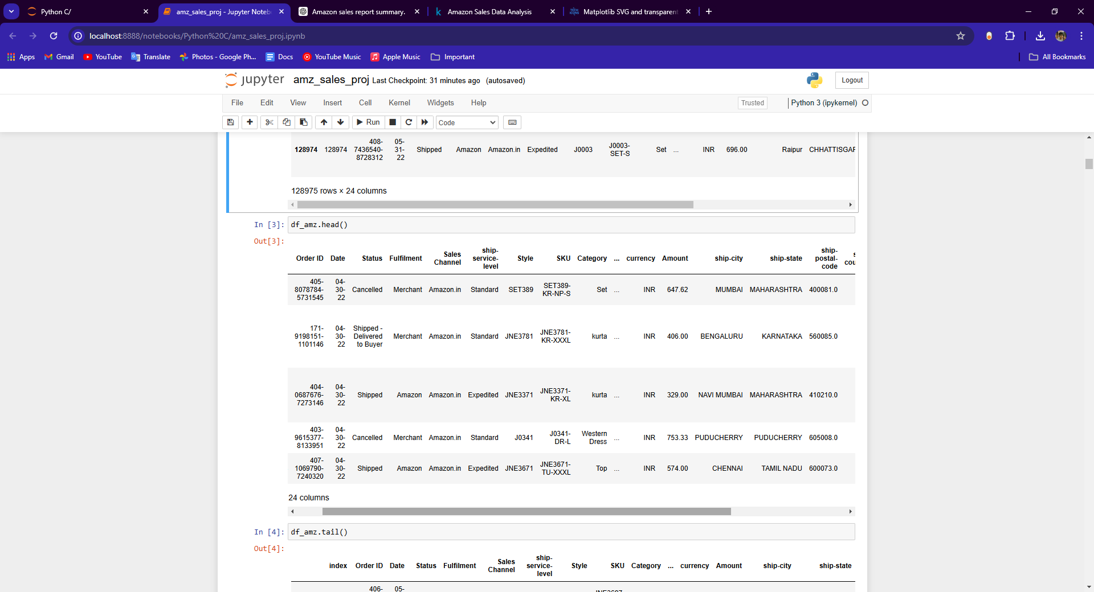

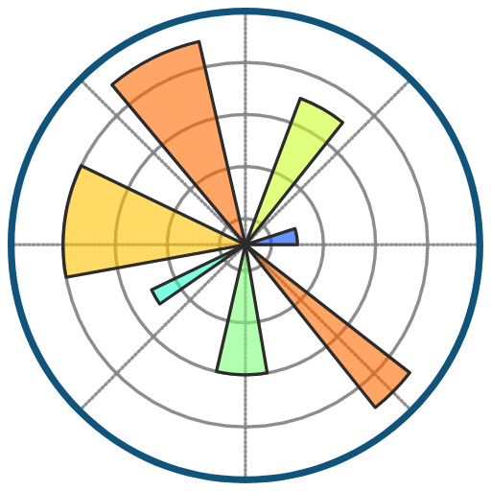
Importing Dataset and Libraries
NumPy
Pandas
EFF BEZOS
SeaBorn
MatPlotLib
Founder

Slide 5
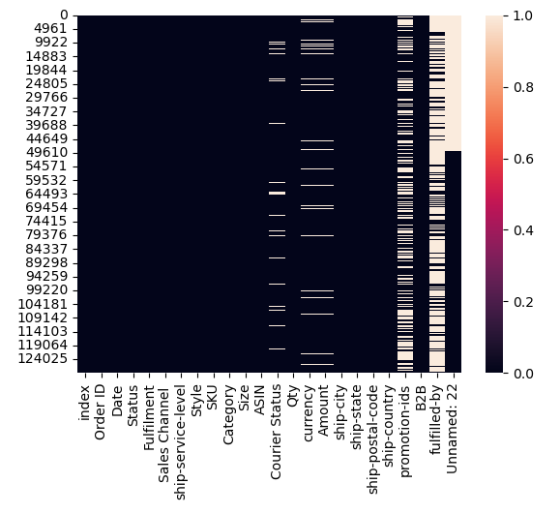
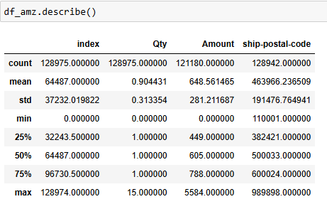
Describing the dataset and creating heatmap
The heatmap reveals strong positive correlations between order amount and order quantity, indicating higher quantities lead to higher sales. Identifying these relationships helps target strategies to maximize revenue and optimize operations.
The describe() function in pandas provides a summary of the central tendency, dispersion, and shape of the dataset’s distribution. Here are some key insights from the “df_amz.describe()”

Slide 6

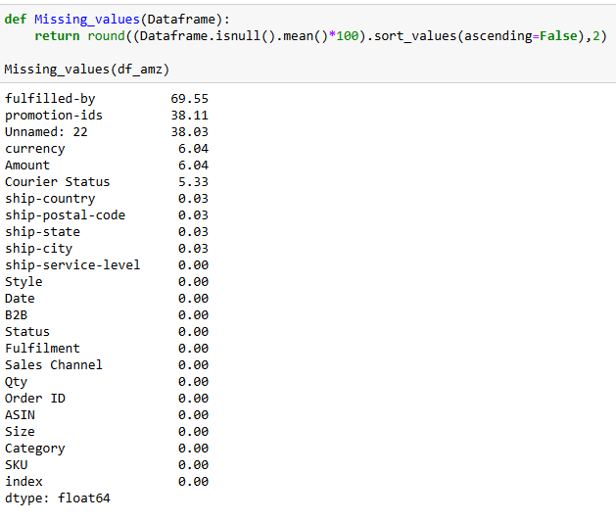

Data Preprocessing
Dropping the columns with more than 50% null values.

Slide 7
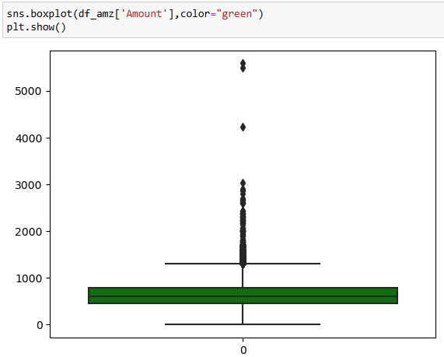
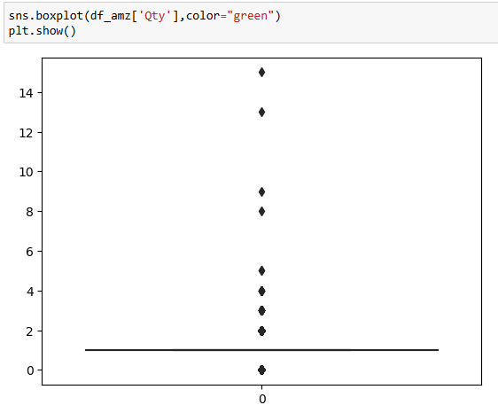
Data Preprocessing
Creating box plots to find the outliers in the columns.
Box plot is created in order to fill the right values in place of null.
Dropping the Unwanted columns

Slide 8
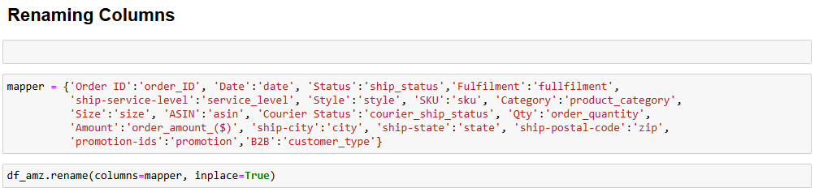
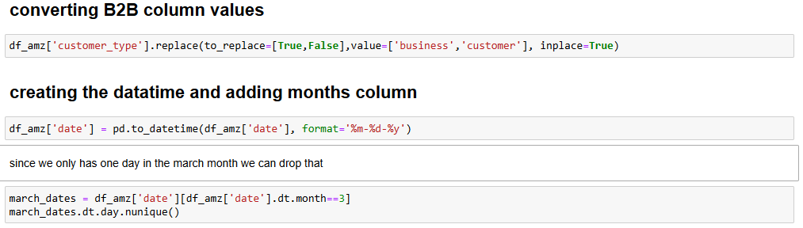
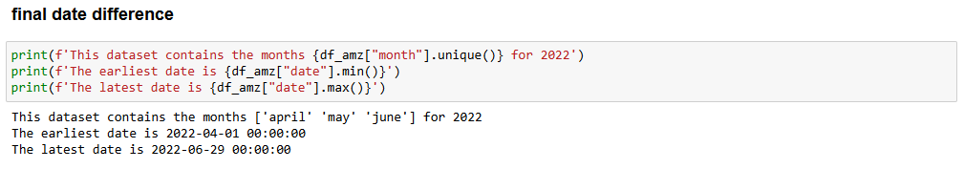
Data Transformation

Slide 9
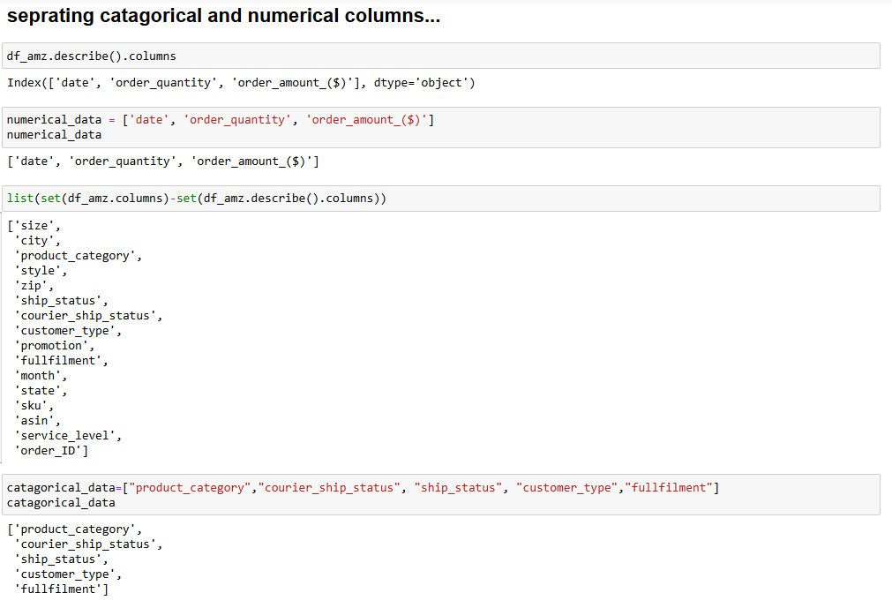
Data Transformation

Slide 10
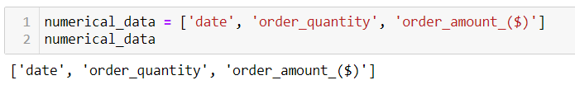
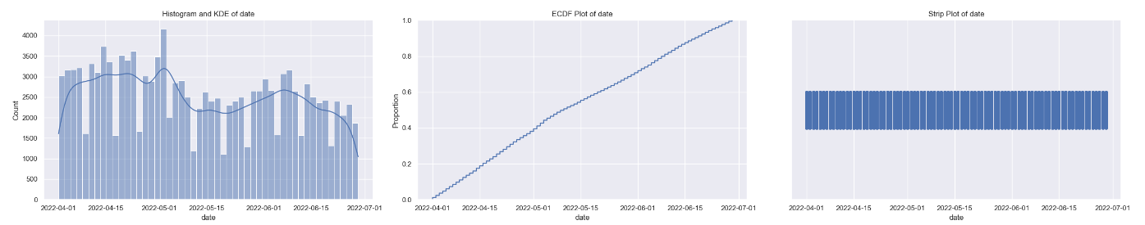
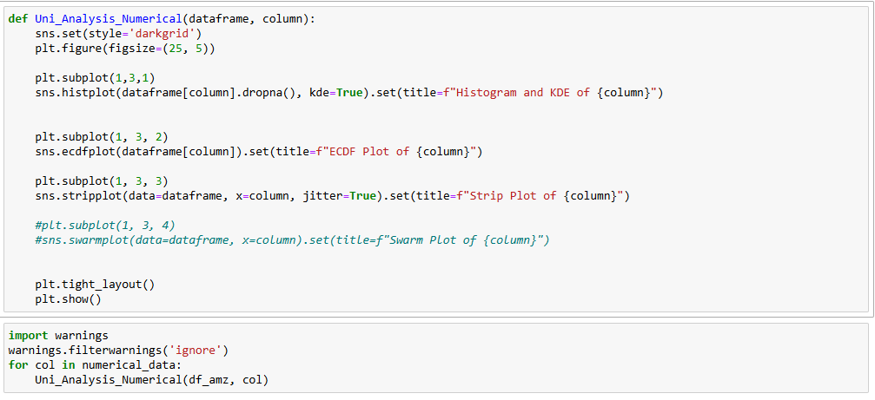
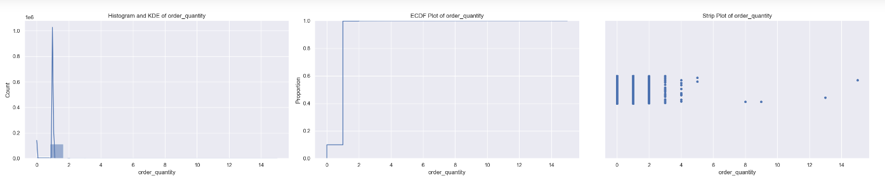
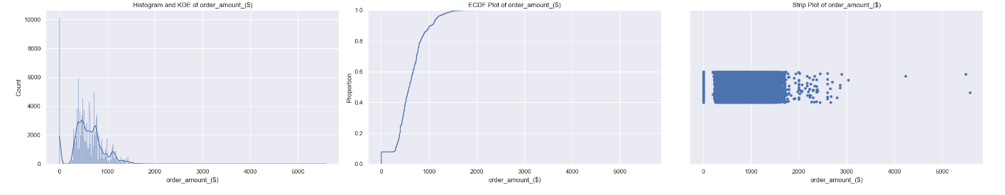
Exploratory Data Analysis (EDA)
Performing Univeriate Analysis
Univeriate analysis on Numerical Columns

Slide 11
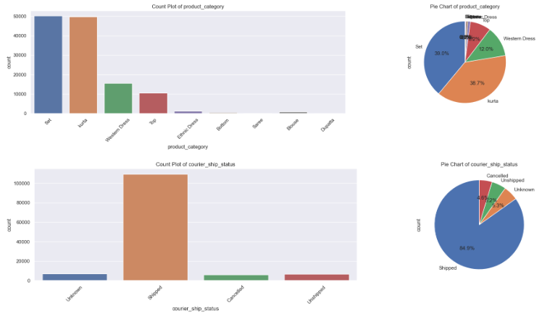
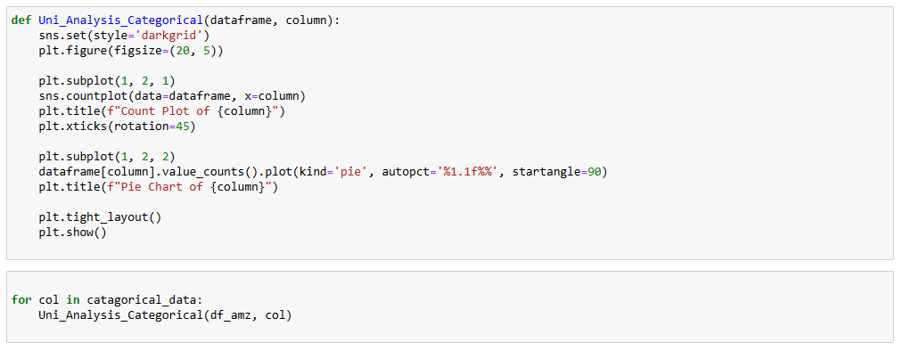
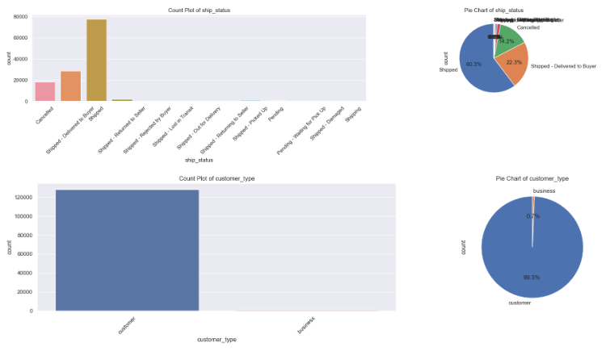
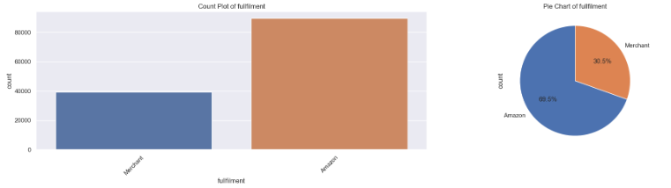
Exploratory Data Analysis (EDA)
Performing Univeriate Analysis
Univeriate analysis on Catagorical Columns

Slide 12
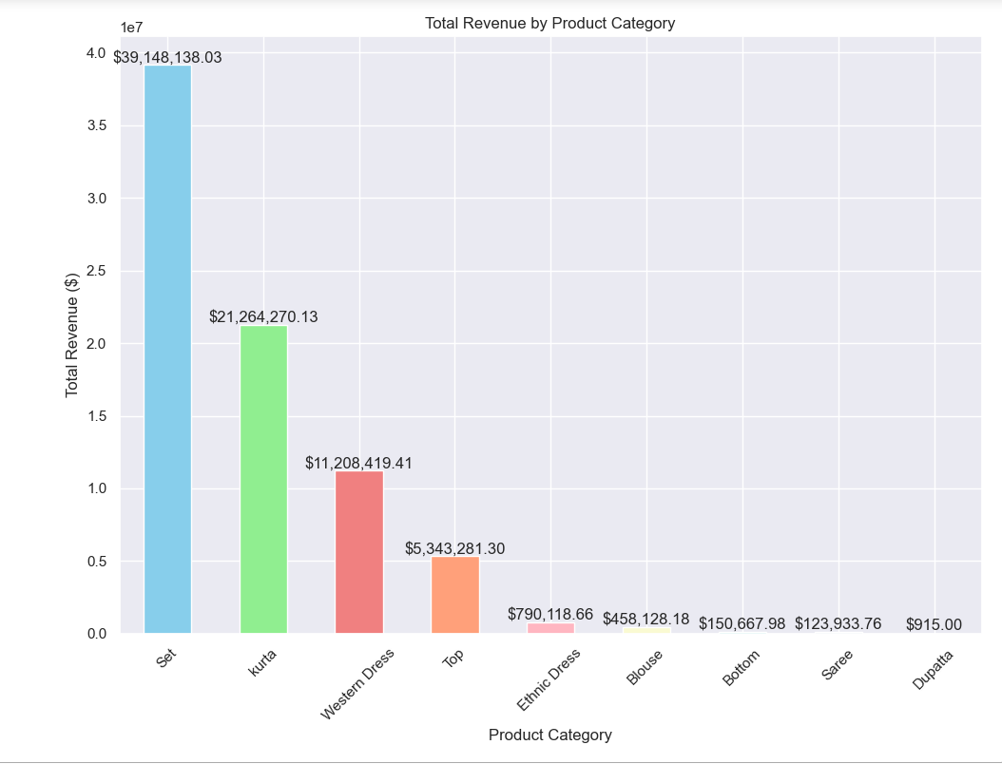
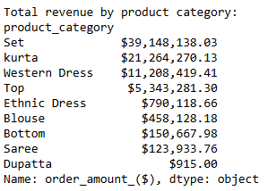
Data Visualisation
What are the top-performing and underperforming product categories in terms of revenue contribution?
Revenue by Product Category:
Insight: Certain product categories generate higher sales revenue.
Recommendation:
Focus on High-Revenue Categories: Allocate more resources to the top-performing categories to maximize revenue.
Cross-Selling Opportunities: Promote complementary products within high-revenue categories to boost overall sales.
Inventory Management: Ensure sufficient stock levels for high-demand products to prevent stockouts and lost sales opportunities.

Slide 13
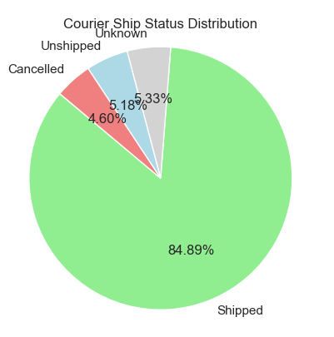

Data Visualisation
What is the distribution of orders based on their courier ship status, and how significant are the proportions of unshipped, unknown, and cancelled orders compared to shipped orders?
Cancelled and Returned Orders:
Insight: A significant percentage of orders are cancelled or returned, affecting overall sales performance.
Recommendation:
Quality Assurance: Implement stricter quality control measures to reduce product defects and improve customer satisfaction.
Improved Product Descriptions: Enhance product descriptions and images to accurately represent products and reduce cancellations due to misrepresentation.
Customer Service Enhancement: Strengthen customer service support to address issues promptly and minimize returns.

Slide 14
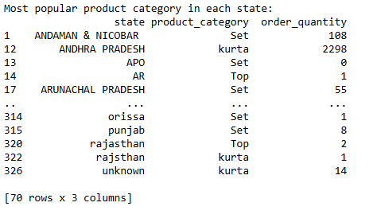
Data Visualisation
What are the most popular product catagories by each states and what are theirs order quantity?
Popular Product Categories by State:
Insight: Different states have varying popular product categories.
Recommendation:
Localized Marketing: Develop localized marketing strategies to promote the most popular products in each state.
State-Specific Promotions: Create state-specific promotions and discounts to cater to local preferences and boost sales.
Regional Inventory Management: Adjust inventory levels based on regional demand to ensure availability of popular products.

Slide 15
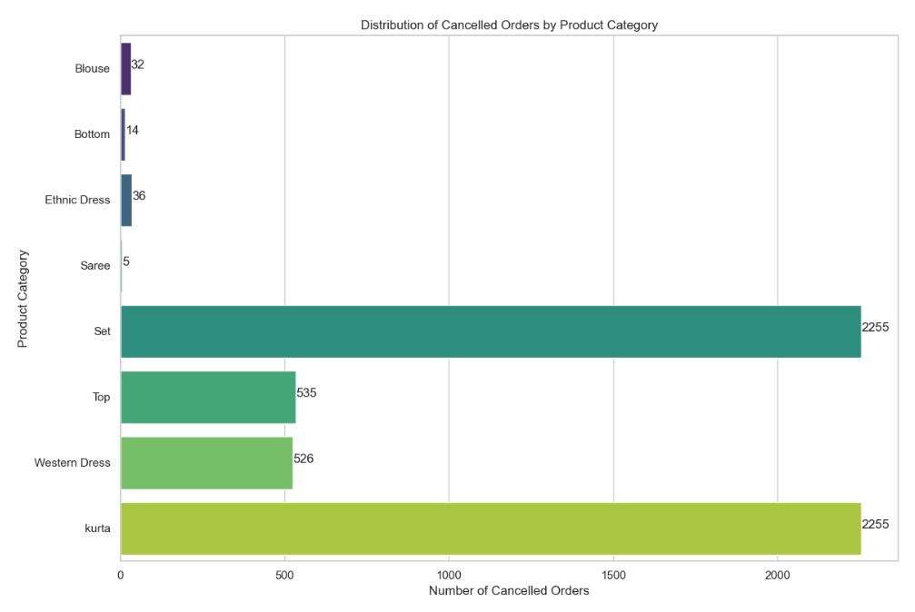
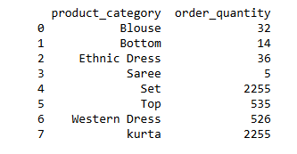
Data Visualisation
Which product categories have the highest rates of cancelled orders, and what could be the underlying reasons for these cancellations?
Product Categories with High Cancellation Rates:
Insight: Certain product categories have higher cancellation rates.
Recommendation:
Root Cause Analysis: Conduct a thorough analysis to identify the reasons behind high cancellation rates in specific categories.
Customer Feedback: Collect and analyze customer feedback to understand pain points and address them effectively.
Enhanced Communication: Improve communication with customers regarding product availability and delivery times to set realistic expectations.

Slide 16
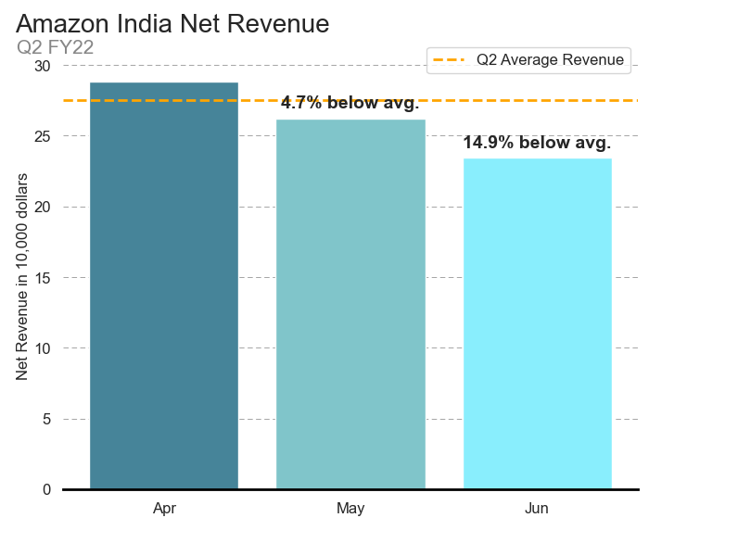
Data Visualisation
How has Amazon India's net revenue in a specific quarter of the year performed?
Declining Monthly Revenue:
Insight: Total revenue decreased from April to June 2022.
Recommendation:
Promotional Campaigns:
Implement targeted promotional campaigns or discounts to boost sales during declining months.
Customer Engagement:
Increase customer engagement through personalized marketing efforts such as email newsletters and social media promotions.
Product Diversification:
Introduce new products or enhance existing ones to attract customers and increase sales.

Slide 17
Result of analysis
Based on the analysis, we can draw some preliminary insights about the Q2 2022 performance of Amazon India:
The total revenue for Q2 2022 decreased by -18.77% from April to June, with May revenue experiencing a -9.06% decrease from April, and June revenue seeing a -10.68% decrease from May, which is a cause of concern.
The revenue is dominated by the product category "Set," which accounts for 49.88% of total revenue, followed by kurta with 27.09% and Western Dress with 14.28%.
The top 5 product categories by average price in dollars are Set ($9.43), Saree (\$9.14), Western Dress ($8.75), Ethnic Dress (\$8.26), and Top ($6.09), indicating that these products are high-value orders.
The total number of cancelled and returned orders was 49,178, which represents 17.53% of all orders. Of these, 14.22% were cancelled and 1.64% were returned.
The average order amount by customer type is $8.21 for business customers and \$7.37 for regular customers.
The most popular product category varies by state, and it may be worthwhile to analyze the reasons behind these trends and invest in marketing campaigns or promotions accordingly.

Slide 18
Analysis summary and recommendation
Use promotions to drive interest in the Western Dress product by targeting the top 50% of states ranked by sales revenue since their revenue is between 10 and 100 times more than the top ranked states by revenue in the lower 50%.
Work with the client to implement the following promotions:
Promotion to drive interest in the Western Dress category
Monitor the Impact of the Strategies
Track sales revenue for Western Dress category after the promotions are implemented
Analyze the Effectiveness of the Strategies
Conduct an analysis after the promotions have been running for some time.

Slide 19
thanks!

