Slide 1

EMPOWER CARE · API SECURITY
Encrypted APIs, no logic change.
Per-vendor payload encryption for 50+ Lambda APIs and 36 vendors
September 2026
www.lumiq.ai

Slide 2
One decorator encrypts every API end to end, per vendor, with no change to business logic
SITUATION
50+ Lambda APIs serve 36 vendors with plain JSON bodies. TLS ends at the gateway, so payloads are visible in logs and intermediaries.
RECOMMENDATION
Add @secure_api() to each handler. It decrypts the vendor's request_key on entry and returns response_key + response_value on exit, with one AES-256 key per vendor.
ASK
Approve the per-vendor secrets (~USD 14/month), the v3.0 deviations, and a pilot: shared stack, 2 vendors, 2 APIs.
Source: payload-crypto, reference API hello-udit-test (ap-south-1)
LUMIQ
02 / 12

Slide 3
Adoption is small per API, and the platform is already proven live
2 lines
36
36 / 36
~USD 16
code change per handler:
import + decorator
vendors, each with its own
AES-256 key
unit tests passing; live checks
on the reference API
a month per account for keys,
plus ~USD 1.25 per million calls
Source: payload-crypto, reference API hello-udit-test (ap-south-1)
LUMIQ
03 / 12

Slide 4
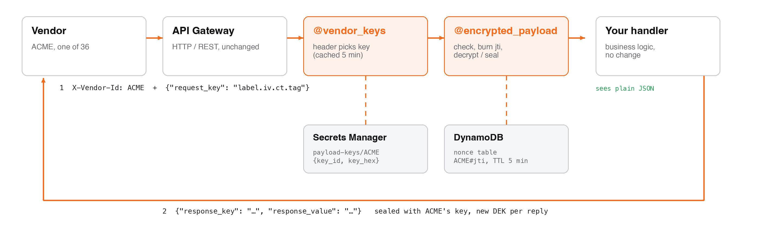
The handler only ever sees plain JSON; encryption happens at the entry and exit
Source: payload-crypto, reference API hello-udit-test (ap-south-1)
LUMIQ
04 / 12

Slide 5
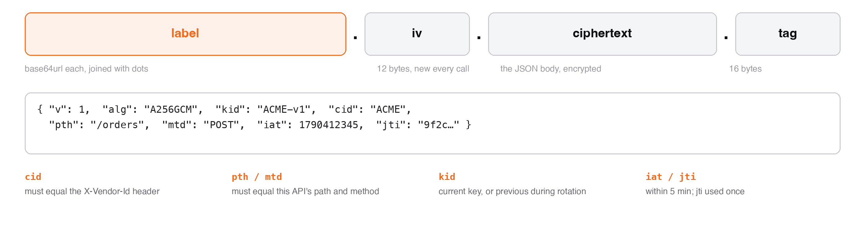
Vendors send one field, sealed with their key and bound to vendor, path, method and time
Source: payload-crypto, reference API hello-udit-test (ap-south-1)
LUMIQ
05 / 12

Slide 6
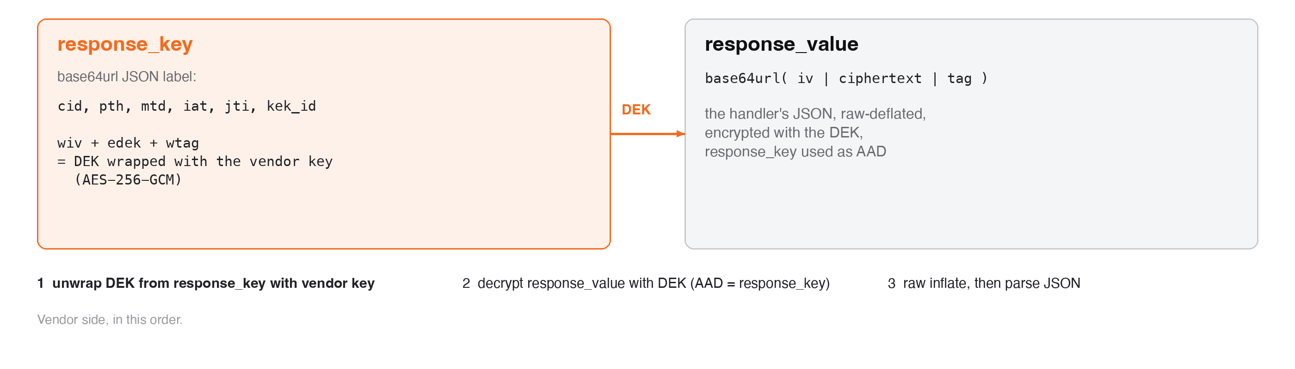
Every reply uses a new one-time key, so the vendor key never encrypts data directly
Source: payload-crypto, reference API hello-udit-test (ap-south-1)
LUMIQ
06 / 12

Slide 7
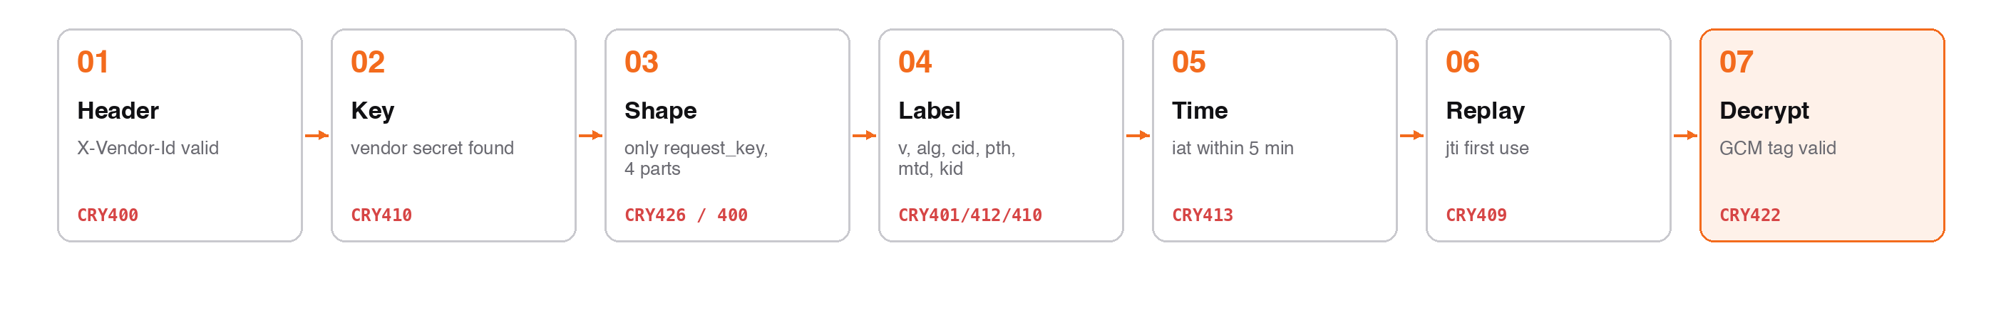
Every request passes seven checks, cheapest first, and is decrypted last
Source: payload-crypto, reference API hello-udit-test (ap-south-1)
LUMIQ
07 / 12

Slide 8
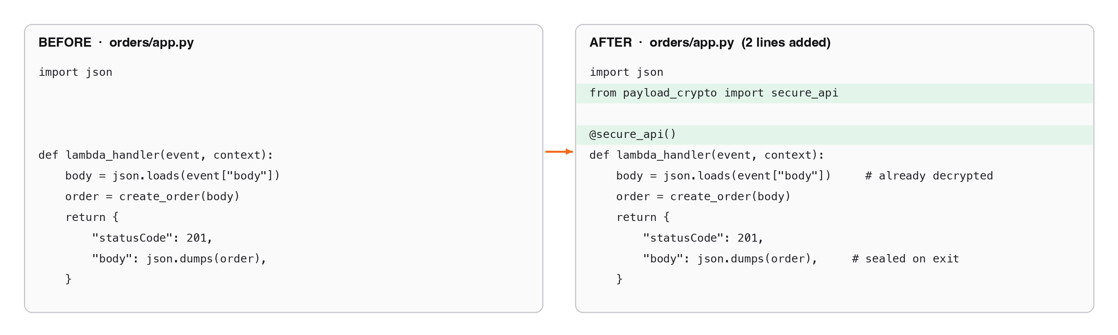
Changing an existing Lambda takes two lines of code and six lines of template
Source: payload-crypto, reference API hello-udit-test (ap-south-1)
LUMIQ
08 / 12

Slide 9
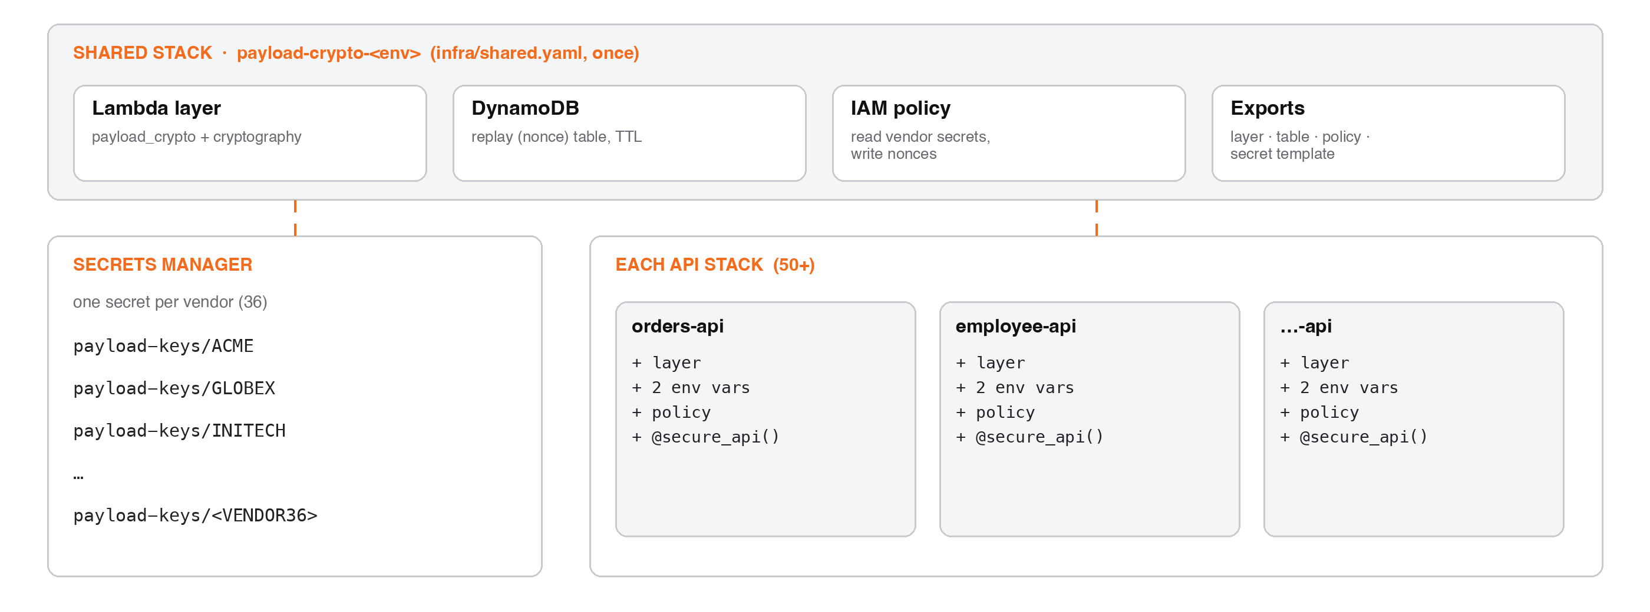
One shared stack per account serves all 50+ APIs and 36 vendor keys
Source: payload-crypto, reference API hello-udit-test (ap-south-1)
LUMIQ
09 / 12

Slide 10
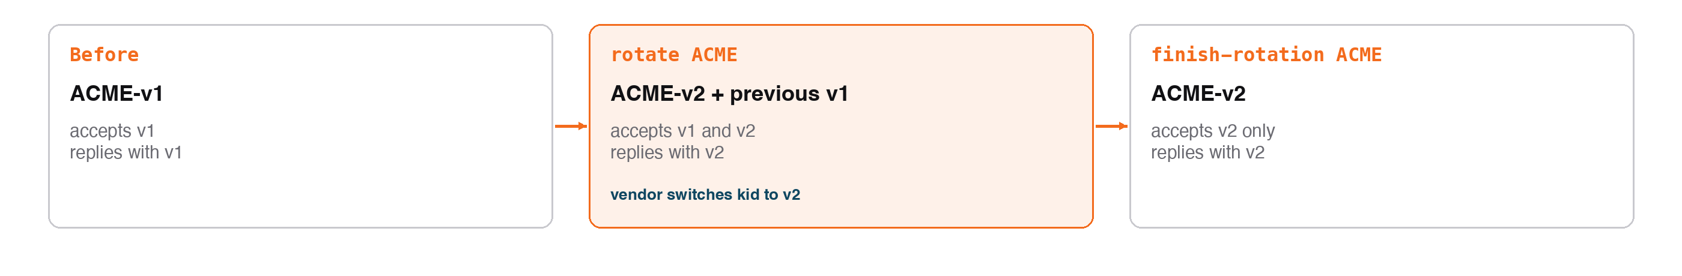
Keys rotate per vendor with no downtime, because both keys work during the switch
Source: payload-crypto, reference API hello-udit-test (ap-south-1)
LUMIQ
10 / 12

Slide 11
Roll out in waves, onboarding each API's vendors before switching it on
NOW · PILOT
NEXT · WAVES
LATER · PRODUCTION
• Deploy shared stack in dev
• Create 2 vendor keys
• Wrap 1–2 low-risk APIs
• Vendors pass test vectors
• 10 APIs per wave
• Onboard those APIs' vendors
• Alarm on CRY422 / CRY413
• Decide plaintext allow-list
• Shared stack in prod
• Same wave order
• Change approval per wave
• Fold deviations into v3.1
Source: payload-crypto, reference API hello-udit-test (ap-south-1)
LUMIQ
11 / 12

Slide 12
Thank you.
Next step: approve the pilot and the two open decisions.
sales@lumiq.ai
Confidential · LUMIQ
www.lumiq.ai

