Slide 1
Laptop Price Prediction for SmartTech Co.
Capstone Project – Machine Learning Model
Presented by: Ritik Kaithwar

Slide 2
Project Overview
Predict Laptop Prices using Machine Learning.
Analyze Feature impact like CPU, RAM etc.
Support strategic market positioning for SmartTech Co.

Slide 3
Tools Used
Category | Tools / Libraries
Languages | Pandas, NumPy.
EDA | Matplotlib, Seaborn.
PreProcessing | Scikit-learn (StandardScaler, SelectKBest etc.)
Modeling | Scikit-learn (Linear Regression, Random Forest etc.)
Evaluation | MAE, MSE, RMSE, R² Score, Cross-Validation

Slide 4
Data Understanding
Dataset Size - 1300 rows, 13 columns.
Key Features: Brand, Processor, RAM, Storage, GPU, OS, Weight.
Target Variable - Price
Checked for nulls, duplicates and data types.

Slide 5
Exploratory Data Analysis
Histograms and Count plots for understanding distributions.
Boxplots to detect outliers.
Correlation heat map shows strong relation of RAM, Weight etc. with Price.

Slide 6
Data Preprocessing
Dropped unnecessary columns.
Standardized feature formats.
Filled the missing Categorical & Numeric values.
Encoded Categorical features.
Handled missing/outlier values.
Parsed CPU, GPU, Memory into structured fields.

Slide 7
Feature Engineering
Normalized weight, RAM, etc.
Extracted numerical features from strings.
One-hot encoded all categorical features.
Extracted CPu_Brand, Cpu_Series, Cpu_SpeedGhz and also with the GPU columns.
Parsed Memory into SSD and HDD components.

Slide 8
Model Development
Trained Models: Linear Regression, Decision Tree, Random Forest, Gradient Boosting.
Used Scikit-learn, pandas, matplotlib.

Slide 9
Model Comparison
Model | R² Score
Linear Regression | 0.74
Decision Tree Regressor | 0.58
Random Forest Regressor | 0.72
Gradient Boosting | 0.78

Slide 10
Final Model: Gradient Boosting Model
Best performance (R² ≈ 78%).
Robust to outliers.
Handles mixed feature types well.

Slide 11
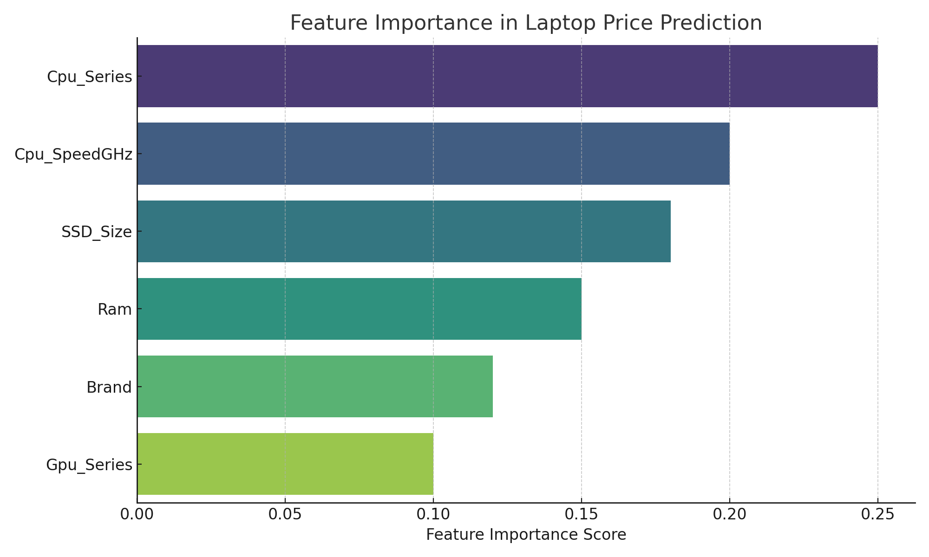
Feature Importance
CPU series and speed.
SSD Size.
RAM
Brand and GPU Series.

Slide 12
Real-Time Prediction Capability
Supports input-based predictions.
Accepts form inputs: Brand, RAM, Storage, etc.
Outputs predicted price.

Slide 13
Key Business Insights
Brand influences pricing :- Apple & Dell priced higher.
SSD over HDD significantly affects price.
GPU type is crucial for high-performance laptops.
High RAM doesn't always imply high price without strong CPU/GPU.

Slide 14
Exploratory Questions Answered
Most impactful features:- CPU series, SSD size, Brand.
Unknown brands:- Model generalizes well with minor drop in accuracy.
High-end vs. budget laptops:- RMSE slightly higher in premium range.
New laptops:- Performs well on extrapolated features via robust engineering.

Slide 15
Limitations & Recommendations
May underperform for new brands.
Needs updates as market evolves.
Future: Add release year, screen refresh rate.

Slide 16
THANKYOU…..!!!!

