Slide 1

My Newsletter
Ritik Agarwal
02996202718

Slide 2

Topics
CERTIFICATE
INTRODUCTION
PROJECT OVERVIEW
FUNCTIONALITY OF NEWSLETTER
FUTURE SCOPE
Lets Begin, Shall we?

Slide 3
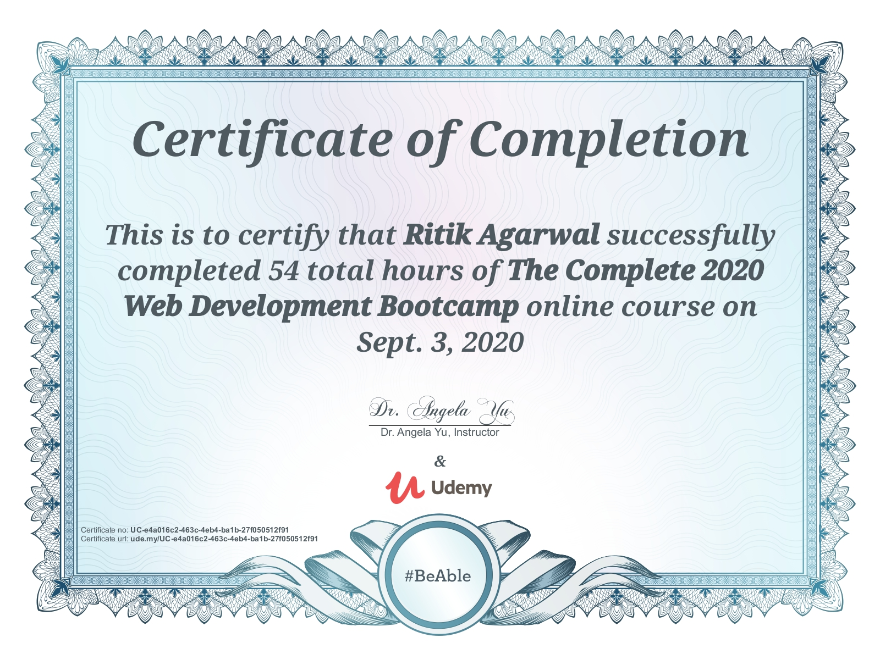
CERTIFICATE
A UDEMY COURSE

Slide 4
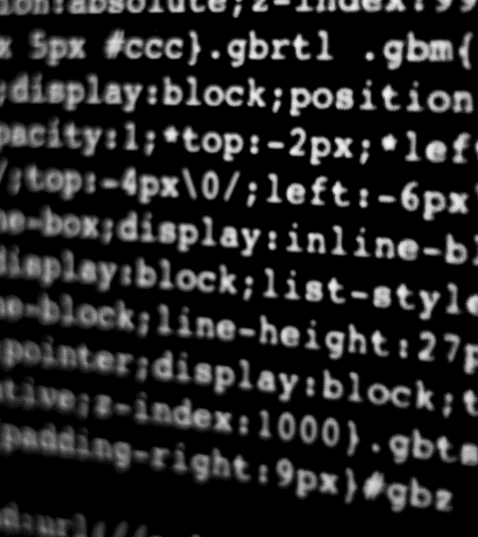
What exactly Newsletter is?
Let’s Dive In

Slide 5

INTRODUCTION
What is Newsletter ?
A newsletter is a printed or electronic report containing news concerning of the activities of a business or an organization that is sent to its members, customers, employees or other subscribers.
Newsletters generally contain one main topic of interest to its recipients. A newsletter may be considered grey literature. E-newsletters are delivered electronically via e-mail and can be viewed as spamming if e-mail marketing is sent unsolicited.

Slide 6

Project overview
What is our motive ?
In this project we are making a sign in for NEWSLETTER .What we are doing is ,we collect the name of the user and his mail id post the data on Mailchimp server using Mailchimp’s API . Store that data on the server and use that mail id to update its members, customers, employees or other subscribers about organization through mails.

Slide 7
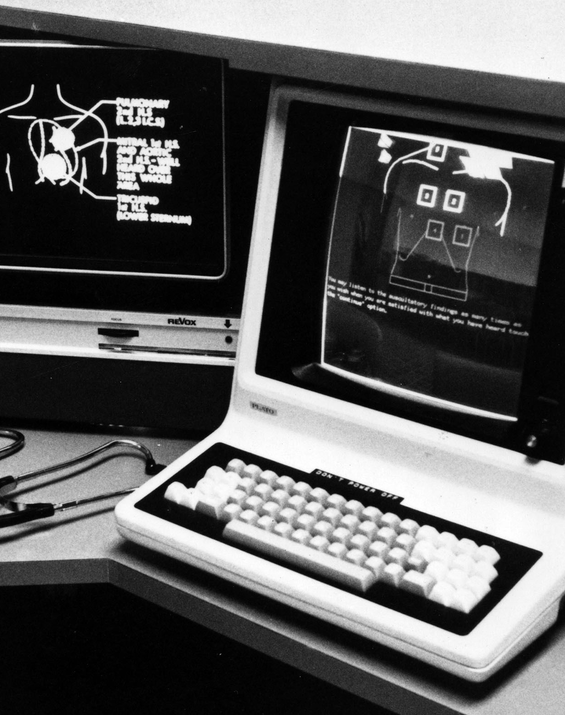
Functionality of newsletter
WHAT IS THE BENEFIT OF USING NEWSLETTER?
Newsletters keep customers and prospects up to date with developments in your company. By selecting the right content, you can keep your audience informed on topics such as new products, special promotional offers and your company’s participation in exhibitions and conferences. We can also use newsletters to inform customers about your financial results and any important executive, sales or customer service appointments.

Slide 8
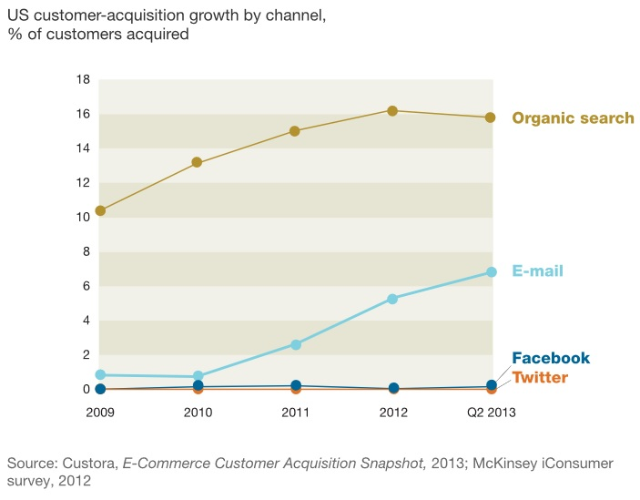
FUTURE SCOPE
WHY WE MAKING A NEWSLETTER IS THERE ANY SCOPE ?
Email is most common thing which almost every person have whether it’s a student or a business man. Newsletter use Email as source to interact with different user to share information among subscriber. As the growth of society increases there are more people who are surfing through the internet and approx. more than 40 times there is a possibility of getting new customer from email marketing than from Facebook or Twitter.

Slide 9



THANK YOU
RITIK AGARWAL
+91 8851351072
ritik.me@gmail.com
Hope to Meet Soon

