Slide 1
Rumour detection from Posts and Comments Reference: PostCom2DR – Utilizing information from post and comments to detect rumours Published by Yanjie Yang, Yuhang Wang, Li Wang, Jie Meng
By Team Strawhats

Slide 2
Introduction
Due to large number of users rumours can be spread widely and easily.
Causing harm to society

Slide 3
Present Techniques and their Drawbacks
Content Based: Using only post content to detect rumor
Disadvantages: Most posts have very less content , causing severe data sparseness and affect performance of above method
User Based: utilize user information on social media to detect rumors
people with high credibility are sometimes disturbed by rumors, which may reduce the detection accuracy of such methods
Propagation Based: Propagation-based methods utilized repost information or comment information on social media to detect rumors
Types: Comments Based, Repost Based
Disadvantage: some users tend to simply forward the original content without expressing any opinion in the early stage of news propagation. This leads to the problem of insufficient available information in repost- based methods
It is very expensive to obtain large repost structures from social media

Slide 4
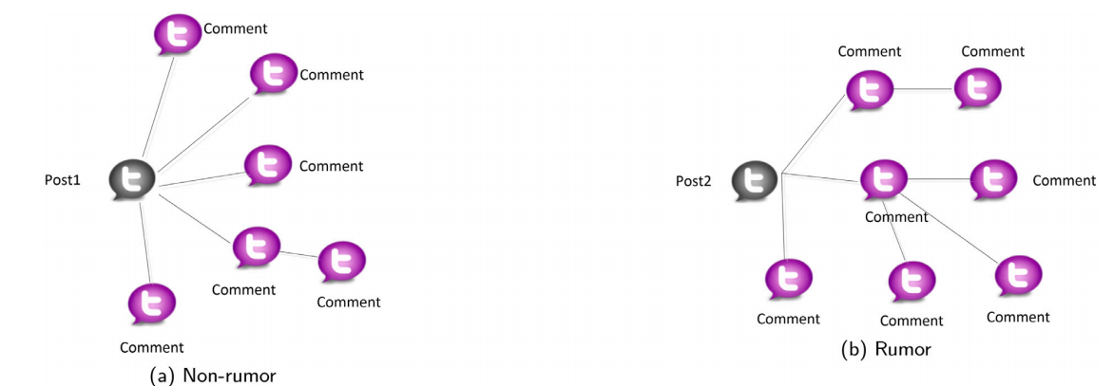
Preliminary –Reply Struct of post and comments
Non rumor comments tends to have first order comments
Rumors have relatively deeper comments. People tend to discuss rumor more intensely and persistently then a non rumor.

Slide 5
Mutual selection between posts and comments
By using repeating themes in the comments we can find the important part of the post
Vies-Versa we can use information from the posts to filter comments and ignore unrelated comments

Slide 6
Topic Drift Within COMMENTS
On rumor posts people tend to shift from the topic more often then in a non rumor post.
To implement this we first we create a graph based on post reply relationship
Then a bilevel GCN and self-attention were built to learn the representation of comments based on reply structure.
Secondly, we introduce a post-comment co-attention mechanism to learn the mutual selection between the post and its comments.
The purpose is to pay attention to the important information of both sides to get global representation. Finally, we introduce CNN to capture the topic drift within the comments and take this output as a local representation. The classification is carried out by combining global representation with local representation.

Slide 7
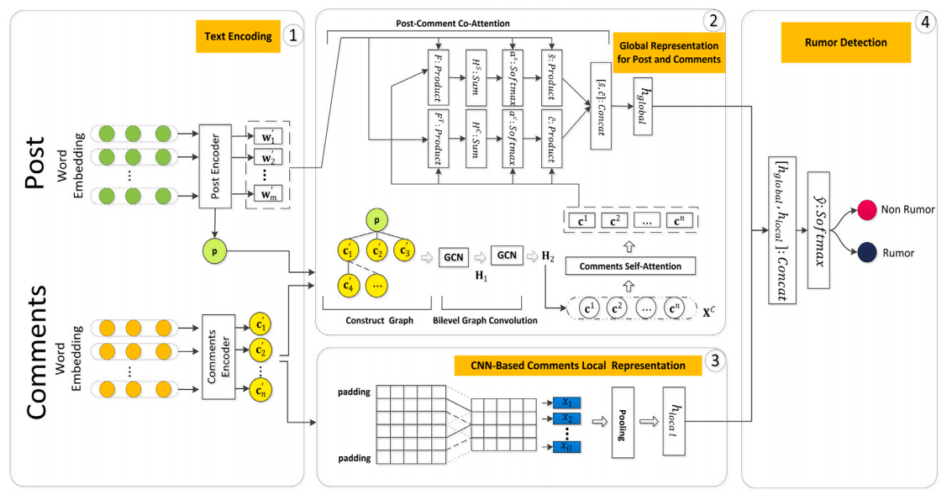
Model overview

Slide 8
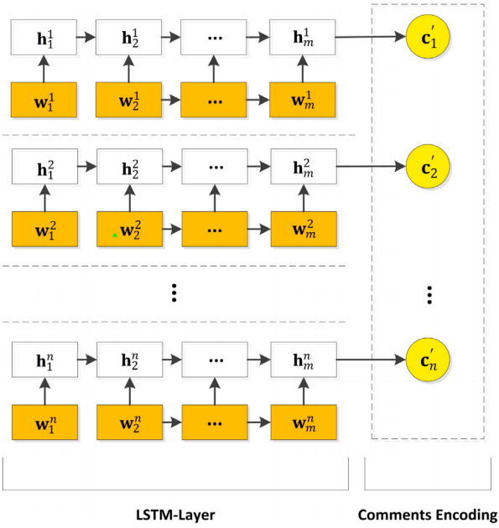
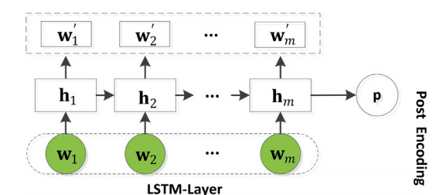
Post and comments encoding

Slide 9
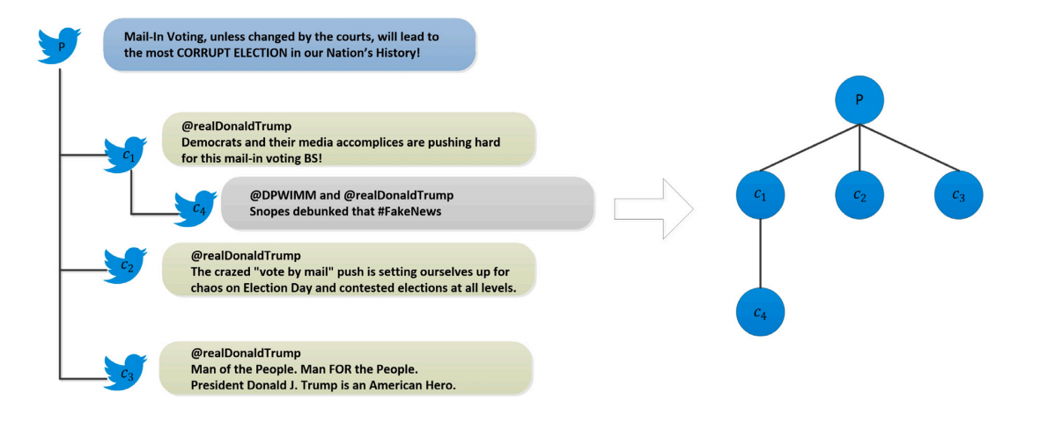
GLOBAL REPRESENTATION FOR POSTS AND COMMENTS
The first step is to construct a reply graph.

Slide 10
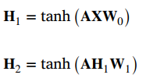
Bilevel GCN
Significance: to capture structural information between posts and comments
A bilevel graph convolution network is built in the second part to
integrate information through the reply graph and obtain enhanced
comments representation.
Where,

Slide 11
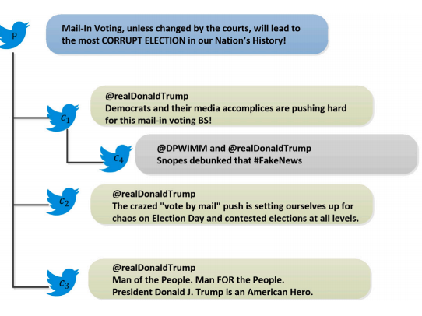
Comments SELF ATTENTION
Although Bilevel-GCN considers the reply structural relationship between the posts and comments, it ignores the influence between comments without direct reply relationship.
For instance, as shown in Fig below , the user may have browsed 𝑐3 before commenting on 𝑐4 to reply to 𝑐1 . 𝑐1 and 𝑐3 are located far-off distance and their relationship would not be well considered only through the Bilevel-GCN. In order to consider this influence, we use the self-attention mechanism

Slide 12

We take the vectors of all comment nodes from 𝐇2 to form a matrix where 𝑛 is the number of comments. The final comment matrix 𝐗𝑐𝑎𝑡𝑡 is calculated as follow
Where,

Slide 13
Post comments co-attention
As introduced in the preliminary part, there is the mutual se-lection between post and comments, which is helpful to detect rumors.
On the one hand, not all the information in the post is helpful. On social media, comments always have a different focus on the post.
The information that attracts most people’s attention and comments is often the important information in the post, so comments can help us to select the important information and eliminate the noise in the post.
For example, some users made comments just because they were interested in some aspects of a word, even some irrelevant advertisements were publicized in comments. We can eliminate these irrelevant comments by post, because they have nothing to do with the post at all.

Slide 14


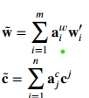
Thus, our goal is to capture this mutual selection to help aggregate information better. As they can help us to get more valuable information in posts and comments.

Slide 15

CNN-based comments local representation
To calculate topic drift we use CNN
Capturing comments in each time period is helpful to get the change of the comment topic and is useful for rumor detection.
Using this we create local representation of posts and comments
We first apply a 1-D convolution on 𝑇 consecutive comment vectors, i.e., < 𝐜′𝑡 ,…,
𝐜′ 𝑡+𝑇 −1>

Slide 16



RUMOR DETECTION
Concatenate Hlocal and Hglobal .Use it to detect rumor or non rumor
Where,

Slide 17

Loss function used
We will use cross entropy to calculate loss

Slide 18
Accuracy
Dataset name | Accuracy | F1 score(Class 1) | F1 score(Class 0)
Twitter 15-16 | 88.429% | 0.8511 | 0.8923
Fake News Net | 81.482% | 0.8787 | 0.6081

Slide 19
Future work
The model failed to select explanatory comments for the results of rumor detection
There is some other valuable information on social media, such as pictures, videos, and other information, which is undoubtedly valuable for rumor detection tasks. However, they have not used these messages in their current work

Slide 20
Thank you

