Slide 1
3 steps Encryption
Mapping
Block shifting
Noise

Slide 2
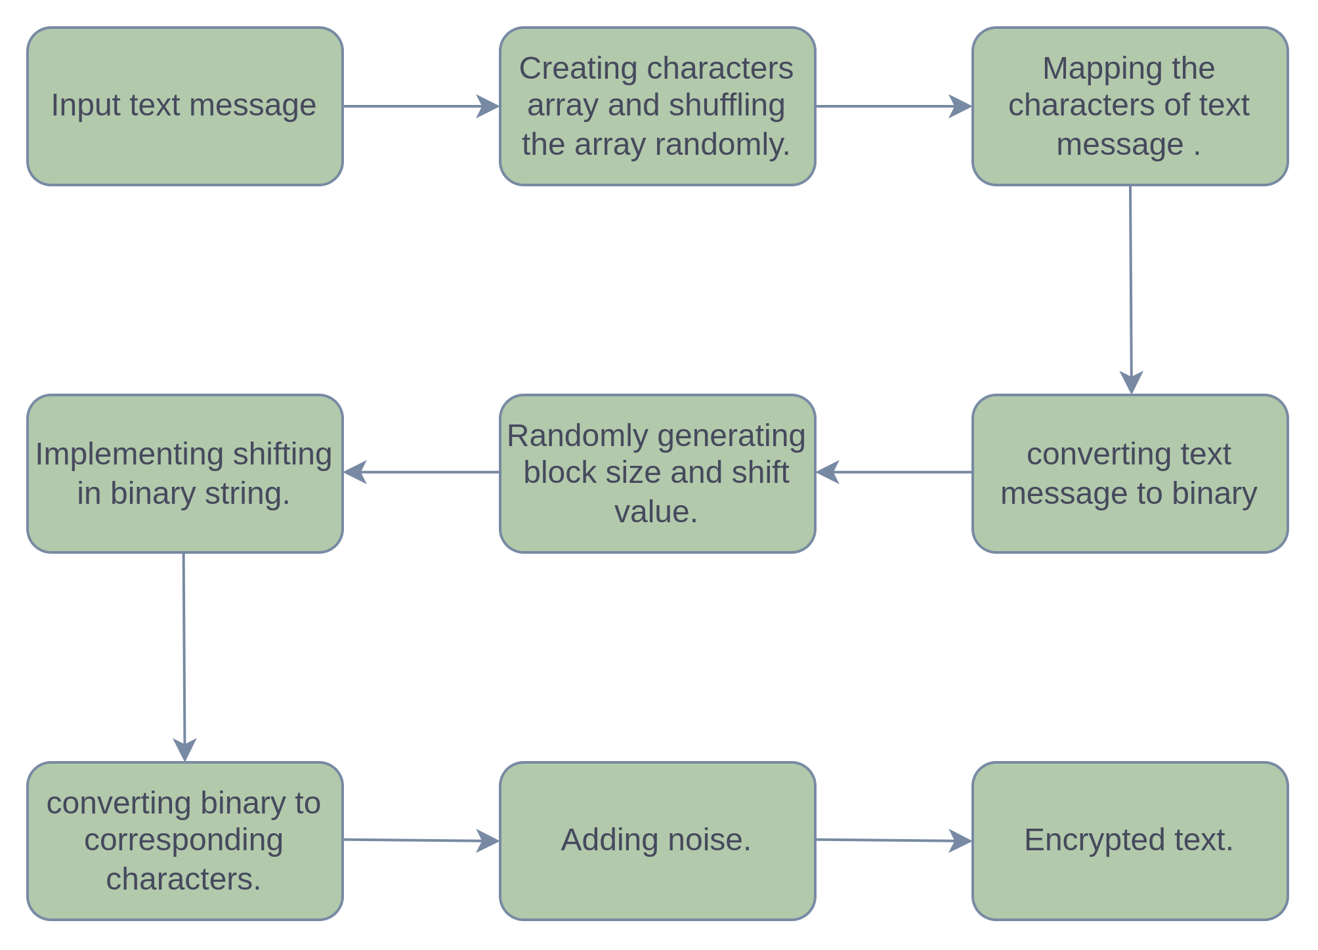
ENCRYPTION

Slide 3
Example :-
ENCRYPTION
Message :-
N I T
Random mapping :-
{2 = 5 ( g ?......& a E / F .....6 R e 1......}
a=97 ?=63 1=49
Ascii in binary :-
(7-bits)
1100001 | 0111111 | 0110001
Blocks :-
1100001011 | 11110110 | 001
10
8
3
Shifted Blocks :-
1000010111 | 10111101 | 100
shifted by-
1 bit
6 Bits
2 Bits
Arranged in 7-Bits :-
1000010 | 1111011 | 1101100
Ascii Values :-
66
123
108
Message after block shifting :-
B { l

Slide 4
NOISE
Random Number Array :
{1,3,4,2,5,1,4,2,5,..........}

Slide 5
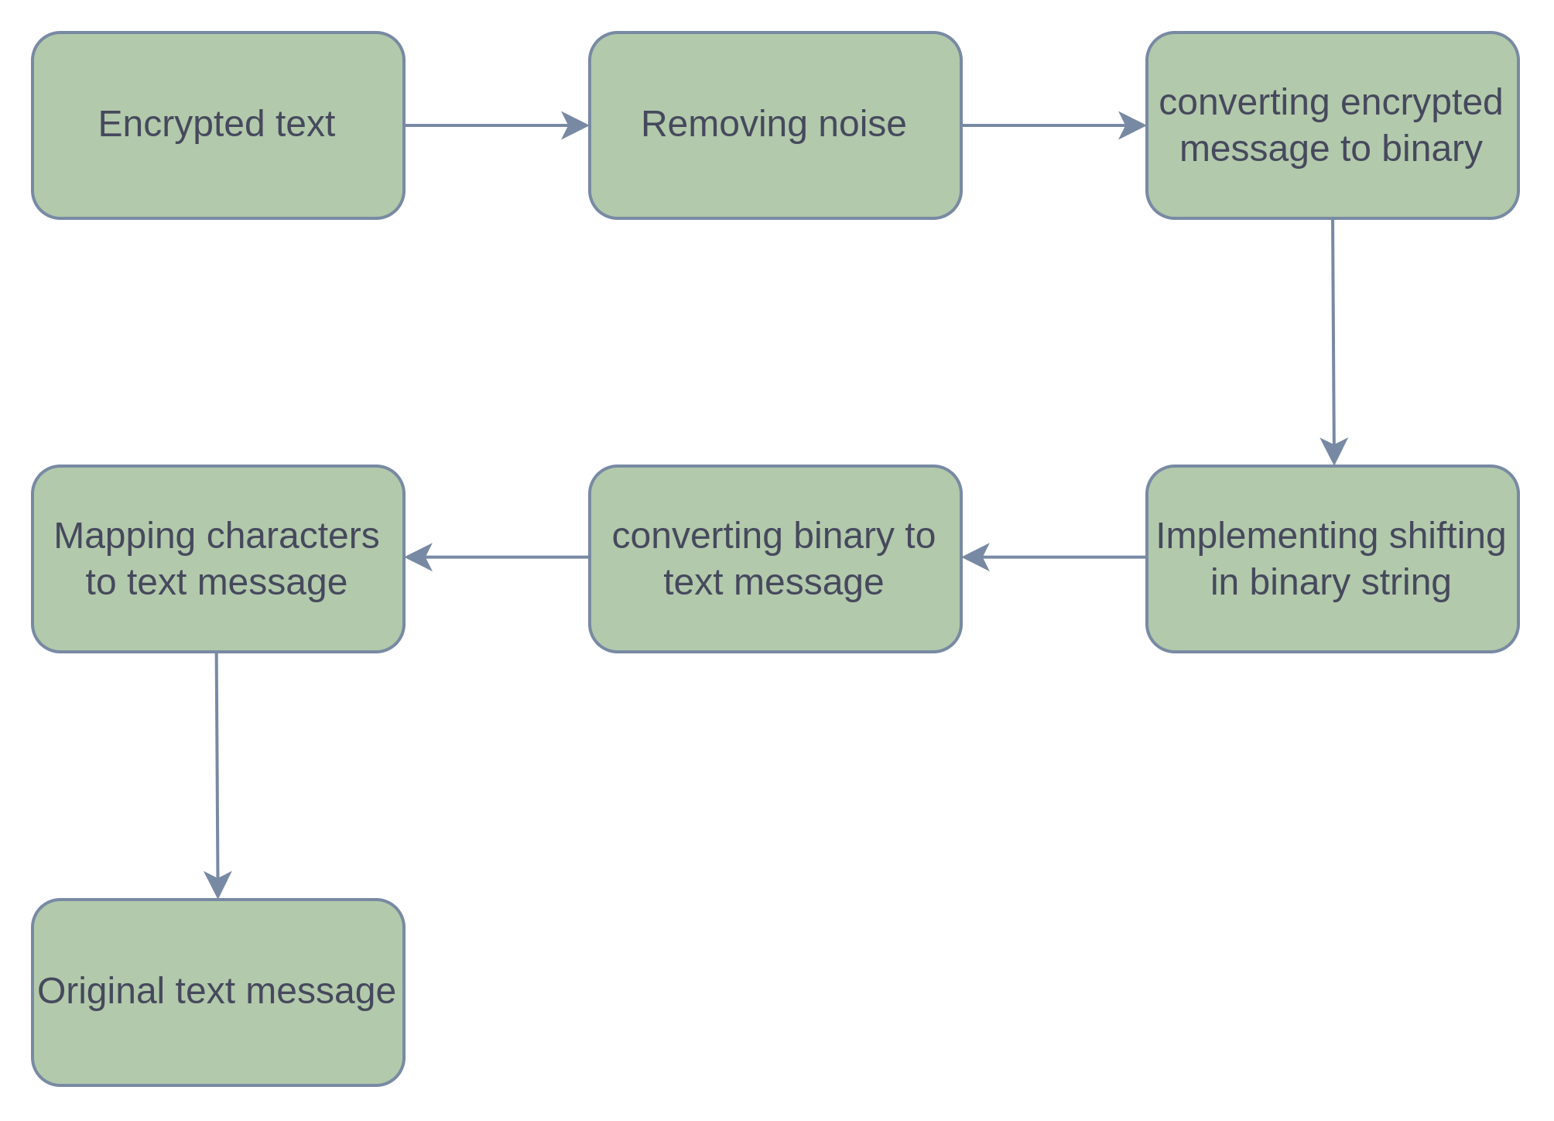
DECRYPTION

