Slide 1
Evaluating Essentials and Accidental Code Complexity Triggers
Insights from Practitioners' Perceptions

Slide 2
I
N
T
R
O
D
U
C
T
I
O
N
I
N
T
R
O
D
U
C
T
I
O
N
I
N
T
R
O
D
U
C
T
I
O
N
I
N
T
R
O
D
U
C
T
I
O
N
I
N
T
R
O
D
U
C
T
I
O
N
M
E
T
H
O
D
O
L
O
G
Y
I
N
T
R
O
D
U
C
T
I
O
N
I
N
T
R
O
D
U
C
T
I
O
N
Agenda and Learnings Expectations :
Introduction to Code Complexity
Types of Code Complexity
Complexity Triggers
Accidental Complexity and its Impacts
How we can Implement as developer !!

Slide 3

I
N
T
R
O
D
U
C
T
I
O
N
M
E
T
H
O
D
O
L
O
G
Y
I
N
T
R
O
D
U
C
T
I
O
N
I
N
T
R
O
D
U
C
T
I
O
N
I
N
T
R
O
D
U
C
T
I
O
N
I
N
T
R
O
D
U
C
T
I
O
N
I
N
T
R
O
D
U
C
T
I
O
N
C
O
M
P
L
E
X
I
T
Y
Code Complexity ?
Complexity is defined as an emergent property of code that expands due to increasing code elements and their interconnections. This is most studied topic of Software Engineering world but still doesn’t have a unit of measurement.
Complexity Types : -
Essential | Accidental
Inherent to programming task | Avoidable complexity due to non-optimal design choices
Complexity Triggers :-
Sr No. | ELEMENTS | TRIGGERS
1. | Logical | operators, variables, branching, looping, nesting, pointer
2. | Representational | naming convention, line-length, indentation, comments
3. | Evolutional | code changes, modification frequency, etc

Slide 4
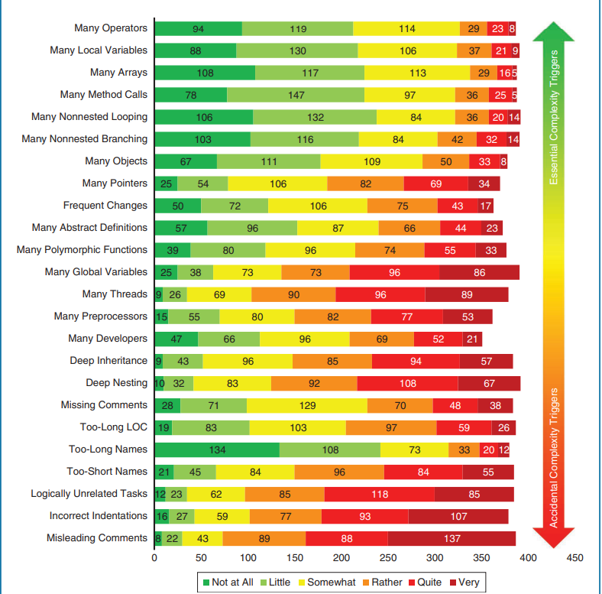
I
N
T
R
O
D
U
C
T
I
O
N
C
O
M
P
L
E
X
I
T
Y
M
E
T
H
O
D
O
L
O
G
Y
T
R
I
G
G
E
R
S
I
N
T
R
O
D
U
C
T
I
O
N
I
N
T
R
O
D
U
C
T
I
O
N
I
N
T
R
O
D
U
C
T
I
O
N
I
N
T
R
O
D
U
C
T
I
O
N
Survey & Methodology :
Survey conducted by 392 developers, from various roles and experience levels.
Use of Likert Scale to evaluate and identify 24 high complexity triggers
Open-source industrial Projects C, C++, Java, JavaScript
Focused mainly on complexity within Methods and Functions.

Slide 5
I
N
T
R
O
D
U
C
T
I
O
N
M
E
T
H
O
D
O
L
O
G
Y
T
R
I
G
G
E
R
S
C
O
D
E
1
I
N
T
R
O
D
U
C
T
I
O
N
I
N
T
R
O
D
U
C
T
I
O
N
C
O
M
P
L
E
X
I
T
Y
I
N
T
R
O
D
U
C
T
I
O
N
Complexity Triggers :
Elements | Complexity Triggers | High Influence (%)
Representational | Misleading Comments | 70.9%
Representational | Incorrect Indentations | 65.1%
Logical | Logically Unrelated Tasks | 62.7%
Representational | Too-Short Names | 60.5%
Representational | Too-Long Names | 55.4%
Representational | Too-Long LOC | 54.8%
Representational | Missing Comments | 53.8%
Logical | Deep Nesting | 52.7%
Logical | Deep Inheritance | 49.7%
Evolutional | Many Developer Changes | 46.7%
Logical | Many Threads | 44.9%
Logical | Many Global Variables | 43.9%
Logical | Many Polymorphic Functions | 41.3%
Logical | Many Abstract Definitions | 38.3%

Slide 6
I
N
T
R
O
D
U
C
T
I
O
N
M
E
T
H
O
D
O
L
O
G
Y
T
R
I
G
G
E
R
S
I
N
T
R
O
D
U
C
T
I
O
N
C
O
D
E
1
I
N
T
R
O
D
U
C
T
I
O
N
Code Based Triggers :
C
O
D
E
2
Logical Element | Trigger | Description | Complexity (%)
Control Structures | Nested structures | Nested loops or conditionals. | 17%
Object-Oriented Constructs | Multithreading | Concurrent execution | 14%
Data Structures and Access | Function/method calls | Functions/method invocations | 12%
Control Structures | Non-nested branching | Basic operations ( if , else , switch ) | 11%
Control Structures | Non-nested looping | loops like ( while, for ) | 10%
Object-Oriented Constructs | Inheritance | Multi-level inheritance chains | 9%
Data Structures and Access | Global variables | Global Scope | 8%
Object-Oriented Constructs | Polymorphism | Context-based behavior variations. | 7%
Data Structures and Access | Operators | Math and logic ops ( +, -, /, * ) | 5%
Data Structures and Access | Objects & Arrays | Class instance & collections | 4%
Data Structures and Access | Local Variables | Variables within function/block scope | 3%

Slide 7
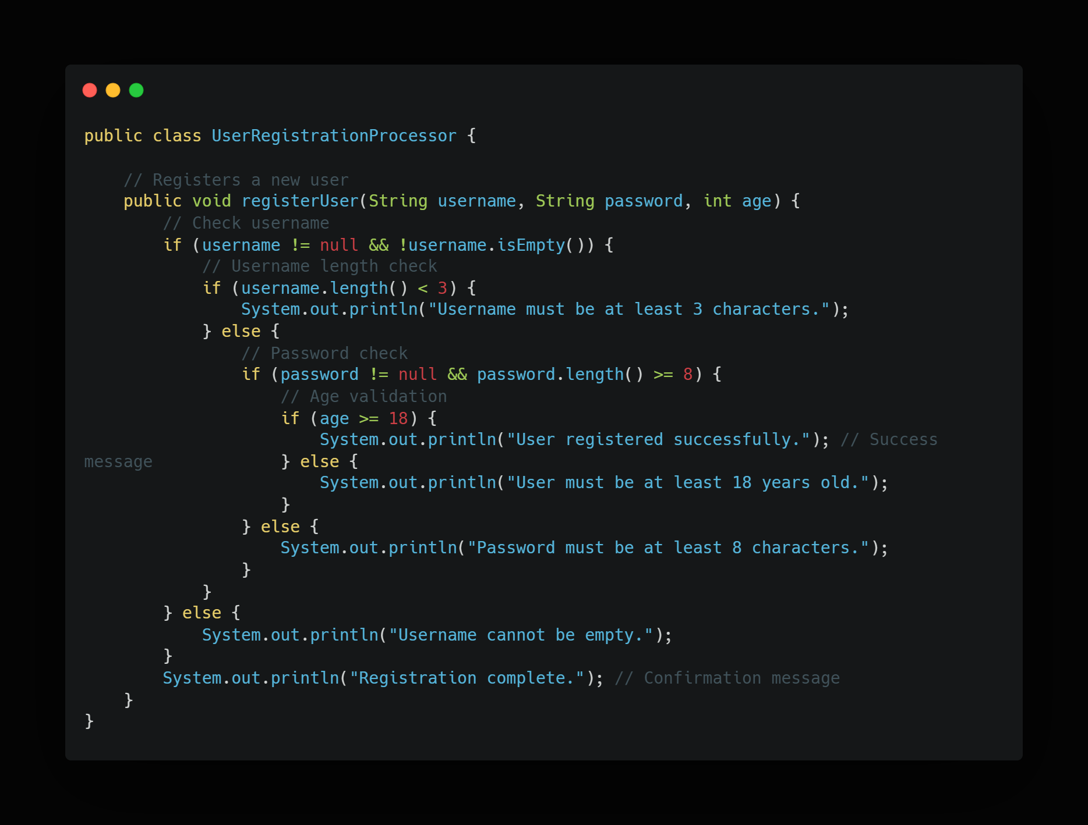
I
N
T
R
O
D
U
C
T
I
O
N
C
O
D
E
1
M
E
T
H
O
D
O
L
O
G
Y
C
O
D
E
2
I
N
T
R
O
D
U
C
T
I
O
N
Code Example :
F
I
N
D
I
N
G
S

Slide 8
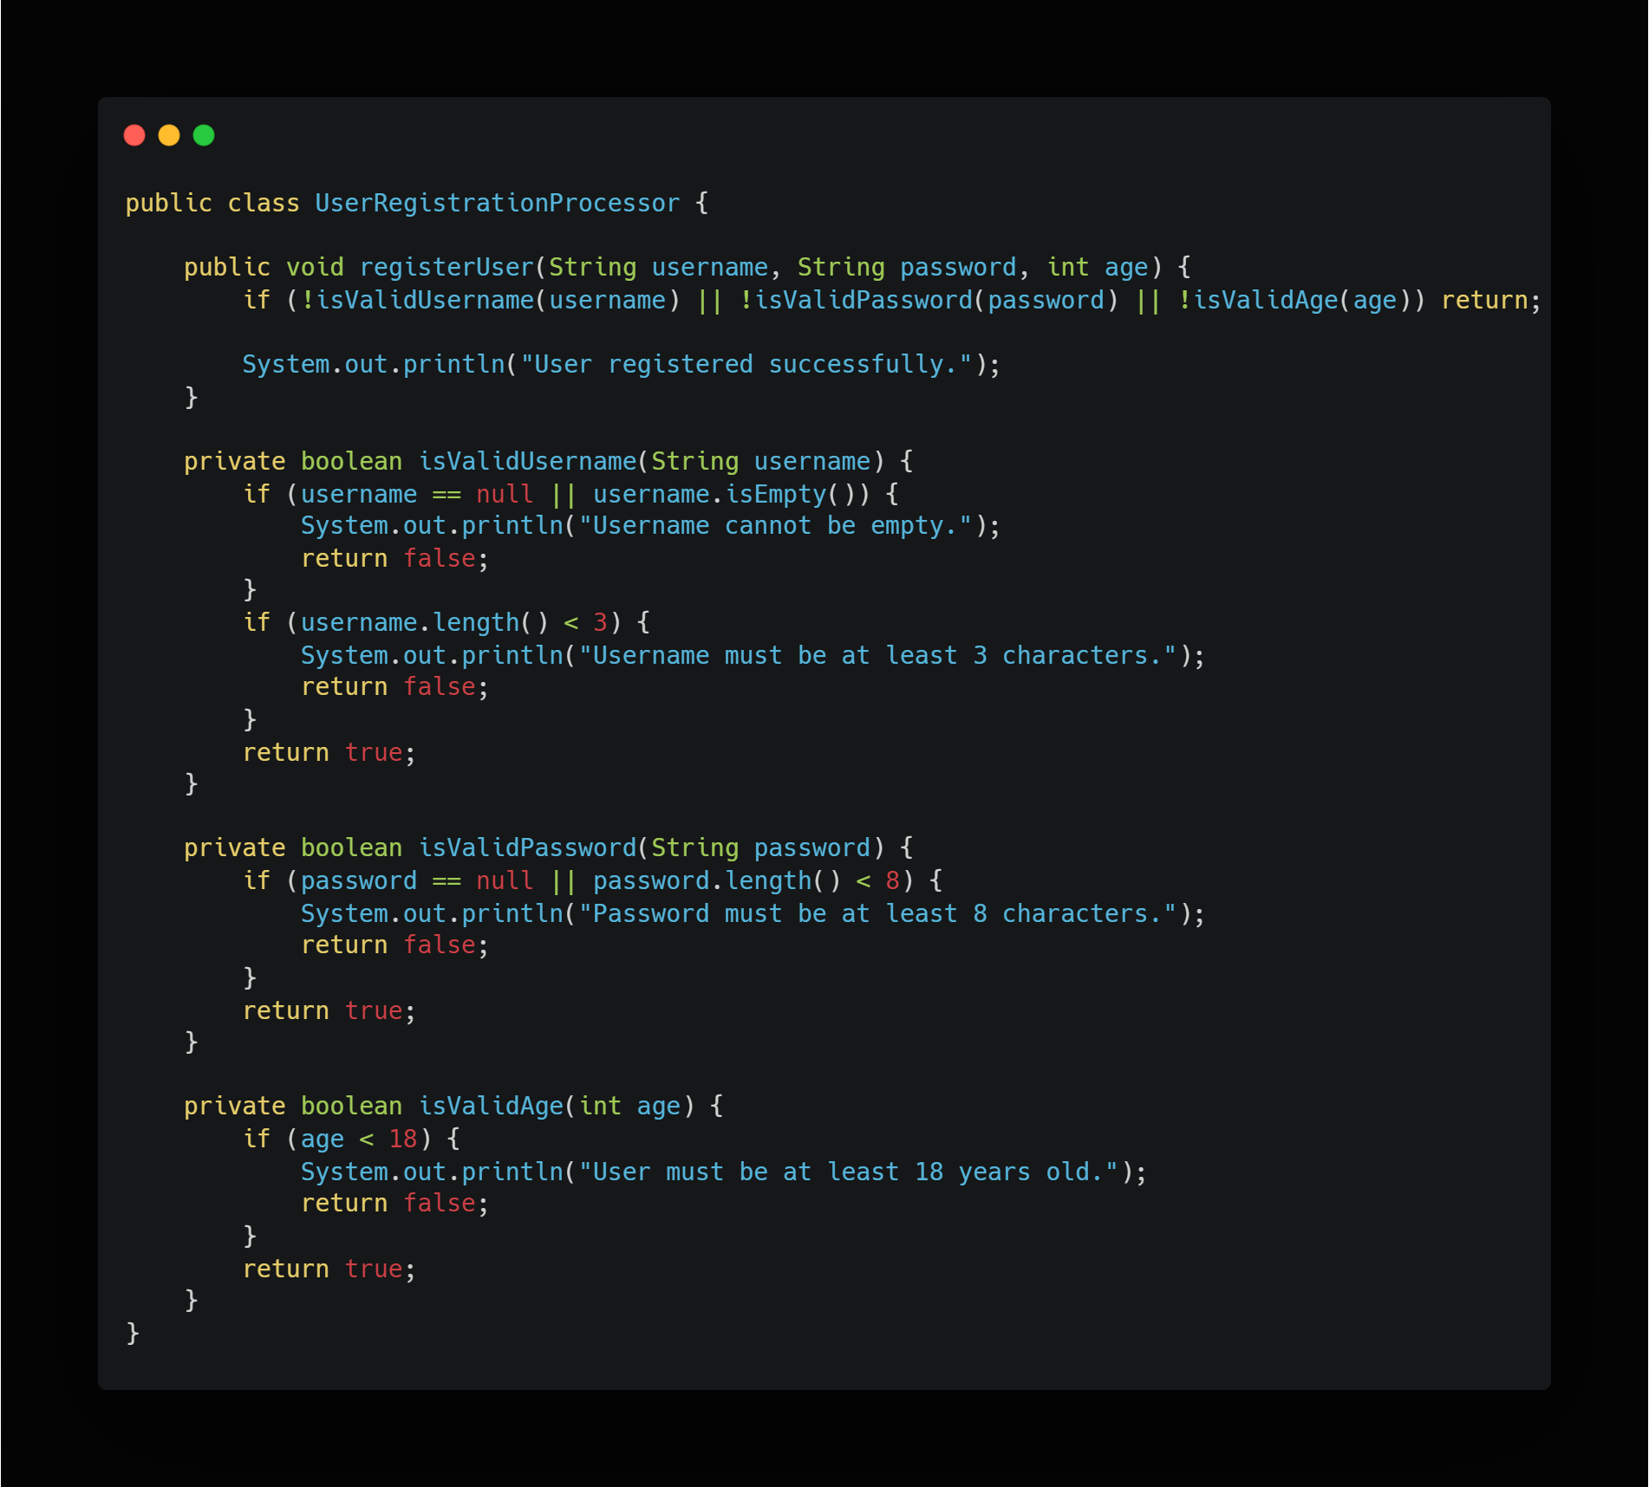
C
O
D
E
2
F
I
N
D
I
N
G
S
I
N
T
R
O
D
U
C
T
I
O
N
C
O
N
C
L
U
S
I
O
N
M
E
T
H
O
D
O
L
O
G
Y
Code Example :

Slide 9
F
I
N
D
I
N
G
S
C
O
N
C
L
U
S
I
O
N
I
N
T
R
O
D
U
C
T
I
O
N
M
E
T
H
O
D
O
L
O
G
Y
Observations and Findings :
Misleading Comments are most influential complexity trigger.
Accidental Complexity have significant impacts (indentation, logical task, etc ).
Elements captured by traditional complexity metrics have less influence than expected.
Practitioners find accidental complexities more challenging than essential ones.

Slide 10
I
N
T
R
O
D
U
C
T
I
O
N
M
E
T
H
O
D
O
L
O
G
Y
C
O
N
C
L
U
S
I
O
N
Conclusion :
Research Paper emphasizes the importance of addressing accidental complexity.
Highlights Limitations of current Complexity Metrics
Need for new metric for incorporating accidental complexity
Recommends best practises for developer for reducing accidental complexity in code.

Slide 11
I
N
T
R
O
D
U
C
T
I
O
N
M
E
T
H
O
D
O
L
O
G
Y
THANK YOU !!

