Slide 1
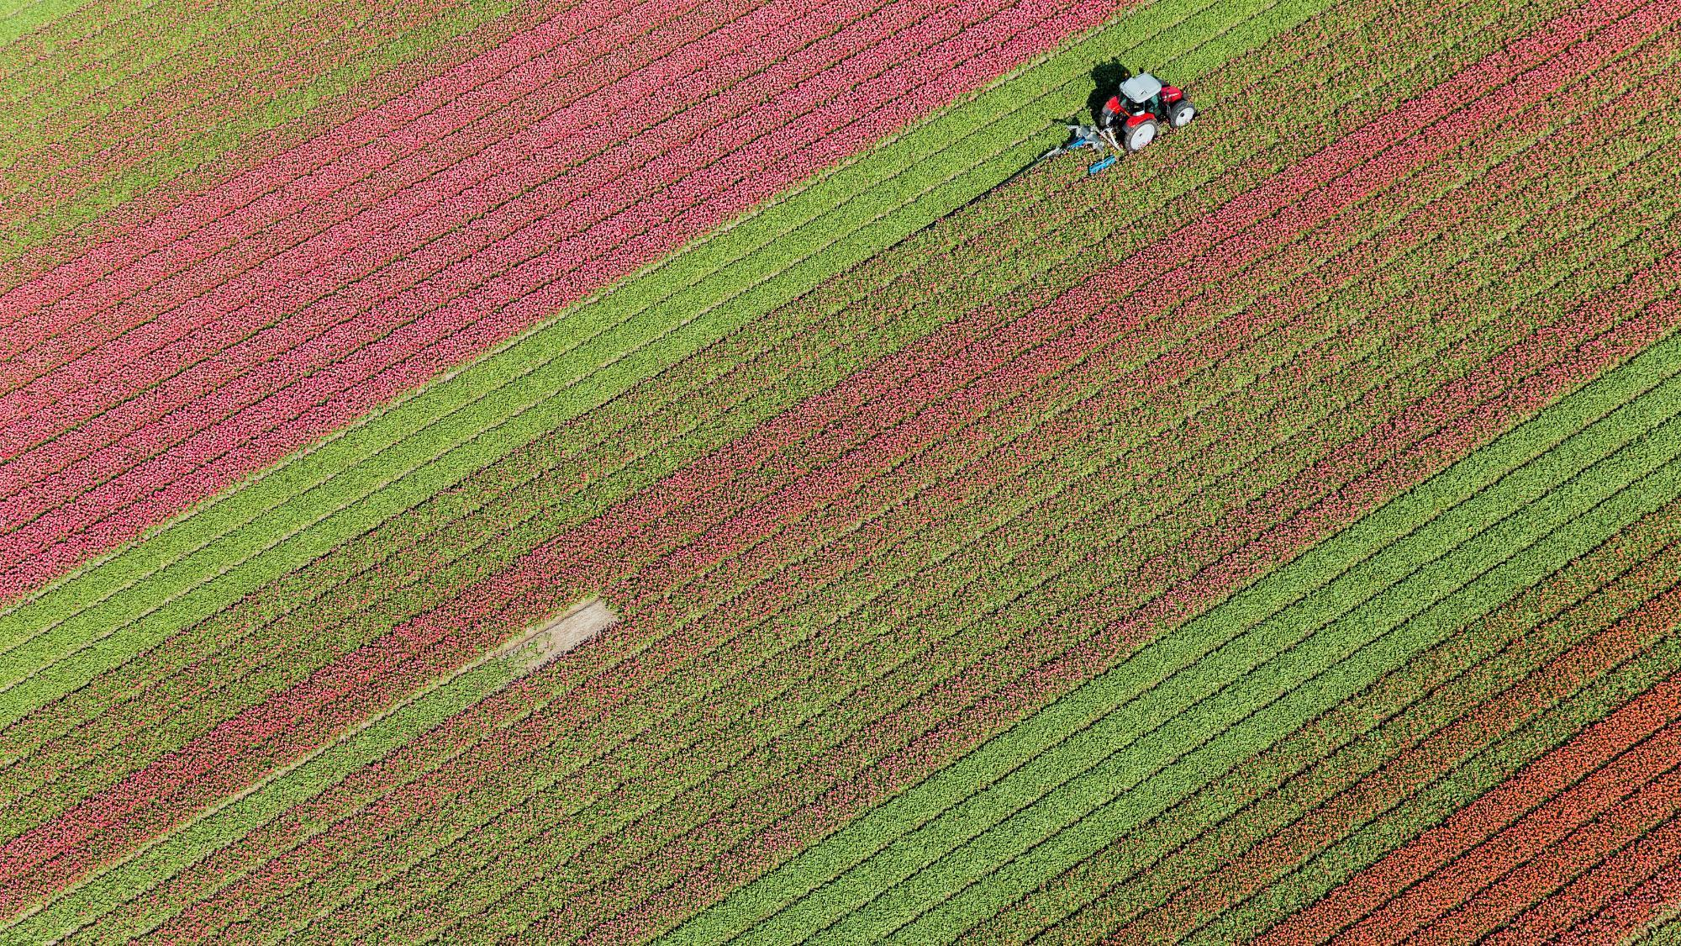

TEAM 14 Sarvottam
AGRINET

Slide 2


TEAM MEMBERS
Chetna Soni
Divija Arora
Mehakpreet Singh
Pabitra Senapati
Ridhima Gupta
Ritika Upreti
Sai Anish Malla
Varshini Akula
TEAM MENTORS
Kuldeep Zaveri
Alok Bhatnagar

Slide 3

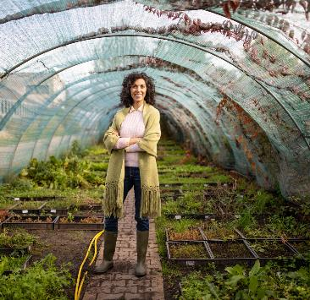
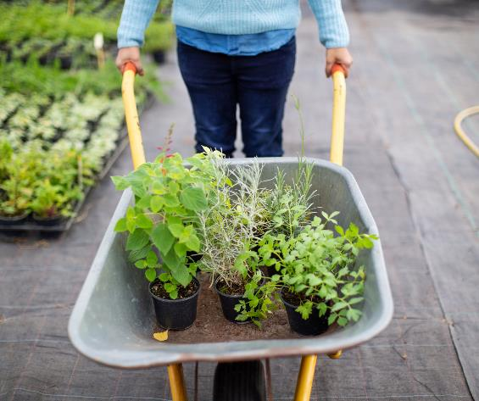
PROBLEM STATEMENT
To display the farmer’s profile and his crop analysis.
Provide a portal where field staff can enter the data of farmers through a form.
Provide a way to analysis and visualize data for economic and social impact
Need to educate farmers about the technology and local resources

Slide 4
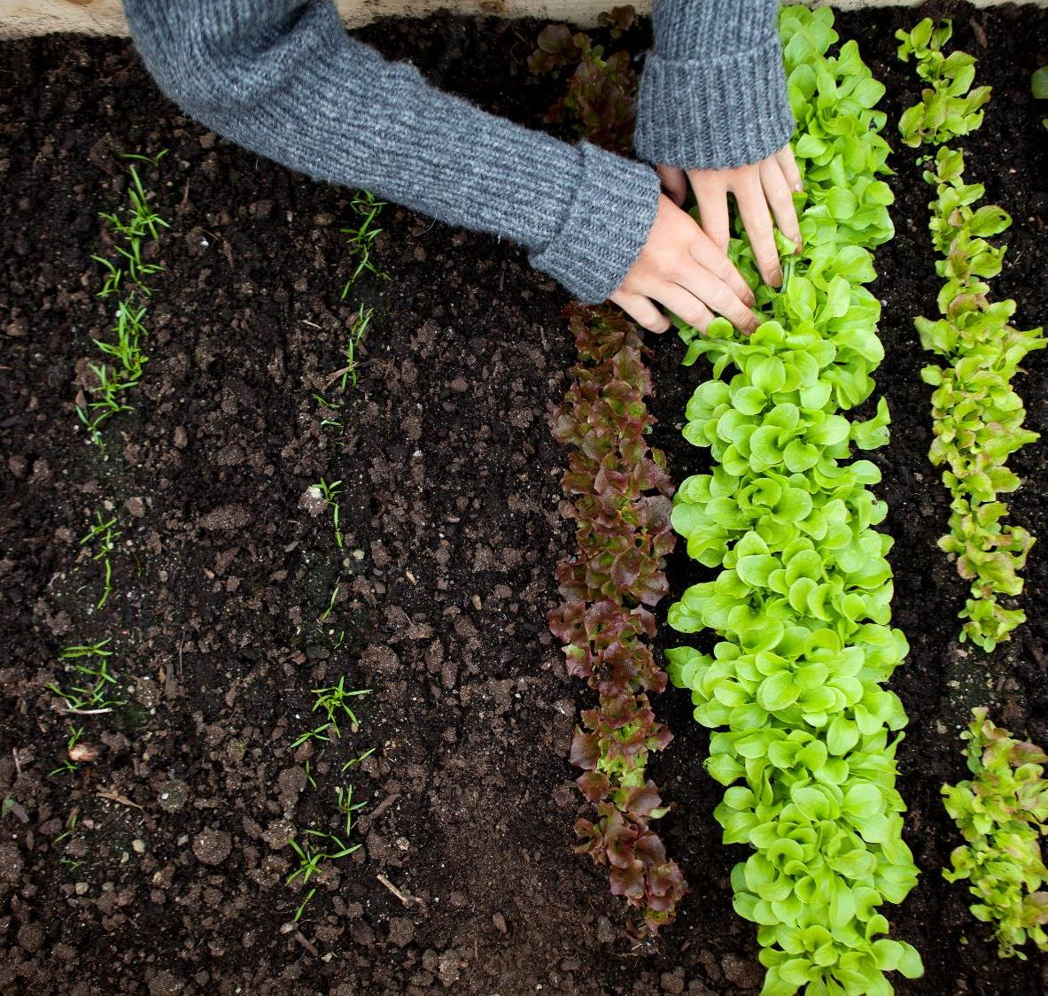
SOLUTION
Simple and user-friendly portal to gather all the data.
Admin, Regional Field Managers, and Farmers have their own database to serve their needs.
Visualization of data in graphical form
Logistics presentation for economic and social benefits.

Slide 5


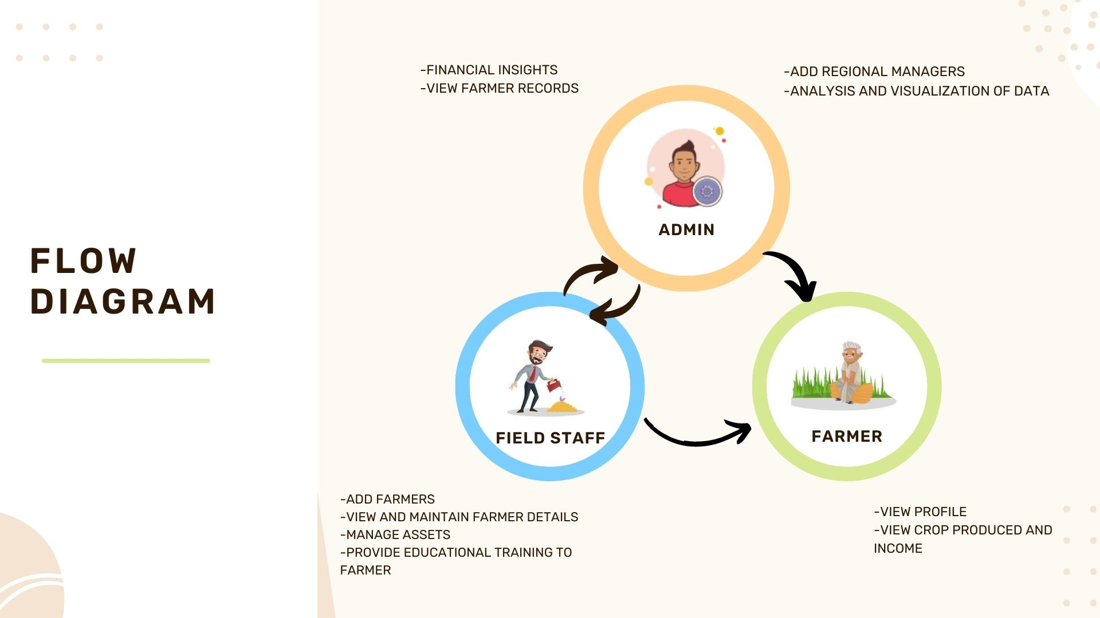
FLOW OF THE PROJECT

Slide 6
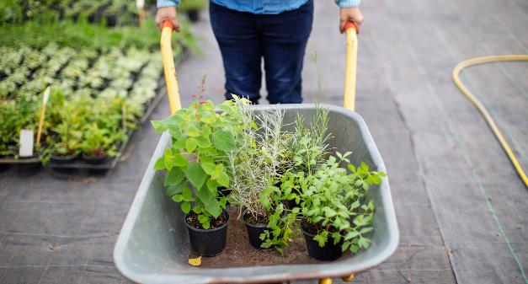
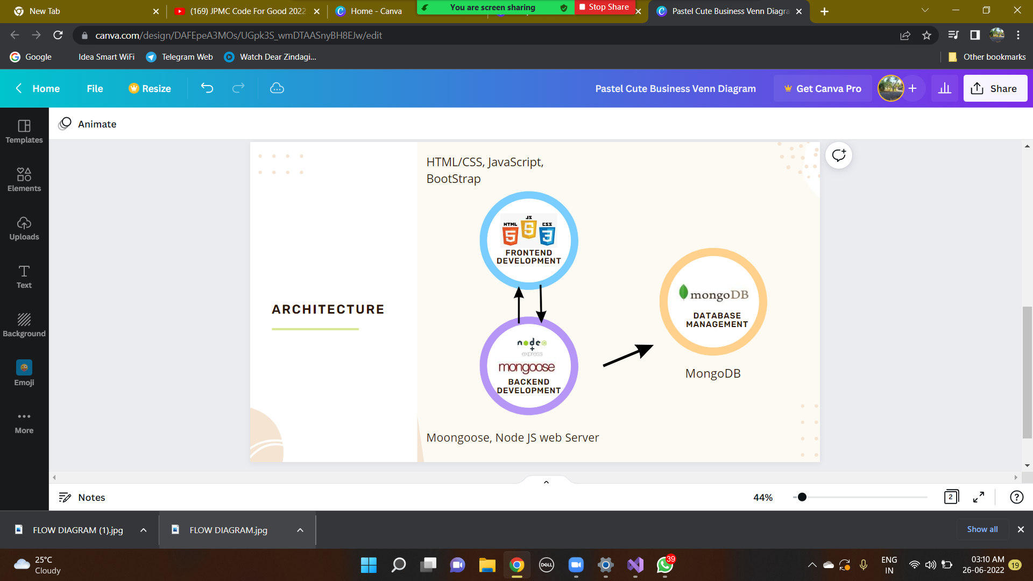
ARCHITECTURE DIAGRAM

Slide 7

FUTURE SCOPE
*
Mobile Application
multi-Lingual platform
Farmer Sign Up portal
Include more than one crop and regions
Video conferencing with farmers.
*
*

Slide 8


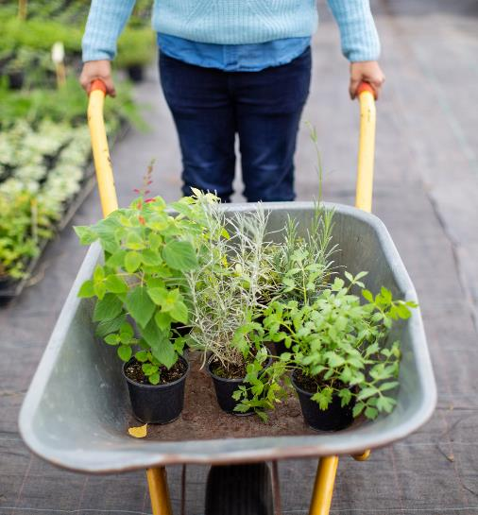

Thank You
Now we can move towards the demo of the project!

