Slide 1
Job Check – Detecting Fake Job Post & Retraining

Slide 2
CONTENTS
Introduction
Data Collection & Data Preprocessing
Model Training
Streamlit App
Conclusion

Slide 3
INTRODUCTION
In recent years, fake job postings have become a major issue on online job portals. Scammers use fraudulent job listings to collect personal information or money from applicants.
Approach:
Collect real-world job data
Clean and preprocess textual information
Train a classification model to detect fraud
Deploy an interactive web app using StreamLit

Slide 4
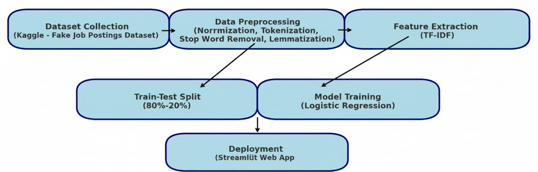
FLOWCHART OF PROJECT

Slide 5
DATASET COLLECTION
Source: Kaggle – Fake Job Postings Detection Dataset
Dataset Size: ~18,000 job postings
Attributes:
Text-based: title, company_profile, description, requirements, benefits
Categorical: employment_type, required_experience, required_education, industry, function
Target Label: fraudulent (0 = Real, 1 = Fake)
The dataset provides a balanced view of both real and fake job posts, ideal for classification tasks.

Slide 6
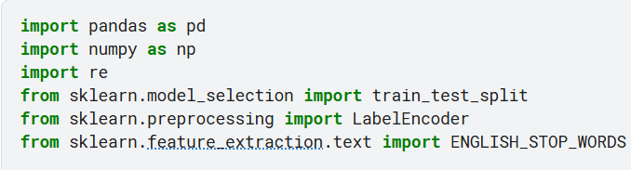
DATA PREPROCESSING
Step 1: Import Required Libraries

Slide 7
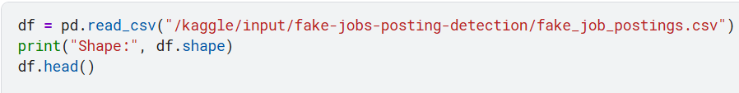
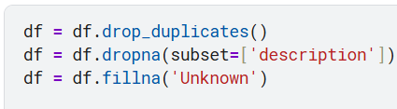
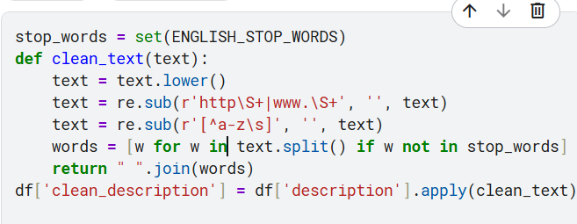
Step 2: Load Dataset
Step 3: Data Cleaning
Step 4: Text Preprocessing

Slide 8
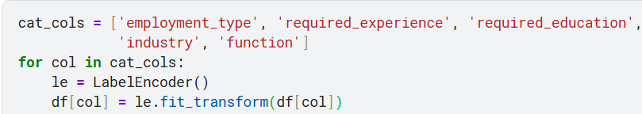
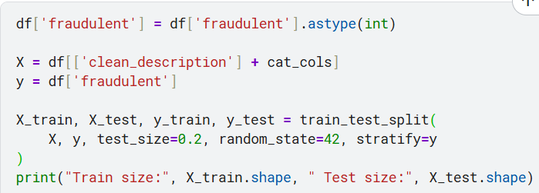

Step 5: Encoding Categorical Features
Step 6: Target Variable & Split Data
OUTPUT:

Slide 9
MODEL TRAINING
Algorithm Used: Logistic Regression
Text Vectorization: TF-IDF (Term Frequency–Inverse Document Frequency)
Features: Combined text columns (title, description, requirements, benefits, etc.)
Target Variable: fraudulent

Slide 10
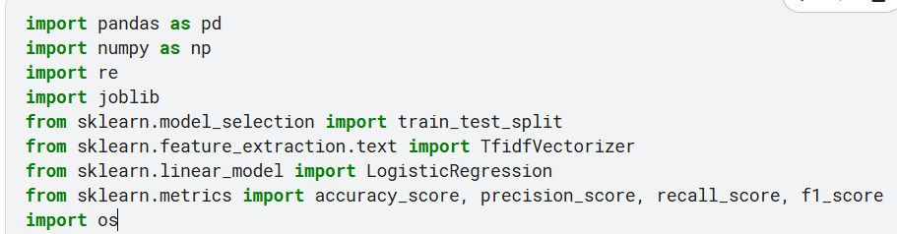
Step 1: Importing Libraries
Step 2: Data Collection
Step 3: Text Preprocessing
Step 4: Train-Test Split

Slide 11

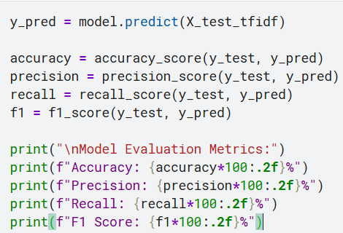
Step 5: TF-IDF Vectorization
Step 6: Model Training (Logistic Regression)
Step 7: Model Evaluation

Slide 12
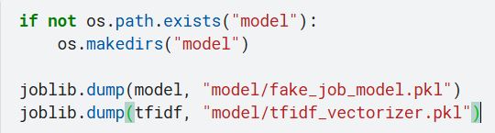
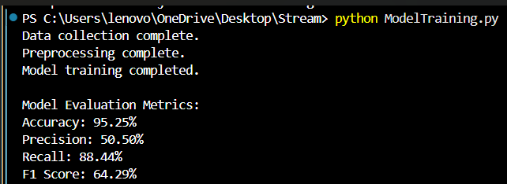
Step 8: Save Model & Vectorizer
OUTPUT:

Slide 13
STREAMLIT APP
PURPOSE: Deploy the trained model as an interactive web app for real-time fake job detection.
FEATURES:
User Input: Enter or paste job description text.
Model Prediction: Displays “ Real” or “ Fraudulent” with probability scores.
Performance Metrics: Shows accuracy, precision, recall, F1-score.
Feedback Section:
Users can mark prediction as correct or incorrect.
Feedback saved to improve model through retraining.
Retrain Button: Updates model automatically using new feedback.
Modern UI: Transparent text area, background image, emojis, and expanders for metrics.
TECH STACK:
Frontend: Streamlit
Backend ML: Logistic Regression (Scikit-learn)
Data Handling: Pandas, NumPy
Vectorization: TF-IDF

Slide 14
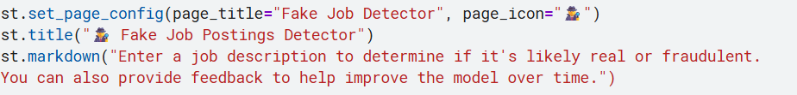
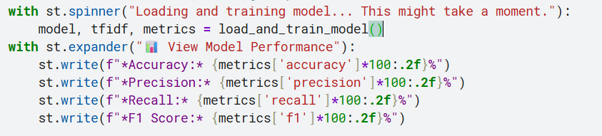
Step 1: Text Preprocessing Function
Step 2: Model Testing & Training
Step 3. StreamLit UI
Step 4. Model Evaluation Display

Slide 15
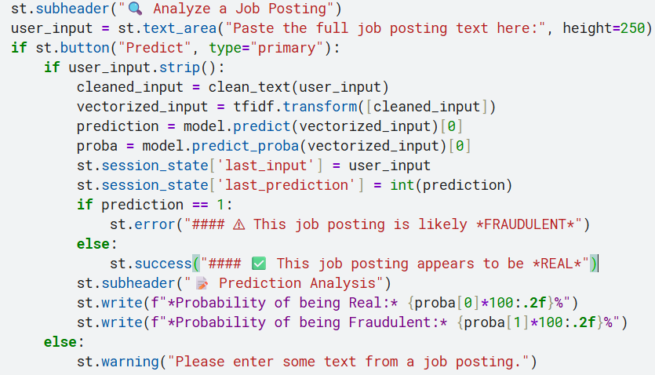
5. Prediction input

Slide 16
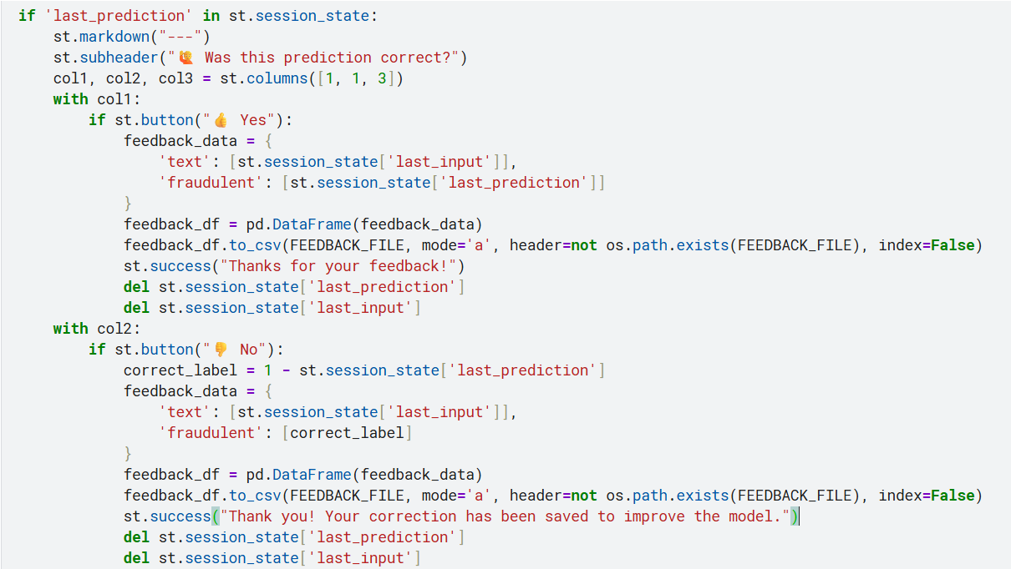
6. Feedback Section

Slide 17
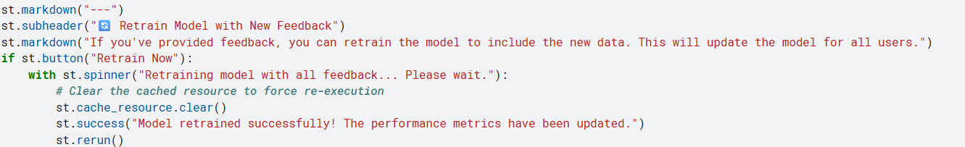
7. Retraining Feature
ABOUT UI FEATURE:
Custom background using base64 image encoding
Transparent text areas and expanders for aesthetic look
Emoji-based icons for visual clarity
Live prediction analysis with probability scores

Slide 18
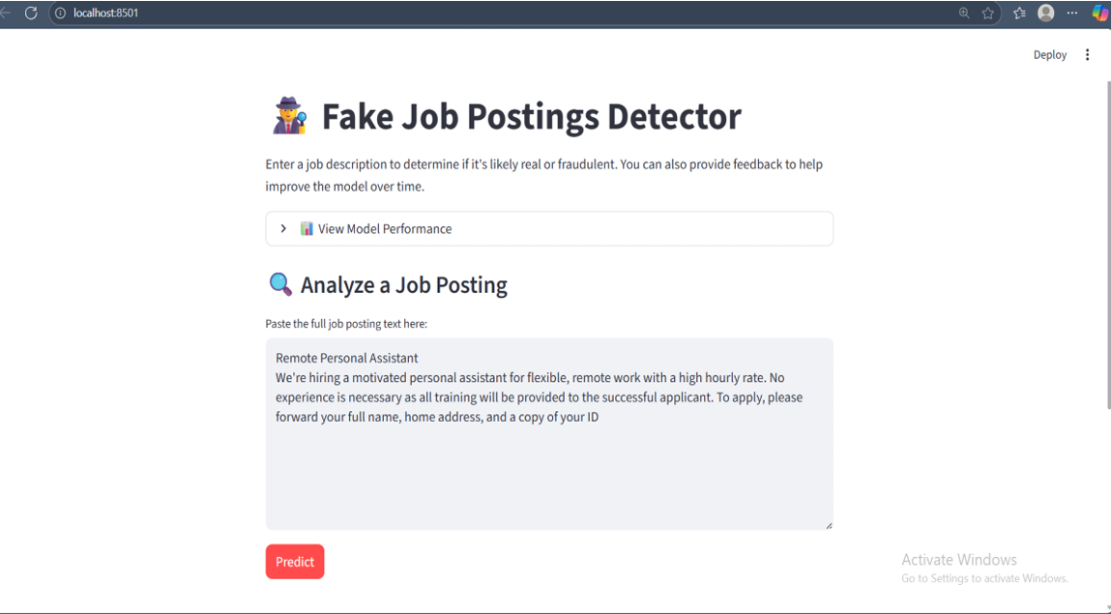
FINAL OUTPUT

Slide 19
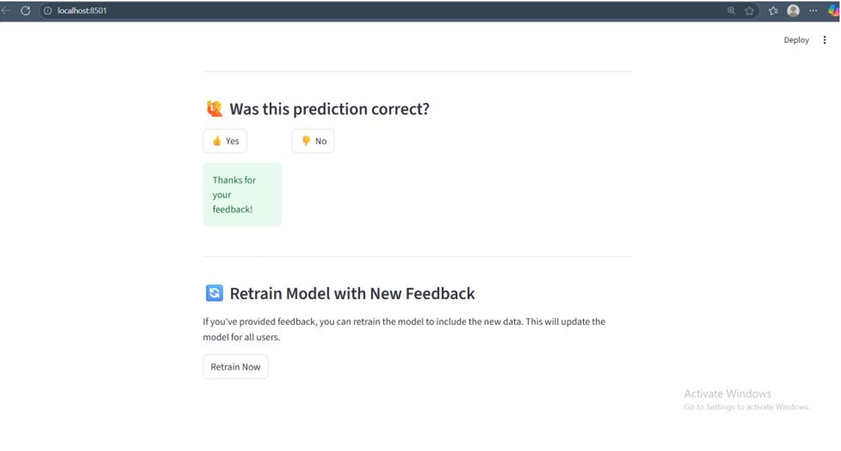

Slide 20
CONCLUSION
The JobCheck project successfully detects fake job postings using NLP.
It helps users identify scam job offers before applying.
The integration of user feedback and retraining makes the system adaptive and continuously improving.
OUTCOME:
Robust and explainable model
Real-time detection through an interactive app

