Slide 1


Forecasting Political Violence
Capstone Project for “Computing for Good”

Slide 2

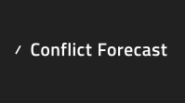
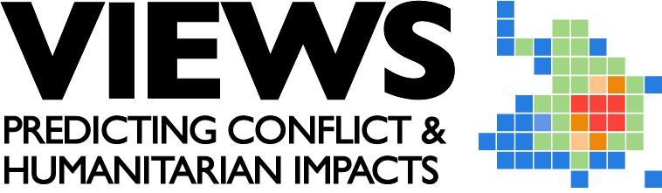
Project Name
Forecasting Political Violence
Organization Name
United Nations Development Programme - Risk Anticipatory Hub
Organizational Need
An integrated approach that seamlessly integrates heterogeneous forecasting outputs to offer a novel resource for uncovering new insights and patterns in political violence, so researchers, policymakers, and the international community can address and mitigate the impacts of political violence effectively.
Project Scope
The project aims to tackle the challenge of consolidating diverse conflict forecasting outputs from three well-established sources: ACLED CAST, ViEWS, and Conflict Forecast. The primary objective is to create an MVP of an automated and aggregated conflict forecasting system by setting up the entire data processing flow (from API call to ingestion into the Data Warehouse to visualization).

Slide 3
Team Members
​All team members will contribute to research (political violence domain) and development (back-end and/or front-end).
​
Zainab Akhtar:
Experience: 3 years of experience in research and development in the disaster risk reduction domain.
Role: Project lead, GIS lead, Data Science and Analysis
Raj Srivastava:
Experience: Software Engineer in R&D. Primarily working with Generative AI and Python backend currently. Previous experience includes NLP research, creating data engineering pipelines with Spark, and designing a Tableau dashboard based on user interviews
Role: Data Analysis, Data Visualization, Machine Learning
Austin Walker:
Experience: Mechanical Engineer in the Energy industry with a focus on modeling and simulation of natural gas pipeline systems. Most of my software experience comes from OMSCS coursework's.
Role: Data Analysis, GIS sub-lead
Ritika Bharati:
Experience: Software Engineer, Solutions Architect with focus on data engineering and data science in financial sector, healthcare, and buildings automation. I mainly focus on creating end-to-end pipelines for data models and work on model implementation as well.
Role: Data Analysis/Engineering, Machine Learning, Web Development

Slide 4
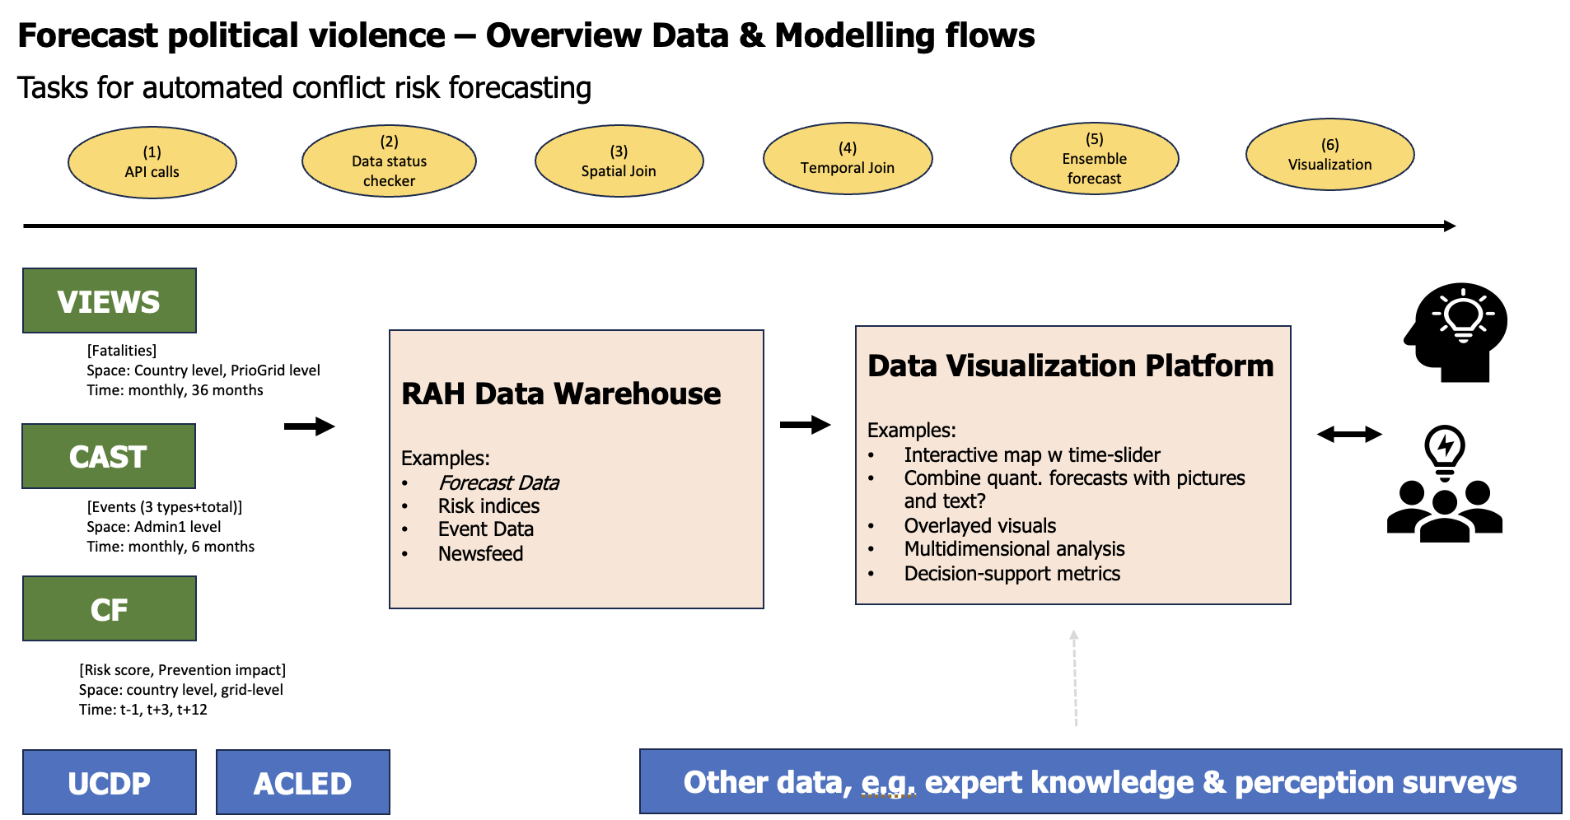
Architecture
The MVP development is divided into 6 stages as seen in the yellow ovals

Slide 5
Architecture Details
API Calls: Python
Download most recent forecasting data (use UNDP DataBricks to feed DWH)
Data Status Checker: Python
Test forecasting data status in UNDP data warehouse (e.g., updated?, completeness, etc.; send E-Mail notification)
Spatial Join: Python
(i) admin0 mapping, (ii) aggregation from grid-level to admin1 level, (iii) admin1 mapping (update tables in DWH)
Temporal Join: Python
aggregate to common time-frame (e.g., monthly, quarterly) (update tables in DWH)
Ensemble Forecast: Python + Research for Metric Formulation
aggregate different forecast measures into one forecasting metric (update table in DWH and store in archive )
Visualization: Any of PowerBI/Tableau/ArcGIS/QGIS/Python Dash
updated well-structured forecasting data in DWH facilitates user-centric tailored visualization for RBs and COs
Produce interactive visualization that provides a global overview (e.g., interactive map / rotating globe with time-slider and linked time-series plots; overlay with other data? Overlay with pictures & text / qualitative data)
* Use DataBricks for job scheduling, data processing and forecast modelling; sql-based DWH for storage and as backend for visualization; and separate data lake for archiving

Slide 6
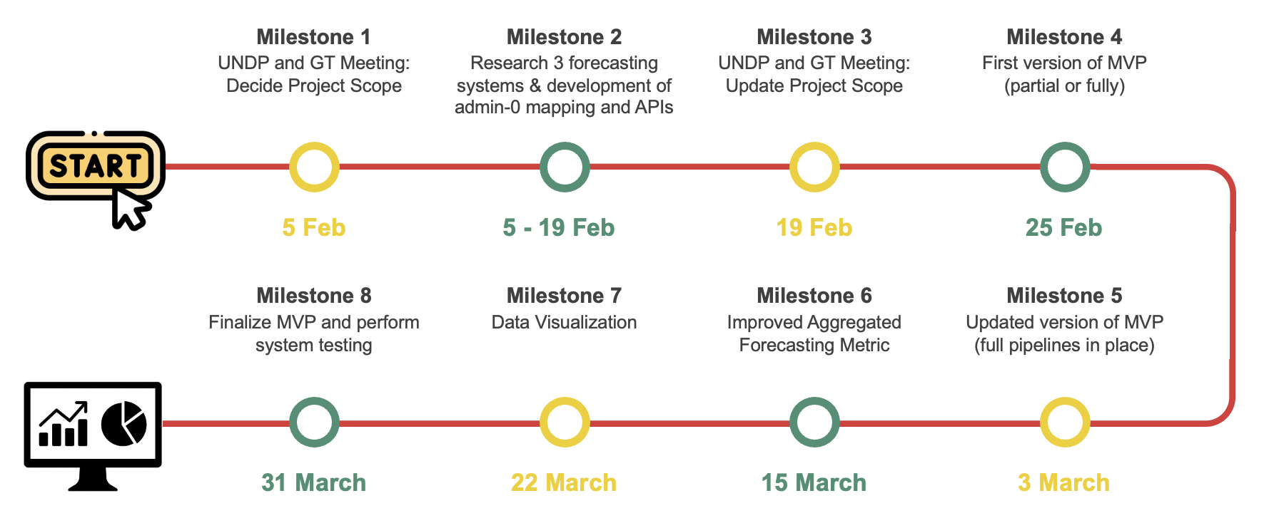
Timeline
Note: This timeline will change over the course of the project as we make progress and meet with our stakeholders

