Slide 1
FASHION MNIST CLASSIFICATION
CAPSTONE PROJECT
Presented By:
Ritika Chaudhary
AICTE Student ID:STU662677c4e59ee1713797060
Internship ID: INTERNSHIP_171273103266163398a8c87

Slide 2
OUTLINE
Problem Statement
Proposed System/Solution
System Development Approach (Technology Used)
Result
Conclusion
Future Scope
References

Slide 3
Problem Statement
Objective: To classify images of fashion items into different categories using machine learning.
Challenge: The dataset includes images of 10 different classes of fashion items. Developing a model that can accurately distinguish between similar classes such as shirts and t-shirts is challenging.
Impact: Accurate classification can help in various applications such as automated inventory management, fashion recommendation systems, and more.

Slide 4
Proposed Solution
Solution Overview: Development of a Convolutional Neural Network (CNN) to classify fashion images.
Key Features:
Use of CNN for image classification.
Hyperparameter tuning to optimize model performance.
Data augmentation to improve model generalization.

Slide 5
System Development Approach
Tools and Libraries:
Python: Programming language.
Pandas: Data manipulation and analysis.
NumPy: Numerical computing.
Matplotlib: Data visualization.
Scikit-learn: Machine learning library.
TensorFlow/Keras: Deep learning framework.
Dataset: Fashion MNIST dataset with 60,000 training images and 10,000 test images, each 28x28 pixels.
Model Architecture:
Multiple convolutional layers.
MaxPooling layers.
Dense (fully connected) layers.
Dropout for regularization.
Library required to build the model : IBM Watson Studio

Slide 6
System Development Approach
Data Preprocessing:
Normalization of pixel values.
One-hot encoding of labels.
Model Training:
Training-validation split.
Hyperparameter tuning using GridSearchCV.
Early stopping to prevent overfitting.
Data Augmentation:
Techniques like flipping, rotation, and brightness adjustments.

Slide 7
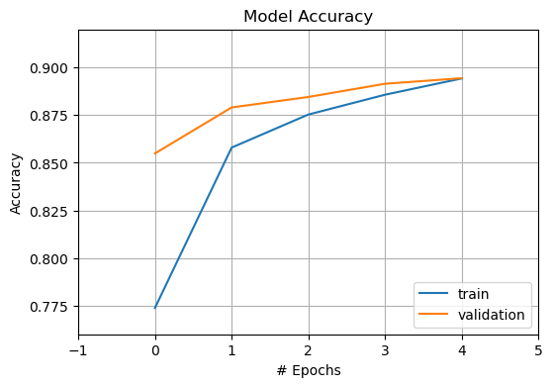
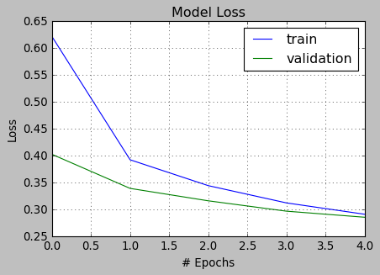
Result
Model performance
Accuracy= 90.04%
Loss = 9.96%

Slide 8
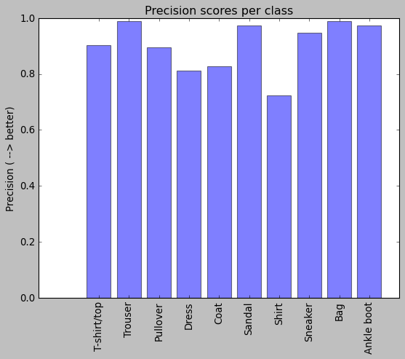
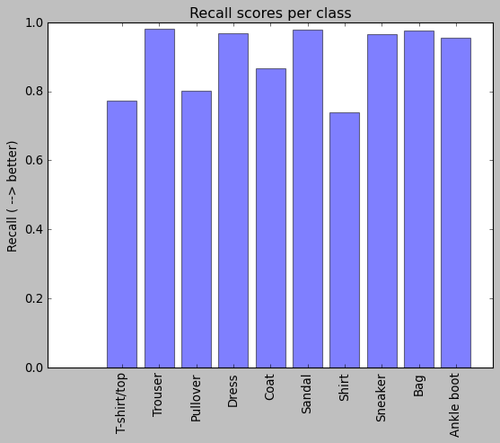
Result
Model performance
Precision Scores Per Class
Recall Scores Per Class

Slide 9
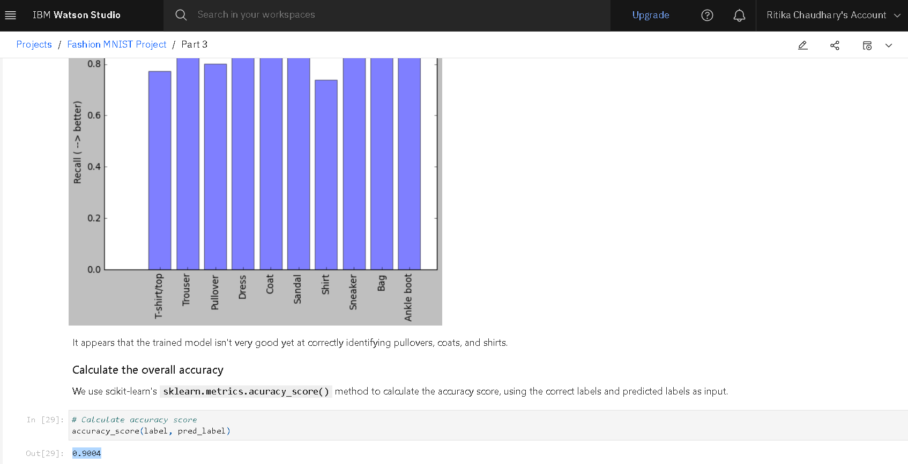
Result

Slide 10
Conclusion
In conclusion, our CNN model has demonstrated effective classification of fashion items with generally favorable accuracy. It excels across diverse categories, yet faces challenges distinguishing closely related classes such as shirts and t-shirts, where misclassification rates are notable. However, through rigorous data augmentation techniques and meticulous hyperparameter tuning, we have successfully enhanced the model's performance. These optimizations have not only mitigated issues with similar item classifications but have also bolstered overall accuracy and robustness. Moving forward, continued refinement and exploration of advanced methodologies will be crucial in further improving the model's capability to handle intricate distinctions within fashion item categories.

Slide 11
Future scope
Improvement : Further tuning of hyperparameters is essential to refine our CNN model's performance. Adjusting parameters like learning rate, batch size, and network architecture can specifically address challenges in distinguishing between closely related classes such as shirts and t-shirts. Optimization of regularization techniques like dropout and batch normalization will also help improve generalization and reduce overfitting, thereby enhancing overall classification accuracy.
Extensions : Deploying our CNN model in real-world applications is a critical next step. Integration into e-commerce platforms or retail systems would enable real-time fashion item classification, validating its practical utility and allowing for iterative improvements based on real-world usage. This deployment not only showcases the model's effectiveness but also enhances its potential impact in enhancing user experience and operational efficiency.

Slide 12
References
IBM Watson studio tutorial
https://developer.ibm.com/exchanges/data/all/fashion-mnist/
https://dax-cdn.cdn.appdomain.cloud/dax-fashion-mnist/1.0.2/fashion-mnist.tar.gz
Data assets
fashion-mnist_test.csv: the core test dataset as obtained from Fashion MNIST.
fashion-mnist_train.csv: the core train dataset as obtained from Fashion MNIST.
Notes:
Data assets
fashion-mnist_test.csv: the core test dataset as obtained from Fashion MNIST.
fashion-mnist_train.csv: the core train dataset as obtained from Fashion MNIST.

Slide 13

course certificate 1

Slide 14

course certificate 2

Slide 15
THANK YOU

