Slide 1
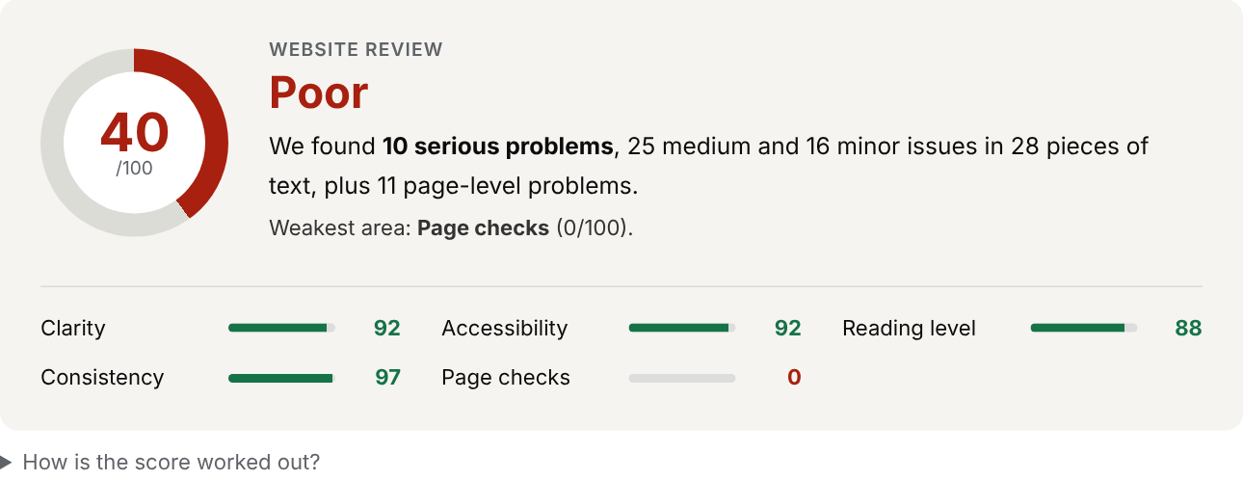
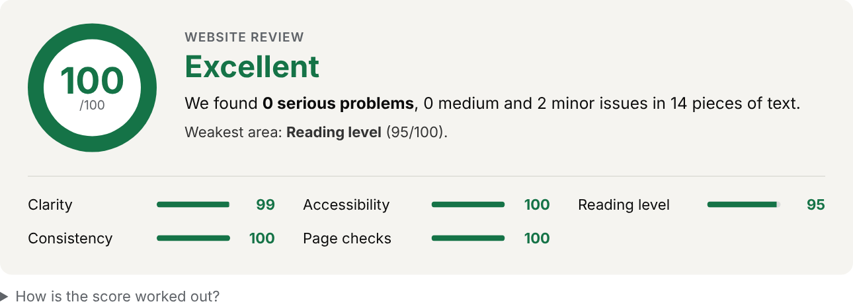
Pune Vidyarthi Griha’s College of Engineering, Technology and Management
NLP MINI PROJECT · GROUP G07
UI Text Accessibility Reviewer
A web app that reads the text of a website, screenshot or pasted content and recommends how to make it clear, accessible and consistent.
Haripujan Prasad (2063) · Soham Muley (2065) · Ritika Paradkar (2066)
Guide: Prof. Mrs. K. P. Goswami
Artificial Intelligence and Data Science · 2026-27
Notes:
Introduce the project: a web application that proofreads interface text. The two cards show the tool rating a badly written demo site (40, Poor) and a well written one (100, Excellent).

Slide 2



Why interface text matters
“Click here”
“Error 0x80070057: invalid parameter”
“SUBMIT”
Meaningless to a screen-reader user who hears a list of links.
A code and jargon, and no hint how to fix it.
Vague, shouted in capitals, and does not say what will happen.
Users hesitate, make mistakes or give up, and for people with low vision, dyslexia or screen readers, unclear text can make a product unusable. Reviewing it by hand is slow, and most checkers look at code, not words.
Notes:
Three real examples of poor interface text and why each one fails users. Most automated accessibility checkers concentrate on markup, not on the quality of the words.

Slide 3




Aim and objectives
AIM
Read text from three sources
Website HTML (incl. JavaScript pages), OCR on screenshots, pasted text
Build a web application that reviews interface text for clarity, accessibility, reading level and consistency, and recommends concrete changes.
Check four dimensions
Clarity, accessibility, reading level and consistency
Measure what the eye sees
Colour contrast and text size from screenshots
Input: website address, screenshot or pasted text.
Score and recommend
Prioritised fixes, rewrites and exports
Notes:
The aim and the four main objectives. The full list of eight objectives is in the report.

Slide 4






How the system works
Website address
NLP REVIEW ENGINE
Score and verdict
Extract and classify text
Tokenise, count syllables
47 clarity, accessibility, reading and consistency rules
Contrast and size from pixels
“Fix these first” list
Screenshot
Suggested rewrites
Pasted text
CSV, JSON, PDF
Notes:
Overview: three kinds of input go into one NLP review engine, which produces a score, a prioritised fix list, suggested rewrites and exports.

Slide 5








Technology stack
Python
Flask
Playwright
RapidOCR + ONNX
Core language
Web server and REST API
Runs JavaScript pages in headless Chromium
Reads text from screenshots
Pillow + NumPy
re + HTMLParser
HTML, CSS, JS
pytest
Colour and size measurement
Pattern matching and page parsing
Front end without a framework
21 automated tests
Notes:
Everything except the optional headless browser and OCR runs on Flask and the Python standard library, so the core tool works offline.

Slide 6


Theory behind the checks
Reading level
Colour contrast
Rule-based NLP
Flesch Reading Ease
206.835 − 1.015·(words/sentences) − 84.6·(syllables/words)
Flesch–Kincaid Grade
0.39·(words/sentences) + 11.8·(syllables/words) − 15.59
Target: grade 8 or lower
Ratio = (L1 + 0.05) ÷ (L2 + 0.05)
L = relative luminance of each colour
WCAG minimum: 4.5 : 1 normal text, 3 : 1 large text
Word lists: jargon, vague actions, synonyms
Patterns: passive voice, negatives, error codes
Transparent: every finding names its rule
Notes:
Reading level uses the two Flesch formulas, contrast uses the WCAG ratio, and the language checks are rule based so that every recommendation can be explained.

Slide 7
Methodology
1
Acquire
2
Extract and classify
3
Pre-process
Fetch the page (and run its JavaScript if needed) or read the screenshot with OCR
Buttons, links, labels, headings, messages, alt text, paragraphs
Words, sentences and syllable counts
4
Apply rules
5
Score
6
Recommend
Clarity, accessibility, reading level, consistency, page and visual checks
Start at 100; lose 22 / 12 / 5 points per high / medium / low issue
Suggested fixes, rewrites, sorted by severity, with exports
Notes:
The ten-step methodology in the report is summarised here as six steps.

Slide 8
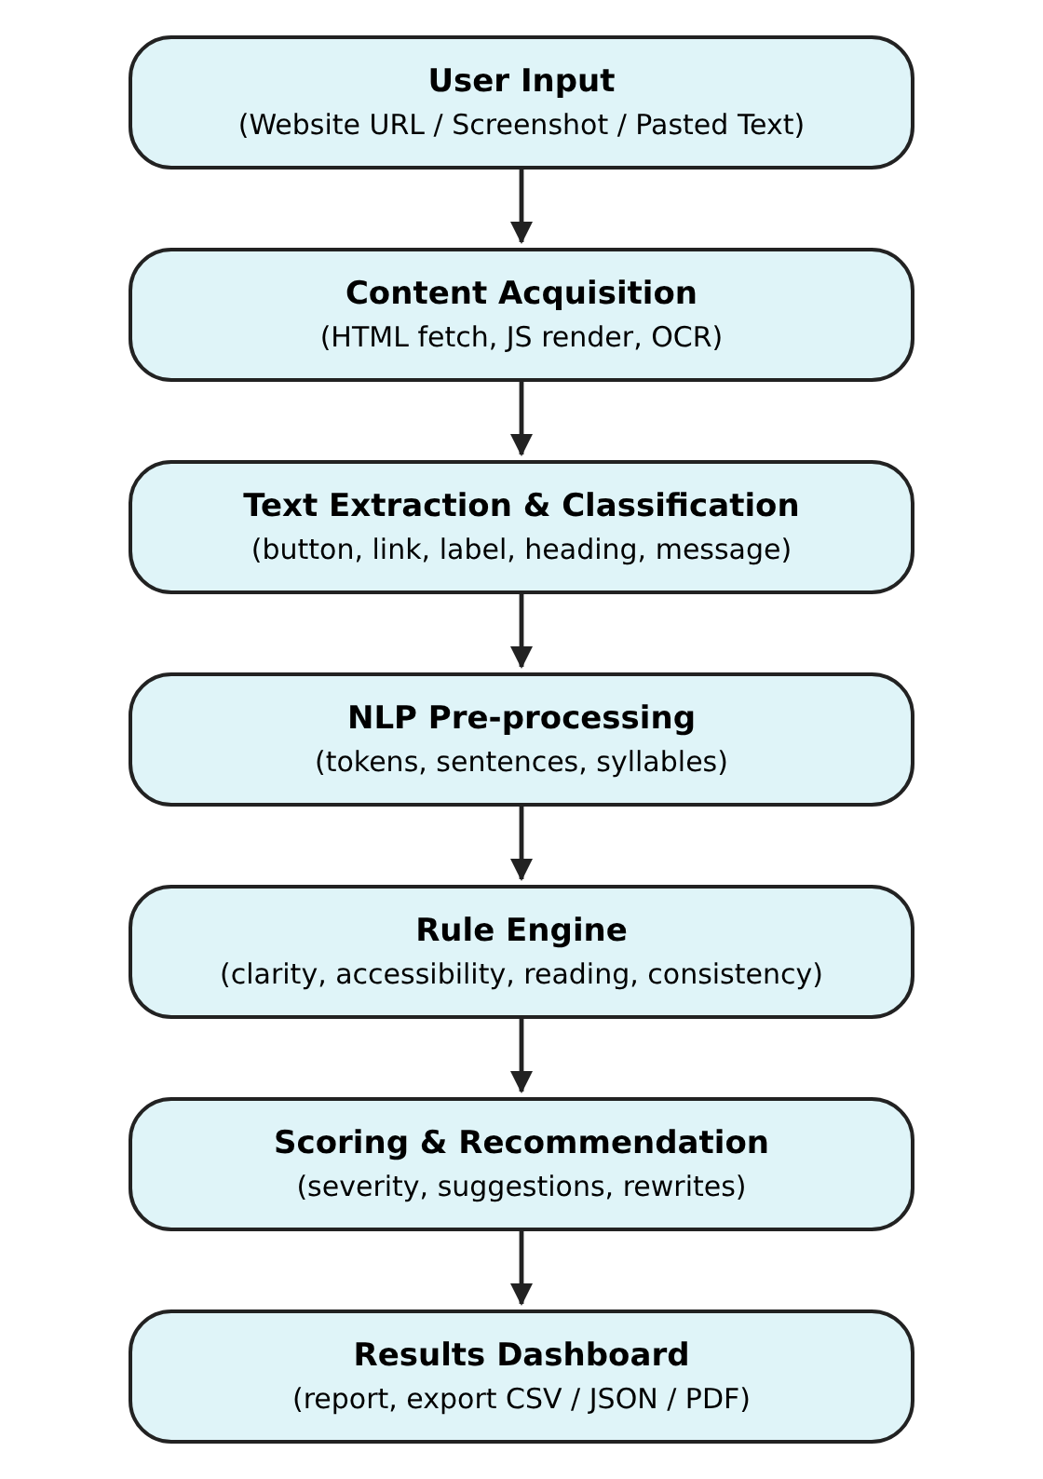
Architecture diagram
Input layer: URL, screenshot or text
Acquisition: HTML fetch, JavaScript render, OCR
Extraction: typed list of interface strings
Pre-processing: words, sentences, syllables
Rule engine: four language dimensions plus page and visual checks
Scoring: severity, suggestions, rewrites
Dashboard: report and exports
Notes:
Seven modules in a straight pipeline; this matches the architecture diagram in the report.

Slide 9
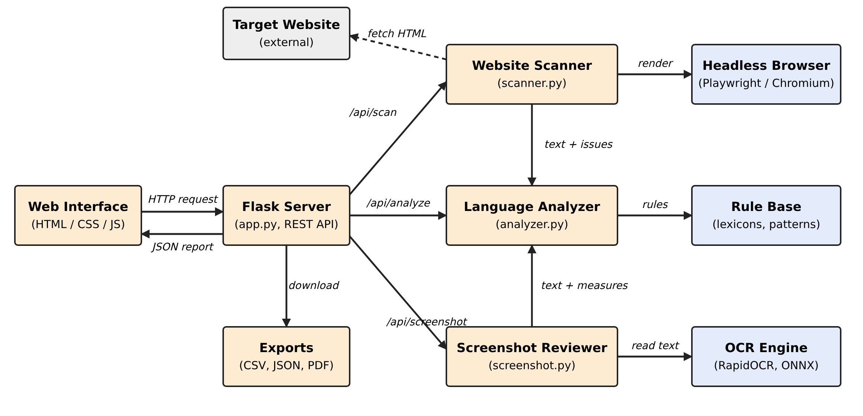
Component diagram
Notes:
The web interface talks to a Flask server. The server calls the scanner, analyzer or screenshot reviewer, which use the headless browser, the rule base and the OCR engine.

Slide 10




What it checks
Clarity
Accessibility
“Submit”
→ “Send message”
“Click here”
→ “View billing history”
Reading level
Consistency
Grade 17 sentence
→ Grade 8: shorter, plain words
Log in / Sign in / Login
→ One term everywhere
Notes:
One example of each dimension: a vague button, a generic link, a hard-to-read sentence and inconsistent terms.

Slide 11
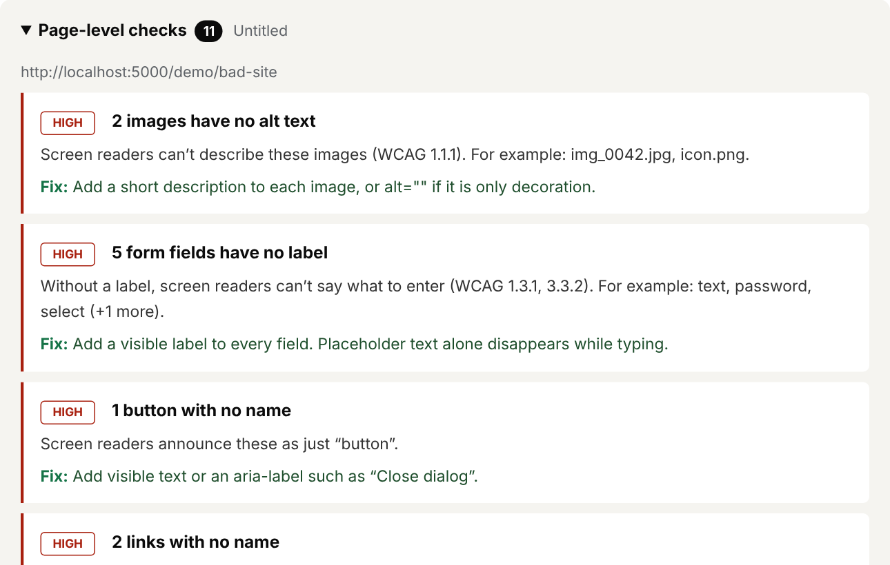
Website scan
Downloads the page safely; internal network addresses are blocked
Runs JavaScript in a headless browser when the page needs it
Extracts buttons, links, labels, headings, messages, alt text and paragraphs
Page checks: alt text, field labels, language, zoom, headings, duplicate link text
Notes:
The website mode combines text extraction with page-level accessibility checks. The right-hand images are real output for the badly written demo site.

Slide 12
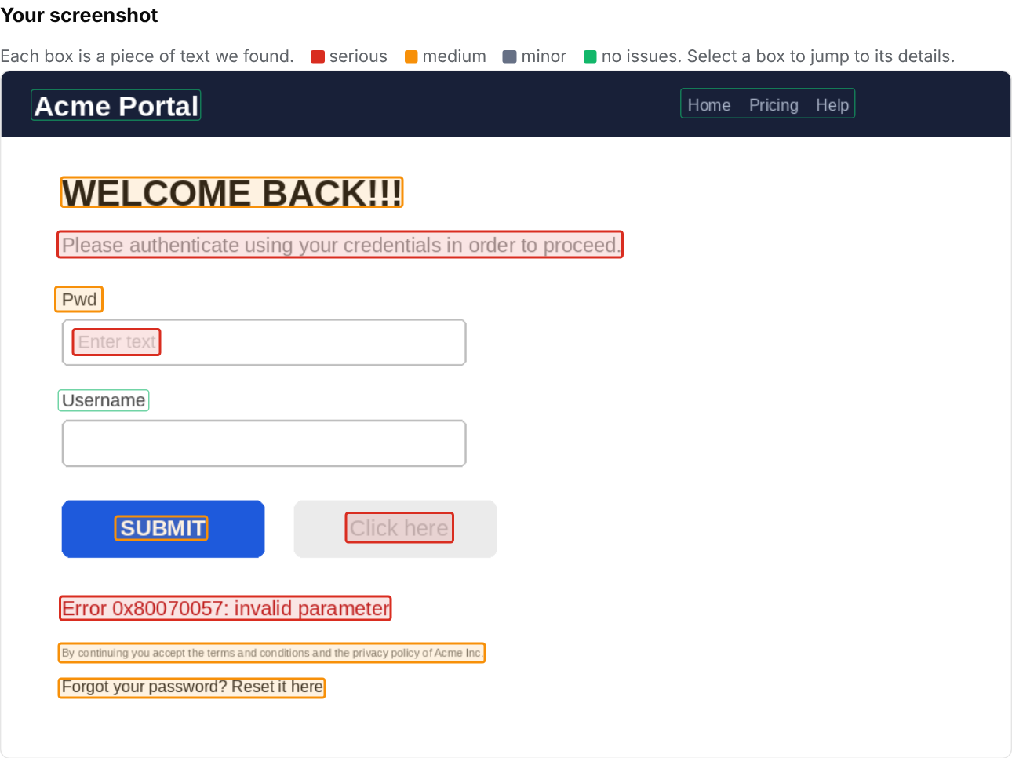
Screenshot review
OCR finds each piece of text and where it is
Contrast is measured against its own background, with a suggested colour
Text size is estimated from the pixels
The words get the same language review as a website
Values are estimates; check surprises by eye
Notes:
Used when a site cannot be scanned, or to review a design. Red boxes are serious problems, orange medium, grey minor and green no issues.

Slide 13
Results
47
3
21
40 → 100
rules: 31 text, 13 page, 3 screenshot
input modes
automated tests, all passing
bad vs good demo site
Input | Overall | Text score | Page checks | Strings | High / Med / Low
Well written demo site | 100 | 99 | 100 | 14 | 0 / 0 / 2
Sample text set | 82 | 82 | – | 19 | 5 / 16 / 9
Sample screenshot | 74 | 76 | 73 | 12 | 6 / 10 / 6
JavaScript-built app | 60 | 87 | 34 | 9 | 4 / 2 / 1
Badly written demo site | 40 | 79 | 0 | 28 | 10 / 25 / 16
Notes:
Real results from the built-in test inputs. The scoring separates the badly written site (40) from the well written one (100).

Slide 14
Scoring and what it shows
Points lost per issue
22
High severity
12
Medium severity
5
Low severity
Each string starts at 100. Sites blend the text score 50:50 with page-level checks.
Notes:
The chart uses the real scores from the demo inputs. A larger gap between text and page scores shows that page-level problems like missing alt text matter.

Slide 15


Conclusion and future scope
What we achieved
Future scope
A working reviewer for websites, screenshots and pasted text
Explainable rule-based NLP with fixes and rewrites
Handles JavaScript pages and measures contrast and size
Limits: rule-based, OCR is estimated, logins cannot be scanned
Scan several pages of a site at once
Hindi and Marathi interface text
Machine-learning model for tone and fluency
Check contrast directly in page styles
Browser extension and design-tool plug-in
Notes:
Summarise achievements and honest limitations, then future work.

Slide 16
Thank you
Questions?
Haripujan Prasad (2063) · Soham Muley (2065) · Ritika Paradkar (2066)
Guide: Prof. Mrs. K. P. Goswami

