Slide 1
What are Chatbots
Some Chatbot Examples
How Chatbots are different from Apps
Types of Chatbots
Why Chatbots are helpful
How to create Chatbot
Conclusion
Q&A

Slide 2
ChatBots
Chatbots are robots programmed to respond like humans
A chatbot is a computer program that is capable of having a human-like conversation with a user by receiving and sending text messages for the purpose of automating a business process.
Chatbots are powered by Artificial Intelligence and Natural Language Understanding

Slide 3
Chat Bot Examples
Order Pizza : Dominos
Product Suggestions H&M’s Kik Bot
Customer Support Spotify
Weather poncho
Personal Finance Assistance HDFC
News CNN

Slide 4
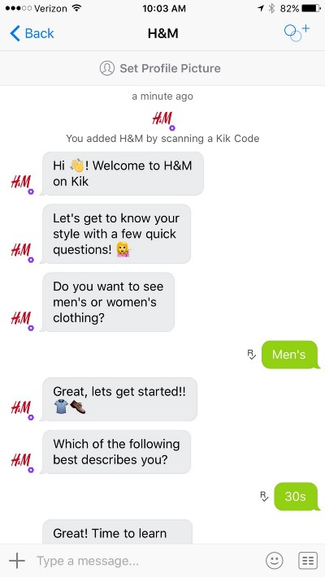
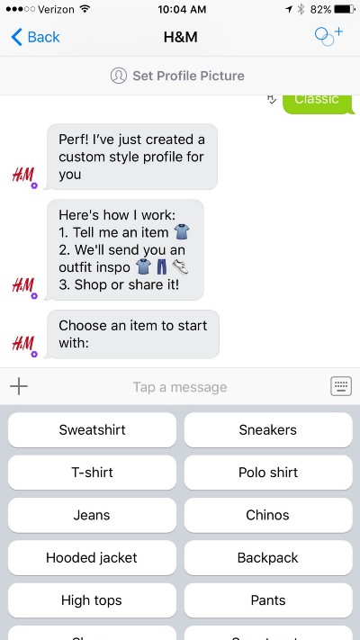
H&M

Slide 5
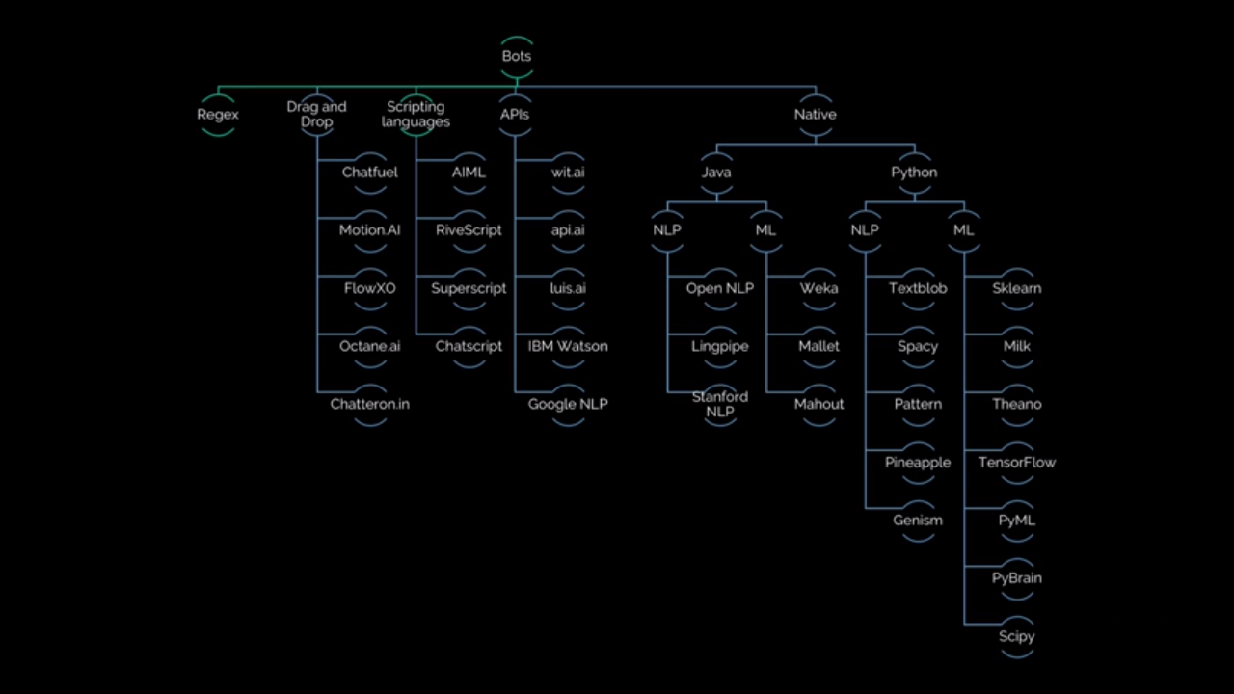
Create Chatbots

Slide 6
Conclusion
Chatbots in apps are basically an upgrade to a mobile user interface, as they bring the most basic type of human interaction into the digital environment. A simpler, faster and more intuitive user interface results in an overall better user experience, which is one of the key factors for mobile growth.
However, not all apps, or app features, require this type of interaction. Specific functions within apps can be improved with chatbots because of their conversational and personalized attributes, and we will probably be seeing a lot more of this technology in the future

