Slide 1
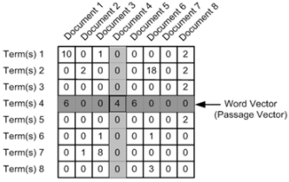



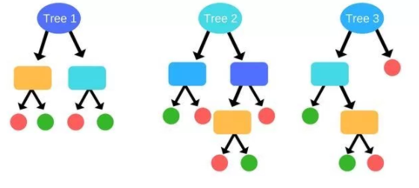

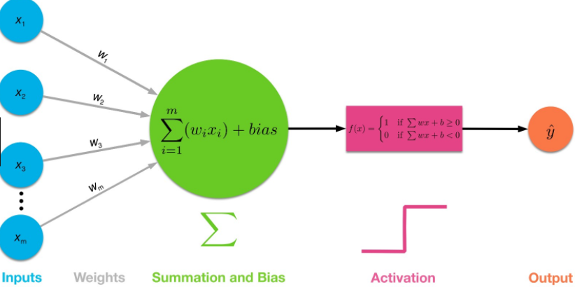

DATA PRE-PROCESSING
METHODOLOGY
Text Processing
Expanding contraction using dictionary of words
Cleaning for added tags
Removing digits and punctuations
Stop words removal
Tokenization
Stemming
Polarity Scoring
Using Sentiment Intensity Analyzer scored each set of headlines on how negative or positive it is as a feature to be used to train model
Term Frequency Matrix
Reducing text to tf-idf matrix, frequency of word in a text and how significant that word.
INPUT VARIABLES
OUTPUT VARIABLES
Polarity Score
TF-IDF Matrix
Flag denoting increase or decrease in stock prices
MODELLING APPROACH
Random Forest
Support Vector
Machine
Multi Layer
Perceptron
Majority Voting Classifier for Final Prediction

