Slide 1
JPA (Java Persistence API)
-Ritika Verma

Slide 2
What is JPA?
The Java Persistence API (JPA) is a Java specification for accessing, persisting, and managing data between Java objects / classes and a relational database.
Persistence here covers three areas:
the API itself, defined in the javax.persistence package
the Java Persistence Query Language (JPQL)
object/relational metadata

Slide 3
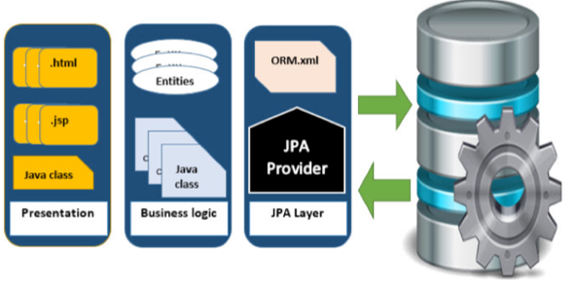
Where to use JPA?
To reduce the burden of writing codes for relational object management, a programmer follows the ‘JPA Provider’ framework, which allows easy interaction with database instance. Here the required framework is taken over by JPA.

Slide 4
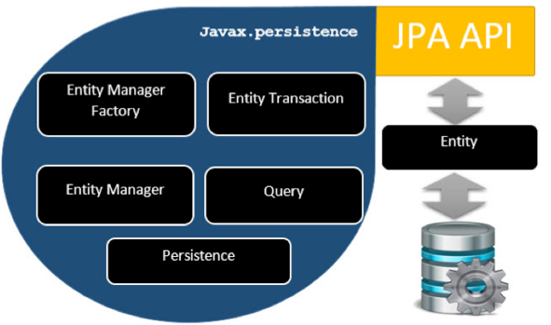
Architecture

Slide 5
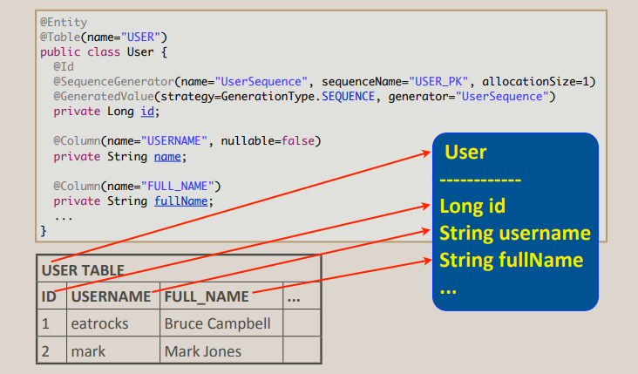

Slide 6
@Entity Annotation
This annotation specifies to declare the class as entity or a table.
@Table Annotation
The @Table annotation allows you to specify the details of the table that will be used to persist the entity in the database.
@Id Annotation
Each entity bean will have a primary key, which you annotate on the class with the @Id annotation. The primary key can be a single field or a combination of multiple fields depending on your table structure.

Slide 7
@Column Annotation
The @Column annotation is used to specify the details of the column to which a field or property will be mapped. Commonly used attributes −
name attribute permits the name of the column to be explicitly specified.
length attribute permits the size of the column used to map a value particularly for a String value.
nullable attribute permits the column to be marked NOT NULL when the schema is generated.
unique attribute permits the column to be marked as containing only unique values.

Slide 8
Relationships
@ManyToOne Relation
@OneToMany Relation
@OneToOne Relation
@ManyToMany Relation

Slide 9
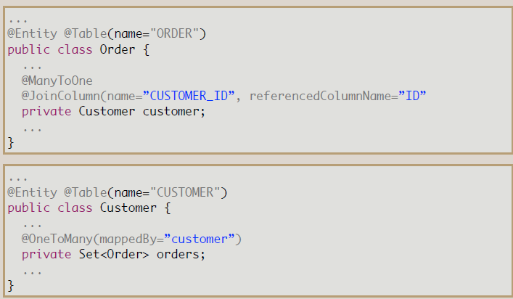

Slide 10
Thank You

