Slide 1
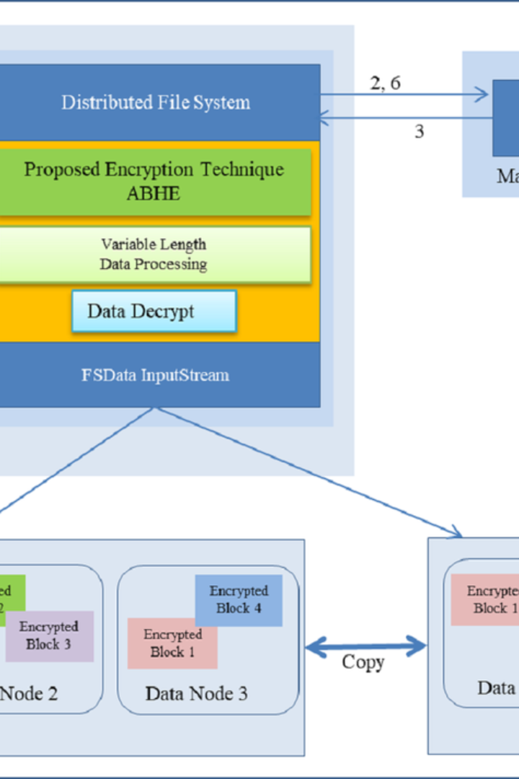

Introduction
Here we present a comprehensive guide to viewing data contents, files, and directories in Hadoop Distributed File System (HDFS).

Slide 2

HDFS command to view contents of files in HDFS
1
Step 1
Identify the file path to be viewed.
2
Step 2
Use the command: hadoop fs -cat /path/to/file.
3
Step 3
Observe the contents of the specified file in the HDFS.

Slide 3
Explanation of HDFS command
1
Importance
2
Efficiency
3
Convenience
This command is essential for viewing the content of files without downloading them.
It allows for quick and efficient data inspection and analysis.
Provides a convenient way to check file contents in HDFS without moving them to the local file system.

Slide 4




Example of using HDFS command
Input
hadoop fs -cat /user/hadoop/example.txt
Output
The content of the file "example.txt" displayed on the terminal.
Analysis
Allows for direct examination of file contents without downloading.

Slide 5
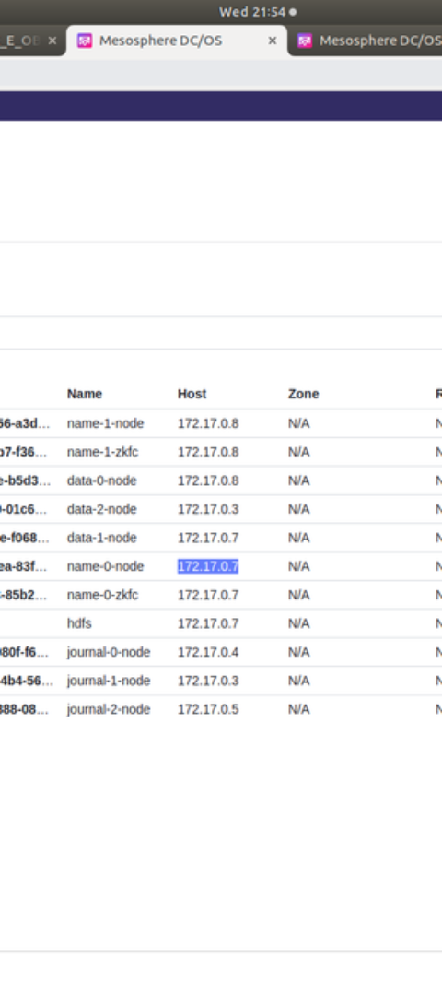
Viewing contents of directories in HDFS
1
Step 1
Specify the directory path to be viewed.
2
Step 2
Use the command: hadoop fs -ls /path/to/directory.
3
Step 3
Observe the contents of the specified directory in the HDFS.

Slide 6
HDFS command to view contents of directories
Command
Purpose
Advantage
hadoop fs -ls /path/to/directory
To list all the files and subdirectories in the specified HDFS directory.
Enables efficient exploration of directory contents in HDFS.

Slide 7

Explanation of HDFS command
1
Usefulness
2
Functionality
Allows checking the content and structure of directories without data transfer.
Provides an overview of files and directories in HDFS.
3
Efficiency
Efficiently handles large-scale directory inspection tasks.

Slide 8
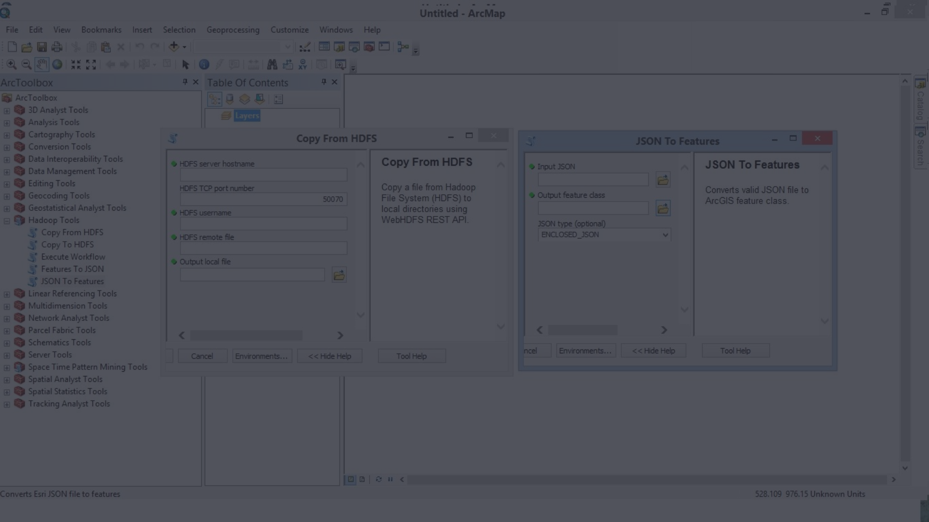



Example of using HDFS command
Input
Output
Analysis
hadoop fs -ls /user/hadoop/directory
List of files and subdirectories within the specified directory.
Facilitates efficient exploration and assessment of directory contents.

