Slide 1
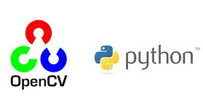
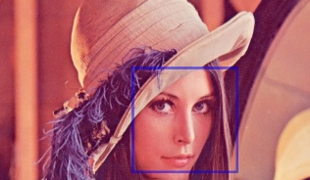
CSC391/691 Intro to OpenCV
Dr. Rongzhong Li
Fall 2016
Notes:
I am going to give you a brief introduction on OpenCV and show some real time examples. For the last 15 minutes, I’ll talk a little about the monster in this box.

Slide 2
Introduction
OpenCV is an image processing library created by Intel and later supported by Willow Garage and now maintained by Itseez.
Available on Mac, Windows, Linux (Terminal environment).
Works in C, C++, and Python ( What’s your favorite language?)
Newest update is version 2.4.13 (Could be a good exam question…)
Open Source and free (May have some commercial packages.)
Easy to use and install (Really? We will see…)
Notes:
OpenCV was started at Intel in 1999 by Gary Bradsky and the first release came out in 2000. Vadim Pisarevsky joined Gary Bradsky to manage Intel’s Russian software OpenCV team. In 2005, OpenCV was used on Stanley, the vehicle who won 2005 DARPA Grand Challenge. Later its active development continued under the support of Willow Garage, with Gary Bradsky and Vadim Pisarevsky leading the project. Right now, OpenCV supports a lot of algorithms related to Computer Vision and Machine Learning and it is expanding day-by-day.
Currently OpenCV supports a wide variety of programming languages like C++, Python, Java etc and is available on different platforms including Windows, Linux, OS X, Android, iOS etc. Also, interfaces based on CUDA and OpenCL are also under active development for high-speed GPU operations.
OpenCV-Python is the Python API of OpenCV. It combines the best qualities of OpenCV C++ API and Python language.

Slide 3
I’m New to Python
Python is a general purpose programming language
Simplicity (syntax, variable) and code readability (forced indentation).
Compared to other languages like C/C++, Python is slower.
BUT it can be easily extended with C/C++.
We can write computationally intensive codes in C/C++ and create a Python wrapper for it.
This is how OpenCV-Python works.
You DON’T need to understand how it works behind the scene.
Notes:
Python is a general purpose programming language started by Guido van Rossum, which became very popular in short time mainly because of its simplicity and code readability. It enables the programmer to express his ideas in fewer lines of code without reducing any readability.
Compared to other languages like C/C++, Python is slower. But another important feature of Python is that it can be easily extended with C/C++. This feature helps us to write computationally intensive codes in C/C++ and create a Python wrapper for it so that we can use these wrappers as Python modules. This gives us two advantages: first, our code is as fast as original C/C++ code (since it is the actual C++ code working in background) and second, it is very easy to code in Python. This is how OpenCV-Python works, it is a Python wrapper around original C++ implementation.
To get a complete picture of what is happening in background, a good knowledge of Python/C API is required. Good news is,

Slide 4
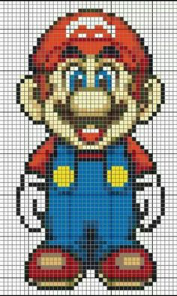

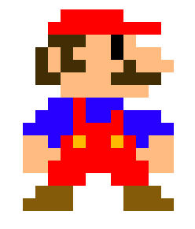
What’s Numpy?
Numpy is a highly optimized library for numerical operations.
It gives a MATLAB-style syntax. (Have you used Matlab?)
Matrix laboratory, optimized for (parallel) matrix operations.
Array structure is important because digital images are 2D arrays of
P-I-X-E-L-S
All the OpenCV array structures are converted to-and-from Numpy arrays.
You can use more convenient indexing system rather than using for loops.
Matplotlib will be your tool to make more complex plots.
0 | 1 | 2 | 3 | 4 | 5 | 6 | 7 | 8
1
2
3
4
5
6
7
8
Notes:
And the support of Numpy makes the task more easier. Numpy is a highly optimized library for numerical operations. It gives a MATLAB-style syntax. All the OpenCV array structures are converted to-and-from Numpy arrays. So whatever operations you can do in Numpy, you can combine it with OpenCV, which increases number of weapons in your arsenal. Besides that, several other libraries like SciPy, Matplotlib which supports Numpy can be used with this.
So OpenCV-Python is an appropriate tool for fast prototyping of computer vision problems.
Question: BigO notation for graphical problems
Problem scale: Small to large (O(N^2)) performance concerns

Slide 5
Demonstrations
Reading image (cv2, matplotlib)
Reading video stream
Drawing
Color channels
Pixel operations
Padding modes
Threshold
Above are basic operations on images and you’re expected
to understand every line of the code and write your own
functions.
Notes:
If you are really interested in developing algorithms, you may want to understand all the math behind the functions. But for this class, we want to focus more on using computer vision algorithms to make useful applications. You do need to understand the input and output arguments of each library function, but the more important skill is to link them seamlessly.

Slide 6
Demonstrations
Transform
Edge detection
Hybrid image
Fourier transform
Template matching
Line detection
Foreground removal
Object recognition
...

