Slide 1
Preprocessing Images for Facial Recognition
Adam Schreiner
ECE533

Slide 2
Solution
Problem
Face recognition systems have problems recognizing differences in lighting, pose, facial expressions, and picture quality.
Apply some sort of processing to images before they are analyzed to increase success

Slide 3
Process
Create a training set
Read in images
Apply Preprocessing technique
  Make it easier to process the data and increase the chances of getting correct matches
  Better chances of success with changes in illumination, pose, picture quality.
  Decrease processing time.
Format data, calculate the face space
Apply same Preprocessing technique to test images
Run test images against the face space
Rank techniques based on number of correct matches, number of false matches, and time to calculate data

Slide 4
Methods to Test
Smoothing
Blurring
Sharpen
Edge Detection
Image Size
Combinations

Slide 5

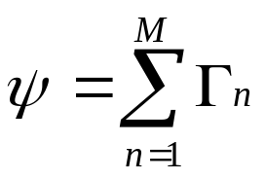




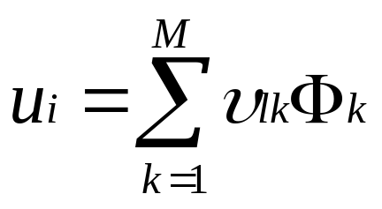
Calculating Eigenfaces
Read in Training Set
Apply Processing Technique
Calculate the mean image
Find the difference between each image and the mean image
Calculate L matrix and eigen vectors
Calculate eigenfaces
Keep the M’ images that correspond to highest eigen values as the face space

Slide 6
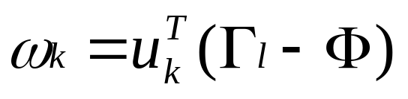
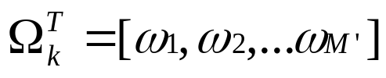

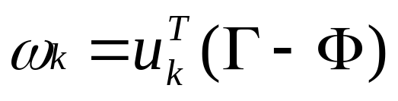
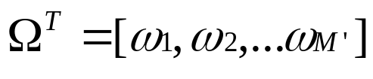
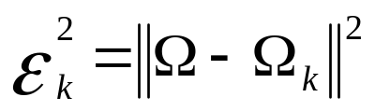
Verifying Faces
Form a set of weights from training data
Get new face image, apply preprocessing technique
From set of weights for new image
Find the distance between the new face and the training data
If distance is less than a set threshold the face is categorized as the k^{th} person in the database.

Slide 7
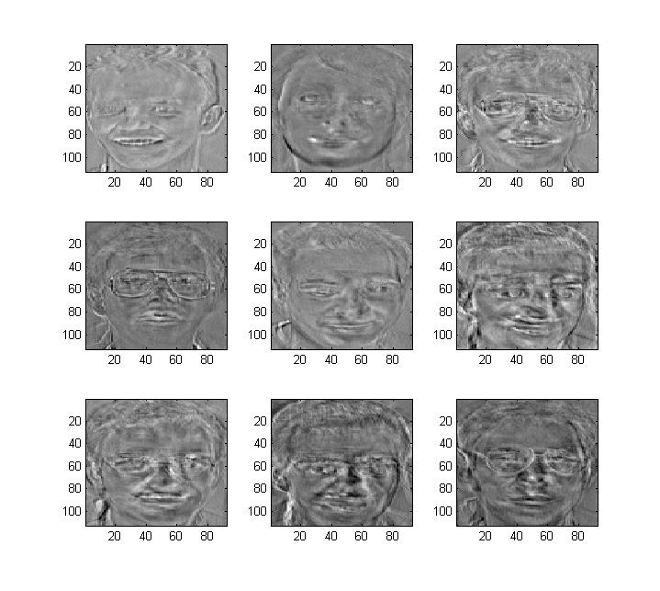
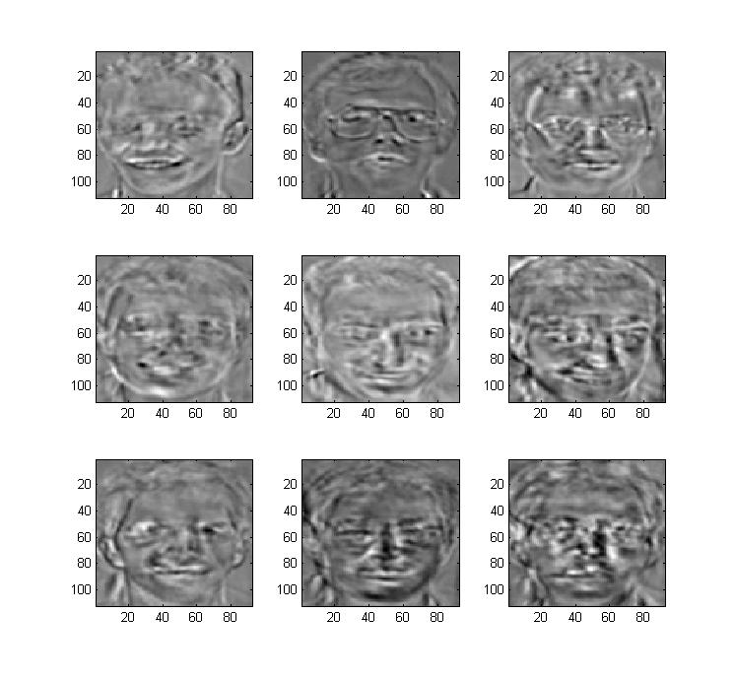
Example Eigenfaces

Slide 8
Results
Will be ranked on best performance based upon
  Correct matching
  Speed
  Incorrect matches

Slide 9
References
M. Turk, A. Pentland, Eigenfaces for Recognition, Journal of Cognitive Neurosicence, Vol. 3, No. 1, 1991, pp. 71-86
W. Zhao, R. Chellappa, A. Rosenfeld, P.J. Phillips, Face Recognition: A Literature Survey, ACM Computing Surveys, 2003, pp. 399-458
Wikipedia
http://ai.ucsd.edu/Tutorial/matlab.html
ECE533 Course Notes
ECE738 Course Notes

