Slide 1
Programming for Engineers in Python
Recitation 10

Slide 2
Plan
Image Processing:
Segmentation using Otsu threshold selection method
Morphological operators
Erosion
Dilation
Denoising

Slide 3
Image Processing in Python
How to handle an image?
The Python Imaging Library http://www.pythonware.com/products/pil/
Example tutorial: http://www.geeks3d.com/20100930/tutorial-first-steps-with-pil-python-imaging-library
The Image Module: http://www.pythonware.com/library/pil/handbook/image.htm
Capacities:
Read / write images
Display image
Basic image processing

Slide 4
Binary Segmentation
Goal – reduction of a gray level image to a binary image. Simple segmentation:
def segment(im, thrd = 128):
width, height = im.size
mat = im.load()
out = Image.new(‘1',(width, height)) # ‘1’ means black & white (no grays)
out_pix = out.load()
for x in range(width): # go over the image columns
for y in range(height): # go over the image rows
if mat[x, y] >= thrd: # compare to threshold
out_pix[x, y] = 255
else:
out_pix[x, y] = 0
return out

Slide 5
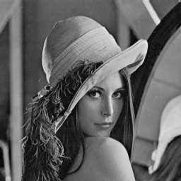
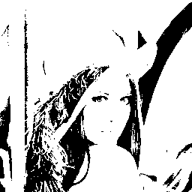
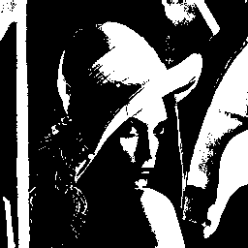
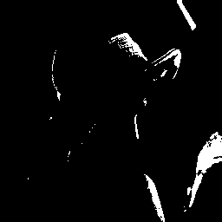
Binary Segmentation
Threshold = 50
Threshold = 128
Threshold = 200

Slide 6
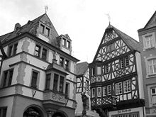
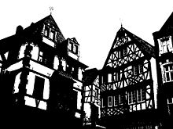
Otsu Threshold
The algorithm assumes that the image contains two classes of pixels - foreground and background.
Finds an optimum threshold separating the classes by:
calculating the image histogram
separating these classes so that their intra-class variance is minimal.
Coming next: image histogram, intra-class variance

Slide 7
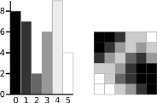
Image Histogram
Histogram of an image: a graphical representation of the colors distribution in an image.
x-axis - represents the colors
y-axis - the number of pixels with a particular color
Gray-scale histogram

Slide 8
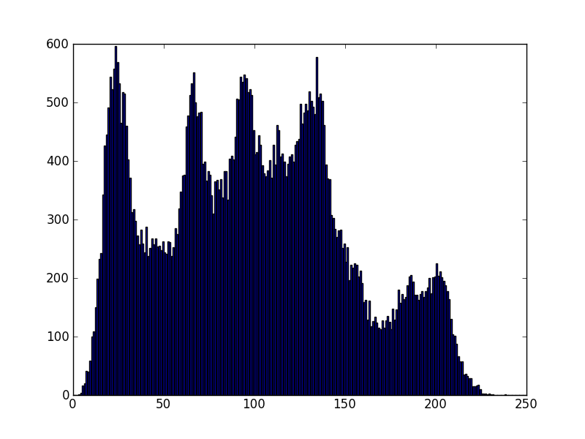
Image Histogram - Code
def histogram(im):
pix =im.load()
width, height = im.size
hist = [0]*256
for y in range(height):
for x in range(width):
gray_level= pix[x, y]
hist[gray_level] = hist[gray_level]+1
return hist
Note: We use the gray level as the index of
the histogram!

Slide 9
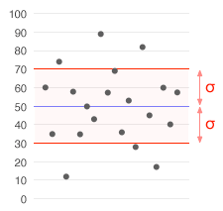
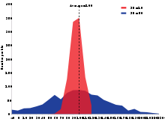
Class Variance
Variance (σ²)- a measure of how much a set of points is spread out, defined as the mean distance² from a point to the set’s center.
A good threshold:
Minimizes within-group variance = resemblance among class points.
Maximizes between-group variance = separation between class centers.

Slide 10
Class Variance - formula
For some threshold t:
Background <= t, low gray levels
Foreground > t, high gray levels
mean_back – mean of the Background pixels
mean_fore – mean of the Foreground pixels
w_back – number of Background pixels
w_fore – number of Foreground pixels
var_between = w_back * w_fore * (mean_back - mean_fore)**2
The Otsu threshold is the threshold that maximizes the var_between over all possible thresholds.

Slide 11
Otsu threshold - Code
def otsu_thrd(im):
hist = histogram(im)
sum_all = 0
# sum the values of all background pixels
for t in range(256):
sum_all += t * hist[t]
sum_back, w_back, w_for, var_max, threshold = 0, 0, 0, 0, 0
total = height*width

Slide 12
Otsu threshold - Code
# go over all possible thresholds
for t in range(256):
# update weights
w_back += hist_data[t]
if (w_back == 0): continue
w_fore = total - w_back
if (w_fore == 0) : break
# calculate classes means
sum_back += t * hist_data[t]
mean_back = sum_back / w_back
mean_fore = (sum_all - sum_back) / w_fore
# Calculate Between Class Variance
var_between = w_back * w_fore * (mean_back - mean_fore)**2
# a new maximum is found?
if (var_between > var_max):
var_max = var_between
threshold = t
return threshold

Slide 13
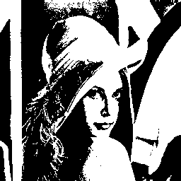
Otsu threshold - Run
>>> im = Image.open('lena.bmp')
>>> th = otsu_thrd(im)
>>> th
97
>>> out_im = segment(im, th)
>>> out_im.show()

Slide 14
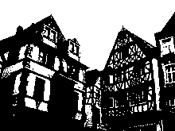
Otsu threshold - Run
Threshold = 149

Slide 15
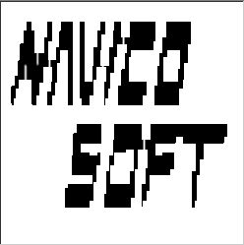
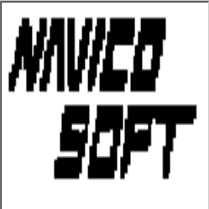
Morphological Operators
Morphology is a technique for the analysis and processing of geometrical structures
Erosion of the binary image A – erode away the boundaries of regions of forground pixels (white pixels), such that areas of forground pixels shrink, and holes grow.

Slide 16


Morphological Operators
Dilation - enlarge the boundaries of regions of forground pixels, such that areas of forground pixels grow and holes shrink.

Slide 17
Morphological Operators - Code
Framework:
def morphological(im, operator = min, nx = 5, ny = 5):
width, height = im.size
out_im = Image.new('L',(width, height), 'white')
in_pix = im.load()
out_pix = out_im.load()
for y in range(height):
for x in range(width):
nlst = neighbours(in_pix, width, height, x, y, nx, ny)
out_pix[x, y] = operator(nlst)
return out_im

Slide 18
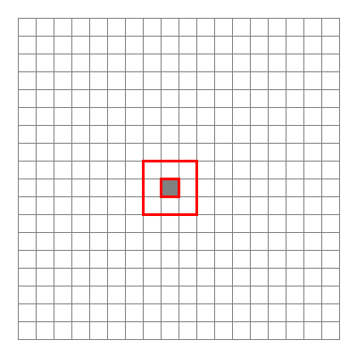
Morphological Operators - Code
Create a pixel’s environment:
def neighbours(pix, width, height, x, y, nx=1, ny=1):
nlst = []
for yy in range(max(y-ny, 0), min(y+ny+1, height)):
for xx in range(max(x-nx, 0), min(x+nx+1, width)):
nlst.append(pix[xx, yy])
return nlst

Slide 19
Morphological Operators - Code
Erosion and dilation:
def erosion(im, nx = 5, ny = 5):
return morphological(im, min, nx, ny)
def dilation(im, nx = 5, ny = 5):
return morphological(im, max, nx, ny)

Slide 20
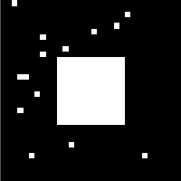


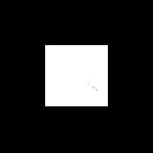
Morphological Operators - Run
im = Image.open('square1.bmp')
out = erosion(im)
out.show()
Image.open('square4.bmp')
out = dilation(im)
out.show()

Slide 21
Dilation for Edge Detection
# find the differences between two images
def diff(im1, im2):
out = Image.new('L', im1.size, 'white')
out_pix = out.load()
p1 = im1.load()
p2 = im2.load()
width, height = im1.size
for x in range(width):
for y in range(height):
out_pix[x, y] = abs(p1[x, y] - p2[x, y])
return out

Slide 22
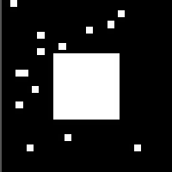
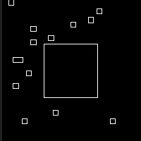
Dilation for Edge Detection
im1 = Image.open('square1.bmp')
im2 = dilation(im, 1, 1)
edges = diff(im, im2)

Slide 23
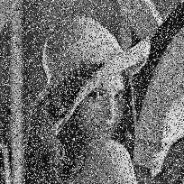
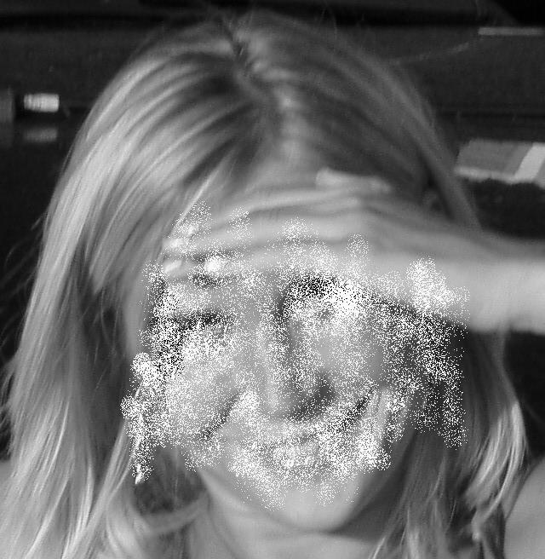
Denoising
We want to “clean” these pictures from noise:
Suggestions?

Slide 24

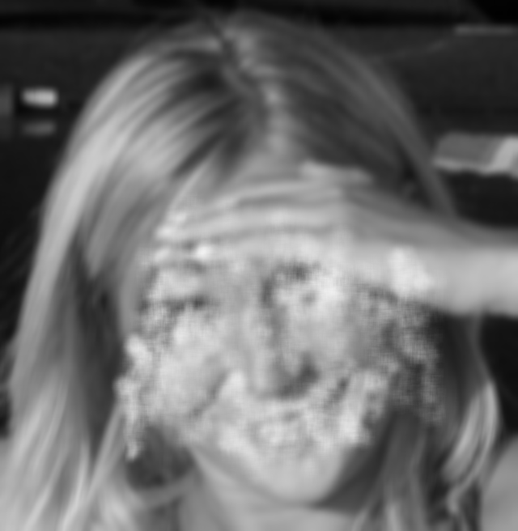
Denoising - Mean
Take 1: Smoothing
Use the morphological framework with mean:
def mean(lst):
return sum(lst)/float(len(lst))
def denoise_mean(im, nx = 5, ny = 5):
return morphological(im, mean, nx, ny)

Slide 25
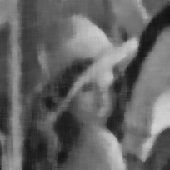
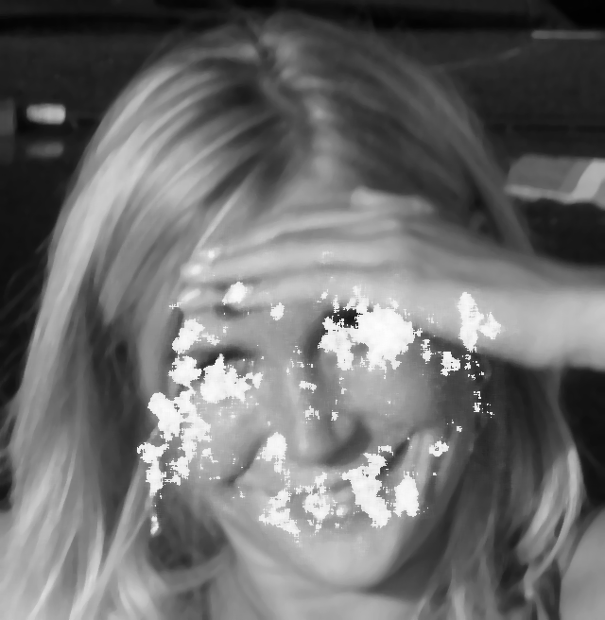
Denoising - Median
Take 2: Median
def median(lst, min_val = 0, max_val = 255):
lst.sort()
return lst[len(lst)/2]
def denoise_median(im, nx = 5, ny = 5):
return morphological(im, median, nx, ny)

Slide 26
Denoising - Median
Can we do better?
Idea – the ‘salt’ is (almost) white, the ‘pepper’ is (almost) black.
We can change very bright or very dark pixels only!
To calculate the median, we will use only neighboring pixels that are not close to the pixel we change.
The noisy pixels surrounded by ‘normal’ pixels will be fixed.
Continue iteratively

Slide 27
Denoising – Bounded Median
def median(lst, min_val = 0, max_val = 255):
lst.sort()
new_lst = [i for i in lst if (i >= min_val and i <= max_val)]
if new_lst:
return new_lst[len(new_lst)/2]
else:
return lst[len(lst)/2]
def fix_white(lst, k = 200):
center = len(lst)/2
if lst[center] > k:
return median(lst, max_val = k)
else:
return lst[center]
def fix_black(lst, b = 50):
center = len(lst)/2
if lst[center] < b:
return median(lst, min_val = b)
else:
return lst[center]

Slide 28
Denoising – Bounded Median
def denoise_bounded_median(im, nx = 3, ny = 3):
for i in range(3):
im = morphological(im, fix_white, nx, ny)
im = morphological(im, fix_black, nx, ny)
return im

Slide 29
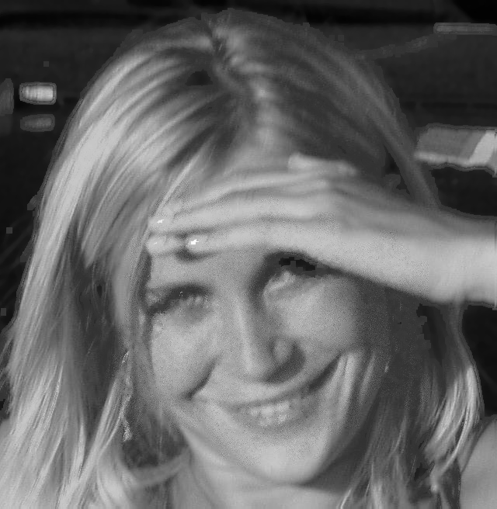


Denoising – Bounded Median
1
2
3
4

