Slide 1
Connected Character Segmentation
for Offline Handwritten
Character Recognition
U.K. Sampath Jayarathna (PS/01/122)
Department of Statistics & Computer Science
Faculty of Science
University of Peradeniya
June 2006

Slide 2
Character Vs Cursive ?
Cursive | Continuous concatenated set of strokes,produced by a human being in a free style.
Character | A single standalone symbol produced by a machine subjected to numerous alternative fonts

Slide 3
Online Vs Offline ?
Online | Captured by pen-like devices. The input format is a 2D signal of pixel locations as a function of time (x(t),y(t)).
Offline | Captured by scanning devices. The input format is a 2D image of gray-scale colors as a function of location I(m*n).

Slide 4
Why Character Recognition ?
Human Eye
Human
Characters
Binary Codes
Computer
Characters
OCR/ICR is needed because, even though humans can read characters, computers can't. Computers use binary codes, collectively known as ASCII, to represent characters. Just as characters aren't recognizable to computers, so too ASCII is completely meaningless to human eye.

Slide 5
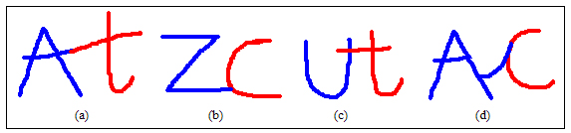
Connected Character Segmentation
Segmentation and Recognition of Connected
characters, is a key problem in the development
of OCR/ ICR systems.
Tow strokes from two adjacent digits touching end to end.
The end of a stroke of the left/right digit touching the side of a stroke of the right/left digit.
Overlapping of two vertically oriented strokes from two adjacent digits.
Stroked connection between adjacent two-digit strings.

Slide 6
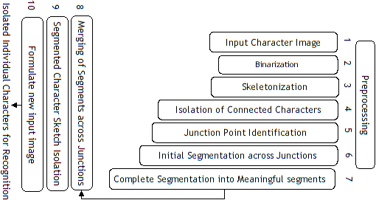
Methodology

Slide 7
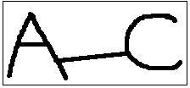

Binarization
If the intensity of a particular pixel is less than a
particular threshold value, it is set to black (0) and if the
intensity value is greater than or equal to the threshold,
it is set to white (255).
Skeletonization
Getting the single order pixel skeletons of the connected
character pattern within the input image.

Slide 8
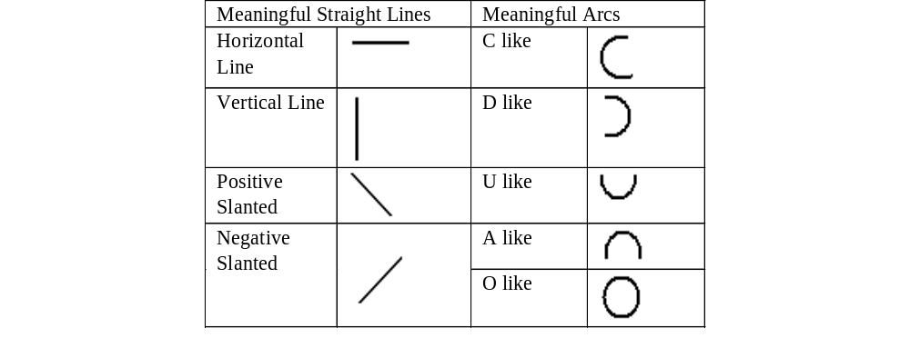
Meaningful Segments

Slide 9
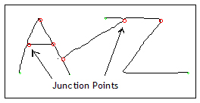
Why the Junction Based Segmentation?
Definition 2:
A Junction Point is a pixel point in the Correlation area having three or more neighboring pixels. It is assumed here that the skeleton is in one pixel thickness.

Slide 10
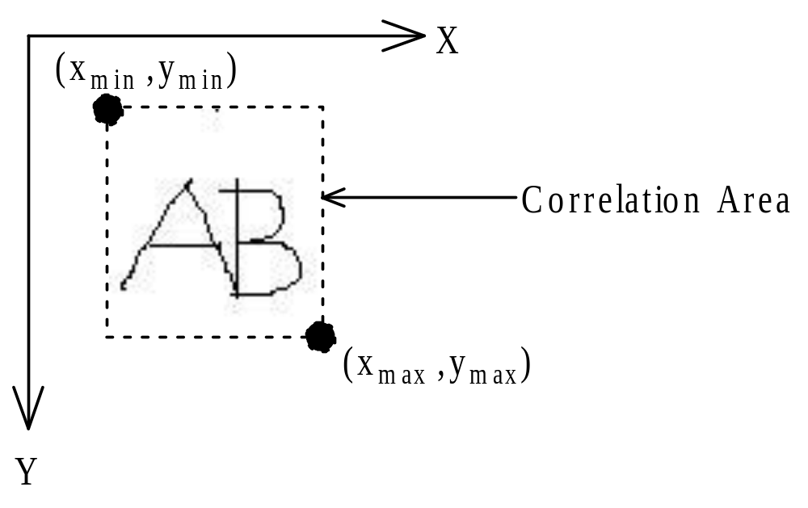
Isolation of Connected Characters
Definition 1:
A correlation area is a rectangular area in the image, which contains connected character skeleton.

Slide 11
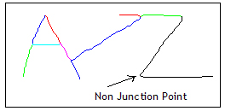
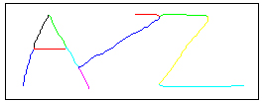
Segmentation Process
Junction Based
Segmentation
Initial Segmentation
Complete Segmentation

Slide 12
Segmentation Algorithm
Two types of major data structures are used in this algorithm, namely,
Point : Holds the X and Y coordinate values of a pixel point.
Segment : A Point array.
The input for this connected character segmentation algorithm is the correlation area of a connected character skeleton.

Slide 13
Segmentation Algorithm
Function ccs_algo (correlation_area) returns total_Segments
Begin
major_starters = empty // a queue of Point to store major starter points.
junction_points = empty // a queue of Point to store junction points.
partial_Segment = empty /* an array of Segment, to store the partial segments identified
by starting traversal with a particular major starter point.*/
init_Segments = empty // an array of Segment, to store all the identified partial segments
complete_Segments = empty /* an array of Segment, to store complete character segments */
total_Segments = empty /* an array of Segment, to store completed/named character segments */
major_starters = find all major starter points (correlation_area)
junction_points = find all junction points (correlation_area)
for each of the initial major start points in major_starters do
partial_Segments = init_Split(major_starter_point, junction_points)
add all the segments in the partial_Segments to init_Segments
end for.
noise_removal(init_Segments)
complete_Segments = complete_Split(init_Segments)
total_Segments = get_Segment_naming(complete_Segments)
return total_Segments
End

Slide 14
Starter/Junction point identification
Point Type
Identification Method
Major Starter Point
(Technique 1)
All the pixel points in the correlation area, those having only one neighboring pixel
Major Starter Point (Technique 2)
In case of character ‘O’ and number zero, they cannot be obtained by the Technique 1, since all the points in such a one pixel thickness, closed ‘O’ like curve would have at least two neighboring pixels. In such a case, the first pixel, which is found on the character skeleton, is taken as its major starter point.
Junction Point
All the pixel points in the correlation area, those having three or more neighboring pixels

Slide 15
Some Definitions…….
Definition 4:
A major starter point is a starter point, which is identified before starting the traversal through the skeleton.
Definition 5:
A minor starter point is a starter point, which is identified during the traversal through the skeleton.
Definition 6:
The traversal direction is the direction from the current pixel to the next pixel to be visited during the traversal.
Definition 7:
An end point is a pixel point in the correlation area, in which there is no neighboring pixel to visit next

Slide 16
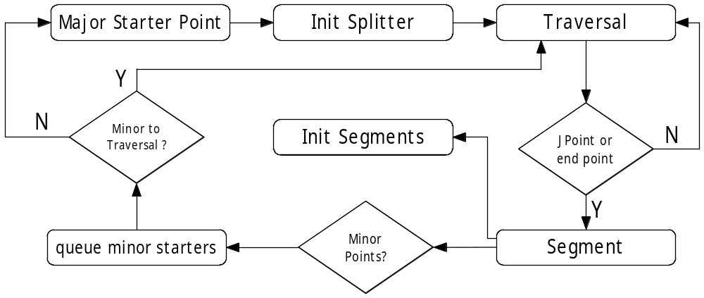
Initial Splitter

Slide 17
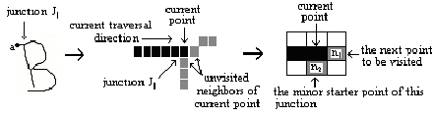
Minor Starters
The initial splitter process mentioned above is continued with all the unvisited major starter points in the major_starters queue, and the final output of the segmentation is used as the input to the complete splitting process

Slide 18
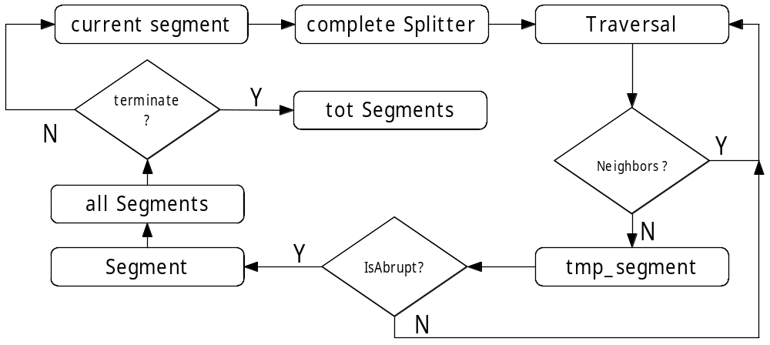
Complete Splitter

Slide 19
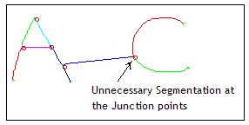
Merging Across Junctions
Merging of each segment across junction is proposed, to avoid unnecessary segmentation and to reconstruct meaningful segments.
In this research, each of the segments in the complete segment list was named with respect to its participating junction point number(s).

Slide 20
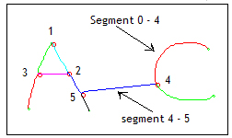
Junction based Naming process
Each of the segment object can be composed in to a first junction number, second junction number and a pixel point segment.
A segment with a first junction and the second junction can be named as follows
“Segment first Junction no - second junction no”
Ex: Segment 3 – 0

Slide 21
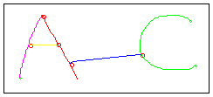
Merging into meaningful segments
each segment in the total segment is categorized in accordance with the related junction number.
Ex:
junction point number 3 is used to create a category, which consists of all segments, which have a junction point number 3 at first or second junction number.

Slide 22
Merging Ctd…..
Relative Positions
Straightness & Arc-ness
MHP(µ Horizontal position)
MVP(µ Vertical position)
MSTR(µ Straightness)
MARC(µ Arc-ness)
Line Types
Curve Types
MVL(µ Vertical line)
MHL(µ Horizontal line)
MPS(µ Positive slant (/))
MNS(µ Negative slant (\))
MCL(µ C-like)
MDL(µ D-like)
MAL(µ A like)
MUL(µ U-like)
MOL(µ O-like)
Relative Lengths
MLENH(µ Length Horizontal)
MLENV(µ Length Vertical)
MLENS(µ Length Slant)

Slide 23
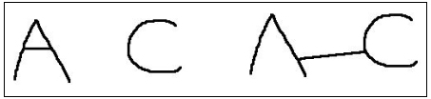
Character Sketches & Isolation
Merged Segments -------------→ Major Segments
Not Merged Segments --------→ Minor Segments
Minor segment group could isolate an unnecessary stroked connection between individual characters.
Each of the segments in the major segment group is used to formulate new input character image by selecting segments from the minor segment group.
This method is used to create input character image with several correlation areas

Slide 24
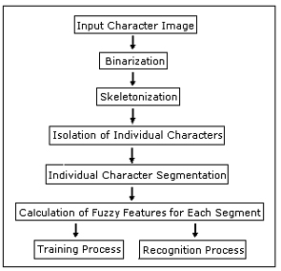
Individual Character Recognition

Slide 25
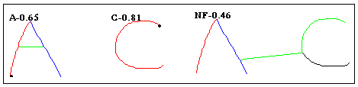
Results & Discussion
The algorithm was tested with the connected character skeletons obtained by the skeletonization process, of handwritten upper case English characters.

Slide 26
Conclusions & Recommendations
Proposed algorithm for the connected character separation was an extremely reliable and relatively simple method for generating the fuzzy description of connected character patterns.
Capable of separating the connections in the uppercase English handwritten characters into meaningful segments accurately.
Can be applicable to any handwritten or machine written offline character recognition system for any character set in any language.
Very flexible and simple to implement, compared to other available methods for offline handwritten connected character recognition.

Slide 27
Future Works……….
The next step in the development of this system will be a connected character separation algorithm in lowercase handwritten English letters and numeric.
Can also be suggested a development of an identification method, which is capable of separating connection styles other than the single stroked connection.

Slide 28
References
[1]. K. B. M. R. Batuwita, G.E.M.D.C. Bandara (2005), “An online adaptable fuzzy system for offline handwritten Character recognition”,
Proceedings of 11th World Congress of International Fuzzy Systems Association (IFSA 2005), Beijing, China, 2005, Springer-Tsinghua, Vol. II, p.1185-1190
[2] LI Guo-hong, SHI Peng-fei (2003), “An approach to offline handwritten Chinese character recognition based on segment evaluation of adaptive duration “, Institute of Image Processing and Pattern Recognition, Shanghai Jiaotong University, Shanghai, China.
[3] Zongkang Lu, Zheru Chi, Wan- Chi Siu, Pengfei Shi, “A Background thinning based approach for separating and recognizing connected handwritten digit strings“, Department of Electronic Engineering , the Hong Kong Polytechnic University, Hong Kong, Institute of Pattern Recognition & Image Processing, Shanghai Jiaotong University, China
[4] Akihiro Nomura, Kazuyuki Michishita, Seiichi Uchida, and Masakazu Suzuki, “Detection and Segmentation of Touching Characters in Mathematical Expressions”, Graduate School of Mathematics, Faculty of Information Science and Electrical Engineering, Kyushu University, 6-10-1 Hakozaki, Higashi-ku, Fukuoka-shi, 812-8581 Japan.
[5] Daekeun Y. , Gyeonghwan K., “An approach for locating segmentation points of handwritten digit strings using a neural network ”, Dept. of Electronic Engineering Sogang University, CPO Box 1142, Seoul 100-611 Korea.
[6] Yi Lu, Beverly Haist, Laurel Harmon, Jhon Trendkle, Robert Vogt., “An Accurate and Efficient System for Segmenting Machine-Printed Text ”, Environmental Research Institute of Michigan, Ann Arbor, MI .
[7]. K. B. M. R. Batuwita, G.E.M.D.C. Bandara (2005), “An Improved Segmentation Algorithm for Individual Offline Handwritten Character Segmentation”, Proceedings of the International Conference on Computational Intelligence for Modelling, Control and Automation (CIMCA’2005), November 28-30, 2005, Vienna, Austria.
[8]. K. B. M. R. Batuwita, G.E.M.D.C. Bandara (2005), “New Segmentation Algorithm for Individual Offline Handwritten Character Segmentation”, Proceedings of the 2nd International Conference on Fuzzy Systems and Knowledge Discovery (FSKD’2005), August, 28-30, Changsha, China.

Slide 29
Acknowledgement
Dr. G.E.M.D.C. Bandara, Department of Production Engineering, Faculty of Engineering. University of Peradeniya.
Dr. S.R. Kodithuwakku, Department of Stat. & Computer Science, Faculty of Science, University of Peradeniya.
Mr. Romesh Ranawana, Computing Laboratory, University of Oxford.
Mr. Ruckshan Batuwita, Department of Stat. & Computer Science, Faculty of Science, University of Peradeniya.

Slide 30
Thank You.

