Slide 1


Slide 2
Presented By: SAKSHI GOYAL (181500609) PRIYA RAJPUT (181500507) RITIKA AGRAWAL (181500581)

Slide 3
PRESENTATION
ON
GAMING ZONE

Slide 4
Outline
About the Project
Requirements
Introduction
Technology Used

Slide 5
Gaming zone
Our full stack project “Gaming Zone” is an online website which consists of different interesting games built with the help of technologies like HTML, CSS and JavaScript.
In today’s world, where there is so much of stress, it become really important for us to maintain our mental composure and we really need something through which we can de-stress ourselves and what can be a better option than playing games. Our websites provide simple to play game which relax you and you regain your energy for doing other important daily tasks. Our website is a static website. It doesn’t include any database or any back-end technologies. So. This website has been made with the help of front-end web development. Currently, it includes four games whose names are Guess the color game, Rock Paper and Scissor, WordBeater and Mix or Match.

Slide 6
OBJECTIVE
PROBLEM STATEMENT
In the stressful life, we all go through the same problem i.e., stress and anxiety due our work and sometimes we don’t get any way to release that stress and anger
PROBLEM SOLUTION
‘Through our website we are hoping that people will definitely get a way to de-stress themselves because gaming is one of the best ways to lighten up anybody’s mood and refresh them. It also helps them to regain their energy for completing their pending daily tasks.
It also sharpens a person’s mind and make them mentally active.

Slide 7
LETS HAVE A LOOK WHAT WE HAVE DONE IN THIS WEBSITE.

Slide 8
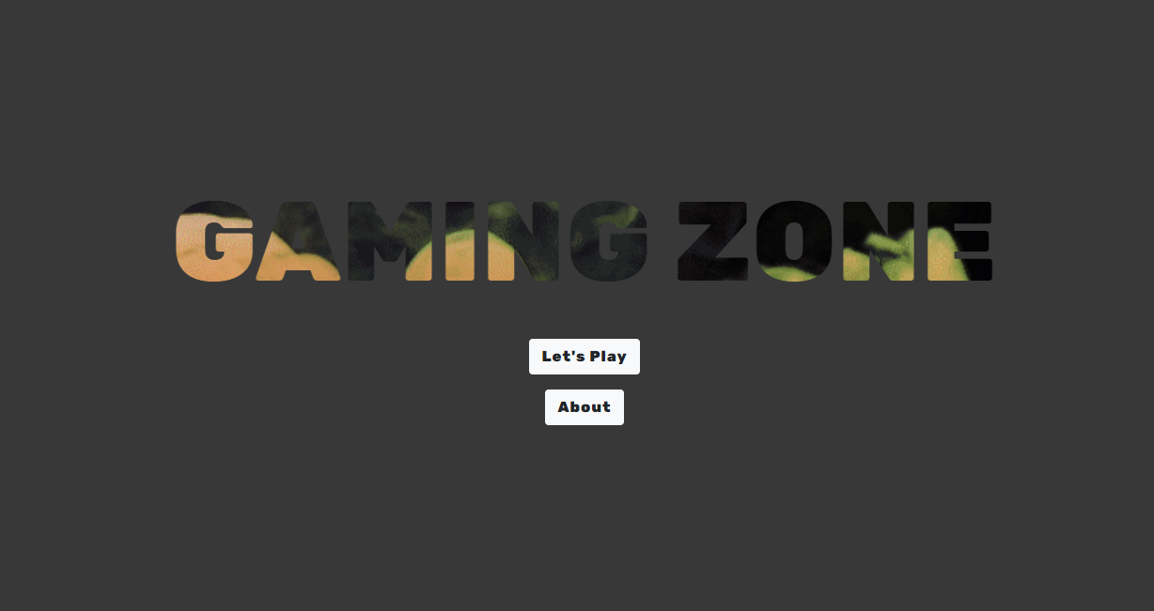
1. Home PAGE

Slide 9
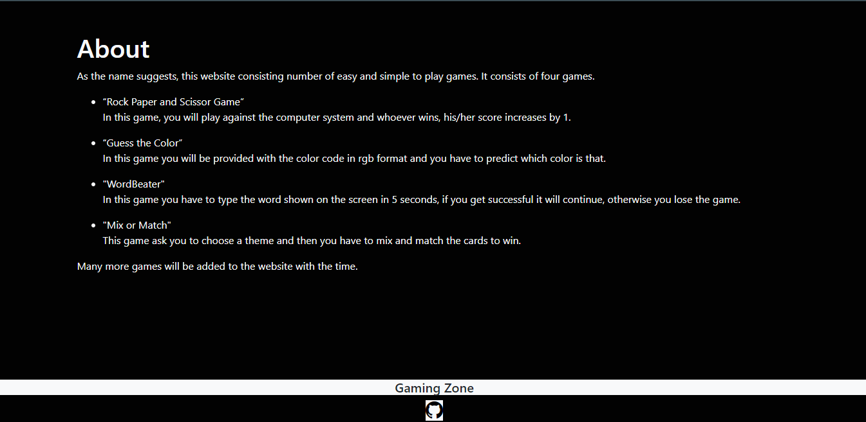
2. ABOUT PAGE

Slide 10
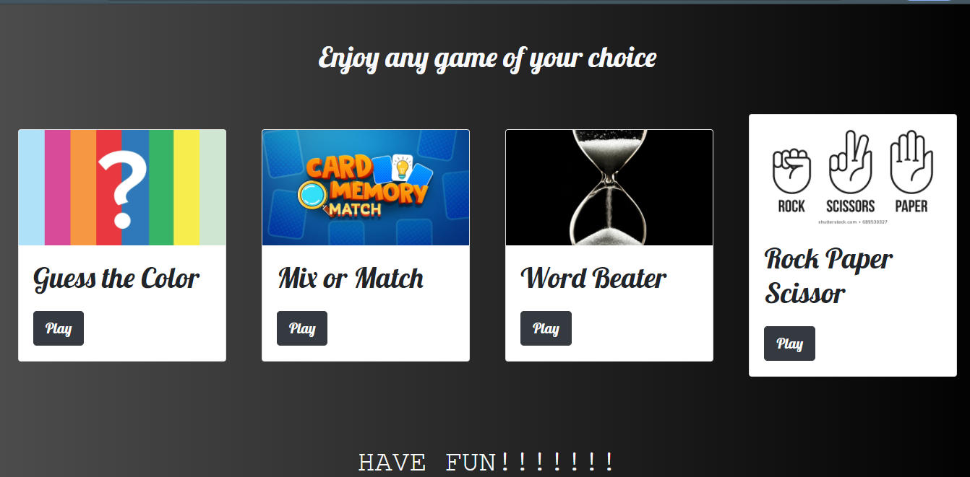
3. Game page

Slide 11
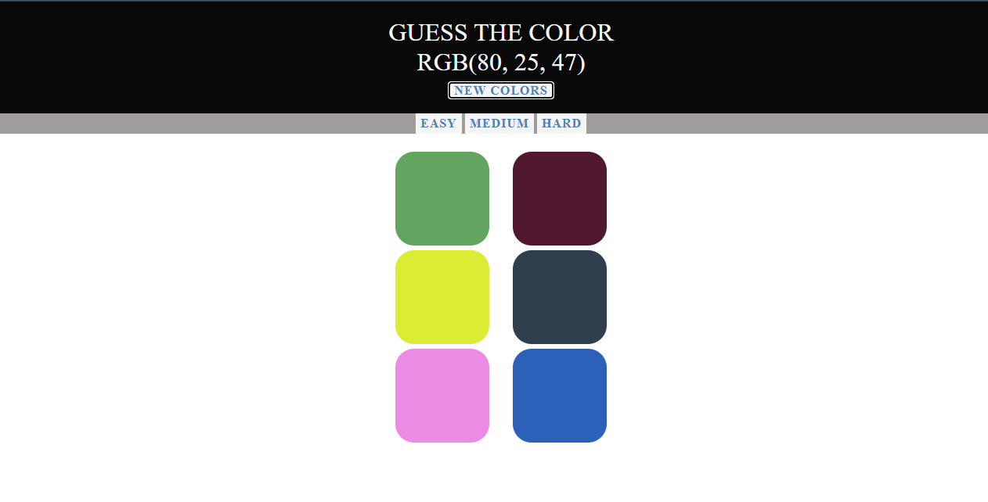
4. GUESS THE Color gAME

Slide 12
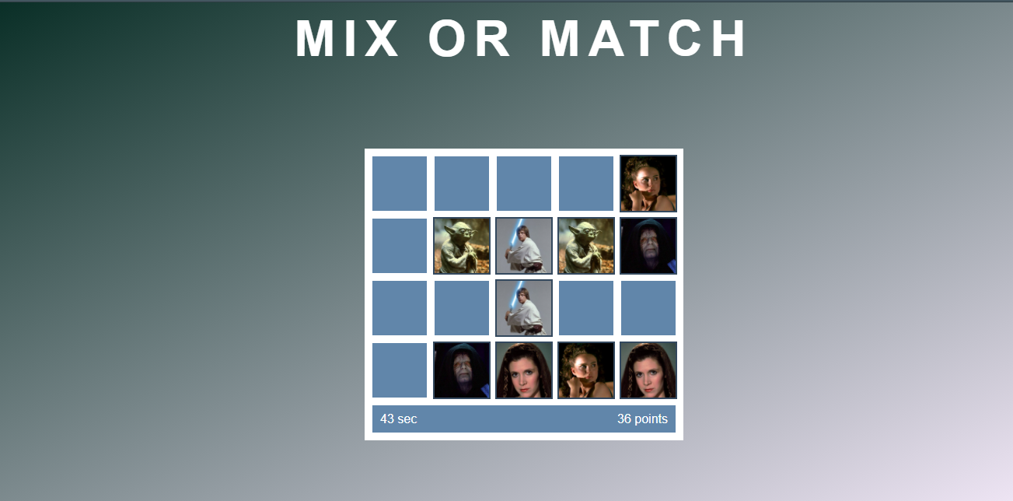
5. MIX OR MATCH GAME

Slide 13
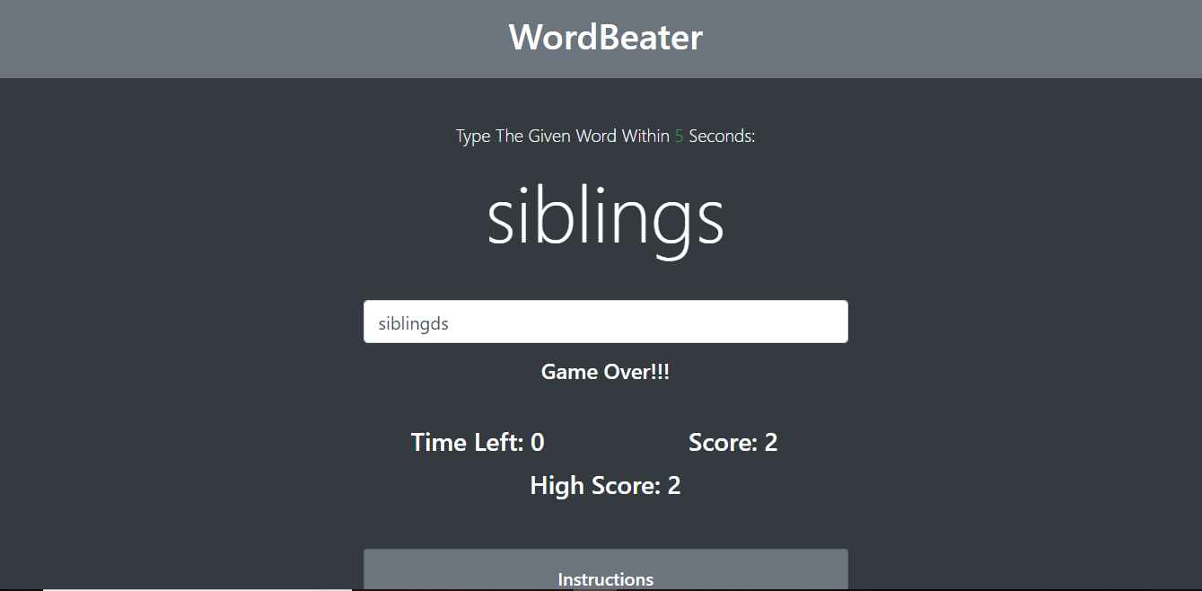
6. WORDBEATER GAME

Slide 14
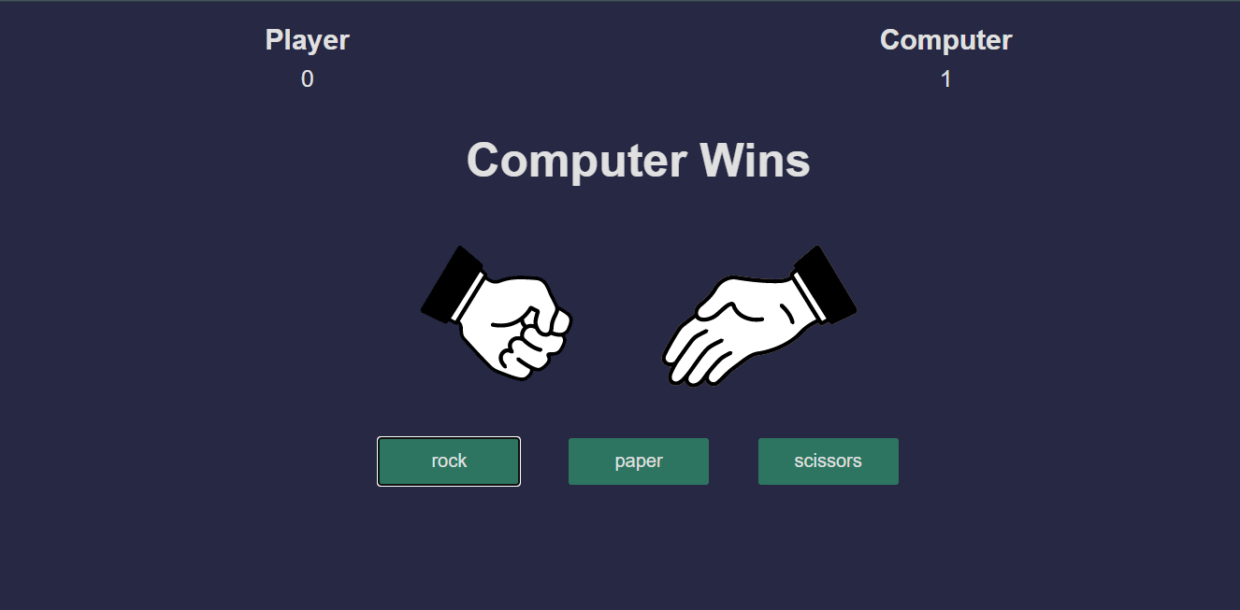
7. ROCK PAPER AND SCISSOR GAME

Slide 15
TECHNOLOGY USED
HTML : Hypertext Markup Language (HTML) is the standard markup language for documents designed to be displayed in a web browser. Web browsers receive HTML documents from a web server or from local storage and render the documents into multimedia web pages. HTML describes the structure of a web page semantically and originally included cues for the appearance of the document.
2. CSS : CSS is designed to enable the separation of presentation and content, including layout, colors, and fonts.This separation can improve content accessibility, provide more flexibility and control in the specification of presentation characteristics, enable multiple web pages to share formatting by specifying the relevant CSS in a separate .css file which reduces complexity and repetition in the structural content as well as enabling the .css file to be cached to improve the page load speed between the pages that share the file and its formatting.

Slide 16
3. Bootstrap : Bootstrap is a web framework that focuses on simplifying the development of informative web pages (as opposed to web apps). The primary purpose of adding it to a web project is to apply Bootstrap's choices of color, size, font and layout to that project. As such, the primary factor is whether the developers in charge find those choices to their liking. Once added to a project, Bootstrap provides basic style definitions for all HTML elements. The result is a uniform appearance for prose, tables and form elements across web browsers.
4. JAVASCRIPT : Alongside HTML and CSS, JavaScript is one of the core technologies of the World Wide Web. JavaScript enables interactive web pages and is an essential part of web-applications. The vast majority of websites use it for client-side page behavior, and all major web browsers have a dedicated JavaScript engine to execute it.

Slide 17
THANK YOU

