Slide 1
AEROFIT SALES ANALYSIS POWER BI DASHBOARD
Name: Ritikaa Rajesh Mishra
Tools Used: Power BI, Power Query, DAX

Slide 2
Objective
Analyze sales data using Power BI
Create an interactive sales dashboard
Identify top-performing products and retailers
Track sales trends across different regions
Support better business decision-making

Slide 3
Dataset Overview
The dataset contains sales-related information of a sportswear retail company
It includes data about products, retailers, regions, sales methods, and profits
The dataset helps analyze sales performance across different areas
Data was cleaned and transformed using Power Query
The dashboard uses this data to generate interactive business insights

Slide 4
Tools & Technologies
Power BI is used to create interactive dashboards and visualizations
Power Query is used for data cleaning and transformation
DAX is used to create calculated measures and KPIs
Excel dataset is used as the data source for analysis

Slide 5
Data Cleaning & Preprocessing
Removed unnecessary columns and corrected data formats
Checked for missing and duplicate values
Transformed data using Power Query
Created calculated measures and KPIs using DAX
Prepared the dataset for dashboard visualization

Slide 6
Exploratory Data Analysis (EDA)
Analyzed sales trends across regions and retailers
Compared sales and operating profit
Identified top-performing products and sales methods
Observed monthly and regional sales patterns

Slide 7
Methodology / Analysis
Imported dataset into Power BI
Cleaned data using Power Query
Created measures and KPIs using DAX
Built interactive dashboard visualizations
Added slicers, maps, and charts for analysis

Slide 8
Key Insights
West Gear generated the highest sales
In-store sales method showed maximum contribution
Western region performed strongly in sales
Retailer-wise profit trends were identified

Slide 9
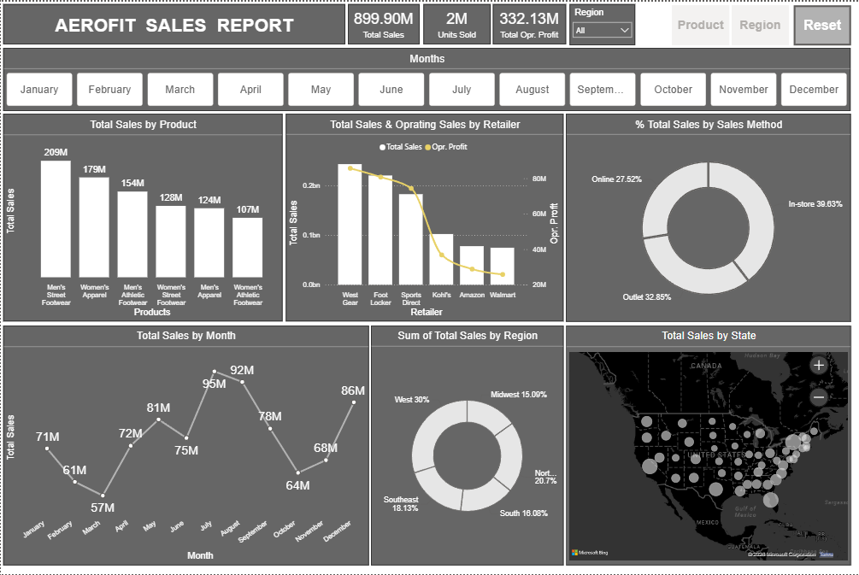
Sales Overview Report
Key Insights
• Total sales reached 899.9M • Men’s Street Footwear had the highest sales • Sales peaked during July and August • In-store sales contributed the most revenue

Slide 10
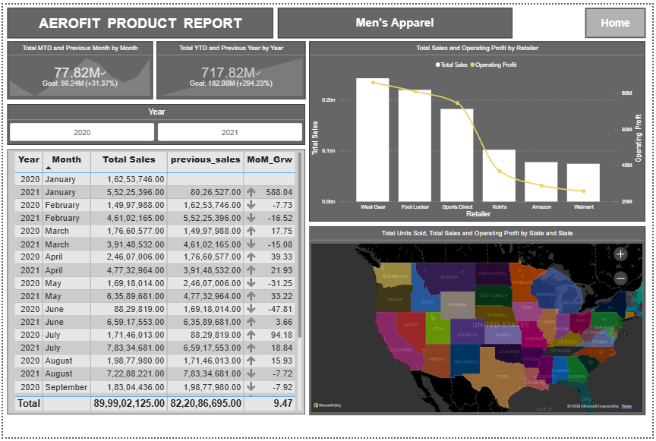
Product Performance Report
Key Insights
• Footwear products showed strong sales • Men’s Apparel performed well • Profit varied by product category • Some products had higher margins

Slide 11
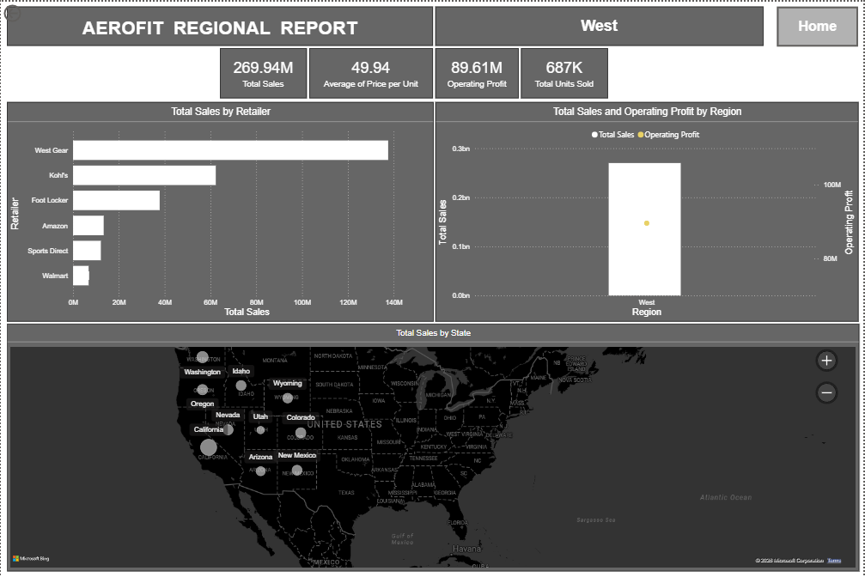
Regional Performance Report
Key Insights
• West region contributed highest sales • Profit varied across regions • Northeast showed strong sales performance • State-wise sales distribution differed

Slide 12
Recommendations
Focus more on high-performing retailers
Improve low-performing sales regions
Promote products with higher sales trends
Use dashboard insights for better decisions

Slide 13
Challenges Faced
Data formatting inconsistencies
Handling large sales data
Aligning dashboard visuals properly
Creating meaningful KPIs and slicers

Slide 14
Conclusion
Successfully created an interactive sales dashboard using Power BI
Dashboard helps analyze sales, profit, products, and retailers
Visualizations improve business understanding and decision-making

Slide 15
Future Scope
Add real-time data integration
Include advanced forecasting analysis
Improve dashboard interactivity and automation

Slide 16
Thank You!

