Slide 1
Retail Sales Exploratory Data Analysis A Data Analysis Project
Name: Ritikaa Rajesh Mishra
Tools Used: Python (Pandas, Seaborn, Matplotlib)

Slide 2
Business Problem / Objective
Business Problem:
Understanding customer behavior and sales trends to improve decision-making
Objective:
Analyze retail sales data to understand business performance
Identify trends and patterns
Understand customer behavior

Slide 3
Dataset Overview
The dataset contains retail transaction data used for sales analysis
It includes the following information:
Customer details: Age, Gender
Transaction details: Date, Quantity
Product details: Product Category, Price per Unit
Sales information: Total Amount

Slide 4
Tools & Technologies
Python (Data Analysis)
Pandas (Data manipulation)
NumPy (Numerical operations)
Matplotlib & Seaborn (Data visualization)
Jupyter Notebook (Development environment)

Slide 5
Data Cleaning & Preprocessing
Checked for missing values and found no missing data
No duplicate records were found, ensuring data consistency
Converted the Date column into datetime format
Created new features:
- Year, Month, Day
- Age Group

Slide 6
Exploratory Data Analysis
Analyzed customer demographics (age, gender)
Studied monthly and seasonal sales trends
Compared product categories based on revenue
Examined customer spending patterns
Identified relationships between variables

Slide 7
Methodology / Analysis
Used data aggregation techniques (sum, average) for analysis
Applied grouping using Month and Product Category
Compared categories using bar plots and count plots
Analyzed relationships using scatter plots
Identified patterns using visualizations

Slide 8
Key Insights
Customer behavior is similar across age and gender
Sales show seasonal variation across months
Electronics category performs slightly better
Most customers are low spenders
High-value customers contribute significantly to revenue

Slide 9
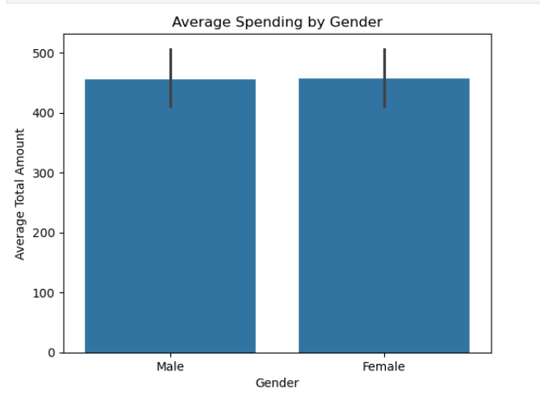
Customer Demographics: Gender Analysis
Insights:
Spending patterns are similar for both males and females
Gender does not significantly influence total spending

Slide 10
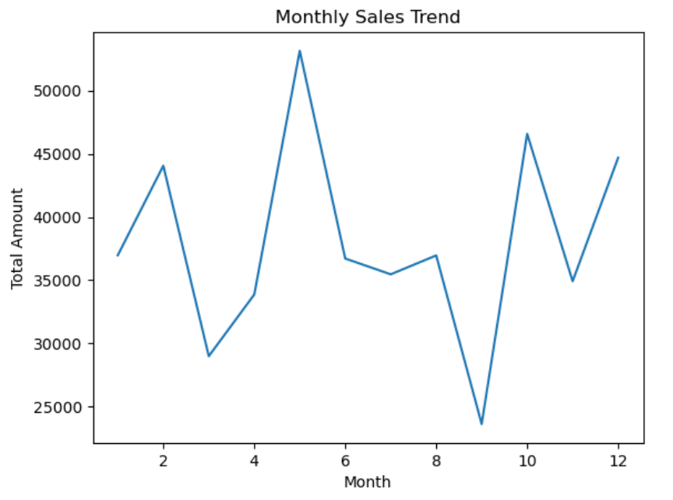
Monthly Sales Trends
Insights:
Sales vary across different months
Highest sales occur in May around (53,150), while lowest in September around (23,620)

Slide 11
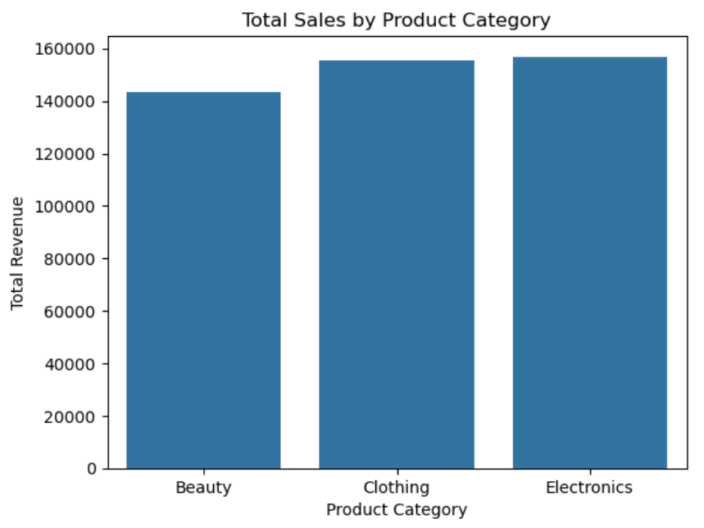
Product Category Analysis: Sales Performance
Insights:
Electronics generates slightly higher sales compared to other categories
All product categories perform similarly with no major difference

Slide 12
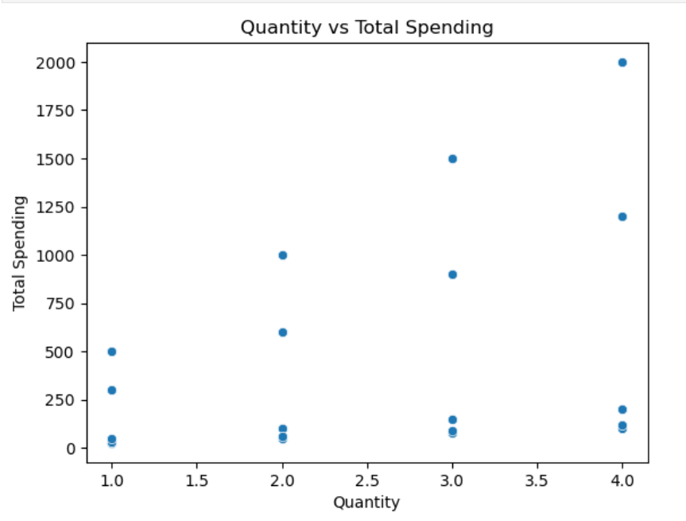
Customer Behavior: Quantity vs Spending
Insights:
As quantity increases, total spending also increases
Customers who buy more items tend to spend more

Slide 13
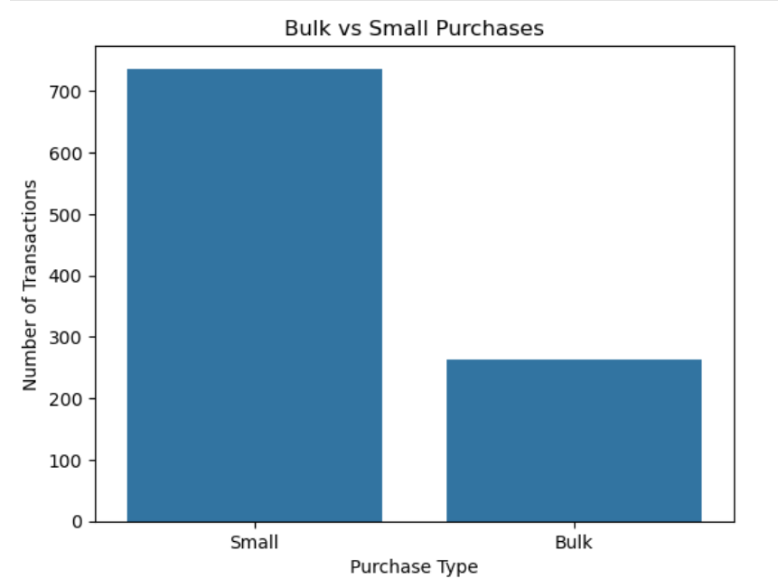
Customer Behavior: Purchase Type Analysis
Insights:
Most customers make small purchases
Bulk purchases are less common

Slide 14
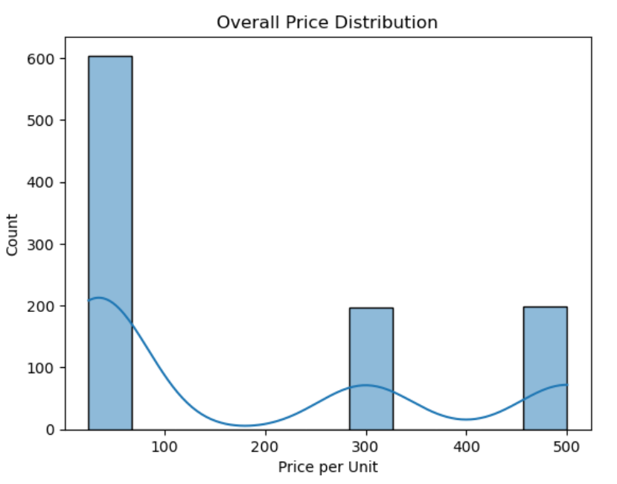
Customer Spending Distribution
Insights:
Most customers spend a low amount
Only a few customers have high spending (high-value customers)

Slide 15
Recommendations
• Focus marketing on high-value customers to increase revenue
• Improve sales during low-performing months using promotions
• Target customers based on purchasing behavior
• Encourage bulk purchases through discounts and offers

Slide 16
Challenges Faced
• Understanding the dataset structure initially
• Creating meaningful features like Age Group
• Interpreting patterns from visualizations
• Selecting the most relevant insights for presentation

Slide 17
Conclusion
Customer behavior is consistent across age and gender
Sales show seasonal variation
Electronics performs slightly better
Majority of customers are low spenders
High-value customers contribute significantly to revenue
→ These insights can help businesses improve marketing strategies and
customer targeting

Slide 18
Future Scope
• Apply machine learning techniques for sales prediction
• Build an interactive dashboard using Power BI or Tableau
• Perform detailed customer segmentation analysis
• Use real-time data for advanced insights

Slide 19
Thank You!

