Slide 1
Store Database Management System SQL Project
Name: Ritikaa Rajesh Mishra
Tools Used: MySQL Workbench

Slide 2
Business Problem / Objective
Business Problem
Lack of data-driven insights in sales and inventory
Difficulty in identifying top products and customers
Objective
Analyze data using SQL
Generate insights for business decisions

Slide 3
Dataset Overview
The dataset consists of multiple tables such as Stores, Customers, Orders, Products, Staffs, and Stocks.
It contains information related to sales transactions, customer details, product data, employee records, and inventory.
All the tables are connected using primary and foreign keys, forming a relational database structure.
This dataset helps in analyzing sales performance, customer behavior, employee efficiency, and inventory management.

Slide 4
Tools & Technologies
SQL (MySQL Workbench) is used for data analysis and writing queries.
Excel is used for data preparation and formatting.
ER Diagram tool is used to design and understand the database structure.

Slide 5
Data Cleaning & Preprocessing
Converted data from Word to Excel and then to CSV format
Removed unnecessary headers and ensured proper structure
Corrected date formats for consistency
Checked for missing or inconsistent values
Imported cleaned data into MySQL for analysis

Slide 6
Data Analysis Using SQL
Performed data analysis using SQL queries on multiple tables
Used JOIN operations to combine data from different tables
Applied aggregate functions like SUM and COUNT for analysis
Used GROUP BY and filtering to extract meaningful insights
Generated results for sales, customers, employees, and inventory

Slide 7
Methodology / Analysis
Used SQL queries for data analysis
Applied JOINs to combine tables
Used SUM and COUNT for calculations
Used GROUP BY for insights
Applied RANK and ROW_NUMBER for advanced analysis

Slide 8
Key Insights
Identified top-selling products
Found high-value customers
Analyzed sales trends
Detected low-stock products
Evaluated employee performance

Slide 9
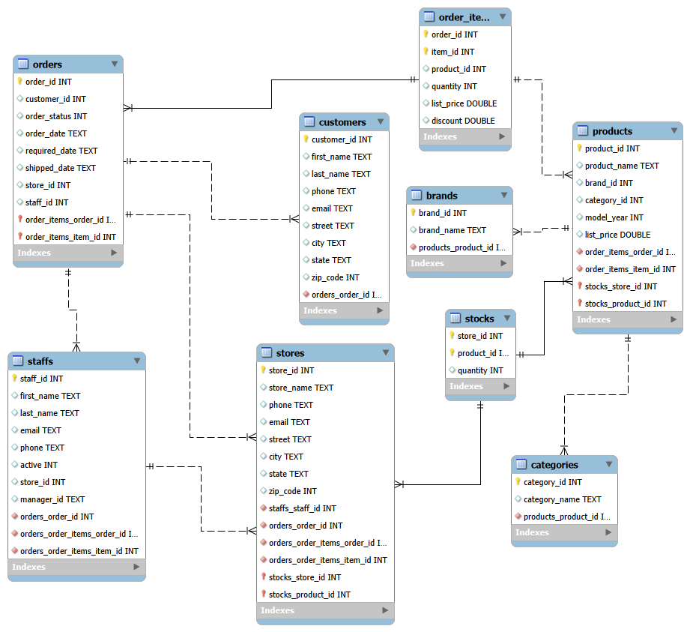
Visualization
ER Diagram showing relationships between tables
Data used for analysis of sales, customers, and inventory
Insights generated using SQL queries

Slide 10
Recommendations
Keep more stock of products that sell more
Focus on important customers
Help low-performing employees improve
Check stock regularly

Slide 11
Challenges Faced
Problem in converting data (Word to Excel to CSV)
Date format issues
Errors in SQL queries Difficulty in understanding joins and functions
Difficulty in solving running total queries

Slide 12
Conclusion
Successfully analyzed store data using SQL
Identified important sales and customer insights
Improved understanding of business data
Gained hands-on experience in SQL

Slide 13
Future Scope
Create dashboards using Power BI
Connect data with real-time updates
Add prediction of future sales
Improve customer analysis

Slide 14
Thank You!

