Slide 1
Data-Driven Narratives: Excelerate Insights Unleashed
Presented by: Ritika Baghel

Slide 2
1. Introduction
Objective: Provide insights into user engagement and opportunities on the Excelerate platform using visuals.
The Excelerate platform aims to empower individuals through learning opportunities, and understanding user engagement is crucial for its success.
The created Excelerate dashboard serves as a valuable tool for understanding user engagement and guiding platform development.
By leveraging these insights, Excelerate can continue to empower learners, bridge the skill gap, and make a lasting impact.
Join us as we explore the purpose and significance of the Excelerate Dashboard in delivering valuable insights.

Slide 3
2. Dashboard Overview
The Excelerate Dashboard is a comprehensive platform designed to provide actionable insights for Excelerate's strategic growth.
The data-driven dashboard presented here offers valuable insights into user sign-ups, geographical distribution, opportunity preferences, demographics, and scholarship awards, painting a comprehensive picture of platform activity.
Let's take a closer look at the key aspects that make up this powerful dashboard.
This dashboard aims to deliver not just data but a compelling narrative, guiding decisions for Excelerate's success.

Slide 4
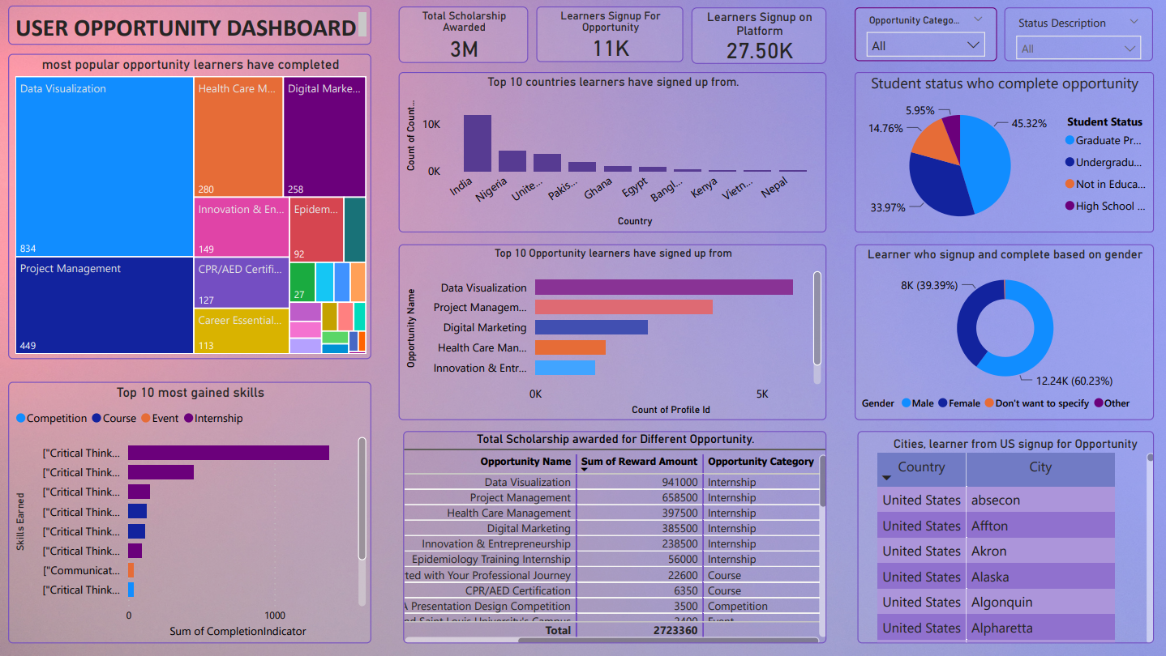

Slide 5
3. Key Decisions and Design Choices
Visualization Selection:
Careful selection of visualizations to effectively convey complex data.
Strategic use of charts, graphs, and tables to represent diverse data points.
Interactivity Features:
Incorporation of interactive elements for a dynamic user experience.
User-friendly features allowing stakeholders to explore data based on specific parameters.
Color Palette and Theme:
Thoughtful choice of colour palette and theme to enhance visual appeal.
Consistent design elements for a cohesive and professional appearance.

Slide 6
4. Challenges Faced
Data Cleaning and Preparation:
Transforming raw data into a usable format for visualization can be time-consuming and require specialized skills.
Choosing the Right Visualizations:
Selecting the most appropriate chart types to effectively represent complex data and avoid misinterpretations can be challenging.
Information Overload and Clutter:
Balancing the amount of information displayed with clarity and user-friendliness is crucial to avoid overwhelming users.

Slide 7
5. Solutions Implemented
Data Cleaning and Preparation:
Standardize processes- Establish clear and documented procedures for data cleaning to ensure consistency and reduce errors.
Choosing the Right Visualizations:
Match the visualization to the data- Choose chart types that are well-suited to the type of data.
Information Overload and Clutter:
Prioritize the most important information- Identify the key insights you want to convey and prioritize them on the dashboard.

Slide 8
6. Insights Derived
User Engagement:
Over 27.5k users registered.
11k active participants
Global Reach:
The top 10 countries for sign-ups
India, Nigeria, the United States, Pakistan, Ghana, Egypt, Bangladesh, Kenya, Vietnam, and Nepal, showcasing a diverse and global user base.
Regional Engagement in the US:
High sign-ups in cities like Chesterfield, Chicago, Maryland Heights, Naperville, and Saint Charles.
Opportunity Preferences:
Data Visualization" is the most popular opportunity for sign-ups.
"Statement Purpose SOP Writing Workshop" is the least popular.
"DataVisualization" exhibits the highest completion rate, indicating strong effectiveness and user interest.

Slide 9
Demographic Diversity:
Over 45.32% of learners who complete the opportunity are enrolled in graduate programs. and 40% of learners who complete the opportunity are undergraduates.
Gender Disparities in Participation:
60% of males sign up for opportunities, compared to 39% of females. However, completion rates show more balanced participation: 42.58% for females and 51% for males.
Scholarship Impact:
Approximately 3 million in scholarship awards are distributed across various opportunities.

Slide 10
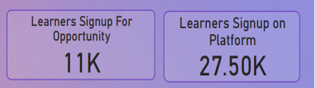
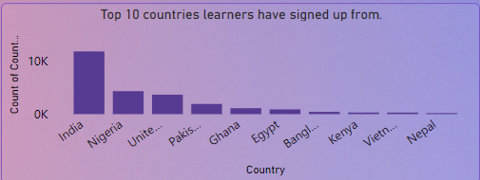
7. Addressing Key Questions
How many people are signed up on the platform, and how many of those have signed up for opportunities?
What are the top 10 countries learners have signed up from?

Slide 11
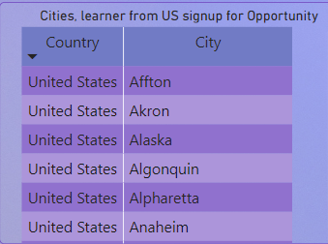
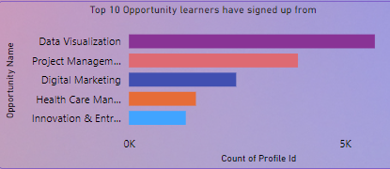
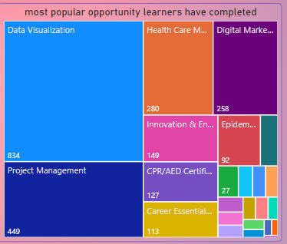
What are the cities in the US learners have signed up from?
Which is the most popular opportunity learners have signed up and completed ?

Slide 12
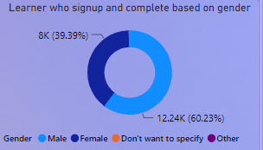
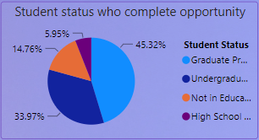

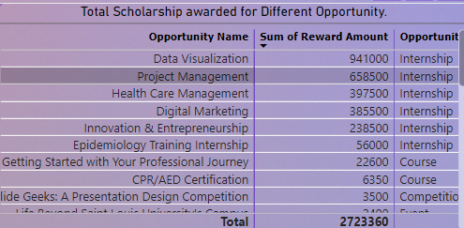
What is the demographic (gender, student status, etc.) of those who have signed up and completed?
How much is the total scholarship awarded and through which opportunities?

Slide 13

7. User Interaction and Guidance
Interactive Filters:
Users can customize displayed data with interactive filters, enhancing personalization.
Drill-Down Functionality:
Users can explore specific data points in detail with drill-down options, facilitating comprehensive analysis.
Tooltip Information:
Interactive tooltips offer instant information and context, aiding quick interpretation of visual elements.

Slide 14
10. Impact on Decision-Making
Strategic Planning:
Insights from user engagement, geographical analysis, and opportunity preferences inform tailored offerings and regional focus.
Resource Allocation:
Understanding demographics and popular opportunities guides efficient resource allocation and scholarship distribution.
Marketing Strategies:
Identifying popular opportunities informs targeted marketing efforts, attracting more users and fostering participation.
User-Centric Improvements:
Insights into demographics and engagement patterns enable user-centric platform improvements for enhanced user experience.

Slide 15
Global Expansion:
Top countries with high sign-ups provide insights for potential global expansion strategies and targeted marketing efforts.
Enhanced User Retention:
Designing programs aligned with user interests enhances user retention and satisfaction.
Financial Impact:
Scholarship program insights aid in budgeting and financial planning, demonstrating Excelerate's financial impact.

Slide 16
Conclusion
The dashboard is vital for Excelerate, offering actionable insights that directly impact decision-making. Aligning strategies with user preferences and global trends leads to improved satisfaction and organizational success. It empowers Excelerate to be agile and responsive in meeting evolving user needs.

Slide 17
THANKYOU…

