Slide 1

PROJECT TITLE : ABHAYAD
TEAM NAME : POWERPUFF GIRLS
1

Slide 2

INTRO ABOUT YOUR TEAM
NAME | YEAR | DEPARTMENT | INSTUTION
MUSKAN GUPTA | 3 RD | Computer science | Vellore Institute Of Technology ,Vellore
RITIKA BHARDWAJ | 3 RD | Computer science | Vellore Institute Of Technology ,Vellore
2

Slide 3
PROBLEM STATEMENT
DOMAIN :
Protecting women from combating against harassment.
PROBLEM STATEMENT :
No matter how many resources are available online for helping women, There are still a lot of women whose voice goes unheard because of lack of appropriate assistance or information.
PROBLEM STATEMENT EXPLANATION :
We all can only imagine how daunting such experiences can be for a women and asking for help or justice is not always possible for everyone as the impact it can hold varies from person to person .What one needs at this time is a helping hand which one can trust and use to raise her voice .
3

Slide 4
SOLUTION
We present to you an AI based chat bot which can be integrated with any website, messaging platform or application to help women get the help they need whether it be regarding
filing a complain or seeking emotional assistance or getting immediate help, this chat bot has covered it all.
4

Slide 5
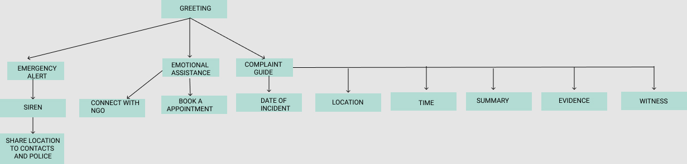
FLOW CHART / ARCHITECTURE DIAGRAM
5

Slide 6
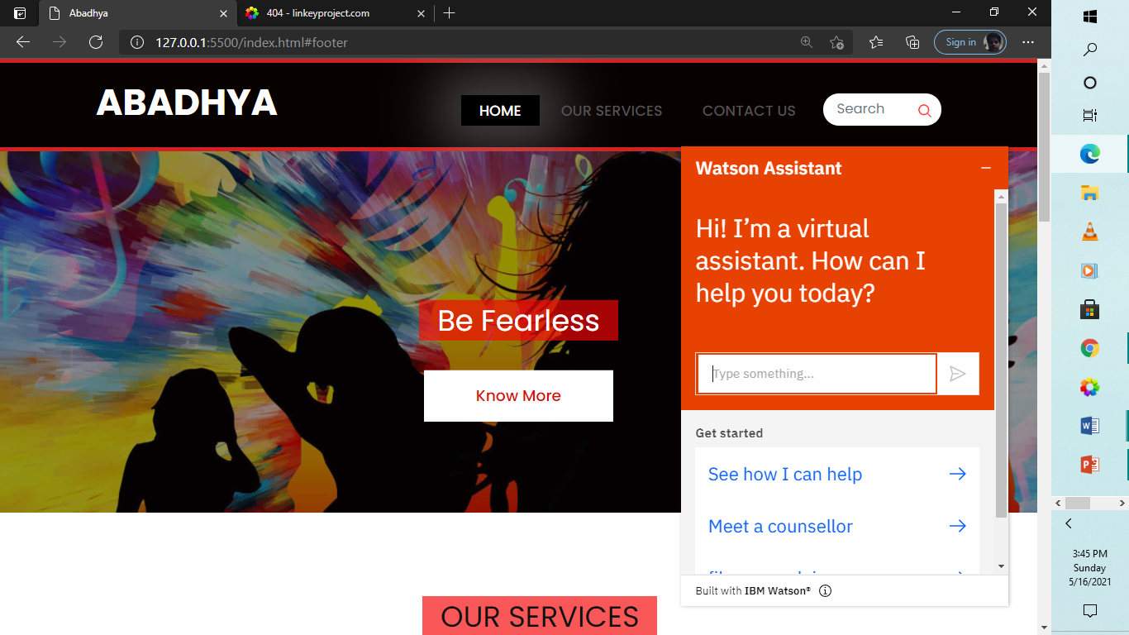
WORKING PROTOTYPE
( IMAGE / VIDEO )
Our website with the assistant demo
6

Slide 7
DEPENDENCIES
Our chat bot is built using IBM Watson assistant. It is currently deployed as web chat. There aren’t many dependencies except a good internet connection. It can also be easily deployed on whatsapp or any other application.
7

Slide 8
SHOW STOPPER
Our Project is a one stop solution which can be integrated with any website or messaging application to maximize it’s reach . The chat bot not only broadcasts an audio when in need of help but also guide the user in the process of reporting a complaint. Any harassment incident can affect the mental health of a person in many ways. So, we also provide service for emotional assistance where one can book an appointment with a professional or contact NGO for emotional support.
8

Slide 9
TECHNOLOGY STACK
IBM Watson assistant
Json
Twilio
HTML
CSS
Javascript
Bootstrap
JQuery
9

Slide 10
CONCLUSION
We think we have provided the solution that we aimed for i.e a virtual guide for women which they can trust and depend on. As future work we aim at collaborating with NGOs in order to help people in reality. Also, we plan to deploy this bot on multiple platforms like WhatsApp or as a separate application.
10

Slide 11
LINK
GOOGLE DRIVE LINK:
https://drive.google.com/drive/folders/16ZqrKeGQZdHHcS4ut_O2VBBFQ0DDt6L9?usp=sharing
YOUTUBE LINK: https://youtu.be/uItL4GulUvY
11

Slide 12

12

