Slide 1
HTML
hypertext markup language

Slide 2

What is html?

Slide 3
Introduction to html
HTML Stands for HYPERTEXT MARKUP LANGUAGE.
With HTML you can create your own Web Site.
HTML is not a programming language, it is a Markup Language.
A markup language is a set of markup tags.
HTML uses markup tags to describe web pages.
HTML is not case sensitive language.
HTML documents contains HTML tags and plain text.

Slide 4
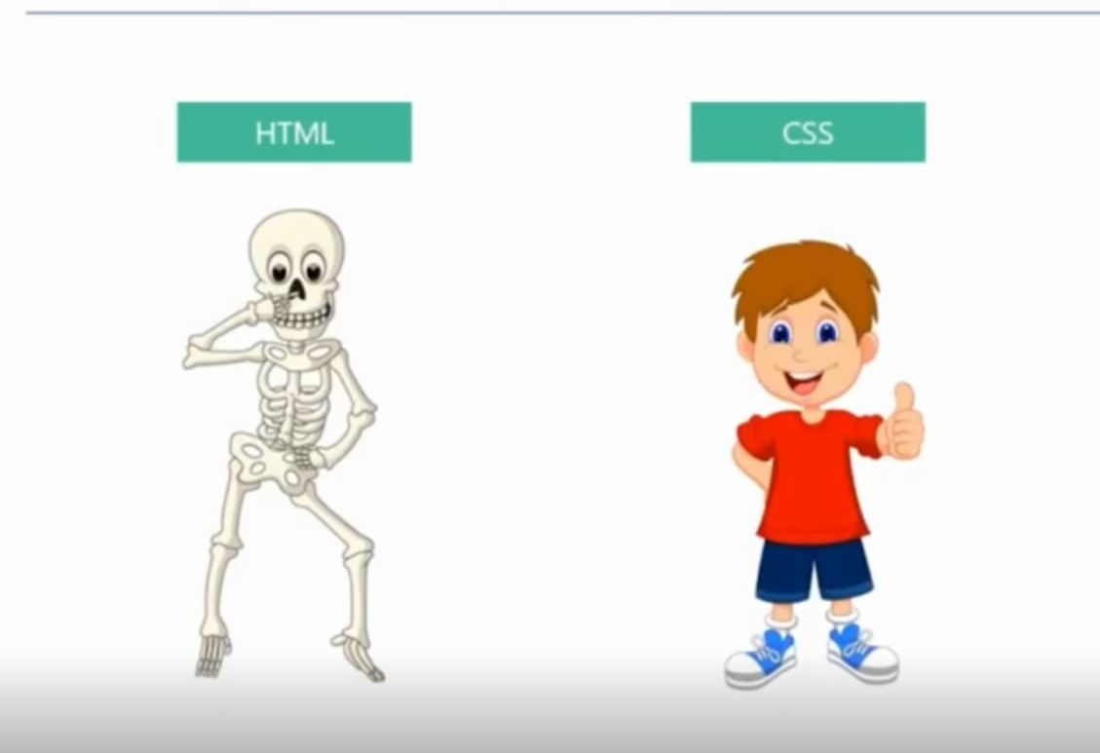

Slide 5
History of html
HTML 1.0
HTML 2.0
HTML 3.0
HTML 4.0
DHTML
XHTML
HTML 5.0 – LATEST VERSION

Slide 6
Building blocks of html
TAGS
ELEMENTS
Attributes

Slide 7

Tags?

Slide 8
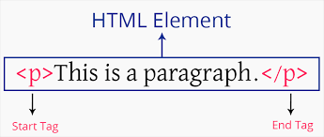
What is a tag?

Slide 9
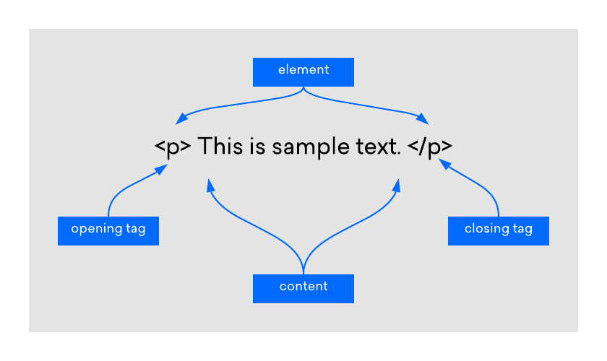
What is an Element?

Slide 10
Types of elements?
Inline Element
Block Element

Slide 11
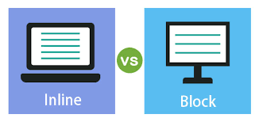

Slide 12
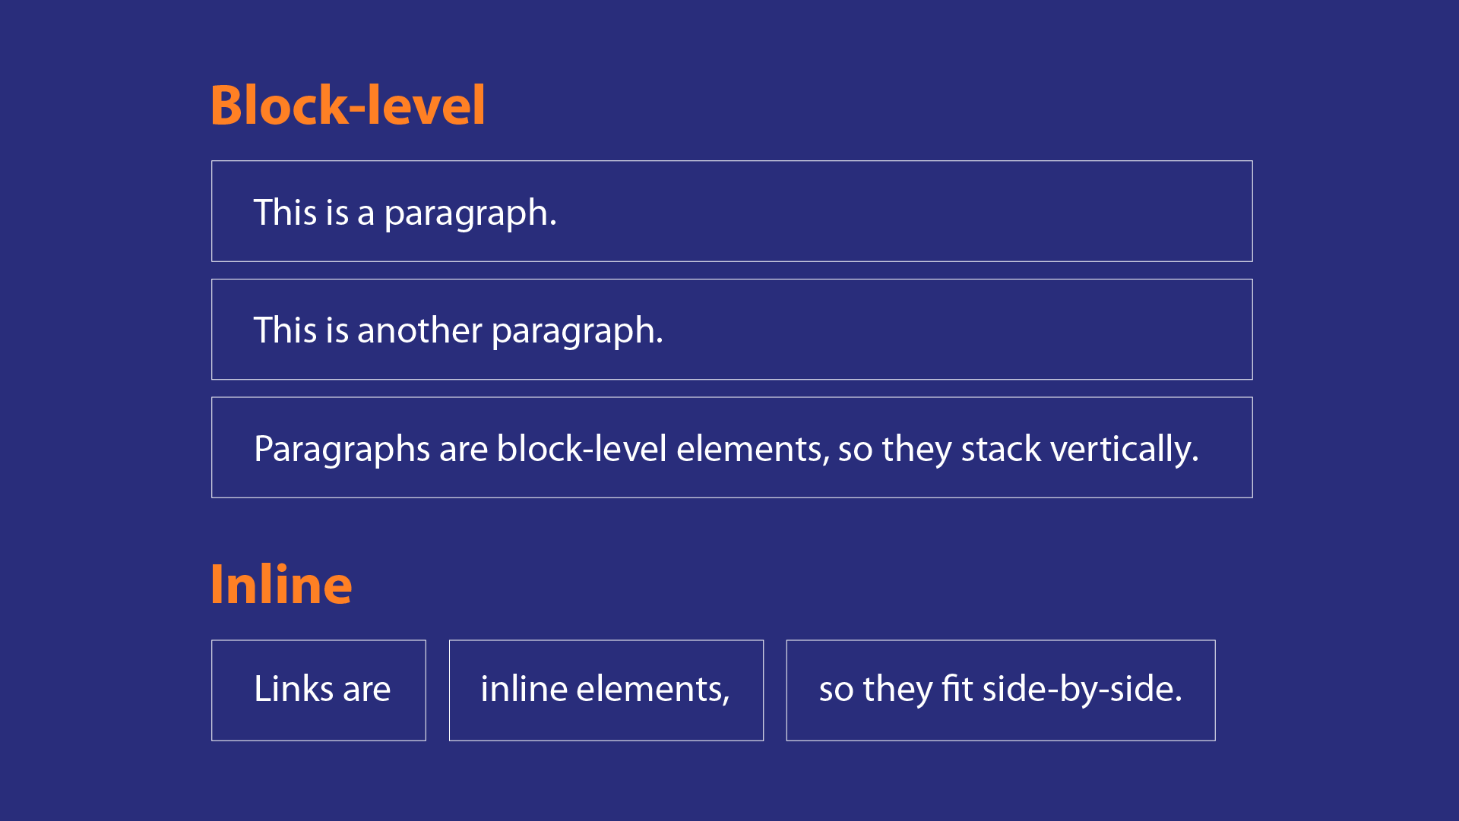

Slide 13
HTML tAGS
Heading Tags
Paragraph
List tag
Anchor
Image
Table

