Slide 1



jaypee institute of informatio and technology
SUMMER INTERNSHIP PRESENTATION
Data Analytics projects
Presented by: Ritika Saini
Mentor: Mr. Surakshit Kapoor
Organization: Imarticus Learning, Delhi
Duration: Six Weeks

Slide 2
Presentation Overview
  Internship domain and objectives
  Employee Payroll Data Analysis
  Mental Health Survey Analysis using Power BI
  Athlete Data Analytics using Python
  Professional development and weekly progress
  Results, learning outcomes and future scope

Slide 3
Internship Objectives
  Understand the complete data analytics workflow
  Work with Excel, Power BI, Python and web-based data tools
  Perform data cleaning, exploration, visualization and interpretation
  Create a model base accuracy in machine learning
  Improve communication, documentation, teamwork and professional readiness

Slide 4
Overall Methodology
  Understand problem and define objectives
  Collect or upload the dataset
  Inspect data types, missing values and duplicates
  Clean and transform the data
  Perform EDA, calculations or modelling
  Visualize and interpret the results
  Validate, document and present the output

Slide 5
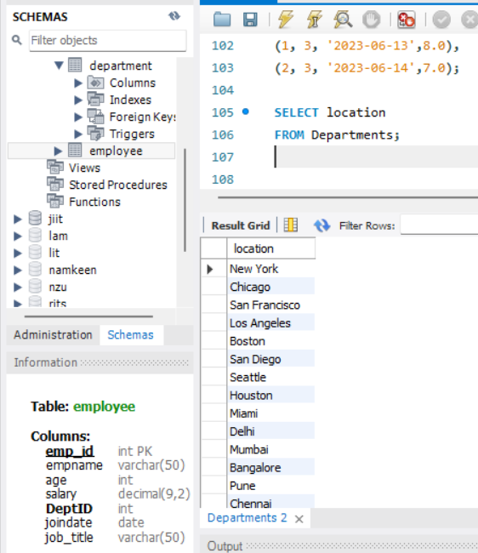
Week 1 – Employee Payroll
Activities
• Worked with employee records and payroll-related attributes
• Used Excel formulas, filters and Pivot Tables
• Analysed salary, experience, city, skills and promotions
Skills Developed
• Spreadsheet-based data analysis
• Business metric interpretation
• Summary tables and structured reporting

Slide 6
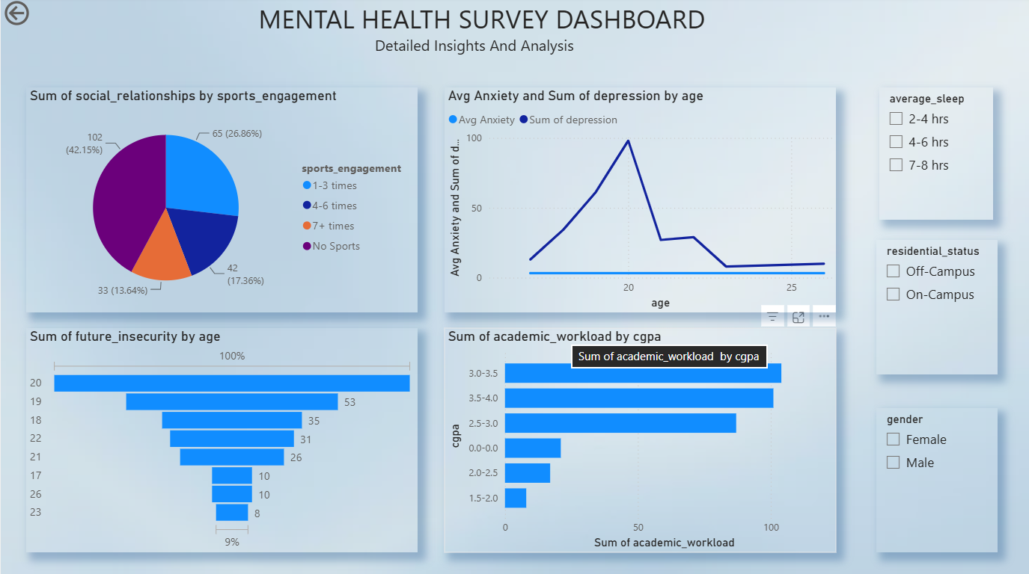
Week 2 – Mental Health Analysis
Activities
• Imported and prepared survey data in Power BI
• Created visuals, cards, charts and filters
• Designed an interactive dashboard
Skills Developed
• Power Query and data preparation
• Dashboard design
• Interactive visual storytelling

Slide 7
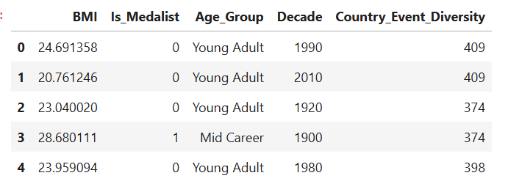
Week 3 – Athlete Data Analytics
Workflow
• Dataset inspection and descriptive statistics
• Missing-value treatment and duplicate checks
• IQR-based outlier detection
• Visualization and correlation analysis
Feature Engineering
• BMI
• Is_Medalist
• Age_Group and Decade
• Country_Event_Diversity
• Encoding and StandardScaler

Slide 8
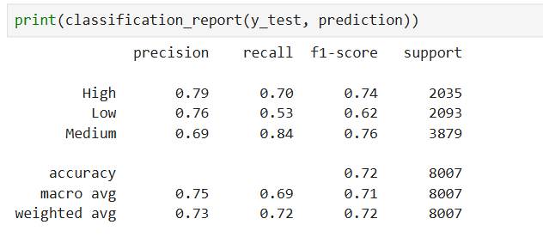
Week 4 – Online gaming behaviour
Activities
  Split the dataset into 80% training and 20% testing
  Built Logistic Regression, Decision Tree, Random Forest, KNN and SVM models
  Applied PCA and retained 95% variance before KNN
Skills Developed
  Model comparison and evaluation
  PCA and dimensionality reduction
  Accuracy, Precision, Recall and F1-score analysis
  Confusion matrix interpretation

Slide 9
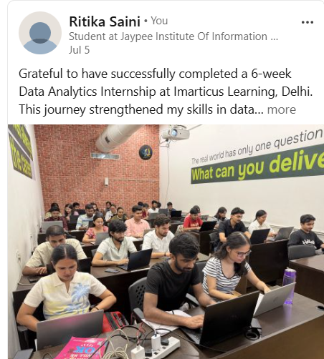
Week 5 – Professional Development
Activities
• Resume preparation and improvement
• LinkedIn profile development
• Communication and presentation practice
Professional Skills
• Interview preparation
• Workplace etiquette
• Teamwork and confidence
• Professional profile building

Slide 10
Six-Week Progress
• Week 1: orientation, analytics fundamentals, employee payroll SQL exercises.
• Week 2: mental health data preparation and Power BI dashboard.
• Week 3: Olympic athlete EDA, cleaning, visualisation, and statistical exploration.
• Week 4: gaming engagement classification, PCA, KNN tuning, model comparison.
• Week 5: resume, LinkedIn, communication, presentation, and interview preparation.
• Week 6: debugging, documentation, final review, and progress diary verification.

Slide 11
Week 6 – Final Review
Final Activities
• Project refinement and debugging
• Documentation and presentation preparation
• Incorporation of mentor feedback
Diary Verification
• Progress diary checked
• Progress diary marked
• Required signature obtained
• Final documentation reviewed

Slide 12
Challenges & Learning Outcomes
• Missing/inconsistent data → inspection and context-appropriate treatment.
• Outliers → IQR detection and capping while retaining legitimate observations.
• Different tools and datasets → adapted workflows to each analytical task.
• Model evaluation → compared multiple classifiers using several metrics.
• Improved Python, SQL, Power BI, debugging, teamwork, documentation, and presentation skills.

Slide 13
Conclusion & Future Scope
• Internship connected academic learning with practical analytics projects.
• Effective analytics requires problem understanding, data validation, suitable methods, and clear communication.
• Future work: richer KPIs, deeper athlete analysis, and more robust ML validation.
• Online gaming analysis can be extended with further feature exploration and model tuning.
• Continue building portfolio projects in data analytics and business intelligence.

Slide 14
Thank you

