Slide 1
E-Commerce Sales and Customer Insights Analysis
Data Visualization Project Excel • Python • Power BI
1

Slide 2
Project Introduction
This project analyzes e-commerce sales and customer data.
The main goal is to convert raw data into useful business insights.
Excel is used for data cleaning and summary analysis.
Python is used for analysis and visualizations.
Power BI is used to create an interactive dashboard.
2

Slide 3
Project Objectives
Understand sales and profit performance.
Find the best-performing categories and regions.
Identify top products by sales.
Track monthly sales trends.
Create an easy-to-understand interactive dashboard.
3

Slide 4
Dataset
Records: 600 orders.
Time period: 2025.
Important fields: Order Date, Region, Category, Product, Sales, Profit and Quantity.
The dataset is prepared for educational/demo project use.
4

Slide 5
Tools & Technologies
Microsoft Excel – cleaning, Pivot Tables and basic analysis.
Python – data analysis using Pandas.
Matplotlib – charts and visualizations.
Power BI – interactive dashboard and business reporting.
5

Slide 6
Methodology
Step 1: Load and inspect the dataset.
Step 2: Clean duplicates and missing critical values.
Step 3: Analyze KPIs, categories, regions and products.
Step 4: Create Python visualizations.
Step 5: Build Power BI dashboard with filters.
Step 6: Present findings and recommendations.
6

Slide 7
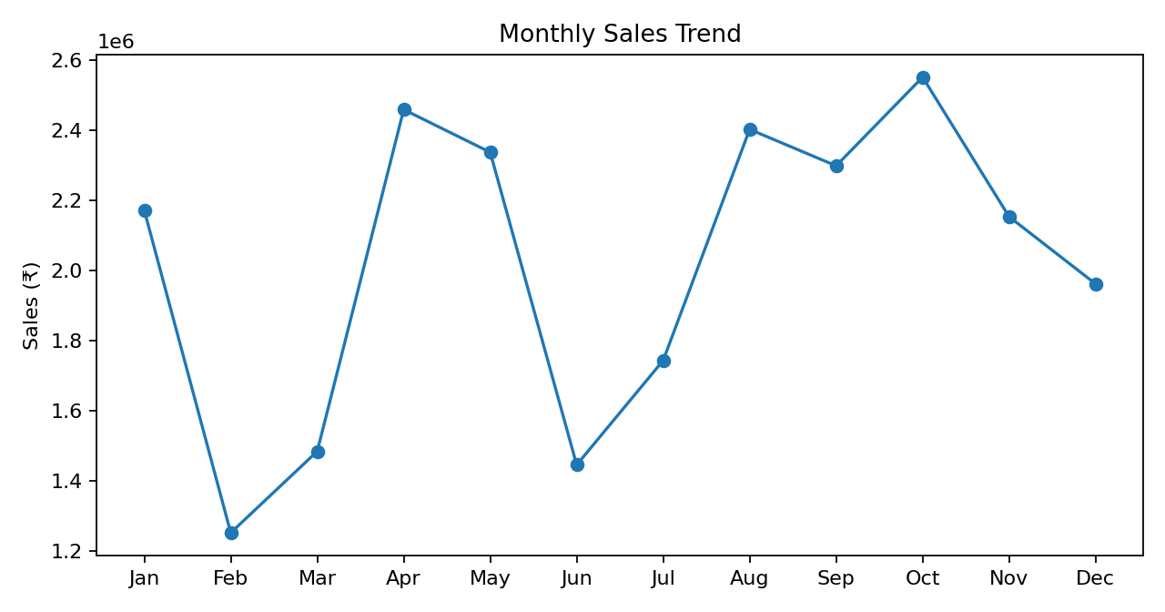
Monthly Sales Trend
7

Slide 8
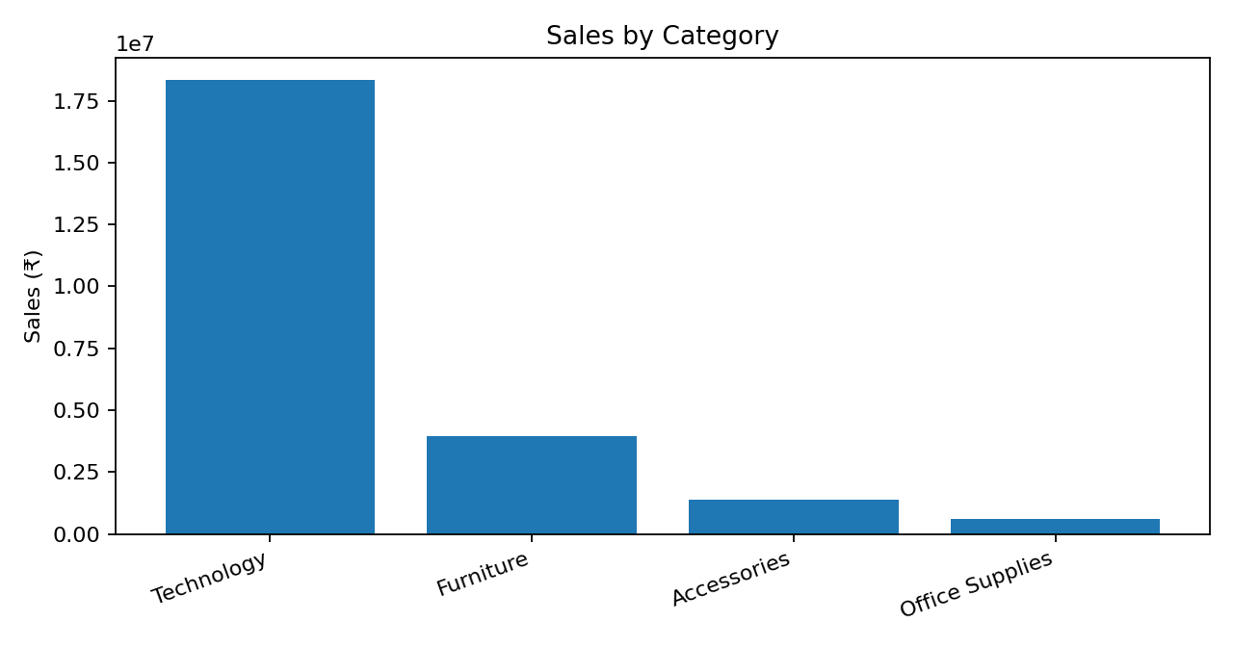
Sales by Category
8

Slide 9
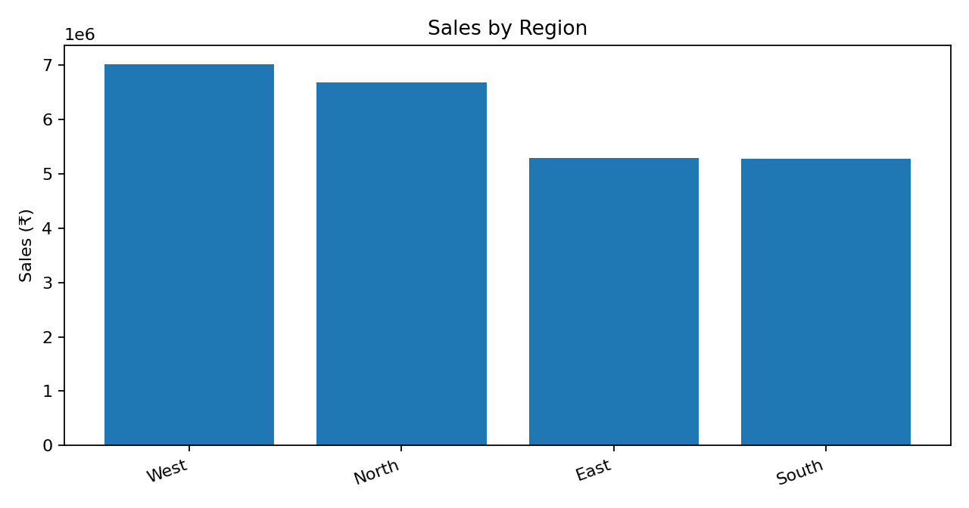
Sales by Region
9

Slide 10
Key Performance Indicators
Total Sales
₹24,258,812.40
Total Profit
₹6,153,941.29
Total Orders
600
Total Customers
177
Average Order Value
₹40,431.35
Profit Margin
25.37%
10

Slide 11
Key Findings
Highest sales category: Technology.
Highest-profit region: West.
Top product by sales: Headphones.
Sales and profit can be compared across categories and regions using the dashboard.
Monthly trend analysis helps identify stronger and weaker periods.
11

Slide 12
Power BI Dashboard – Final Layout
Top row: Total Sales, Total Profit, Total Orders, Total Customers.
Middle: Monthly Sales Trend + Sales by Category.
Bottom: Sales/Profit by Region + Top 10 Products.
Slicers: Region, Category and Quarter.
Use a clean single-page layout so the dashboard is easy to explain.
12

Slide 13
Learning Outcomes
Learned how to clean and organize business data.
Learned Pivot Table and KPI-based analysis in Excel.
Learned data analysis and visualization with Python.
Learned how to create an interactive Power BI dashboard.
Improved data interpretation and presentation skills.
13

Slide 14
Conclusion
The project converts raw e-commerce data into meaningful business insights.
Using Excel, Python and Power BI together gives a complete data visualization workflow.
The dashboard makes it easier to understand sales, profit, customers and products.
This approach can be extended with forecasting and customer segmentation.
14

Slide 15
Thank You
I am ready for your questions.
15

